Slide 1
Effective Listening Skills
Diann Newmann, Ed. D
newmand@fiu.edu

Slide 2
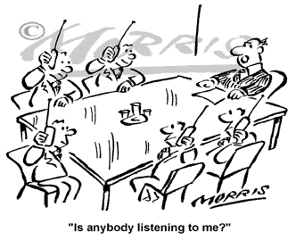

Slide 3


Young man,
I told you to have my daughter home by a quarter of twelve!
Sir, Three
is
a quarter of twelve

Slide 4

Communication Styles
Handout – Communication Styles

Slide 5
Communication Styles
Drivers

Slide 6

Communication Styles
Expressives

Slide 7

Communication Styles
Stabilizers

Slide 8
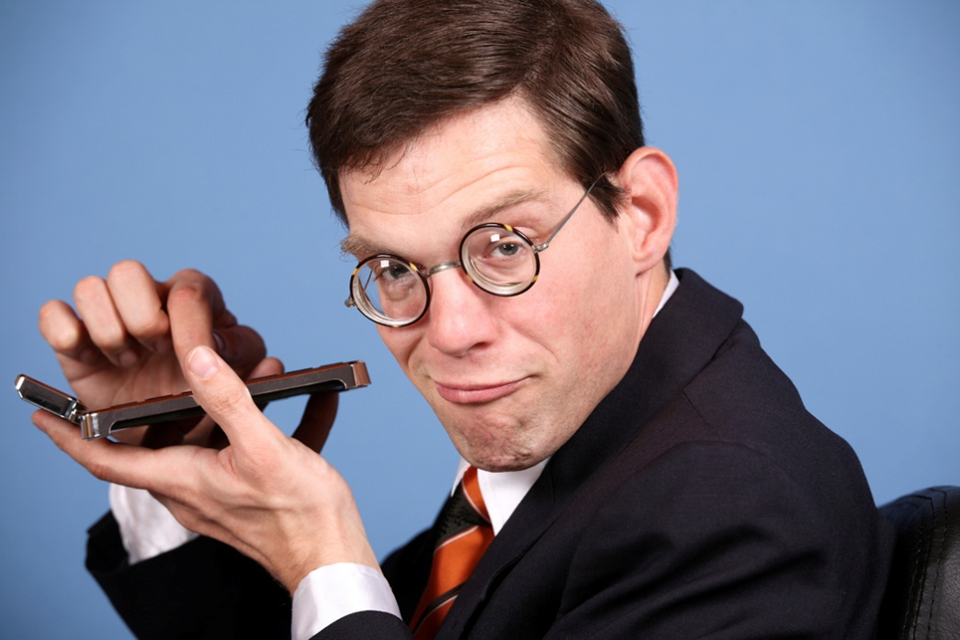
Communication Styles
Analyticals

Slide 9

Communication Styles
What I wish others would know about us…

Slide 10


4 X 4
4 words that describe you
4 apps that you need on your phone
4 things you love about your job
4 Pet Peeves

Slide 11

Questions ?
Diann Newman, Ed. D
newmand@fiu.edu

