Slide 1

Total Cost Of Ownership For Travel Payment
Lynne Schreiber – AirPlus International
Vaibhav Agarwal – University of Notre Dame
Dave Gorecki – Anthony Travel

Slide 2
Agenda
1
Payment Methods: Pros & Cons
2
Corporate Cards & Central Travel Accounts
3
Credit Fees & Reconciliation
4
Virtual Payment
5
The Notre Dame Hybrid Solution
6
The TMC Perspective On Travel Payment

Slide 3

Payment Methods: Pros & Cons

Slide 4






Travel Programs Rely on a Variety of Payment Methods
Payment Methods That Company’s Travelers Can Use
90%
Invoice
23%
Corporate
credit card
Direct supplier
invoice
55%
22%
Personal
card/ cash
Company cash
advances
$
53%
10%
Central Travel
Account
Single-use
virtual account
Larger companies are less likely to allow their travelers to use personal credit or cash when compared with SME’s

Slide 5
Prevalence of Corporate Cards Within A Company
Of the Travel Managers whose company has corporate cards….
64%
say cards have been issued to less than half of employees company-wide

Slide 6
Payment Methods: Pros and Cons
PROS
CONS
Corp Cards
Flexibility to make transaction at point of sale
Rewards can be linked to personal cards in some cases
Easy to set spend limits and monitor
Corporate cards are difficult with infrequent and non-employee travelers
Increased risk of fraud
Compliance can be harder to enforce
Central Bill
Fully reconciled statement
Easy to administer & maintain
Reduced risk of fraud & increased compliance
Cannot be used for meals and incidentals
Company liability
Various levels of enhanced data
Personal Credit/Cash
No card usage to monitor & no risk
Float for employer from employee
Lack of visibility into spend data
No automatic feed to EMS/GL software
Travelers with little credit are burdened

Slide 7
Payment Methods: Pros and Cons
PROS
CONS
Direct Bill
Flexibility in invoicing
Greater float
Potential for discount
Limited transaction information
One extra bill to process and reconcile
Difficult to import data into EMS/GL systems
Cash Advance
No fees
Acceptance
No transaction data capture at time of transaction
Increased fraud potential due to lack of visibility of spend
Negative float
Virtual
Almost no risk of fraud
Integrated with EMS/GL
Visibility
Some travel suppliers are still uneducated about the payment method
Uneven levels of acceptance

Slide 8

Corporate
Cards & Central Travel Accounts

Slide 9
Travel Managers Are Satisfied With Several Elements of Their Card Program

Slide 10
They Are Ambivalent With Their Card Program When It Comes to Data and Internal Cost Savings

Slide 11
Of the 80% of Companies That Receive Rebates, Most Receive the Full Amount
But 25% have no idea how much of a rebate they are receiving

Slide 12
Rebates – Understanding The Structure And Questions To Ask
Limited Time
Does the rebate hold at the same rate for the life of the contract or is there an intro rate that is lowered after the first year?
Ramp Up Period
Is there a rebate percentage incentive for the first few months and then a different rebate thereafter?
UNDERSTANDING
REBATES
Minimum Spend
What is the minimum spend required to receive a rebate? Is it retroactive to the first dollar spent?
Time Periods
Is your rebate calculated on a monthly (billing cycle) or annual spend?
Do the average payment days affect the rebate amount?
Value
Affinity program (rewards) expenses are deducted from cash rebate, so you may end up with a lower/no rebate.
Does the rebate exclude certain transactions (e.g. foreign transactions, minimum transaction amounts)?
Charges that capture level 3 data are typically incented at a lower rate.

Slide 13
The Central Travel Account (CTA) Evolution
Today
Mid 1990’s
Kiosk check in allowed
Rail added
Electronic file export
Automated CC Rec
Air, Rail, Car & Hotel
TMC fees related to transactions
Pre - Invoice Reconciliation
Daily feed to T&E systems
Automated upload to financial systems
Automated allocation to GL
Travel Agency Fees added
Limited electronic files
Manual CC Rec
Airline tickets only
Simple statements
Limited data
Early mid 2000’s
In the beginning

Slide 14
Travel Managers Are Very/Satisfied With Various Elements of Their CTA

Slide 15
Where Travel Managers See Opportunity For Improvement

Slide 16

Credit Fees & Reconciliation

Slide 17
Do You Know What Fees You Are Charged?
If you don’t know what you are being charged, you might be missing a savings opportunity.

Slide 18
Are Your Travel Expenses Settled In Local Currencies?
This is a great opportunity for you to show cost savings for your travel program if you are not settling in local currency.

Slide 19
A Majority of Companies Reconcile Expense Data Internally
Do you know the time/effort that your company expends to manage expense reconciliation?

Slide 20
What Department Is Responsible For Reconciliation?
Think about how automation could save time and money with expense reconciliation.

Slide 21

Virtual Payment

Slide 22

What Is Virtual Payment?
The customary aspects of a virtual card
Traditional credit card number, without the physical card
Transaction specific, one–to–one payment
  Authorized for a specific transaction
  Range of dates
  Amount cap
  Vendor restrictions
Once the transaction is complete, the account number is inactive
Specific traveler data collected at time of card creation, allows for easy allocation
Along with virtual payment – mobile application of virtual payment is a new innovation available in the market.

Slide 23
Virtual Payment On The Rise
The use of virtual cards as a form of payment has risen dramatically. In research conducted earlier this year, virtual card usage was below 1% in 2016 and has shot to over 10% in 2017*
* Based on International Travel Management Study 2017 – AirPlus International

Slide 24


Benefits for Virtual Card
Travel Managers & Travelers Enjoy Benefits Of Virtual Payment
I have a secure form of payment for my travelers and worry less about fraud.
The detailed data means there are almost no reconciliation challenges.
Transactions automatically feed into the EMS/GL systems keeping our internal financial teams thrilled.
I have a “no hassle” check-in & check-out – invisible payment.
I don’t have to worry about reimbursement.
This is integrated into my expense reporting system.
Notes:
Don’t have to use personal card
No cash advance
Automated expense reporting

Slide 25
Your Payment Program Has Many Elements
Data Detail & Quality
Total Cost of Ownership
Currency Settlement
Rebate
Reconciliation
Fees
Fraud Risk
Is Your Payment Program Optimized To Your Specific Travel Program Needs?

Slide 26
Considerations Other Than The Numbers
Total Cost of Ownership
Service
Consistency
Grow With Client & Innovate
Global/ Multinational Fit
Don’t forget to consider value-added qualitative aspects of a payment provider.

Slide 27

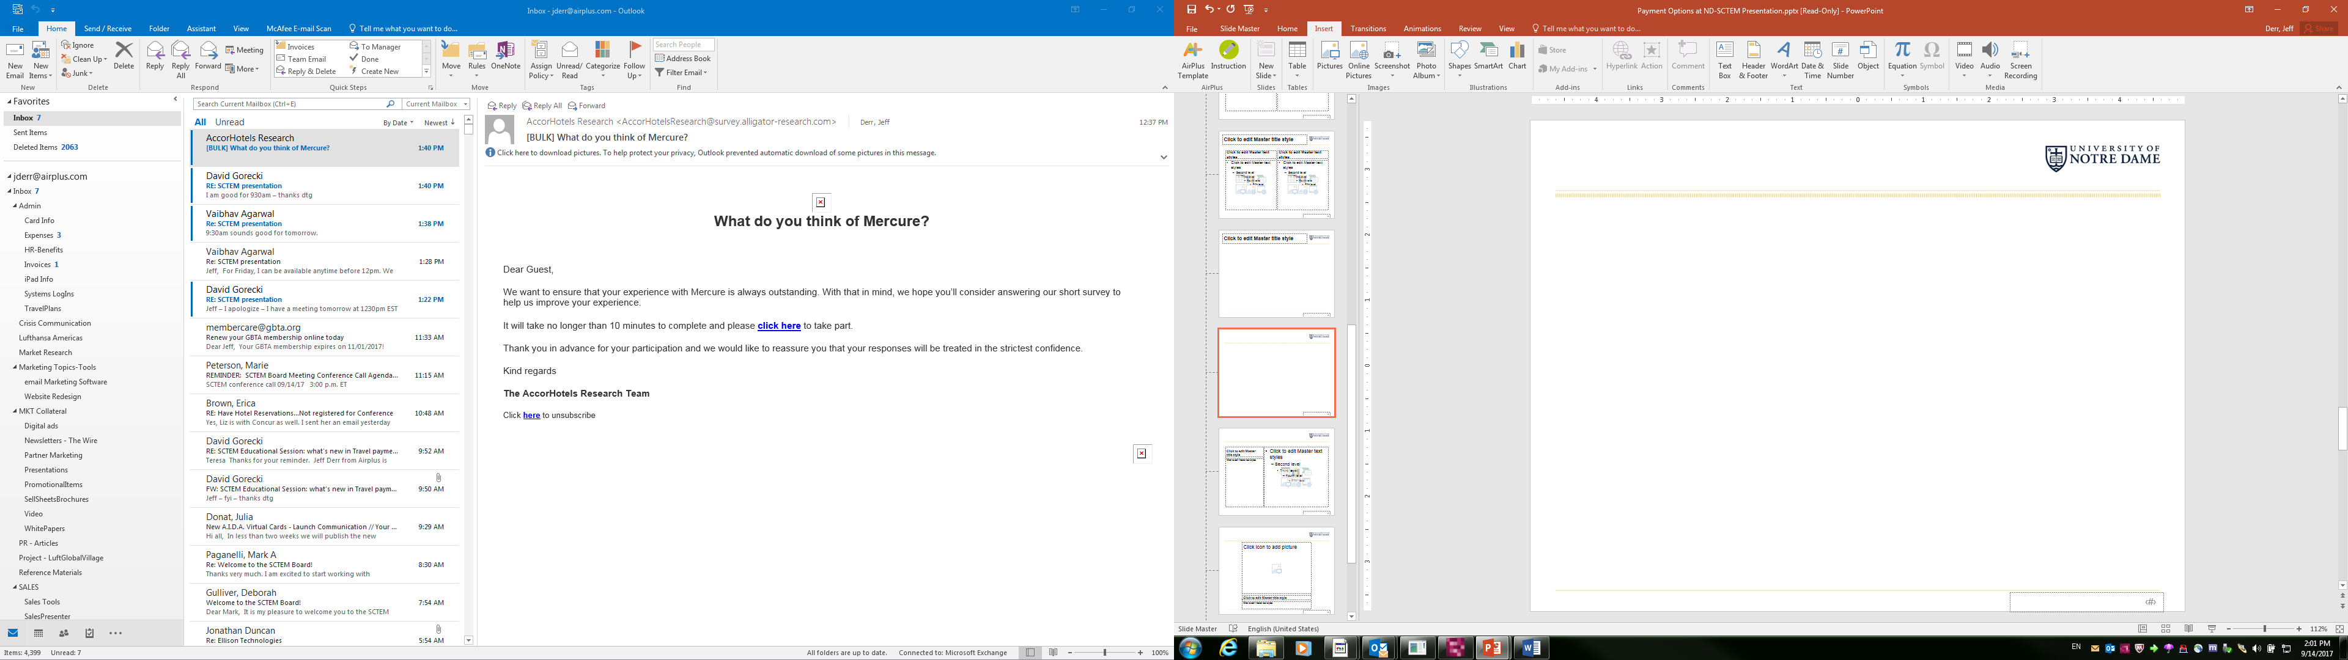
Payment Solution: A Hybrid Approach

Slide 28
Our Payment Options
Travel & Expense
    Central Travel Account (aka Ghost Card)
    Travel Card
    Meeting Card
    Personal Card/Cash
    Why?
      Traveler Ease Of Use
      Expense Policy Compliance
      Integration With Expense System Reporting

Slide 29
Corporate Cards – By The Numbers
 | Travel Cards | Meeting Cards
Open Cards | 1,198 | 246
Active Cards | 823 | 197
FY Spend | $4.5M | $9.3M
* Projected thru end of Oct 2017 (contract term)

Slide 30
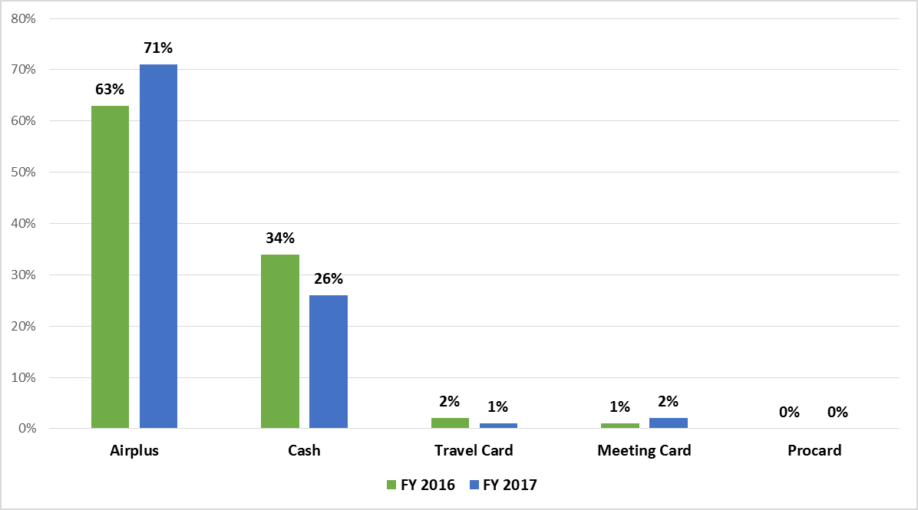
Airfare Spend – By Payment Type
* Does not include Air Charter Spend. FY 17 data.

Slide 31
Central Travel Account (CTA)
Attributes
  Airfare charges only; directly charged to budget unit
  Corporate bill/ Corporate pay
  Corporate liability
  Charges available in expense management system for documentation on expense reports
Challenges
  Inclusion of payment charge on expense reports for full-trip compliance
  Managing group travel and guest travel charges

Slide 32
Corporate Card
Attributes
  Any T&E expense for traveler
  Individual bill; Individual pay (IBIP)
  Corporate liability
  Charges available in expense management system for documentation on expense reports
Challenges
  Increasing usage of travel cards
  Delinquency follow-up

Slide 33
Meeting Card
Attributes
  Any T&E expense for a small groups, athletic teams
  Individual bill/Corporate pay
  Corporate liability
  Charges available in Concur for documentation on expense reports
Challenges
  Timely submission for university payment of card
  Easily perceived as a substitute for individual travel card

Slide 34
What’s Next?
Central Travel Account
    Continue to promote use of CTA (direct charge to budget unit)
Corporate Card
    Continue to encourage use of travel cards
    Faculty vs. staff
Meeting Card
    Monitor appropriate use of meeting card

Slide 35


TMC Perspective On Travel Payment

Slide 36
Travel Payment Solutions
TMC Challenges
  Ability to implement and support multiple solutions for clients
    Higher Education needs
      Athletics/Team Travel
      Conferences
      Faculty/Staff
      International
      Distinctive Events
      Guests
      Integration of data into existing systems

Slide 37
Solutions
Hybrid Approach
No solution is 100%
  Central Bill
    Travel Program Adoption
    Data Enrichment
    Reconciliation
  Direct Bill
    Time Consuming
  Corporate cards
    Fraud
    Declined Credit Cards - Re-work

Slide 38
Solutions (cont.)
Meeting Cards
Personal Cards/Cash
    Credit Limits -re-work
    Access to data
Virtual Card
    Banking Relationship/Support
    Security – PCI Compliance
    Reduced processing times in some areas
    Implementation and Setup
    24 by 7 support
    Data Enrichment
      85% on reporting fields
      95% success on amounts

Slide 39

Thank You For Your Time
Q & A
Lynne Schreiber – AirPlus International
lschreiber@airplus.com
Vaibhav Agarwal – University of Notre Dame
vagarwal@nd.edu
Dave Gorecki – Anthony Travel
davidgorecki@anthonytravel.com

