Slide 1
University and Supplier Collaboration
Vincent Johns

Slide 2
GW Background
Private research university, four blocks from the White House
Chartered by act of Congress in 1821
27,159 students
$51,950 undergraduate tuition
5,252 Faculty and staff
$1bil annual operating budget
$1.6bil endowment
Notes:
We’re not large, but we’re expensive. Our students are politically active. If there is something to protest it will occur on our campus.

Slide 3
GW Annual Travel Spending
$6,073,710 $5,928,796
$337,688 $31,674
*Approx. 1/3 of which is federal research dollars
Notes:
Midsized travel program. Data collected from expense reports, pcards and TMC’s.

Slide 4
GW Annual Airfare
Notes:
Many of our research grants require foreign travel. Student study abroad and personal travel is not included.

Slide 5
GW Travel Program
Program initiated in 2012
JP Morgan centrally billed p-cards (1,467 cards)
Concur Expense (required usage)
Concur Travel
Travel Management Companies
Travel Leaders
Anthony Travel (Athletics)
Notes:
GW’s travel management program contains all the components of a well managed travel management program, but few of the “mandates” necessary to encapsulate our spending.
Traveler’s must adhere to spending policy, e.g., no first class travel, receipts for all expenses, etc., but usage of the TMC’s and pcard are not required.
JPM is a great partner and an integral component of our program, for those that choose to adhere to the program. The pcard is a payment platform that populates Concur Expense with expense items and pays GW a rebate. However, usage of pcard is not required.
Concur is the platform on which the travel program is built. Everyone on campus must use Concur Expense. Concur Travel is our self-booking tool.
Our TMC’s are valuable partners and we rely on them heavily. They interact with our travelers daily and have a significant influence upon their buying choices; which drives policy compliance and supplier usage in our non-mandated program.
Revised travel policy (7 pages) and creation of corresponding travel policy manual (32 pages).

Slide 6
GW iBuy+ Travel Adoption Rate
Notes:
Internally, GW rebranded Concur Travel as iBuy+ Travel. Unfortunately, you can see that only a quarter of our travelers utilize the booking tool. Throughout the year, we partner with suppliers to offer traveler incentives in order to increase adoption and drive business to preferred suppliers. Incentive eligibility requires usage of iBuy+ Travel.

Slide 7
GW Supplier Programs
Airline programs
United pricing agreement
Delta pricing agreement
Southwest pricing agreement
American Business Extra rewards program
Hotel programs
Best Western
Wyndham
InterContinental
Hotels.com
Club Quarters
Local DC hotel agreements
Enterprise/National Car Rental (E&I Cooperative)
Enterprise CarShare
Uber and Lyft
Charter buses and chauffeured service
Notes:
In all instances, spending data is critical when establishing and evaluating vendor agreements. Producing data is painful and time consuming for us. We scratch, pull and glean data from multiple sources. Our TMC’s can produce all the data we need, but only a percentage of our travelers use the TMC’s.
We have successfully negotiated airline pricing agreements and were contacts were not possible, reward programs were established.
Most of our supplier contracts are negotiated and renewed annually. TMC and ground transportation services are bid every five years.
Usage of peer-to-peer services (Uber, Lyft, Airbnb, etc.).
In order to advance our travel management program, supplier relations will continue to be a focus at GW.

Slide 8
GW Usage of Contract Carriers
Notes:
The data displayed was gleaned from expense reports and pcard usage. Thru regular communications, prompts and incentives, our travelers are voluntarily choosing suppliers with whom we have relationships.

Slide 9
GW Usage of Car Rental Suppliers

Slide 10
GW Future Initiatives
Concur TripIt
Concur Locate
Increase program adoption
Notes:
TripIt may be implemented in the near future. It is hoped that TripIt will capture travel data booked outside the TMC’s and allow us to better evaluate our spending.
Concur Locate is being evaluated as a tool to fulfill GW’s moral and legal obligation to provide duty of care. Locate will be used campus wide, including students. Project implementation will be time consuming and require involvement of many departments on campus.
We will continue to market the program and drive adoption thru workshops, communication and incentives.
GW leadership benefits of the travel program and is questioning lost savings from low adoption. Change could be afoot.

Slide 11
Vincent C. Johns
Travel Services Administrator
The George Washington University
45155 Research Place, Ste 235J
Ashburn, VA USA 20147
571-553-4269
vjohns@gwu.edu
https://ibuy.gwu.edu/travel-services

Slide 12
COLLABORATION: A Story of Evolution and Partnership
With tales, tips and insights from the frontline

Slide 13
PRESENTED BY
Terri Gill –
Director Travel Management Services
UW System Administration – Office of Financial Administration
Additional Insights from Senior Leadership & Travel Program Sponsors –
Sean Nelson – Vice President of Finance, UW System Administration
Julie Gordon – Associate Vice President of Finance, US System Administration

Slide 14
UNIVERSITY OF WISCONSIN SYSTEM IS……
UW System
13 – Four-Year Universities
13 – Two-Year College Campuses
72 – UW Extension Offices
181,000 Students / Year
40,000 Faculty and Staff

Slide 15
PROGRAM GOALS The “Art” of Continual Balance
Program Goals
Traveler Wants
Strategic Sourcing – Develop Partnerships with Suppliers
Consolidate Spend with Contract Suppliers to Contain Costs/Enhance Services
Accountability
Process Efficiency
Enhanced Data
Clear Policy/Process
Duty of Care
Best Pricing
Comfort & Convenience
High Degree of Service
Highest Quality of Accommodations
Highly Flexible “Process”
Independence

Slide 16
TMC & BOOKING TOOLS A STORY
Travel Management Company + Concur Travel
Concur Travel for Online – Reservations supported by Fox, including 24/7 online team support
UW Dedicated Agent Team- Full Service
After hours support provided in-house
Onsite Employee/Agent for Student and non-employees (interview candidates, etc..)
Agency Discounts/Terms for Group Block Air
Automation of Business Rules
User, Management Reporting, “Duty of Care Notifications)
Fox World Travel Motto – “Find a Way”
TMC + Concur + Supplier Offerings = Savings, Service, Efficiency

Slide 17
EFFICIENCY = SAVINGS
Per the 2012 University Traveler Survey:
It takes *45 minutes searching multiple public websites to book air, car, and hotel reservations. *Average time according to UW survey statistics.
If multiple people are involved in searching; productivity savings is multiplied by the number of people involved.

Slide 18
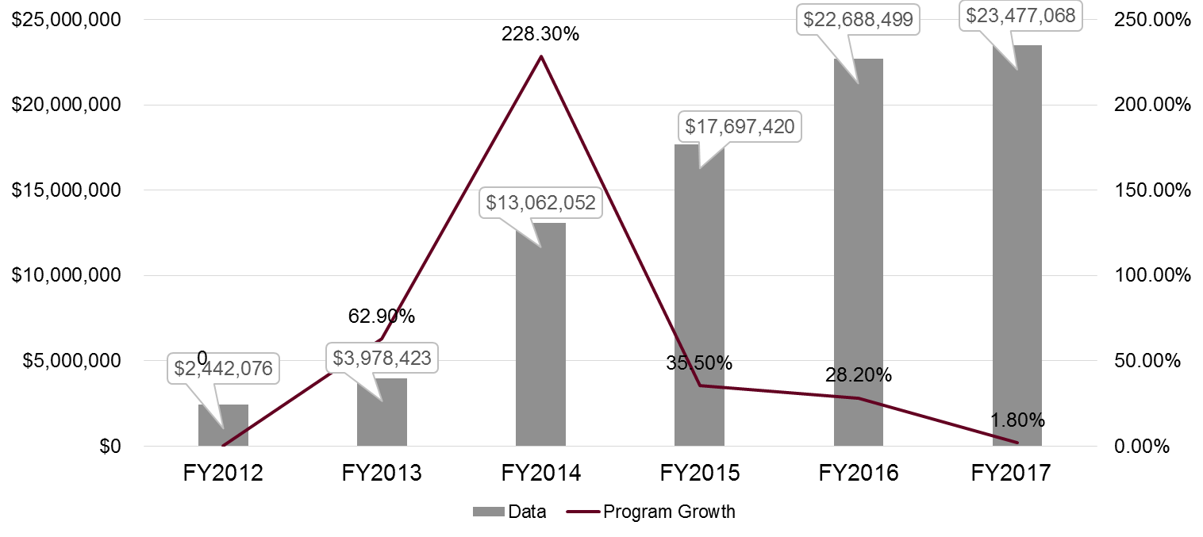
AIR PROGRAM GROWTH BY FY

Slide 19
AIRLINE PARTNERSHIP TIPS
Good travel policy and transparent data through the GDS is key to successful airline partnerships – get a booking tool/TMC
Analyze your financial data and top travel destinations to select a partner
Prepare to change your policy and drive adoption & growth
Offer discounts and rewards exclusively through your booking channel – always strive for more than what traveler’s can get on their own!
Negotiate benefits beyond discounts – traveler comfort is a key success metric and still a cost savings
Continual Engagement - Meet with your partners often!

Slide 20
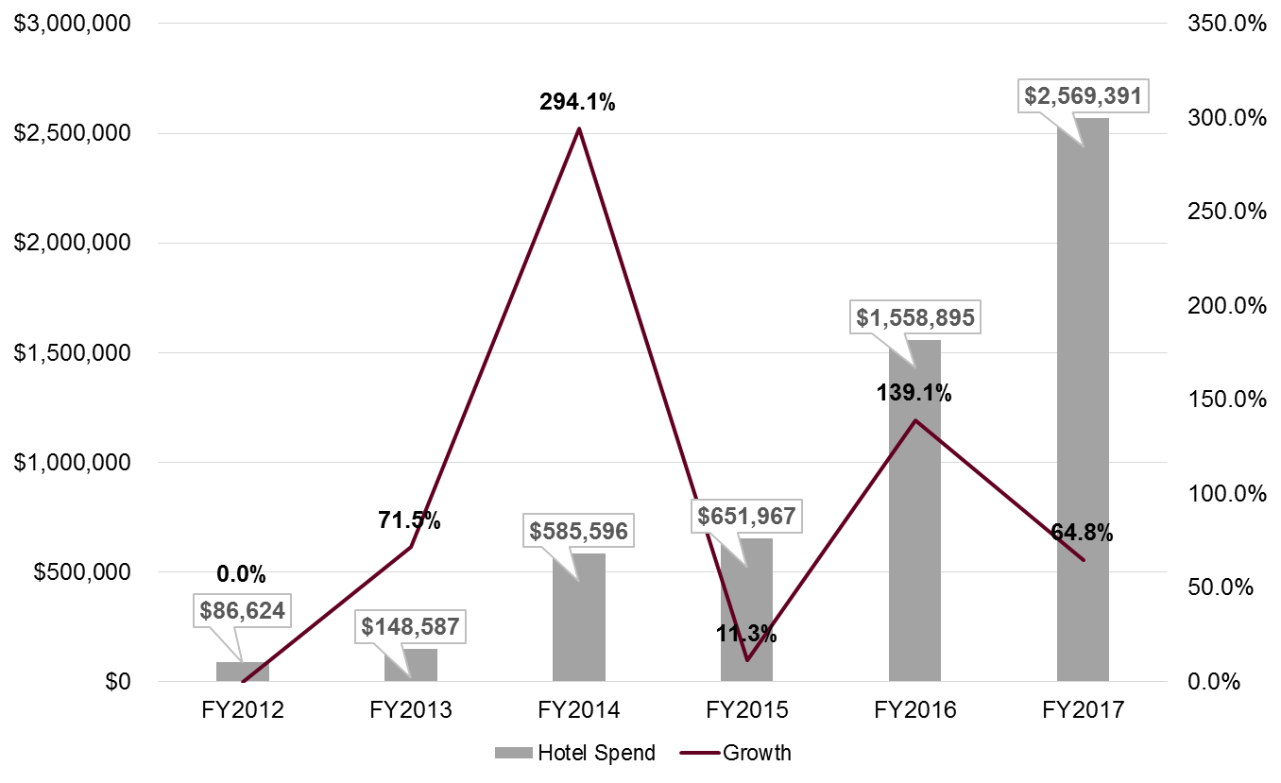
HOTEL PROGRAM GROWTH BY FY

Slide 21
HOTEL PARTNERSHIP TIPS
Offer exclusively through your booking channel!
General published rates w/discounts, AAA, AARP – Super Efficient!
Consolidate – drive additional volume through meetings/event spend for space & catering
Look at local use and # sleeping nights for contracts and consortium opportunities for other high volume locations
Opportunities for chain-wide agreements are there – look to your local reps and TMC
Be prepared to offer at minimum 200 room nights
Don’t overlook consortium or TMC opportunities
NASPO Hotel Program
GSA – FedRooms/State Rates
Network with Suppliers at SCTEM!

Slide 22
CAR RENTAL GROWTH BY FY

Slide 23
CAR RENTAL PARTNERSHIP TIPS
Car rental one of the most flexible contracts and travelers are rapid adopters with the right program!
Integrate into your booking channel, particularly for non-local outlet reservations – ultimate efficiency to tie all (air, car, hotel) reservations together
Reasonable daily rates & unlimited mileage – often more cost effective than university fleet
Car share, including business use car share available
Extra benefits give traveler perks beyond contract pricing
If you don’t have a contract look to WSCA/NASPO or E&I for consortium opportunities

Slide 24
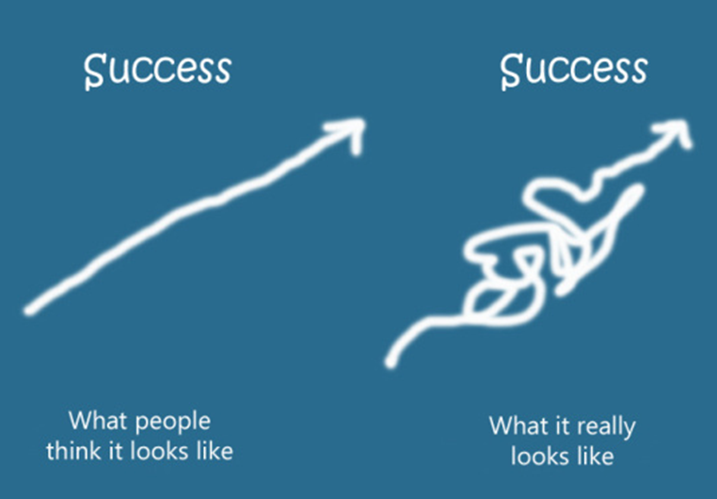
WHAT SUCCESS LOOKS LIKE

Slide 25
COMBINED PROGRAM SAVINGS FY2017
Avg. Savings Per Traveler Invoice = $89

Slide 26
MOVING FORWARD Maintaining Success & Addressing Challenges
Largest ongoing challenge for the UW System and the Travel Program is COMMUNICATION!
With such a large population and decentralized operations it is extremely difficult to reach travelers directly
Some travelers have tendency not to read user guides, UW TravelWise portal information
As such…….hard to communicate partner benefits to all
UW System Travelers are not yet adopters of social media or mobile devices for information
Continually looking for new and improved ways to reach our mutual customers without desensitizing them.

Slide 27
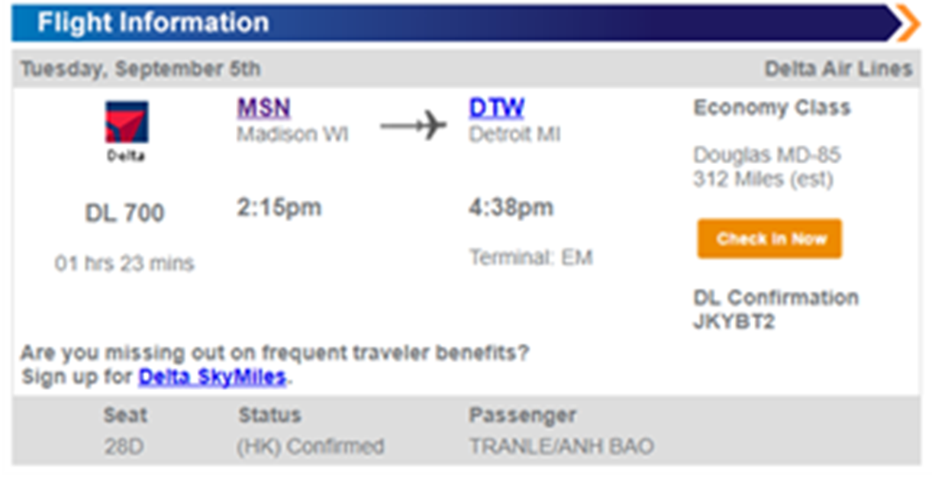
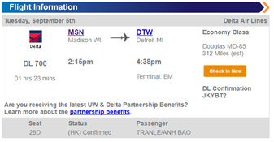
NEW APPROACH - SUPPLIERS Integrate Partner Offerings Into Itinerary

Slide 28
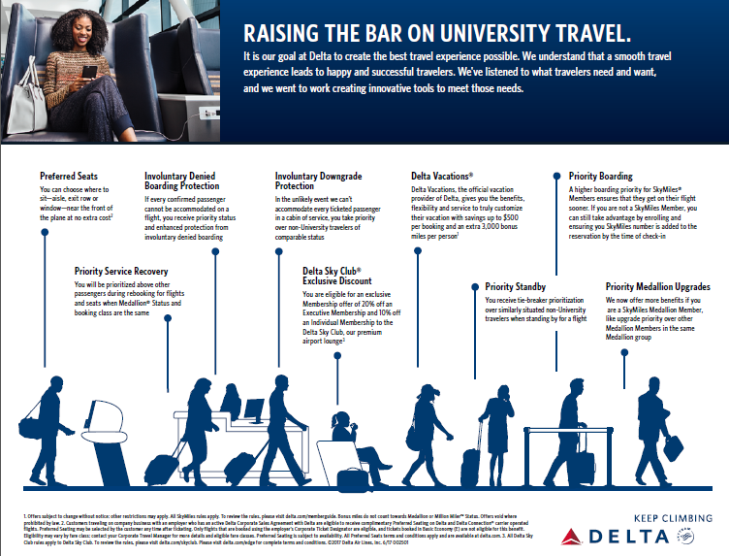
PARTNER BENEFITS

Slide 29
WE’RE HAPPY TO TAKE ?

Slide 30
MANAGED TRAVEL BEGINS & CONTINUES WITH STRONG TOP – DOWN LEADERSHIP A few words from our Travel program sponsors
Sean Nelson – Vice President of Finance, UW System Administration
Julie Gordon – Associate Vice President of Finance, US System Administration
Notes:
10 minutes
The Reality of the Travel Program -
Sean Nelson Senior V.P. of Finance
Julie Gordon Assoc. V.P. of Finance
Will address audience on what it’s taken to lead the program to success, biggest challenges and what’s ahead for the UW’s Travel Program

Slide 31
MOVING FORWARD Maintaining Success & Addressing Challenges
Tone at top and throughout organization
Travel is managed system wide with accountability to the Board
Board established policy at the start of program
CORE (Commitment to Operational Reform & Excellence) - part of UW System’s strategic framework
Regular communication with Chancellors and CBOs
Standards and Efficiencies
Committed to strategic partnership with the right suppliers
Committed to continual feedback from or dialog with UW travelers

Slide 32
MOVING FORWARD Maintaining Success & Addressing Challenges
Duty of Care Commitment for UW Sponsored Travel
Defining UW Sponsored Travel to include more than employee, students/guests
Realized Traveler Support Services - Assistance for air delays, cancellations, critical travel events and mitigating costs that come with those occurrences
New lodging policy to establish non-reimbursement for noncompliance
Traveler Needs & Program Resources To Address
Survey’s for feedback from travelers/arrangers to gather “paint points”
Continued expansion of regional approach with travel managers to support travelers, program goals, standards and efficiencies

Slide 33
Thank You !!!
Terri Gill – tgill@uwsa.edu
Sean Nelson – snelson@uwsa.edu
Julie Gordon – jgordon@uwsa.edu

