Slide 1
Collaboration in the Sharing Economy
Dustin Earle, Lyft
Kelsey Moon, UC San Diego

Slide 2
Vision
Develop an innovative, comprehensive, and mutually beneficial rideshare partnership that:
  Improves access
  Reduces congestion
  Enhances transportation experience
  Supports UC San Diego programs
  Scalable for higher education

Slide 3


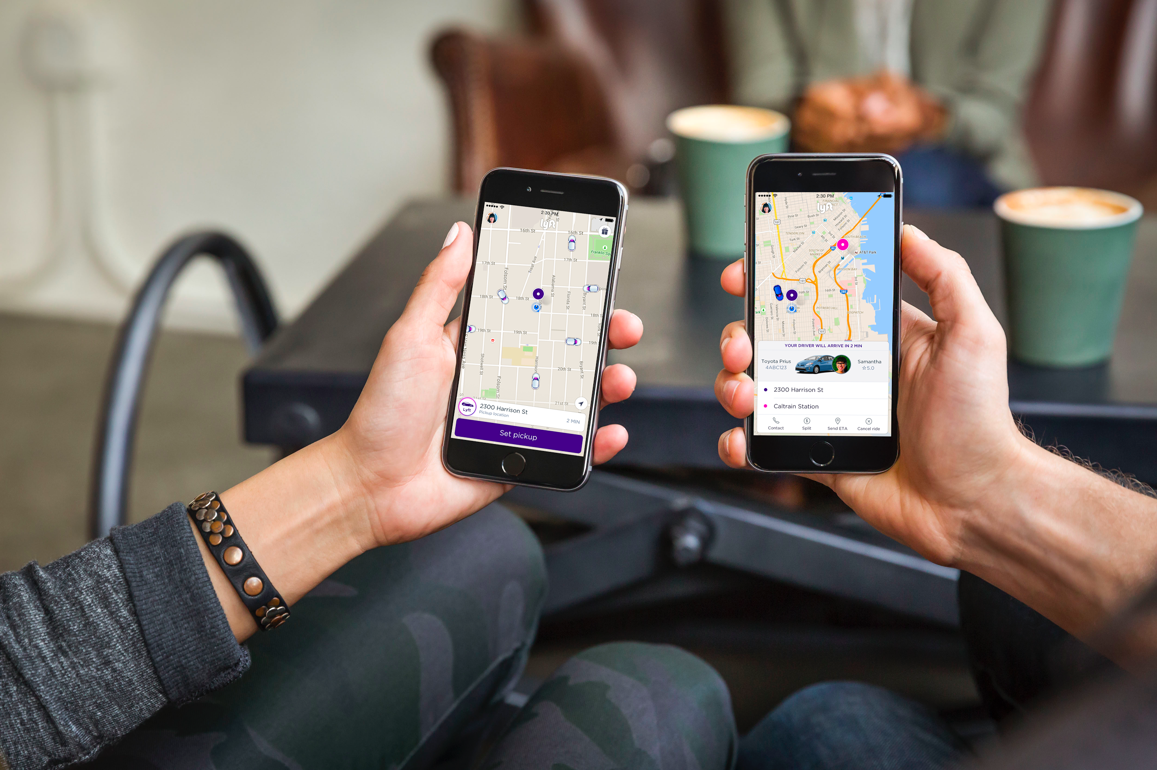
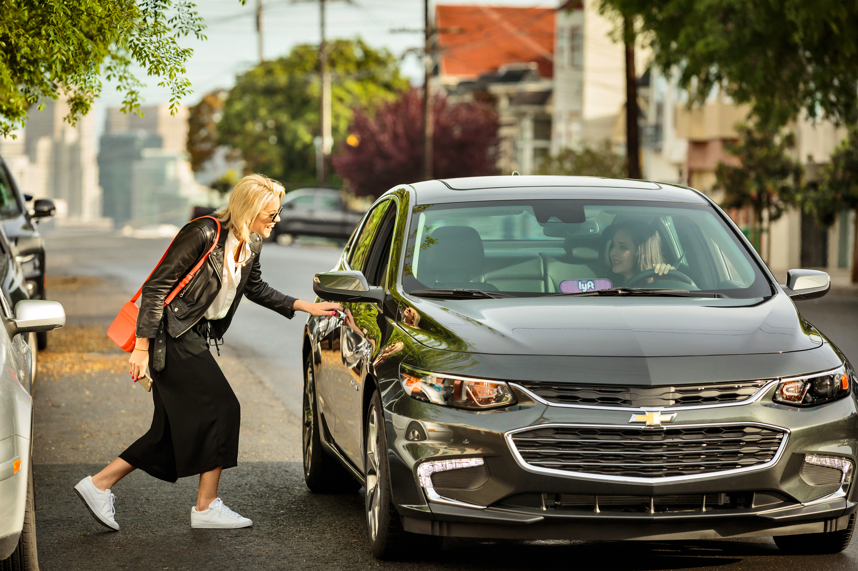
Lyft Mission & Values
Environmental: minimize CO2’s and take cars off the road
Safety: uphold the highest level of safety standards for our community
Customer Service: treat our drivers and our passengers right
CONFIDENTIAL - LYFT PROPRIETARY INFORMATION

Slide 4

Lyft by the Numbers
Available in 48 states, with statewide coverage in 40 (94% of US population within coverage)
1M+ Rides Per Day
$250M+ in Driver Tips to Date
>40% rides are shared rides where Lyft Line is available
CONFIDENTIAL - LYFT PROPRIETARY INFORMATION

Slide 5

Lyft Safety Standards
In-Person Driver Vetting
Sterling Background Checks
  SSN Search
  DOJ Sex Offender Registry
  Federal & County Check
$1M Commercial Liability Insurance
19 Point Vehicle Inspection
5 Star Rating System
24/7 Critical Response Line
Zero Drug and Alcohol Tolerance Policy
CONFIDENTIAL - LYFT PROPRIETARY INFORMATION

Slide 6
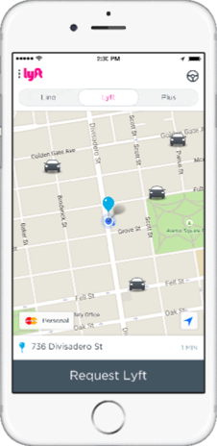
Features
Geofencing - Restrict subsidized rides to a specific geographic zone
Timeboxing - Restrict when subsidies are offered (i.e. commute times, late night rides)
Admin Portal - Data Reporting, Ride Transparency, User Management
Business Profiles - Verify university email address, business or personal ride
Venue Mapping - Mapping campus for designated pick up and drop off locations

Slide 7
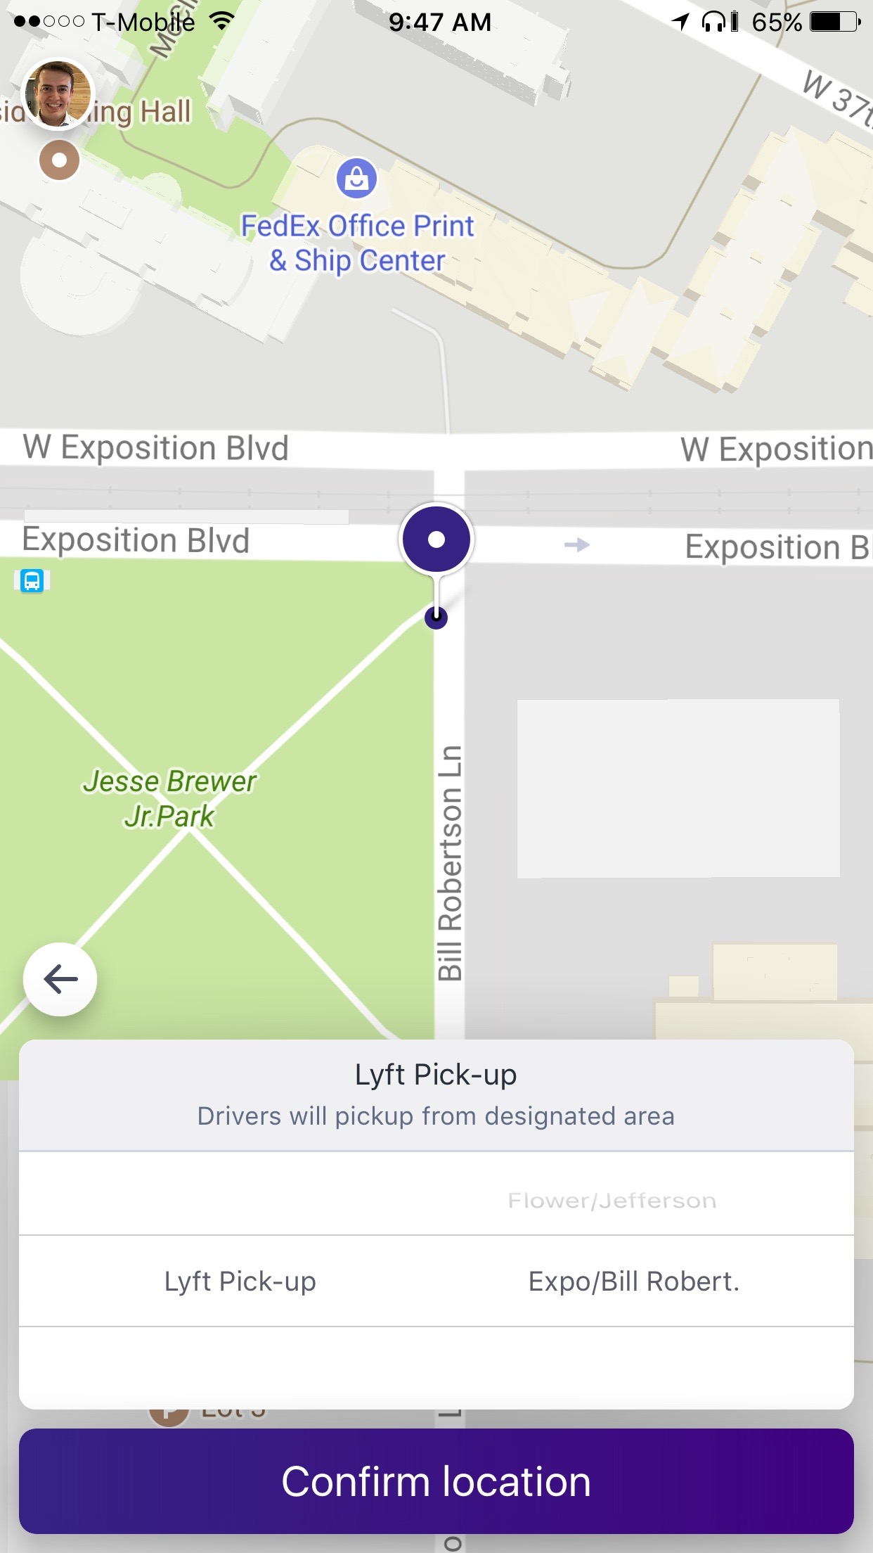

Campus Venue Mapping
Custom pickup/drop-off locations
Flexible Scheduling
  Summer semester
  Campus closures
  Games/events
  Student Move in Day
Reinforce behavior
CONFIDENTIAL - LYFT PROPRIETARY INFORMATION

Slide 8
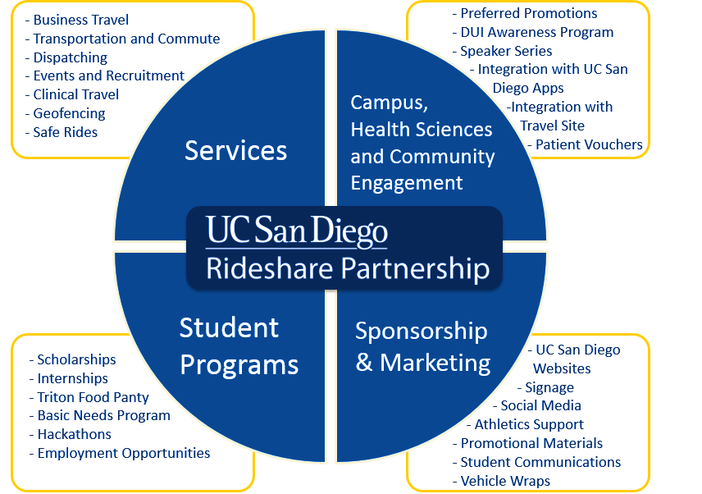

Slide 9












Rideshare Scope
$8.5M
64,406
$1M
8
Campus Transportation
20+ Major All-Campus & Community Events
25,000+ Human Subject Participants
Students, Faculty & Staff
Chartered Travel for Athletics
TRANSPORTATION
$3.8M
Medical Centers
FACULTY
Business Travel – Ground
ATHLETICS
HEALTH SYSTEMS
TRAVEL
RESOURCE MANAGEMENT AND PLANNING
39,000 Business Trips (annually)
ASSOCIATED STUDENTS
710,393
BOOKSTORE
STUDENT AFFAIRS
ADVANCEMENT
Patient Visits
ALUMNI
HEALTH SCIENCES
Transportation Metrics
$3.5M
student transit passes
17,000
parking spaces
52,168
never used for
intracampus
35,420
never used
rideshare
64,406
students, faculty,
& staff
57%
students live
off campus
30,680
SOV’s
per day
$23M
parking passes
revenue
0.40%
Car Share
56.9%
All modes
less SOV
2,150
UC San Diego
Acres
52,000
people visit
daily

Slide 10
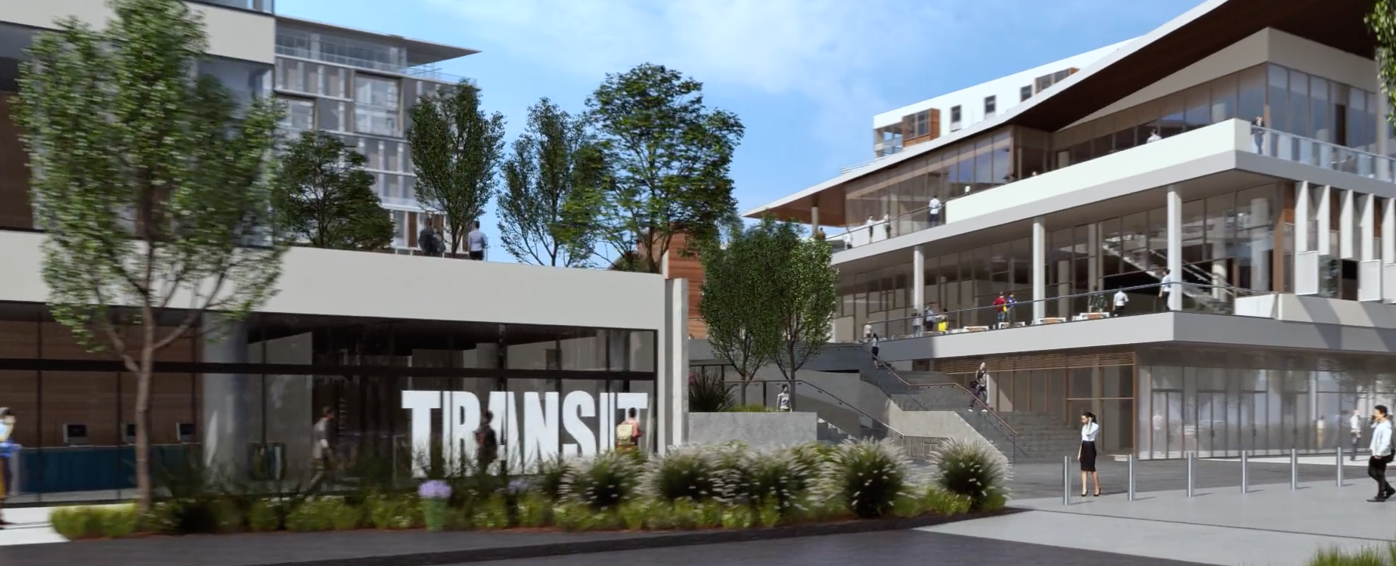


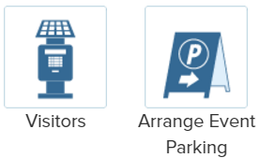


Current State

Slide 11

Rideshare and the Dalai Lama

Slide 12
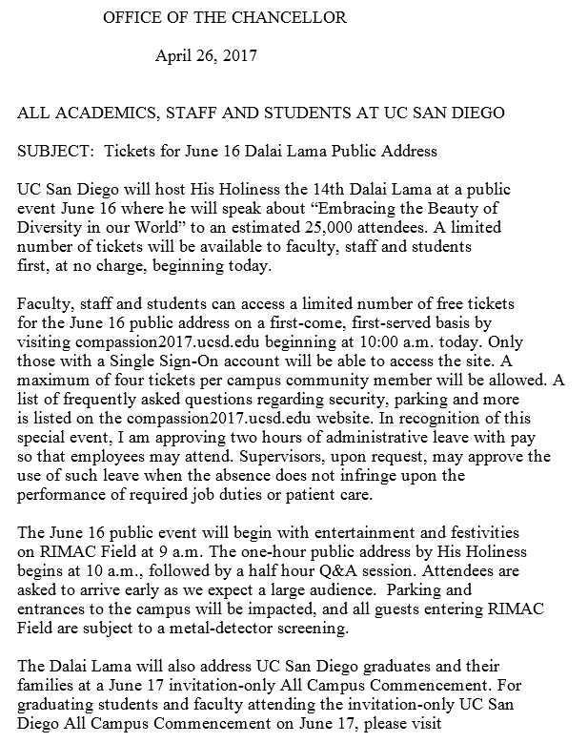


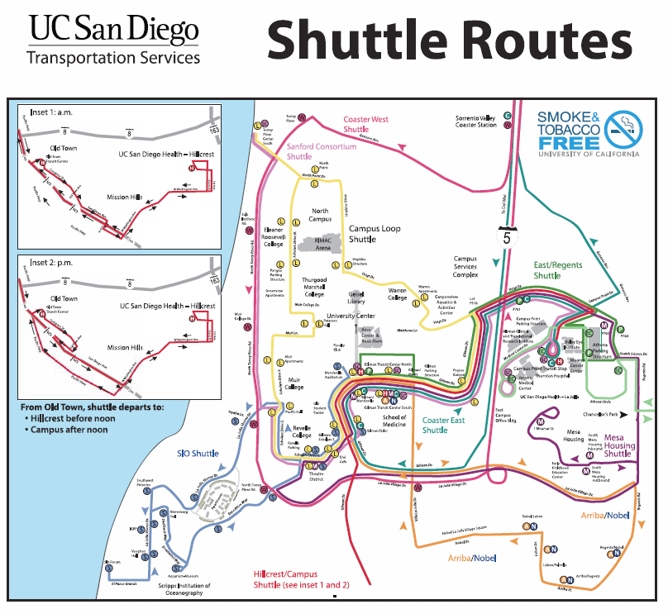
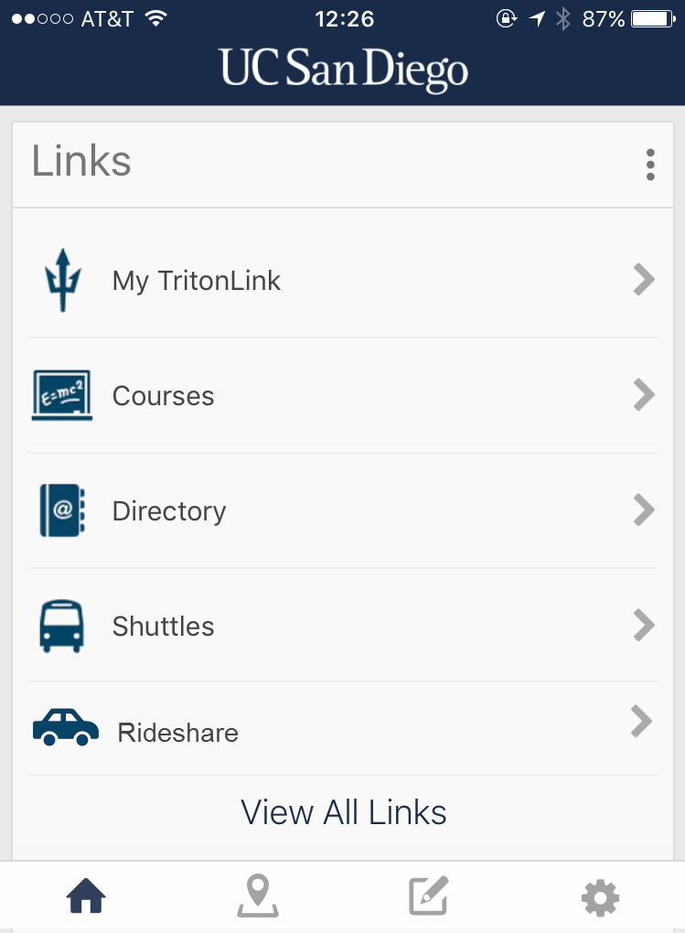


Promo Code
The official UC San Diego rideshare partner is offering promo codes that will be made available at the time of registration. There will also be designated pick-up and drop-off locations.

Slide 13










Rideshare Roadmap
Onboard Concierge Platform: Patient Experience Team
Product Development
FALL 2017
Activation Bonuses and Scholarship programs
FALL 2017
Reinvestment Strategy
Activate Business Travel Accounts
Revamp Safe Rides program
Lyft
Pilot Programs
Mixed-use parking permits
Supplement existing pro-ride programs
Rebates and Rideshare credits to support UC San Diego programs

Slide 14
Kelsey Moon, Connexxus Manager University of California San Diego
ksmoon@ucsd.edu

Slide 15














Thank you to our sponsors!
Diamond Sponsor
Platinum Sponsors
Silver Sponsors
Bronze Sponsors
Follow us on Twitter: @sctem_org
Facebook: SocietyForCollegiateTravelandExpenseManagement
Use #SCTEM2017 for your photos and posts!

