Slide 1
Collaboration in the Current Political Climate
Christopher C. Daniel, MA, CEM Director, International Health and Safety, Michigan State University
Jared Bickenbach, Assistant Director of Emergency Management & Global Preparedness,
Baylor University
Nicholas Vasquez, International Travel and Security Manager, College of William & Mary
Hanan Saab, Assistant Director for International Issues, Congressional and Governmental Affairs, Association of Public and Land-grant Universities
GRAND BALLROOM II | 3:15 – 4:45 PM

Slide 2
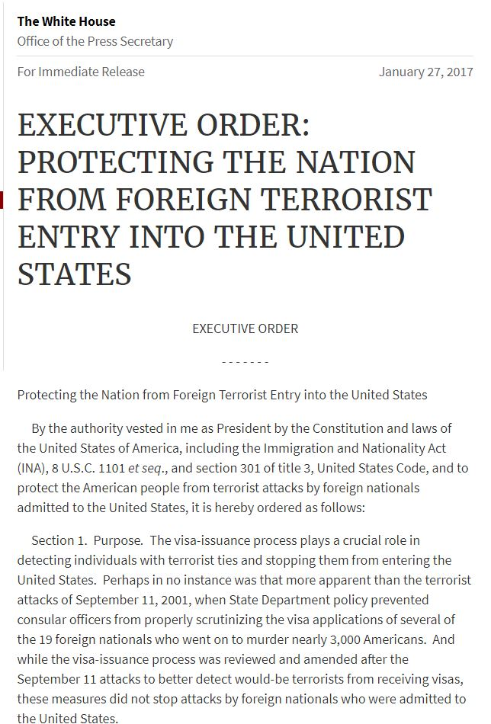
Certain Uncertainty: The New Normal

Slide 3
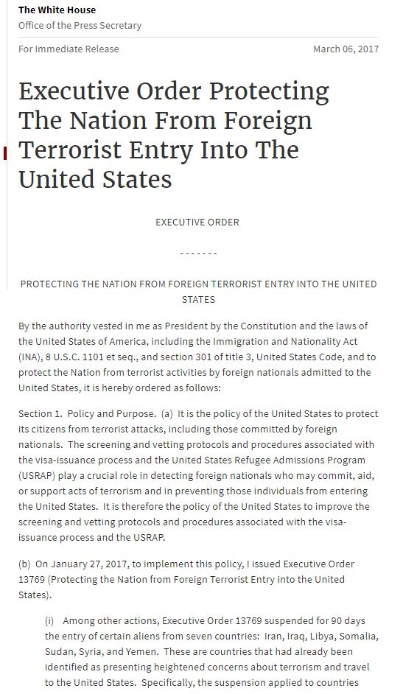
Travel Ban 2.0

Slide 4
DACA: Repealed

Slide 5
Immigration & Visa Policy
“Extreme Vetting”
Sierra Leone
Eretria
Guinea – Student Visas
Cambodia

Slide 6
Internal & External Collaboration
Student Enrollment
Retention
Education Abroad
International Business Travel

