Slide 1
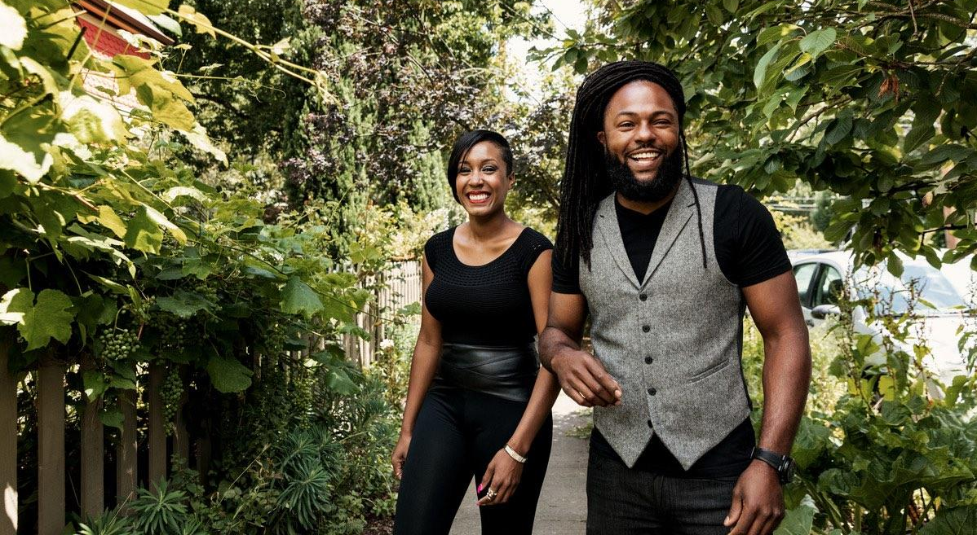
Higher Ed & The Sharing Economy
Case Study:
Airbnb & University of Alberta
Greg Bell, Business Travel, Airbnb & Phil Webb, Procurement, University of Alberta
Notes:
Thank you to SCTEM for allowing us to be here and present this case study.

Slide 2
Quick about me
Notes:
My name is Greg Bell and I’m on the Business Travel Team at Airbnb
I’m from Cleveland, OH and went to THE Ohio State University, who have beat Michigan in football 5 years in a row
I’ve been with Aibnb for 2 years now but before that I spent 10 years in the hotel industry doing sales and marketing and operations
And my fun fact is that I have an identical twin brother, and he and his wife just had a baby and it’s kind of a trip that he looks like me.
Finally, a lot of people have been asking where I’m staying and I actually AM staying here at the Turnberry Isle. Brings up a good point that for situations like this – a self contained conference where the meetings and events are all under one roof – it makes perfect sense to stay in a hotel. But if I were coming to Miami for a longer term stay and had to conduct business in different parts of town, I might choose to want to live like a local and stay in a condo in South Beach or Brickell
It not about Airbnb vs hotels – it’s about options. And having the flexibility to choose the right type of accommodations for each trip.

Slide 3
Contents
Part 1: Intro to Airbnb and Airbnb for Work
Part II: Case Study: University of Alberta and Airbnb for Work
Notes:
Today we’re going to talk about the Sharing Economy and Higher Ed travel. This session is really going to broken down into 2 parts.
In Part 1 - I’m going to take the 1st 15 minutes to give you a quick background on the sharing economy and Airbnb. How it started and where it is today, and then pivot to our Business Travel Solution, Airbnb for Work, some of it’s benefits and common use cases.
In this part you’ll develop a better understanding the Sharing Economy and Airbnb & Airbnb for Work and hopefully clear up some misconceptions.
In Part 2 Phil Webb and I are going to take about 30 mins to run you through a Case Study on how our partnership came to fruition, from our first meeting with his colleague Nicole Fluet (which took place at the SCTEM conference last year) to U of A fully vetting, approving and rolling out an Airbnb program in their travel policy. We know that a lot of Universities out there are interested in learning more about alternative lodging options like Airbnb, and to some extent your travelers are already using them.
We hope that you’ll learn some key insights on how to navigate the waters within your institution should you be interested in implementing an Airbnb program
A lot of information to cover in a short amount of time, so let’s get to it.

Slide 4
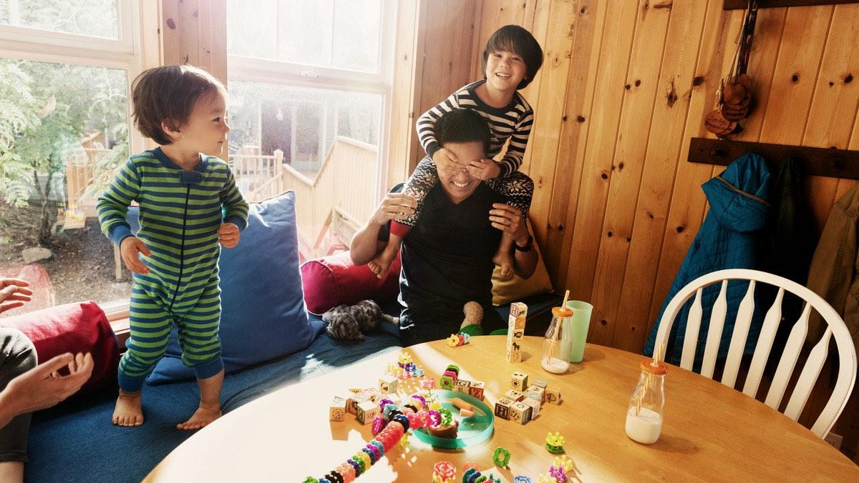
Fun Fact :
About Airbnb
It all started at a business conference
Notes:
Let’s take a closer look at one of these companies, Airbnb

Slide 5
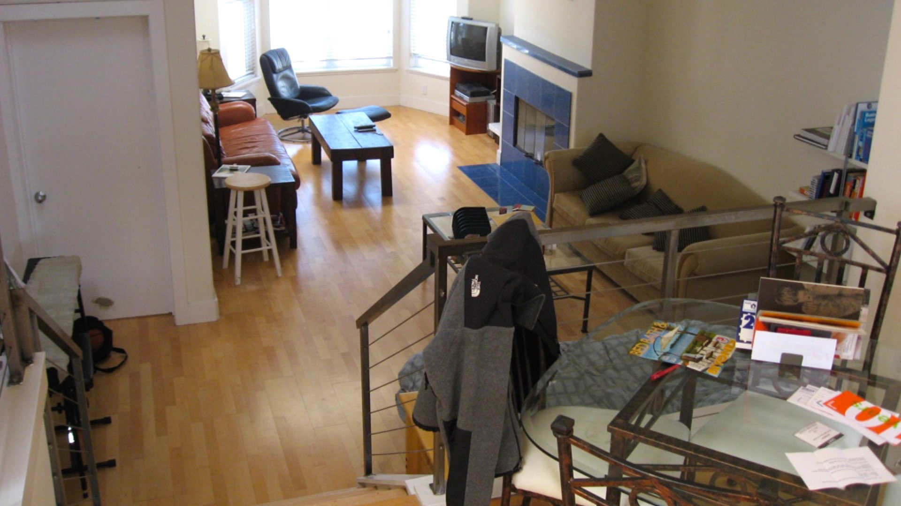
Notes:
As the story goes
Founders were living in this apartment in SF that they loved
Rent increased by 50% - had to quickly find a way to make $ to stay in their beloved apt
They were recent graduates of Rhode Island School of Design and were attending a design conference in SF, and because they were attending they knew that most of the hotels in the city were sold out, and the few remaining were selling at sky high rates.
Recently gone on a camping trip & had 3 extra Airbeds
Came up with an idea – pull out Air mattresses and turn their apartment into a bed and breakfast, offering affordable housing for people still looking to attend the conference.

Slide 6
Notes:
They called it Airbed and Breakfast (for the air mattresses)

Slide 7
Notes:
And with the help of their programmer friend, our 3rd founder, Nate, they whipped up this website that they marketed on the conference website.

Slide 8
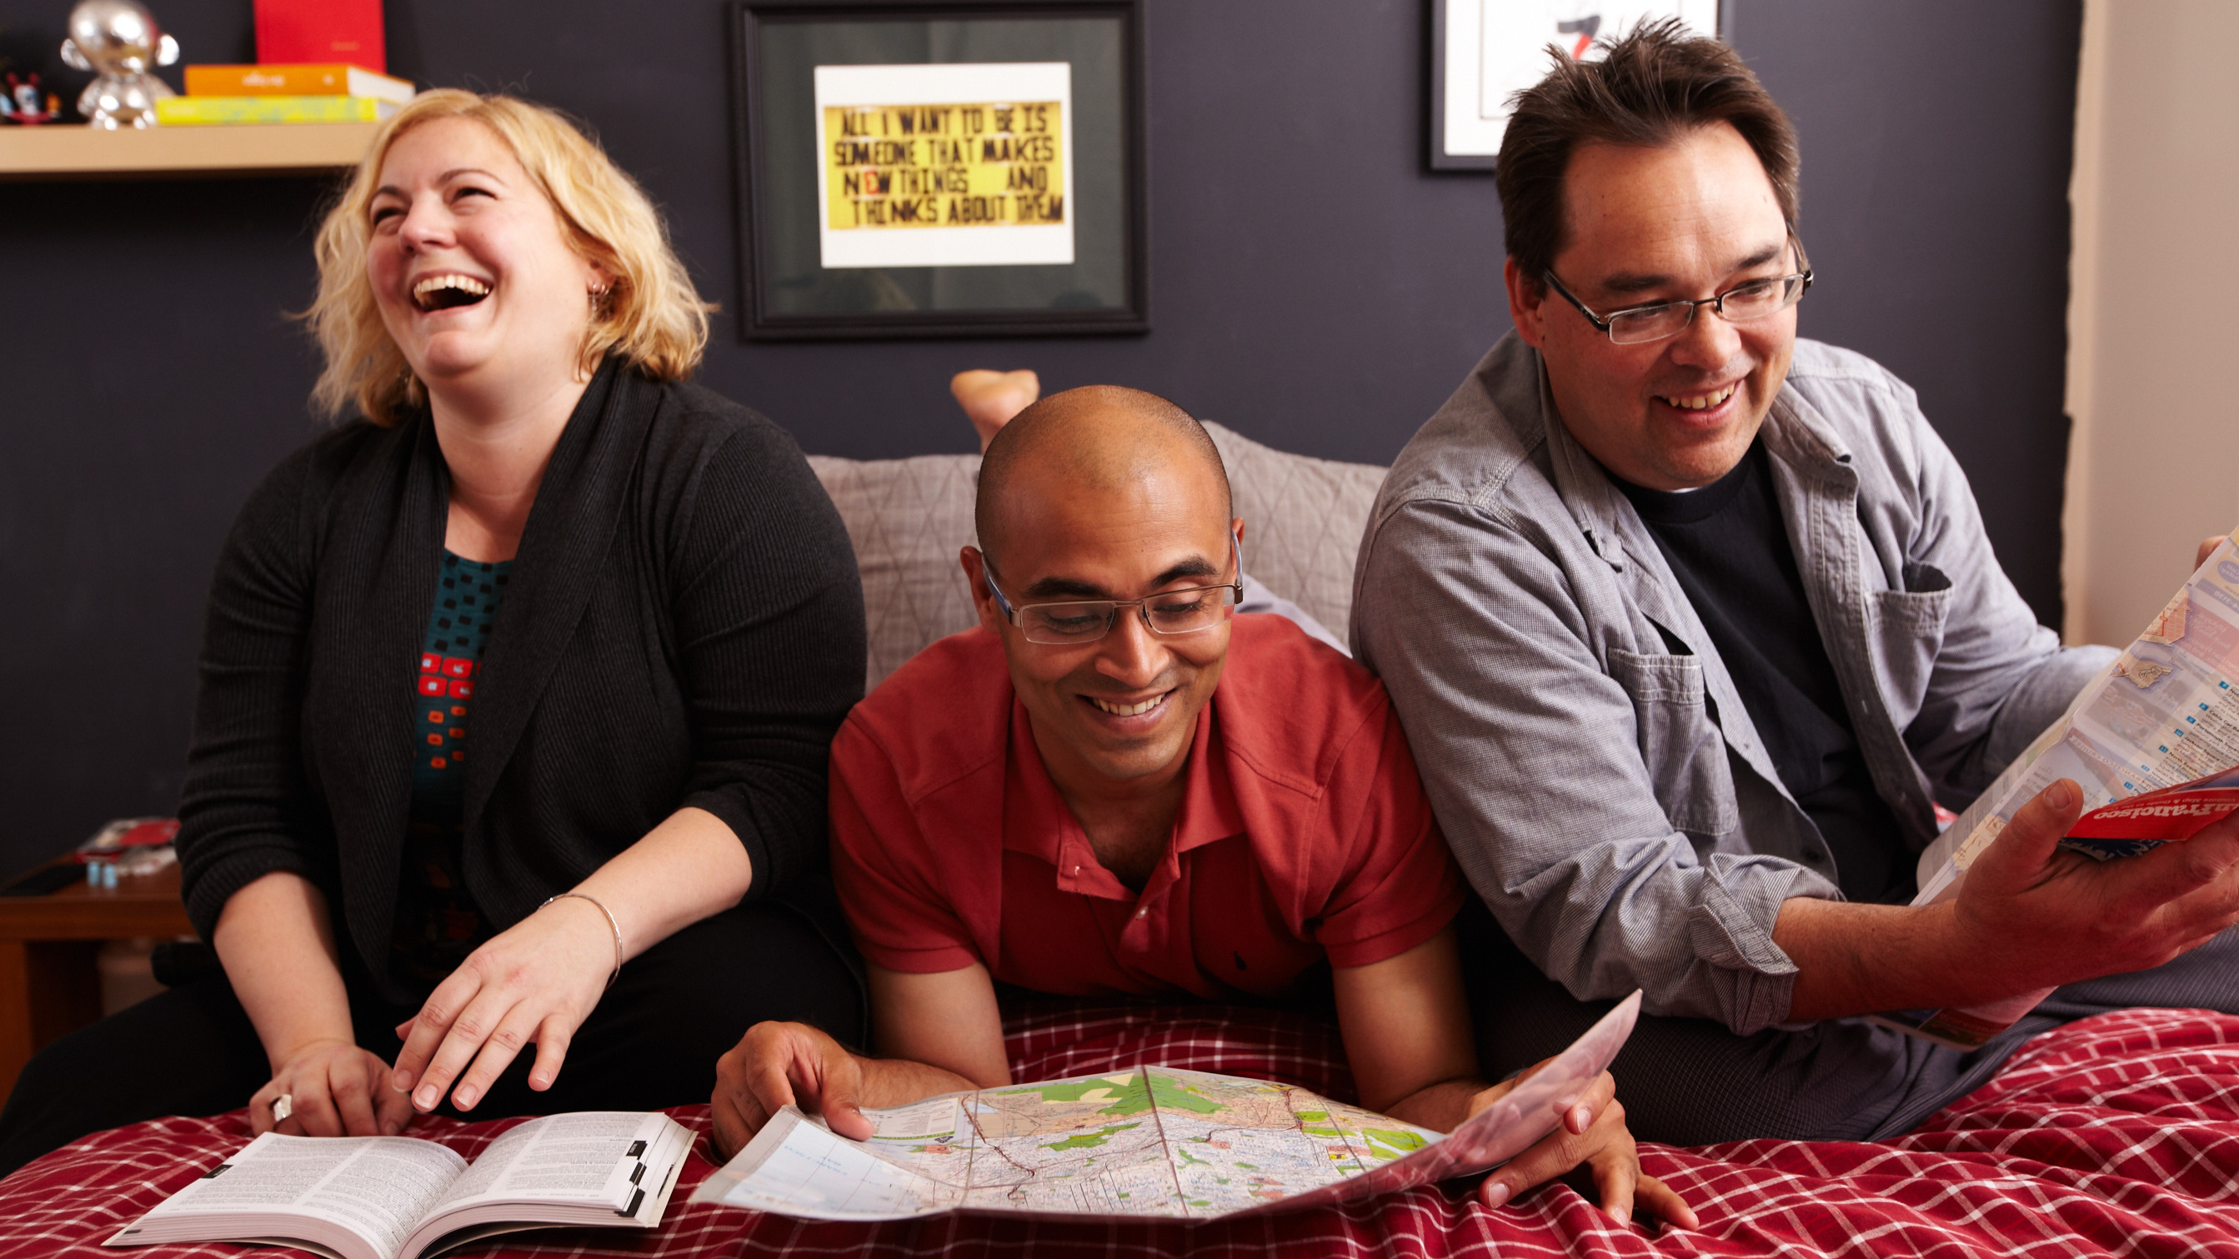
Michael
Amol
Kat
Notes:
And, somehow, IT WORKED
For $80 per night, these 3 people, who were perfect strangers from around the worlds, booked the first ever Airbnb
Giant photos of these guys in our HQ office. To this day still brand ambassadors to Airbnb.

Slide 9
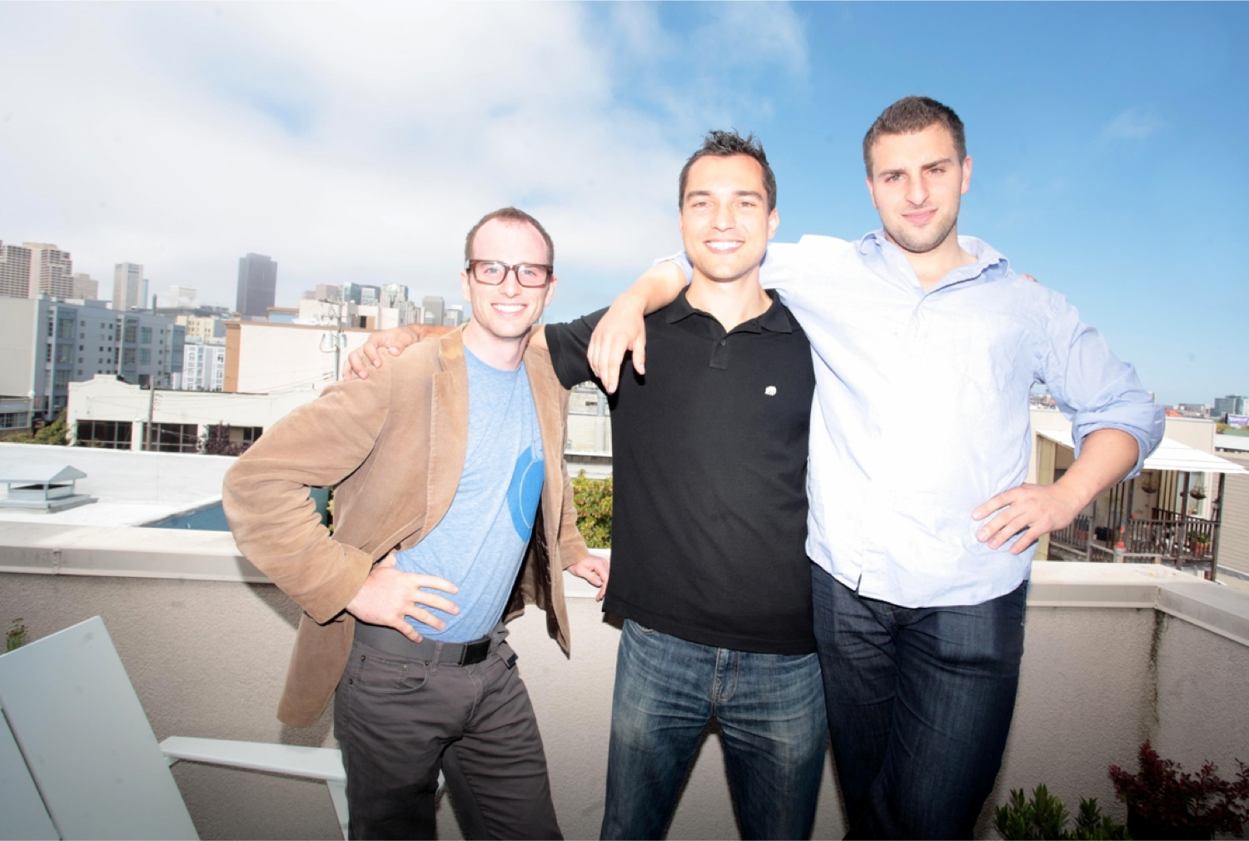
Notes:
Our Founders and the first 3 hosts on Airbnb. They love saying that this was the worst idea that ever worked.
What really set off the lightbulb with our founders wasn’t the money they made but the transcendent experiences these guests had. The founders cooked for their guests and became their tour guides around SF for the week. They all hugged at the end of the stay and have stayed in close contact with th ever since
[Also the smiles you have on your face when your AirBed idea turned you all into millionaires]

Slide 10
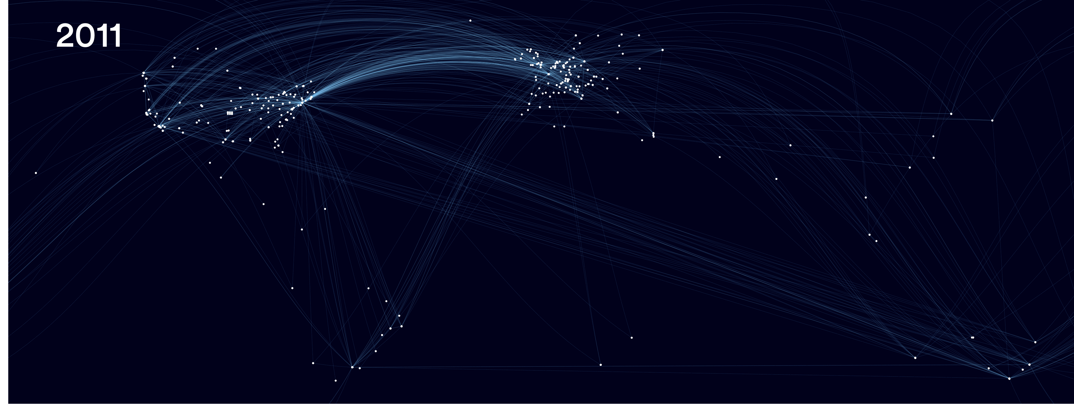
Notes:
These next few slides illustrates the growth we’ve experienced since that first stay

Slide 11
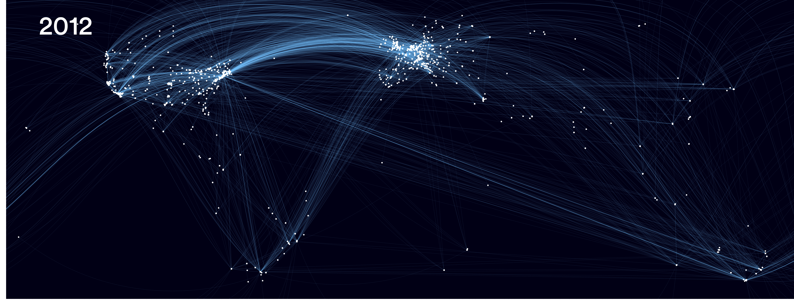

Slide 12
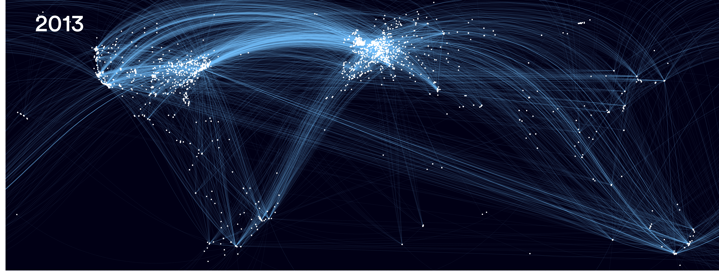

Slide 13
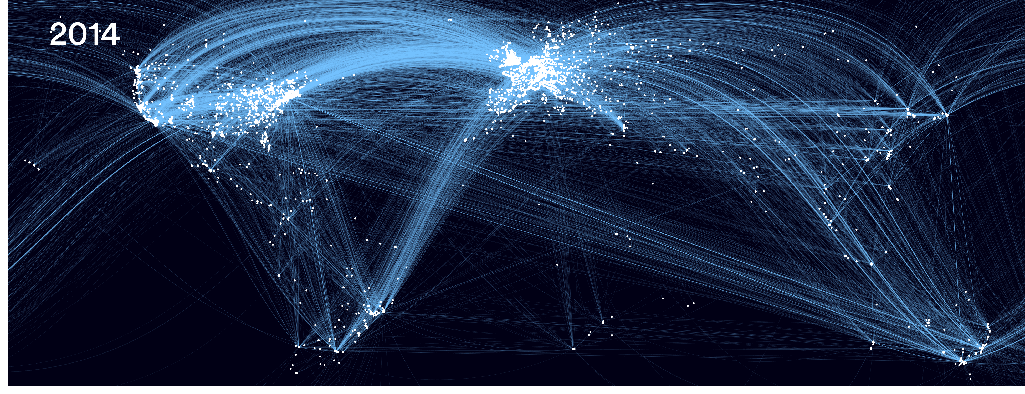

Slide 14
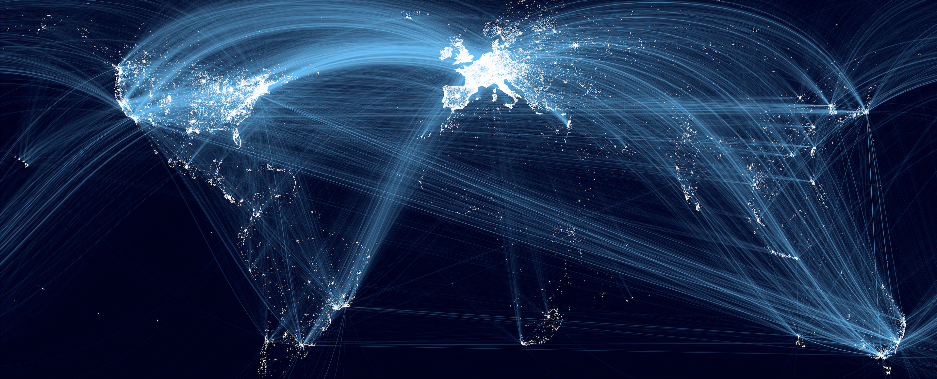
2015

Slide 15
About Airbnb
Airbnb is the world’s largest community driven hospitality company with over 4 million active listings - from city apartments to mountain retreats, all over the world.
191 Countries
65,000 Cities
200M+ Guests
4M Properties
15
Notes:
That’s more places to stay than the top 5 hotel companies, combined.
On any given night, we have over 2 million people on average staying in Airbnb’s

Slide 16
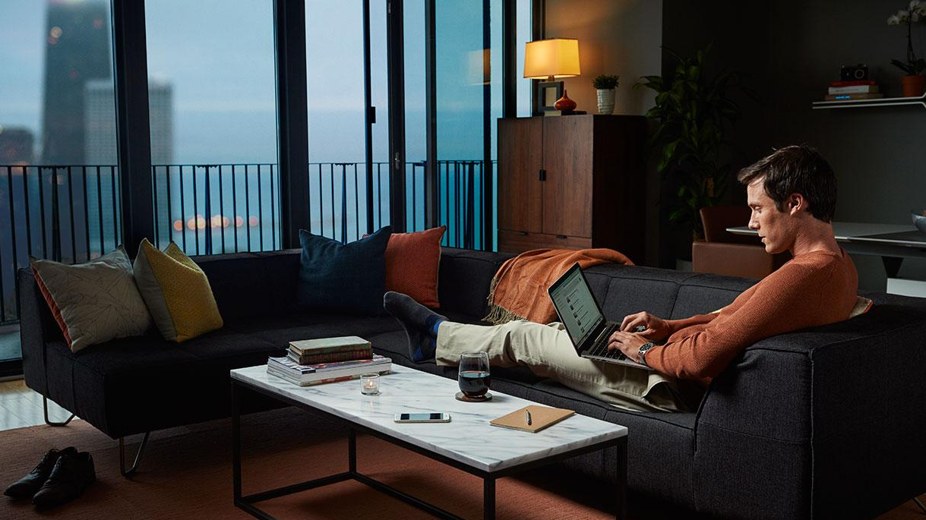
About Airbnb for Work
Travel for work, feel at home
Notes:
Quick background on Airbnb and Airbnb for Business
Our business travel solution really evolved within Airbnb over the last 3 years
Even though our 1st 3 guests were technically business travelers, for the 1st 7 years our product & service was really focused on leisure travel
A few years ago we started to get more and more travelers and travel managers asking for better solutions to serve their needs
and we really built our business travel solution, Airbnb for for Work, based on that feedback
I’ll take a couple minutes to share a few of the high level findings.

Slide 17
Companies had concerns with consistency of quality, check-in, and amenities.
Notes:
The way it was:
One Airbnb would be the best business experience – had everything they needed, the next would be really poor – no hangers, no wifi, etc.

Slide 18
Amenities
Special ‘Business Travel Ready’ listings receive a majority of 5-star reviews and include:
Wireless Internet
Laptop-friendly workspace
Keyless entry
Smoke detector
Carbon monoxide detector
Iron and ironing board
Hair dryer
Hangers
Shampoo
Essentials (toilet paper, clean towels, and fresh linens)
18
Notes:
So we created our Business Travel Ready program to address this consistency issue. How this works is our hosts can earn this Business Ready badge if they hit these 10 criterion:
Couple big ones:
Had to have been reviewed 5 times and majority of those reviews have to be perfect scores
Keyless Entry - be it a keypad, lockbox or phone app
Safety features like smoke and CO2 detectors

Slide 19
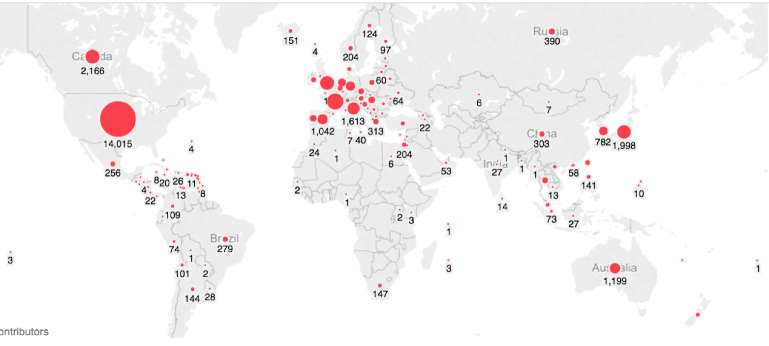
Business Ready Listings
200,000+ listings in more than 130 countries
Notes:
Launched this program about a year and a half ago and now have over 200,000 globally

Slide 20
Business travelers needed be able to quickly find, book and expense business appropriate listings
Notes:
2nd:
Before the program: Business traveler searches a city like Portland: see everything from Tree houses, to houseboats on the river, to airbeds on a floor, to penthouse apartments. Too much time to find something business appropriate.

Slide 21
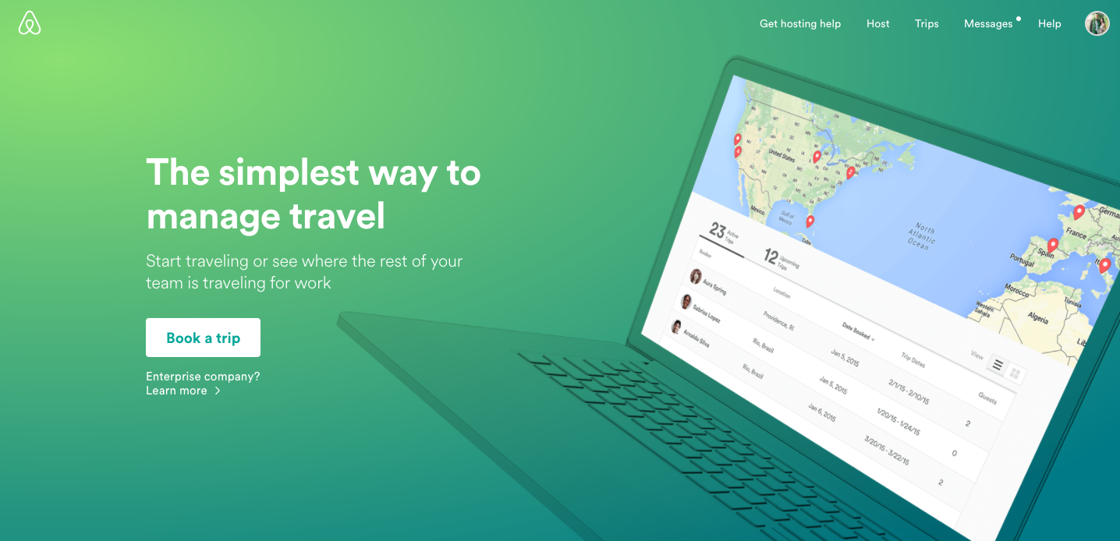
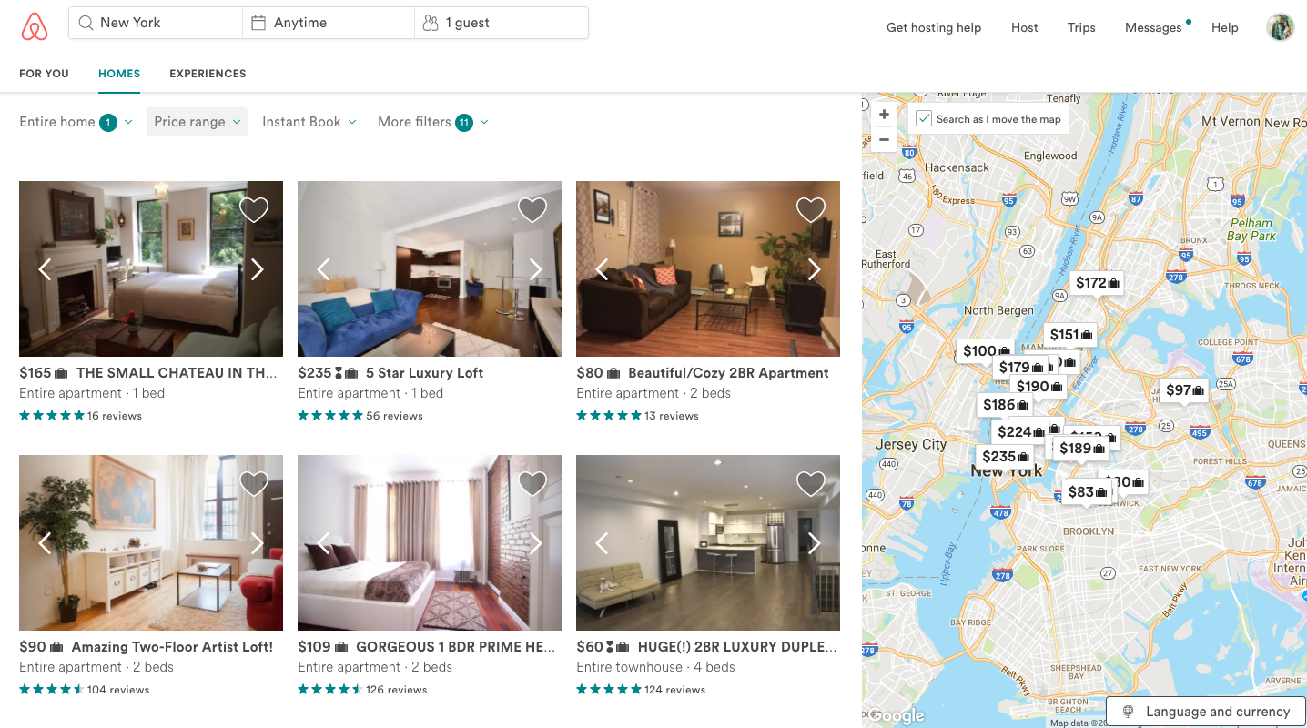
Airbnb Business Search
Business search only shows Business Travel Ready listings
Removes “private room” and “shared room” options which aren’t always business appropriate, allowing you to quickly find a business friendly listing
21
Notes:
So we created our business search which only shows entire homes that are business travel ready

Slide 22
Travel and Risk Managers needed visibility of their travelers on Airbnb
Notes:
Finally,
In the past, if travelers booked Airbnb’s, their travel and risk managers would have no visibility as to where they were and how to get in touch with them in case of emergency

Slide 23
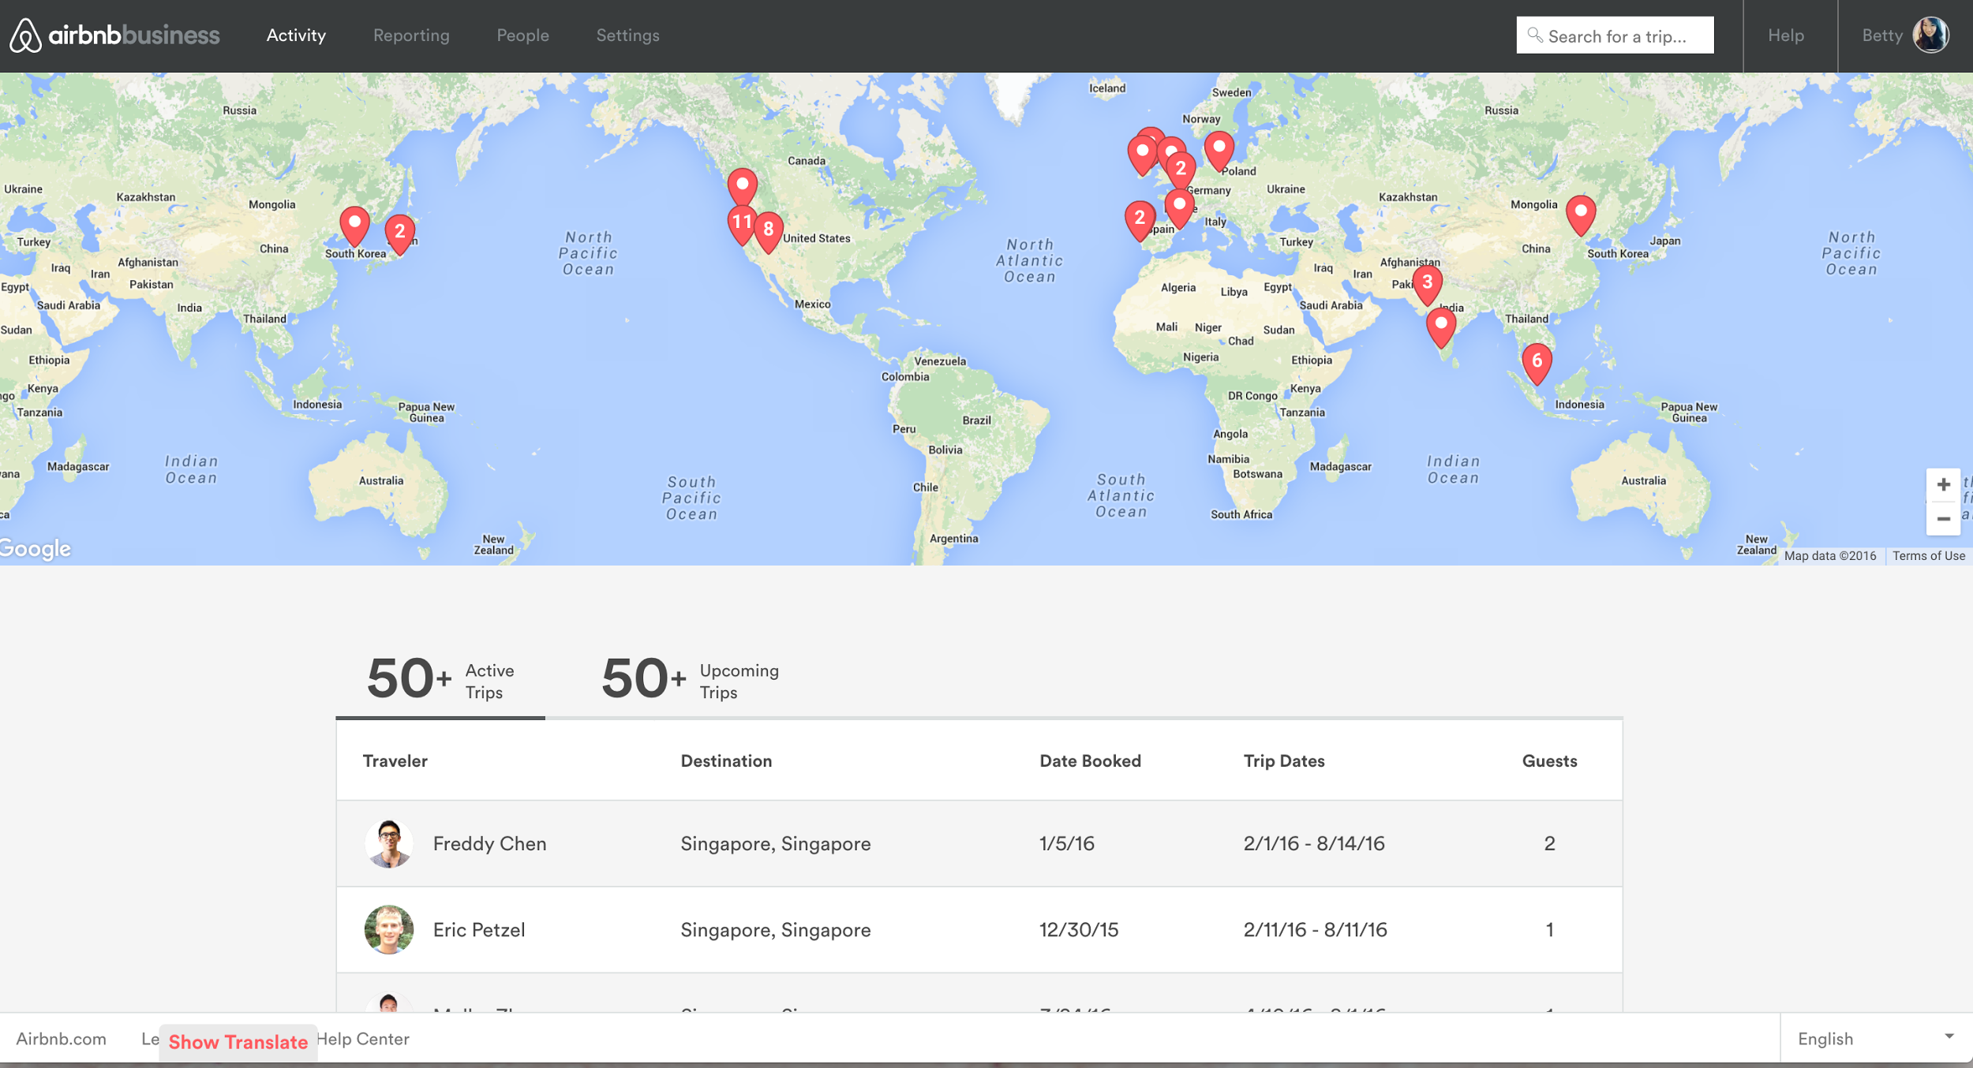
Visibility
Real time travel tracker
Your Airbnb dashboard shows each team member’s itinerary and detailed information on the property and host, and how to contact the traveler and host.
23
Notes:
So we created a real time travel travel tracker feature.

Slide 24
Notes:
Here’s a closer look at the dashboard – gives you full visibility into all current and future bookings on Airbnb, and also integrates with several of the major Duty of Care providers like ISOS, iJET and Anvil

Slide 25
Ultimately, our goal was to reduce friction for business travelers and give Travel and Risk Managers full visibility and support

Slide 26
About Airbnb for Work
Airbnb for Work is the world’s largest provider of alternative accommodations for work trips.
200,000+
Business Travel Ready Properties
500,000+
Companies using Airbnb globally
20M+
Business Travel Nights and counting
26
Notes:
Fast forward to today we now have close to 1 million companies using Airbnb - our 2nd largest vertical being higher ed.

Slide 27
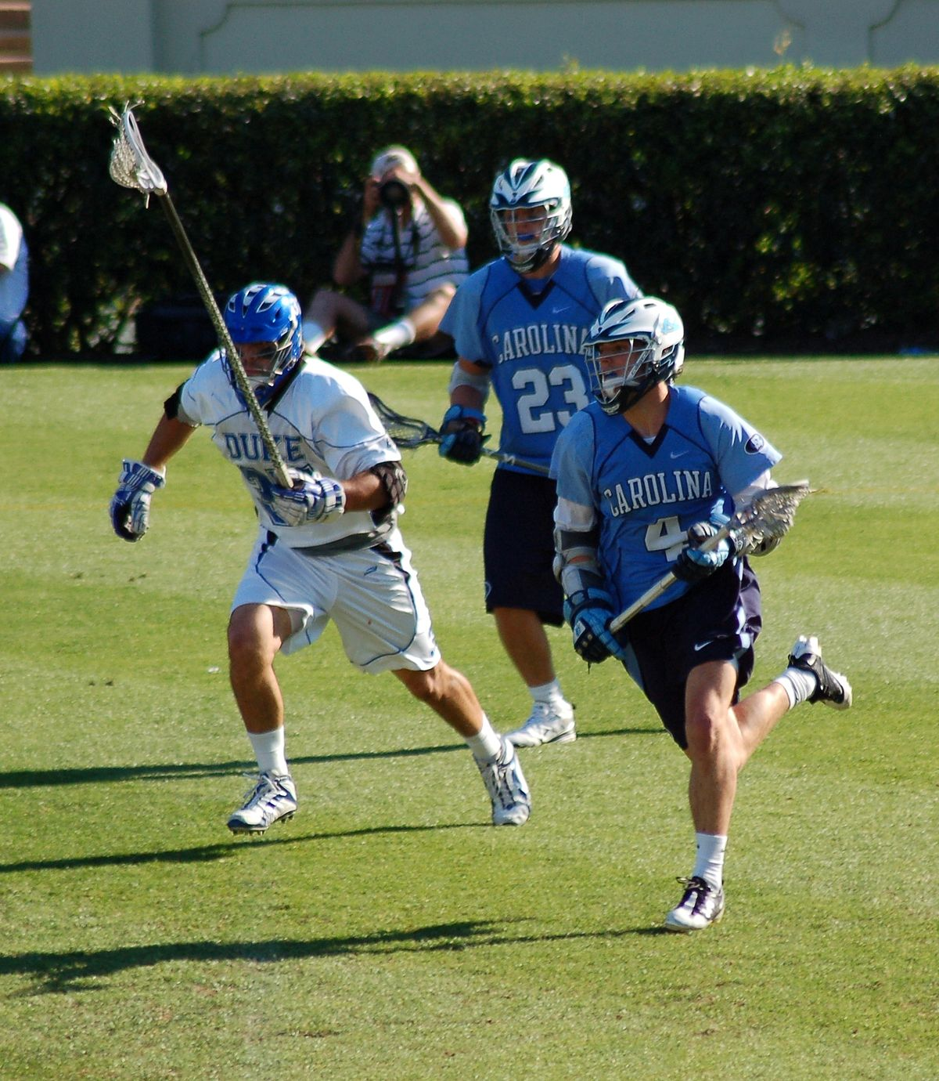
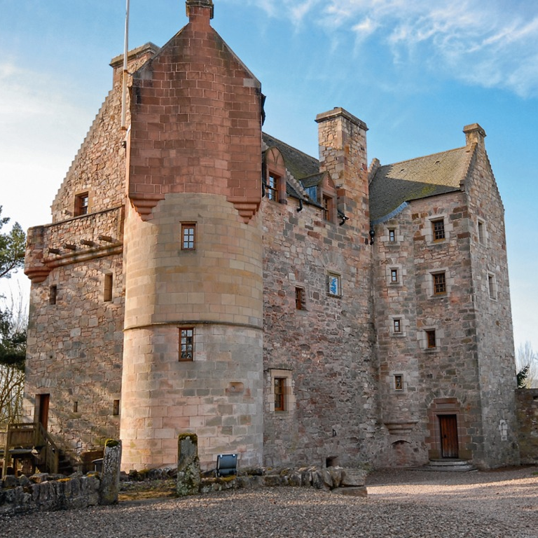
Common Higher Ed Use Cases
Conference Travel
Research travel
Athletics Travel
Meetings & Events
Availability when and where it’s needed during conferences
30% - 40% savings
Being able to live in a real home for long term research travel improves employee experience
Choose a large home so your whole team can stay under one roof
A unique way to meet with the team
Notes:
The typical use cases

Slide 28
Improved Travel Experience
Business travelers give Airbnb an industry-leading satisfaction rating of 4.7 out of 5.
Host Accountability
Our hosts are personally responsible for guests’ satisfaction and frequently go above and beyond to ensure positive experiences and good reviews
28
Notes:
Not meant to be a billboard – just illustrates that we wouldn’t hit these numbers and satisfaction ratings if Airbnb wasn’t an incredibly safe and comfortable way to travel we wouldn’t

Slide 29
Trust and Safety at Airbnb
Notes:
Which leads to Trust and Safety at Airbnb - the single most important thing we work on every day.

Slide 30
Trust & Safety
How We Keep You Safe
Risk Scoring
Background Checks & Watchlists
Data Privacy & Cybersecurity
Preventing Scams
Home Safety
Detailed Profiles
Secure On-Platform Messaging
Reviews
24/7 Global Response & Assistance
Insurance
30
Notes:
Not going to get into all of these, but I will tell you that if anyone is interested in doing a deep dive into any or all of these security measures, we’d be happy to set up a call and we can even pull in one of our Trust and Safety or Insurance leaders. And as you’ll see in a moment, that was one of University of Alberta’s steps in their due diligence process.
Risk Scoring: To prevent bad actors from ever accessing our platform in the first place, every reservation is scored ahead of time for risk. Our real-time detection system uses machine learning and predictive analytics to instantly evaluate hundreds of signals to flag and then stop any suspicious activity.
Detailed Profiles: Every person on Airbnb has a detailed profile with information about themselves and their home. In order to sign up for Airbnb, you must provide a full name, date of birth, photo, phone number, and email address. Hosts can also require that guests provide a government ID before booking their listing, and then the host in turn is required to do so as well.
Background Checks & Watchlists: All global hosts and guests are screened against regulatory, terrorist, and sanctions watch lists. For United States residents, we also run background checks for certain felony convictions, sex offender registrations, or significant misdemeanors.
Secure Messaging: we have a safe and easy way for guests to get to know their potential host before requesting a reservation. Our secure messaging tool can help you break the ice and ask questions—something we highly recommend.
Data Privacy & Cybersecurity: Every transaction conducted on the platform is guaranteed to be secure, your money is protected, and funds are always guaranteed. We also take a number of measures to safeguard your Airbnb account, including using multi-factor authentication.
Reviews: If you’re curious what previous guests have thought about your potential host or home all you need to do is check their reviews. Guests and hosts publicly review each other and only after the reservation is complete, so you know the feedback is informed, unbiased, and real.
Preventing Scams: Fake or misrepresented listings have no place in our community. These scams are rare, and as long as you don’t communicate offline or pay anyone directly, you have no reason to worry. Plus, we never release payment to a host until you are safely checked in, so you have recourse in case something isn’t as advertised.
24/7 Response & Assistance: In the rare event that any issue should arise, our global Customer Service and Trust and Safety teams are on call 24/7 in 11 different languages to help make things right with rebooking assistance, as well as refunds and reimbursements.
Business Travel clients have the added peace of mind of a dedicated Account Manager and priority Customer Service support.
Home Safety: We run home safety workshops with hosts and local fire services to equip our community with the latest advice from leading experts. A Business Travel listing is only available if it is known to have a working smoke and carbon monoxide detector. We have made it easy for you to know what to do if there is an emergency by providing online safety cards containing emergency phone numbers, locations of fire extinguishers, and fire alarms, as well as emergency exit routes.
Insurance: We also provide a $1 Million USD Host Protection Insurance program in order to protect hosts – and guests – in the unlikely event that a guest gets injured or causes damage in a property.

Slide 31
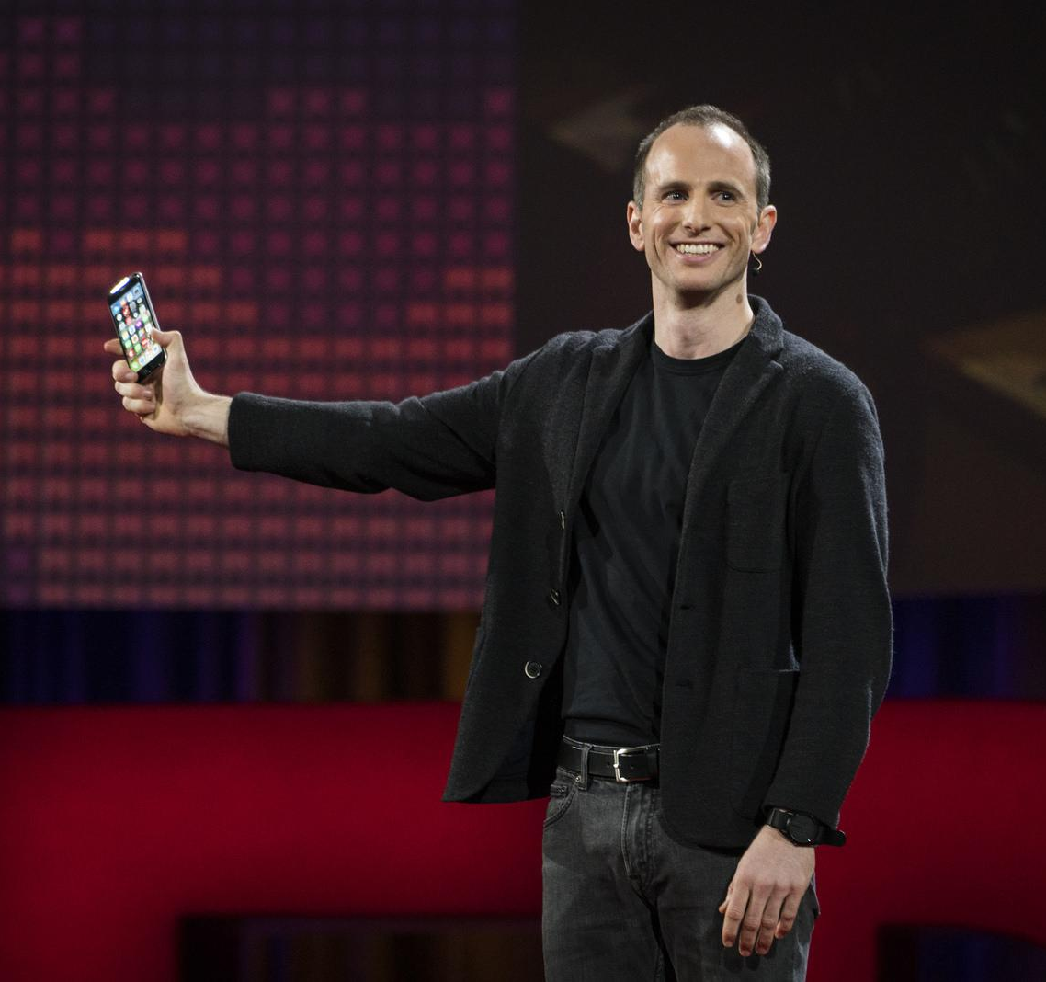
Trust & Safety
Building a safe & trusted environment is the most important thing we do.
How Airbnb Designs for Trust
There have been more than 200 million guest arrivals in Airbnb listings to date and negative incidents are extremely rare.
Photo: Joe Gebbia, Co-Founder
Notes:
But I will say that buildingg a safe and trusted environment for travelers is the most important thing we do. There have been more than 200 million guest arrivals in Airbnb listings to date and negative incidents are extremely rare.
Before flipping it over to Phil from the University of Alberta, I wanted to leave you with this quick clip from our founder, Joe Gebbia’s TED talk, which explores how our entire platform was designed for Trust and Safety, enjoy.

Slide 32
Trust & Safety
Building a safe & trusted environment is the most important thing we do.
How Airbnb Designs for Trust
There have been more than 200 million guest arrivals in Airbnb listings to date and negative incidents are extremely rare.
Photo: Joe Gebbia, Co-Founder
Notes:
Building a safe and trusted environment for travelers is the most important thing we do. There have been more than 180 million guest arrivals in Airbnb listings to date and negative incidents are extremely rare.
Even so, we’re constantly working to improve our platform, our policies, and our protections, because even one incident is one too many.

Slide 33
About The University of Alberta
Notes:
40000 Students (7700 graduate students, 7800 international students from 151 countries, 3600 academic staff and 15000 support and trust employees, consists of 18 faculties-
Faculty of Agricultural, Life and Environmental Sciences, Alberta School of Business, Faculty of Arts, Augustana Campus, Campus Saint-Jean, Faculty of Education, Faculty of Engineering, Faculty of Extension, Faculty of Law, Faculty of Medicine and Dentistry, Faculty of Native Studies, Faculty of Nursing, Faculty of Pharmacy, Faculty of Phys Ed and Recreation, Faculty of Rehabilitation Medicine, School of Public Health and Faculty of Science

Slide 34
The University of Alberta
Travel Program Spend Fiscal Year 2016
T & E Claims
Airfare
Ground Trans
Vehicle Rental
Private Auto
Accommodations
Meals
Registrations
Hospitality
Communications
T & E Spend
Central Pay Spend
Grand Total
$5,390,606
$1,171,089
$438,233
$1,198,020
$6,538,890
$2,547,864
$2,412,419
$1,045,152
$29,641
$20,771,915
$8,555,118
$29,327,033

Slide 35
Airbnb + U of A

Slide 36
Timeline
Due Diligence Phase
September, 2016
October 2016
November, 2016
December, 2016
1st meeting.
Greg & Nicole Fluet (Associate Director, Business Services) meet at SCTEM conference in San Diego, CA
Intro call.
As a follow up to their meeting, Greg and Phil schedule an intro call
2nd meeting.
Greg and Phil have a follow up meeting at ACTE Canada in Vancouver
U of A creates solution support document.
Travel Management at U of A build their case
Notes:
Phil
Phil jumps in for last to lead into support doc

Slide 37
University of Alberta’s Internal Support Doc
Notes:
Jump over to support document

Slide 38
Timeline
Implementation Phase
May, 2017
June 2017
July, 2017
August, 2017
October 2017
Contract Executed
Reference checks
Rebate negotiations
Redlines and final legal reviews
Onboarding Call
Airbnb Account Manager and U of A’s travel stakeholders discuss action plan to activate program
U of A Launches Airbnb program
Email to staff, newsletter mention, update to U of A’s travel webpage
Check in Aug. 22
Stats post launch:
2017 YTD data
Travelers: 2669 + 284 since go live (6/15)
Nights 4170 + 744 (6/15)
Spend $219,561 + $47,090 since (6/15)
U of A Travel Fair
Airbnb to attend U of A’s travel fair to promote program
Notes:
Phil: Cover 1st and talk about reference checks and internal contract review
Phil: Covers launch and explains how they announced program.
Then talks about their travel fair – I’m sure a lot of schools are considering doing this. Explain what it is, and what Airbnb will have the opportunity to accomplish by attending

Slide 39
Thank You Greg Bell Airbnb Business Development, Business Travel gregory.bell@airbnb.com Phil Webb University of Alberta Director, Logistics and Business Services phil.webb@ualberta.ca
Notes:
Now we’re going to turn it over to Lyft and University of ___

