Slide 1
Persuasive
Presentations
The ability to present an idea is as important as the idea itself.
Notes:
Music on click – 3:10

Slide 2
Persuasive
Presentations
Doug Carter
Presentations Etc. Inc.
Notes:
Lied to you

Slide 4
For YOU to:

Slide 6
Notes:
Put my hand up is signal to stop. When you see a hand up, put yours up too.

Slide 7
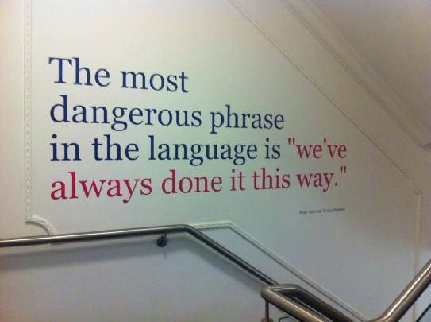

Slide 8
BIG CHANGES
tiny tweaks
Notes:
Amy Cuddy

Slide 9
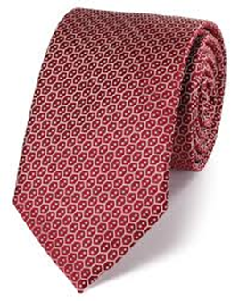

Slide 10
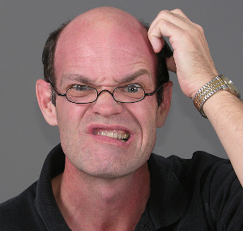
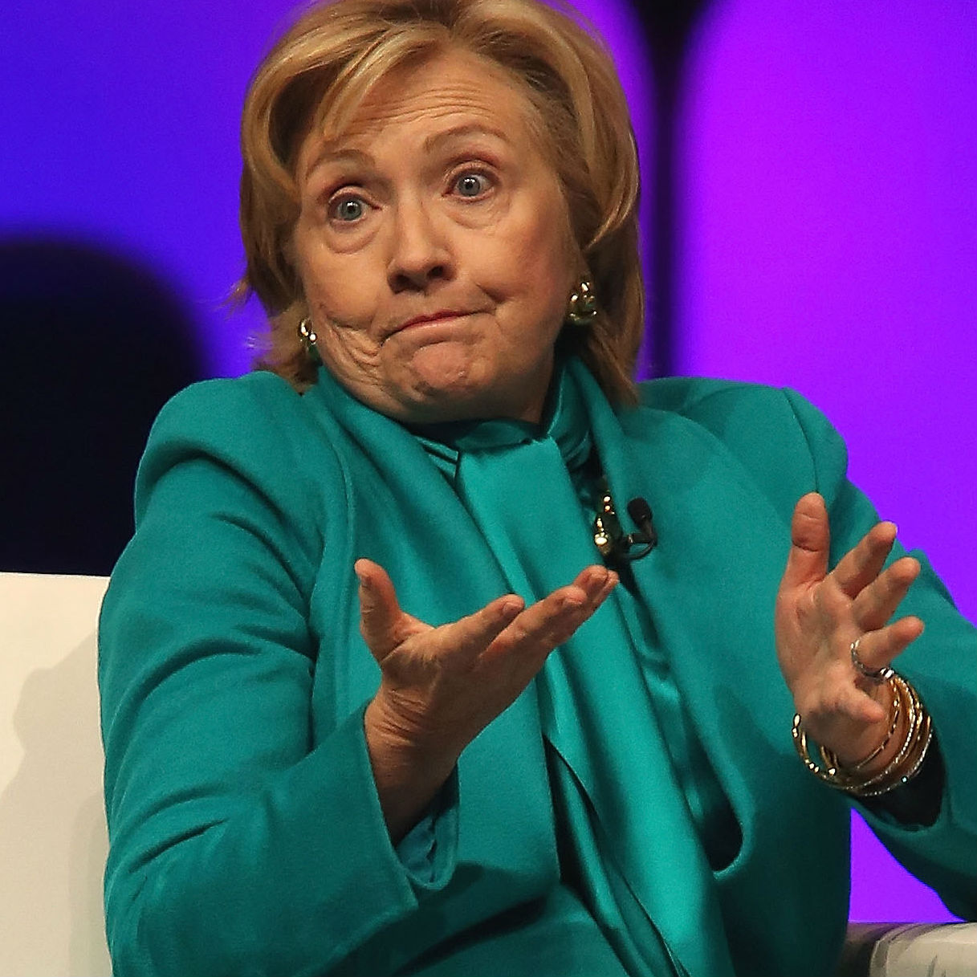
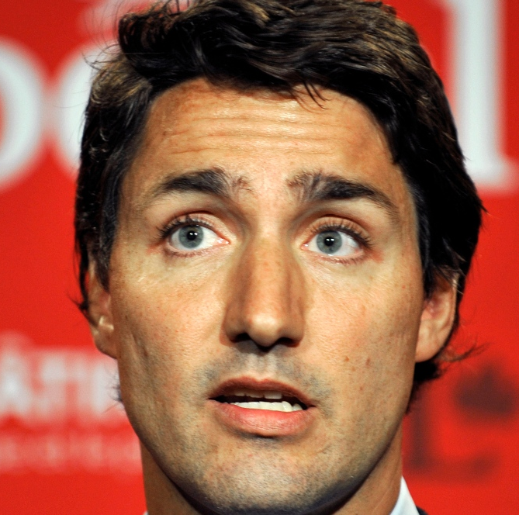
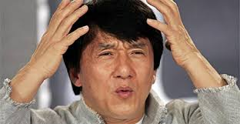
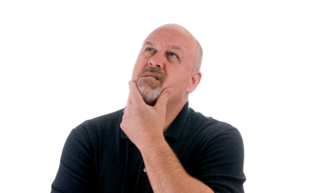
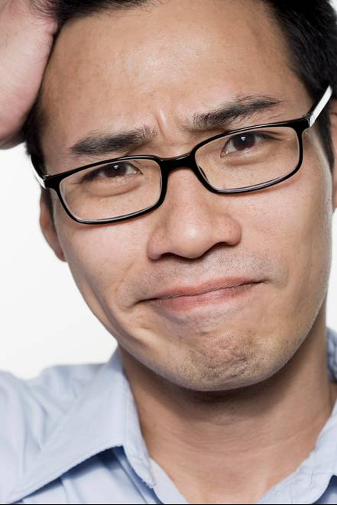

Slide 11
What will my Audience
if I am successful?
Objective

Slide 12
“At the end of this presentation, my audience will…”
Objective

Slide 13
Three Things You MUST
Know About Audience
1. Goals
2. Challenges
3. Needs
Notes:
Your Solution aligns (Feature / Relevance) to the above
How find out? Ask them!!!

Slide 15
“You”
“Your”

Slide 16
Why
Should
I Care?

Slide 19
The Good, the Bad and the Ugly.
Up, up and away.
Going, going, gone.
Past, present and future.
I came, I saw, I conquered.

Slide 20
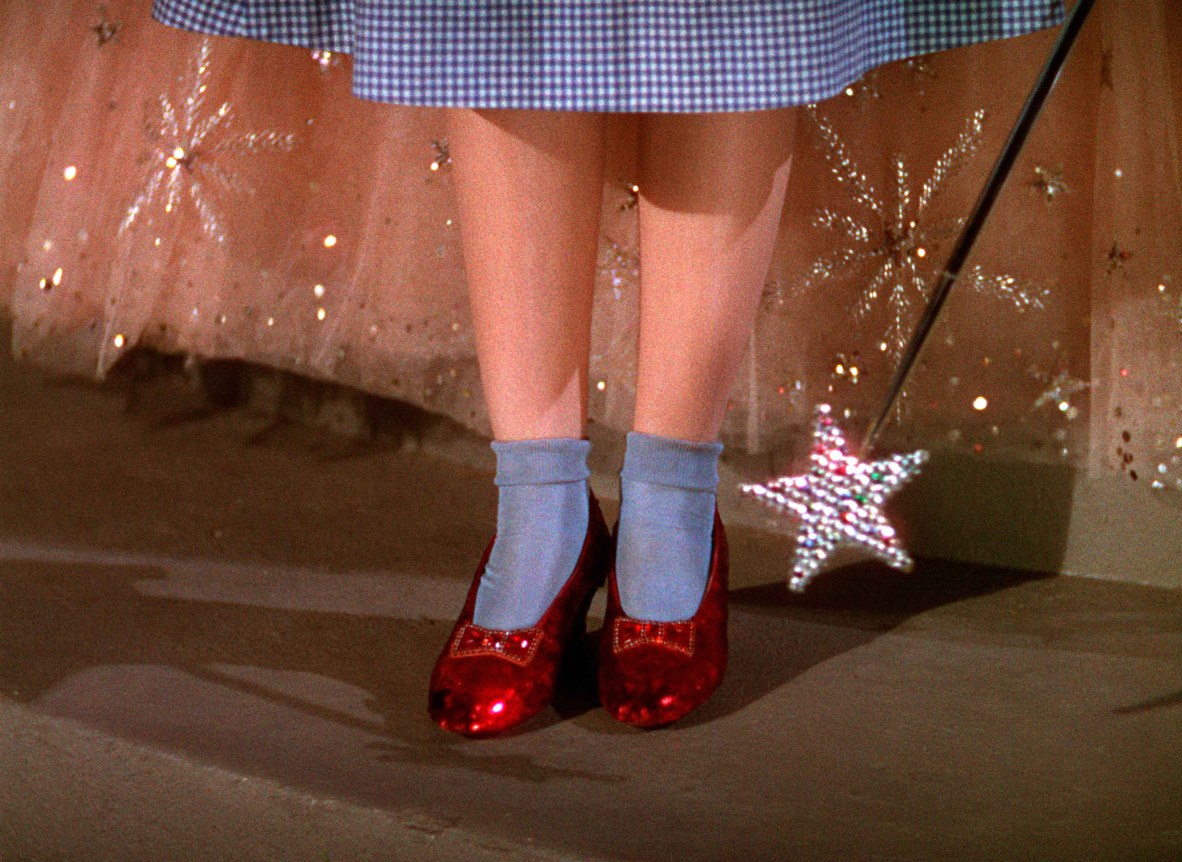
Notes:
Tell neighbour

Slide 21
What are your Three key concerns when you are deciding on a Supplier?
What are your Three key differentiating selling points?

Slide 22
Your Presentation
Objective
Supporting
Supporting
Supporting
Supporting
Supporting
Supporting
Supporting
Supporting
Supporting

Slide 23
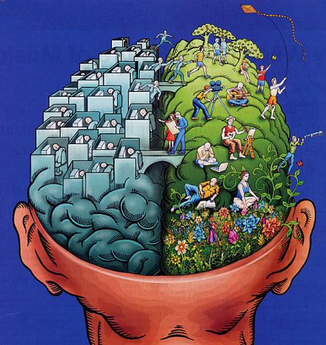
Credentials
Content
Logic
Passion
Confidence
Enthusiasm

Slide 24
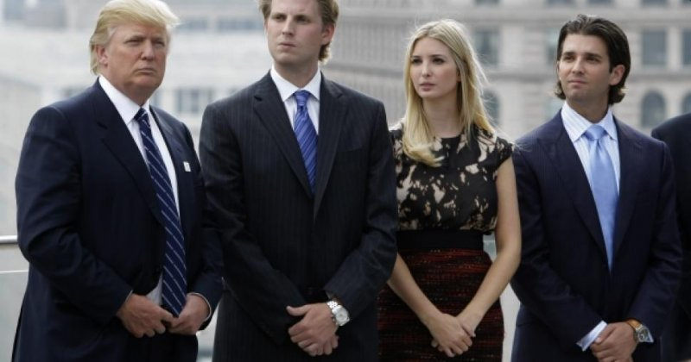

Slide 26
1

Slide 27
Think
Conversation,
NOT Performance.

Slide 28
Most people tire of a lecture in ten minutes.
Clever people do it in five.
Sensible people don’t go to lectures at all.
Stephen Leacock

Slide 29
Here are some words on the screen.

Slide 30
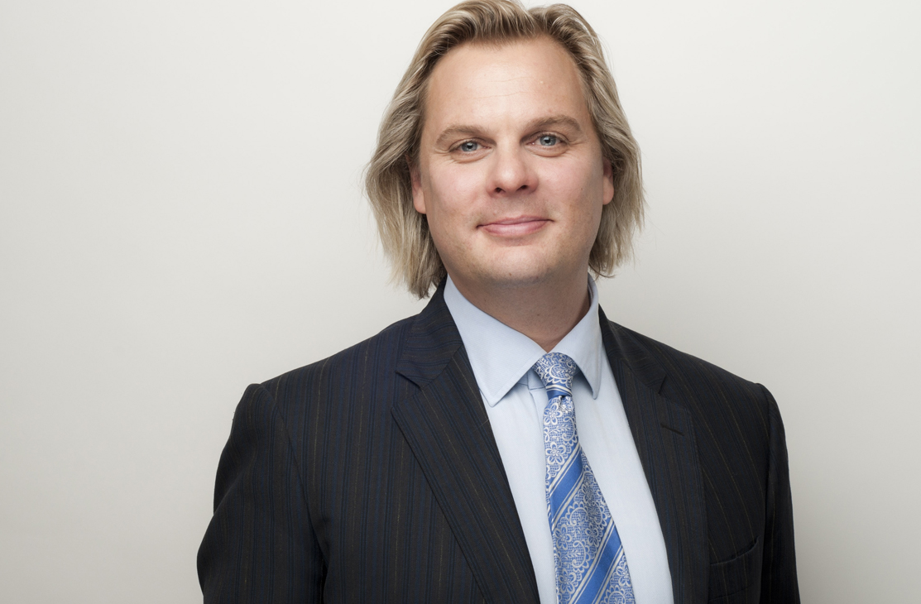

Slide 31
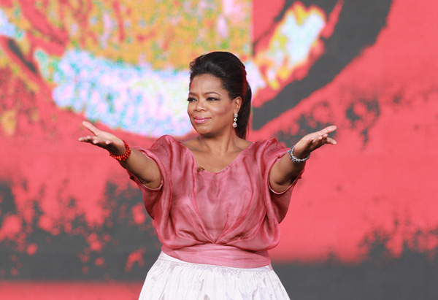
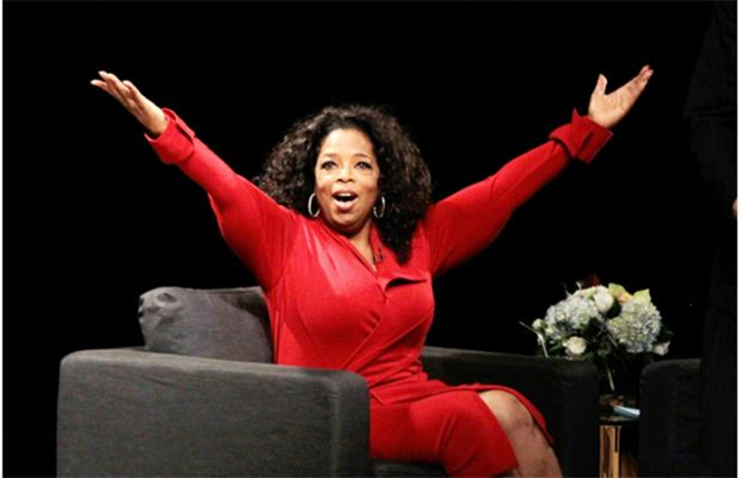
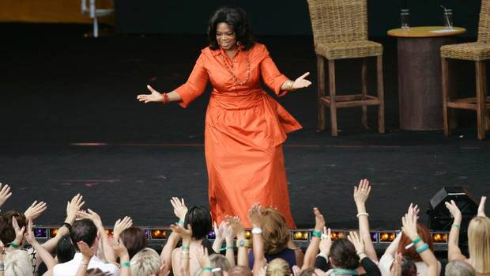
Always shown
Not half-hearted

Slide 32
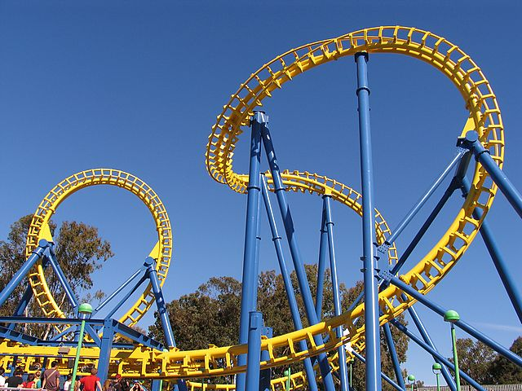
Vary pace and PAUSE…
for effect.

Slide 35
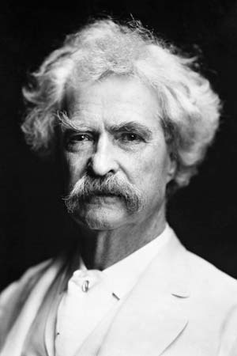
I have been through some terrible things in my life, some of which actually happened.

Slide 36
Notes:
Stand as I talk

Slide 37
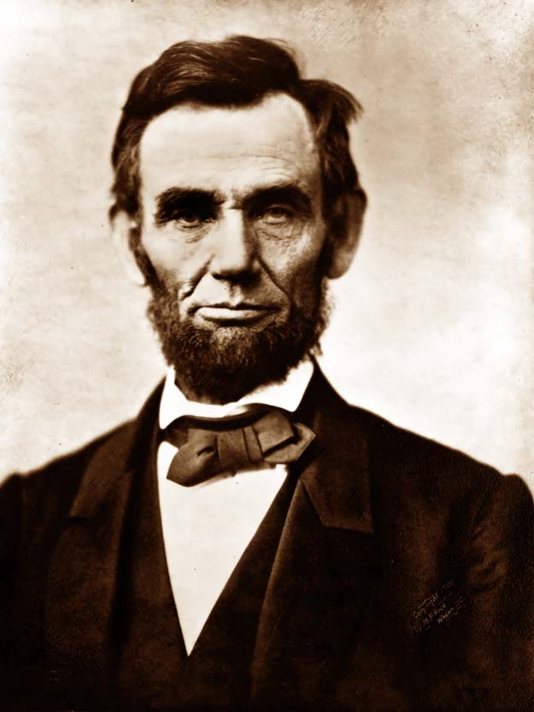
If I had eight hours to chop down a tree, I’d spend six sharpening my axe.

Slide 38
Conversation
MEMORIZE Opening

Slide 39
Notes:
Content is King
Delivery Trumps Content
Which do YOU believe
Then talk about Largest Audience…

Slide 41
One
Two
Three
Four
Five
Six Six Six Six Six Six

Slide 43
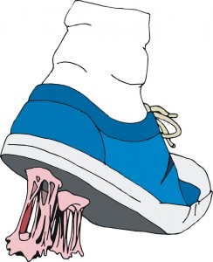
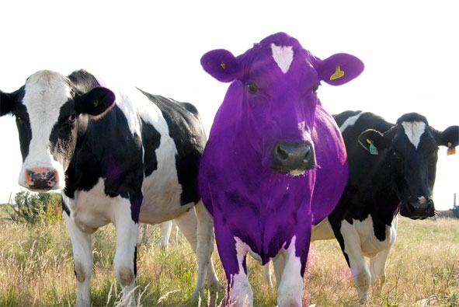
4 Principles of Stickiness
1.
Transform verbal information into visual information as much as possible.
2. Concrete
3. Unexpected
4.
Notes:
Habituation leads to less attention. This means that as people get used to a specific stimulus, they pay less and less attention to it. Habituation has negative consequences in presentations because attention paves the way to memory.

Slide 44
Stories
are More Powerful
Than Your Data!

Slide 45
Data
Message
Input
Output

Slide 46
Why?
Personal Stories
1.
Unique Content: never heard before = ‘sticky’
2.
Your Delivery improves

Slide 48
Your Success Story
1.
Initial Situation
2.
Obstacle / Barrier / Issue
3.
Lesson Learned: “Since then I…”

Slide 49
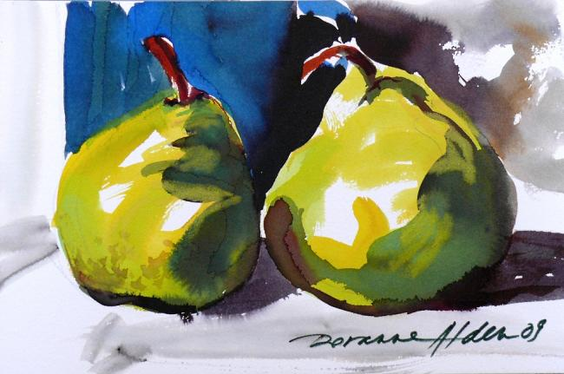
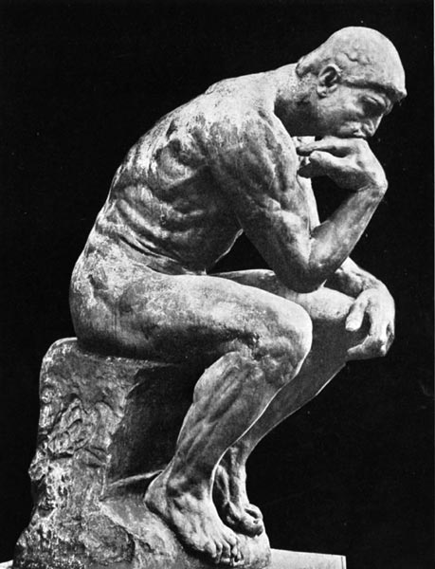
First Job – Lesson Learned
Notes:
When I change slide please stop

Slide 50
Tell your Story for 2 minutes.
Your partner just listens.

Slide 51
Each person now tells the story they just heard. (i.e.: you tell your partner’s story)
+

Slide 52
Notes:
Put my hand up is signal to stop. When you see a hand up, put yours up too.

Slide 55
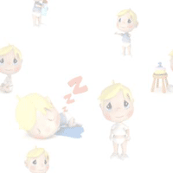

Slide 56
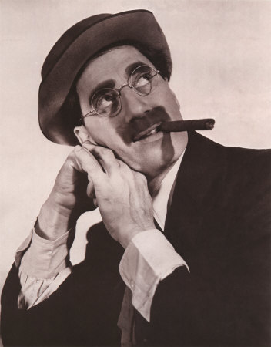
These are my principles - if you don’t like them, I’ve got others.

Slide 57
Persuasive
Presentations
Doug Carter
Presentations Etc. Inc.

