Slide 1
Doug Carter
Presentations Etc. Inc.
www.PresentationsEtc.ca
Notes:
Music + start session

Slide 2
“The opposite of
Networking is
NOT working.”
- Someone smart

Slide 3
“Work jointly on an activity, especially to produce or create something.”
Notes:
To create and build relationships and strategies to do so.
Look around the room. Do you know everybody? Purpose of this session is for you to meet a number of them and to introduce yourself. How you introduce yourself and what you say, well… that will be done by you, in collaboration with others.

Slide 4
Notes:
Ask questions at any time.

Slide 5
Notes:
Ask questions at any time.

Slide 6
Notes:
Put my hand up is signal to stop.
When you see a hand up, put yours up too. Do it to practice.

Slide 7
What would you like to get out of this Conference?
Find a partner –
someone you don’t know.
Notes:
Find a partner but I want it to be someone you don’t know.
Similarities?

Slide 8
Find a partner –
someone you don’t know.
Notes:
Do this three times

Slide 9
Notes:
Put my hand up is signal to stop. When you see a hand up, put yours up too.

Slide 10
What did you say?
Notes:
I don’t believe in Elevator Pitches – perhaps because I could never come up with a good one.
What is an Elevator Pitch? When you meet someone for the first time, do you IMMEDIATELY go into an Elevator Pitch?
The first time you meet someone you don’t want to SELL. People are tired of getting Pitch Slapped.

Slide 11
Notes:
I don’t believe in Elevator Pitches – perhaps because I could never come up with a good on.
The first time you meet someone you don’t want to SELL. People are tired of getting Pitch Slapped.

Slide 12
Notes:
Purpose of Networking
People want to know WHO you are: What you do changes regularly

Slide 13
benefit them
Notes:
Purpose of Networking
People want to know WHO you are: What you do changes regularly

Slide 14
The currency of
real networking
is not greed, but
generosity.
Keith Ferrazzi

Slide 15
1. Why do you do what you do?
2. What do you want to be known for?
3. What makes your heart sing?

Slide 16
1. Get into groups of three.
2. You speak for one minute and they make notes of key words that they heard about you.
3.

Slide 17
Notes:
Put my hand up is signal to stop. When you see a hand up, put yours up too.

Slide 18
1. Form new groups of three.
2.
3.

Slide 19
Notes:
Put my hand up is signal to stop. When you see a hand up, put yours up too.

Slide 21
Netplaying
1. Be Prepared and
2. Ask Open-Ended Questions to engage
3. All about Them / Use their names
4. Eye Contact / Open Body /
5. Just say,
Notes:
Tell story about Purolator and I said no I couldn’t.

Slide 22
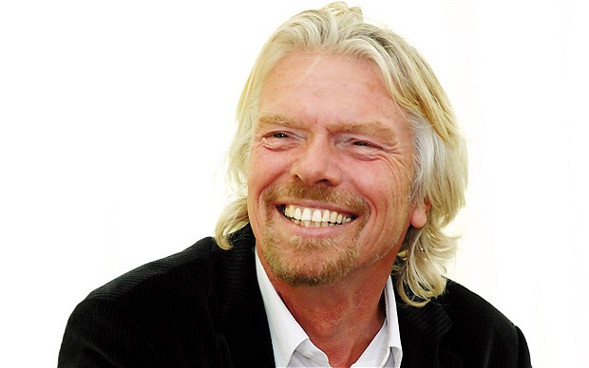
If someone offers you an amazing opportunity and you’re not sure you can do it, say yes – then learn how to do it later.

Slide 24
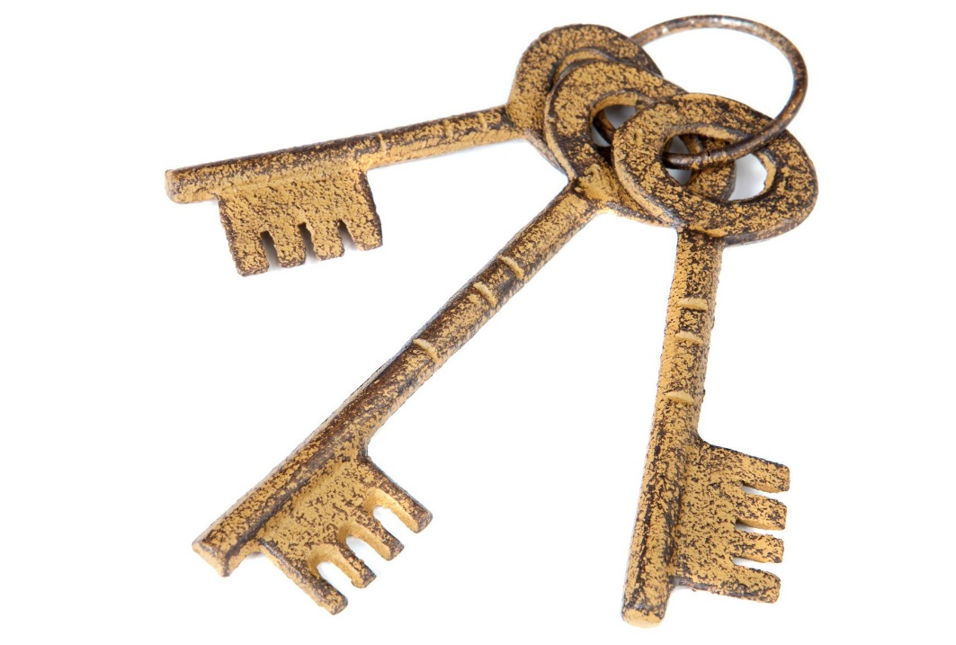

Slide 26
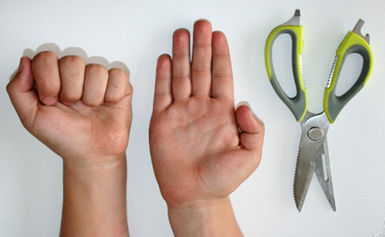
Notes:
Remind about hands up to get us all quiet.

Slide 27
Doug Carter
Presentations Etc. Inc.
www.PresentationsEtc.ca

