Slide 1
Growing a Travel Program: “The Road Less Traveled” A Spartan Story with Strategic Travel Management Company Partners
Michigan State University
Conlin Travel
Anthony Travel STA Travel

Slide 2
University Travelers are Diverse
Notes:
Diversity photo – who we are; needs, differences and similarities
Why did we choose this path?
How did we select partners?
1:Many
Specialized Services
Pilot

Slide 3
Story 1: Happiness Factor
WOW…98% Approval Ratings!
You Guys Rock
Hands Down – Best Customer Service Ever
Can NOT live without them
Travel up
Cost down
Prompt, Friendly, Expert Service
Notes:
They love us; they really, really love us!
Talk about annual reviews
Peer to Peer Knowledge sharing
Increased buy in and support from university leaders

Slide 4
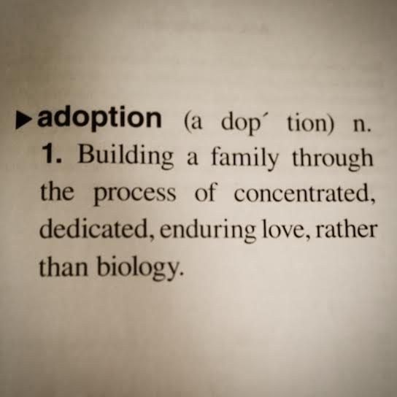
Story 2: Adoption
Notes:
Adoption of online and adoption of agencies
Conlin and Concur
STA & Study Abroad/Away/Student travel
Anthony – 100% mandate
Internal Marketing Effort - Rebranding

Slide 5
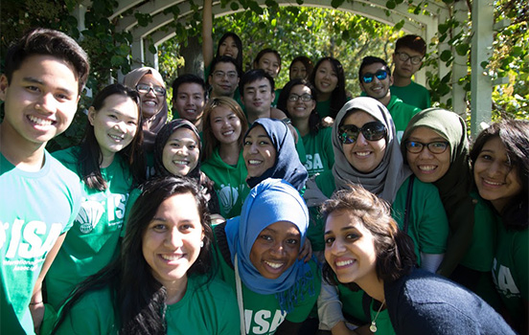
Story 3: Savings
Travel at State’s FY17 program savings would finance 670+ Undergrad Semesters @ MSU!
Notes:
Quarterly Reporting – highlight key points
Unused Tickets
Expired tickets = 175 @ $84K
Used tickets (exchanged & refunded) = 2,117 @ $1.7M
Hotel
Car Rental
Airfare
Agency support/involvement

Slide 6
And Now, A Word from our Partners…
Notes:
Short and sweet
How did you approach RFP and partnership?
Is this relationship working?

Slide 7
OUR STORY

Slide 8
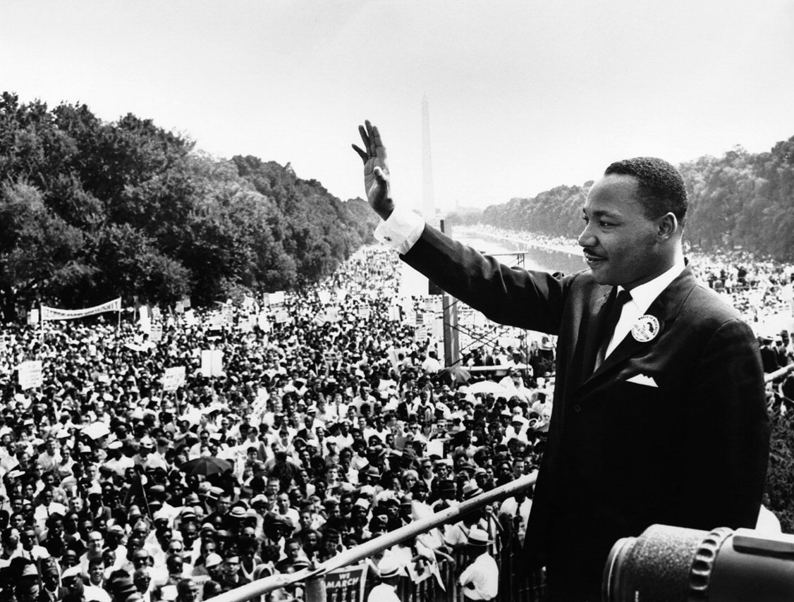
Looking for a name and event !
August 28, 1963
Washington D.C.
“… I HAVE A DREAM …”

Slide 9
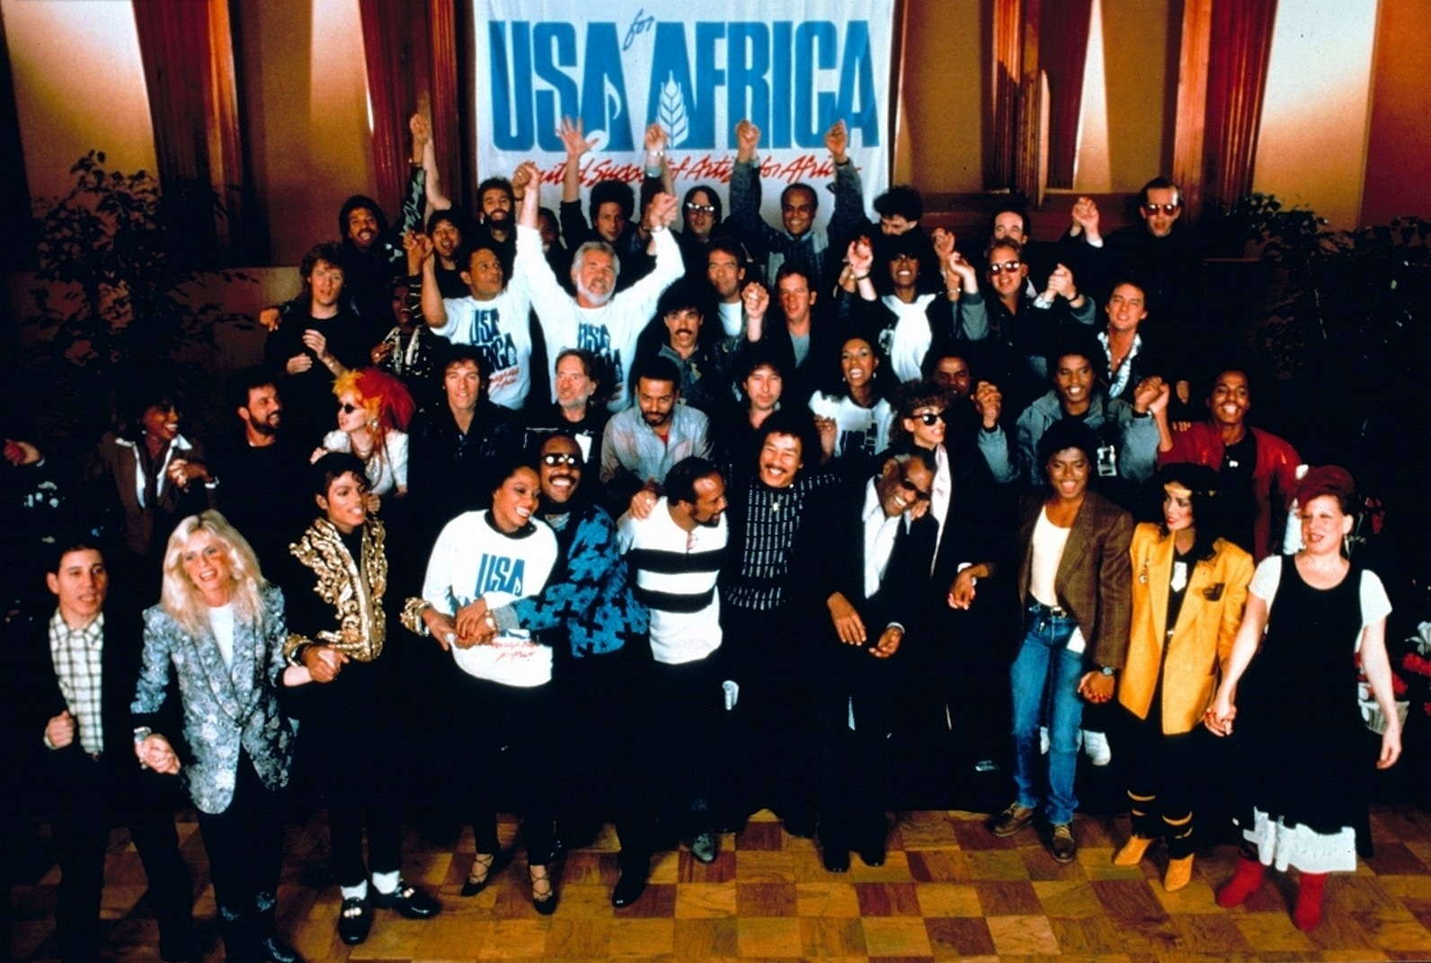
Looking for a name and event !
March 7, 1985
Los Angeles, California
“Check your ego at the door”

Slide 10
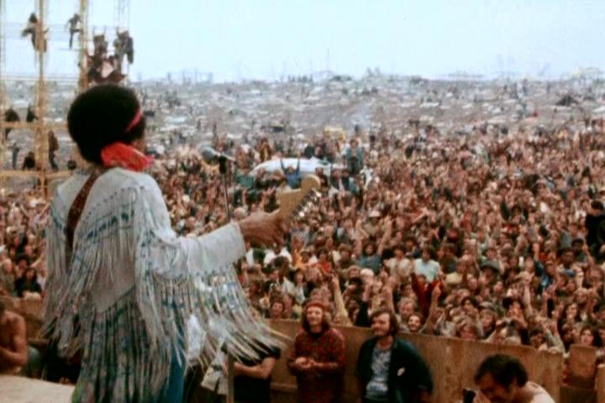
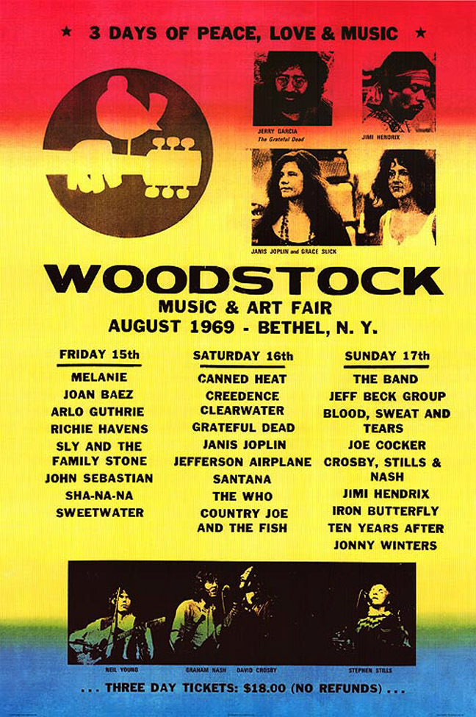
Looking for a name and event !
August 15-18, 1969
Bethel, New York
“… 3 days of fun and music …”

Slide 11
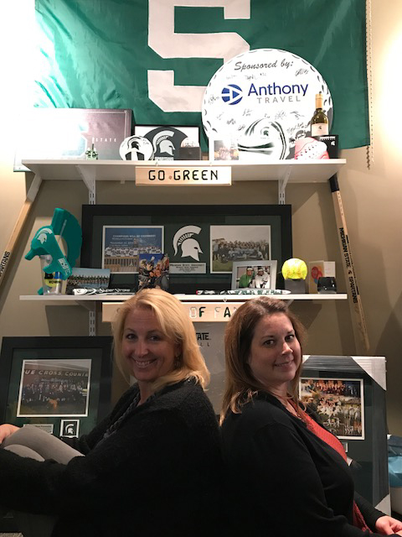
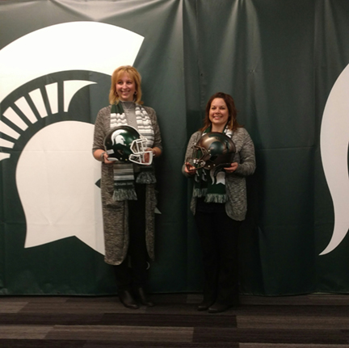
Amy Peck & Stacey Warren
MSU Athletic Department On-Site Travel Agents

Slide 12
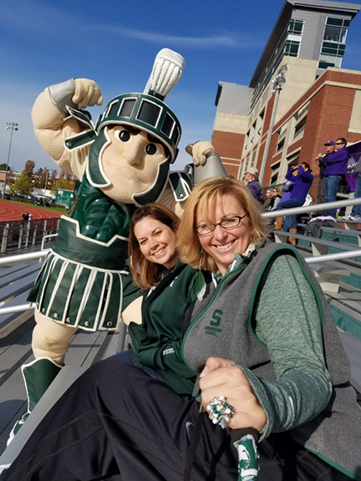
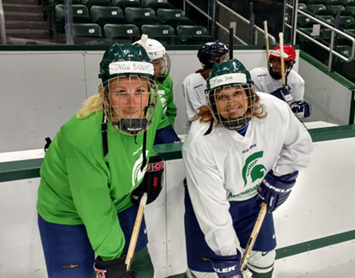
Amy Peck & Stacey Warren
MSU Athletic Department On-Site Travel Agents

Slide 13
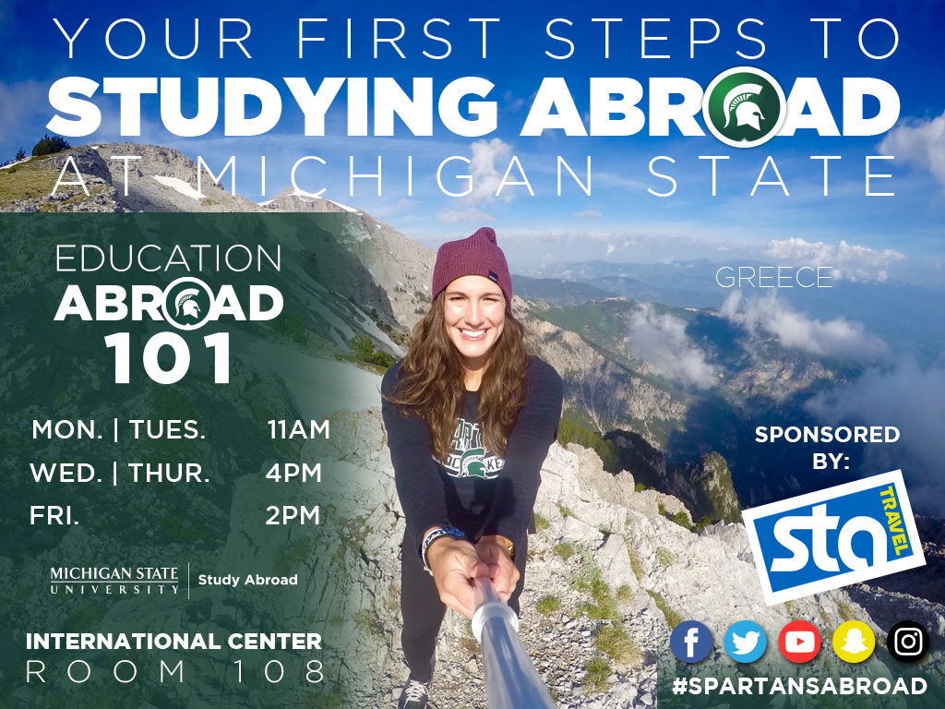
Education Abroad Promotion

Slide 14
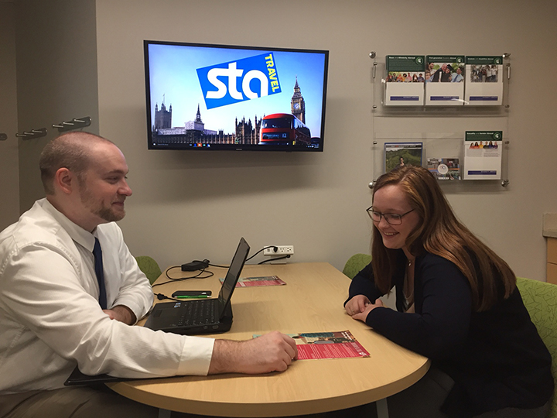
On-site Travel Advising

Slide 15
Victory for MSU!

