Slide 1
Executive Orders: Opportunities & Challenges
Hanan Saab
Assistant Director for International Issues, Congressional and Governmental Affairs
Association of Public and Land-grant Universities
GRAND BALLROOM III | 10:30 AM – 12:00 PM

Slide 2
Authority to Issue Executive Orders
No Constitutional Provision authorizing executive orders
Presidents rely on constitutional grant of executive authority and constitutional duty to “take care that the laws be faithfully executed”

Slide 3
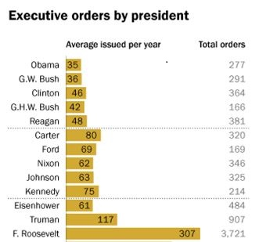
Source: Pew Research Center, January 2017

Slide 4
Congress can limit the underlying statute, but when they don’t states can trigger judicial power

Slide 5
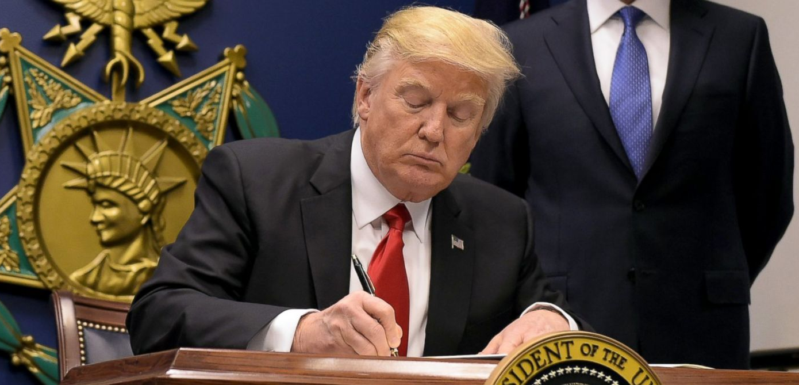
First Executive Order 13769 Friday, January 27

Slide 6
Executive Order 13769
Section 3(c)
Suspended entry into U.S. by nationals of Iran, Iraq, Syria, Yemen, Somalia, Sudan and Libya for 90 days
Section 5
Suspended U.S. Refugee Admission Program for 120 days
Barred Syrian refugees indefinitely
Section 5(b)
Prioritized admissions of individuals on the basis of religious-based persecution, provided that the religion of the individual is a minority religion in their country

Slide 8
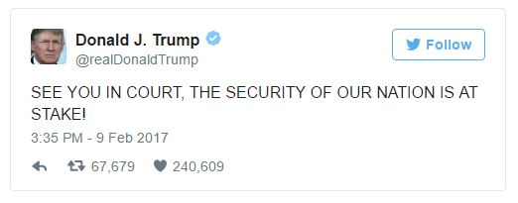
Alleged Source of Authority
General constitutional authority
Immigration and Nationality Act
Impacts
Immediate effect
Tens of thousands of visas reinstated
Green Card holders, visa holders, dual citizens able to return

Slide 9
New Executive Order
March 6, 2017
Effective date: 10 days notice
Deleted: green card holders, dual citizens, visa holders
Eliminated Iraq
Syrian refugees: Treated like other countries (120 day moratorium)

Slide 10
New Executive Order
Suspends entry for those without a visa, outside the U.S., from Iran, Libya, Somalia, Sudan, Syria, and Yemen.
Suspends U.S. refugee program and decreases admissions by more than half
Permits waivers on a case-by-case basis
Contains examples of security concerns

Slide 11
Intent & Litigation
President Trump: “The principles of the executive order remain the same”
Senior Policy Advisor Stephen Miller: New order reflects “mostly minor technical differences”—will produce the “same basic policy outcome”
United States Supreme Court Set to Hear Case Oct. 10
Ban partially in place until Court rules

Slide 12
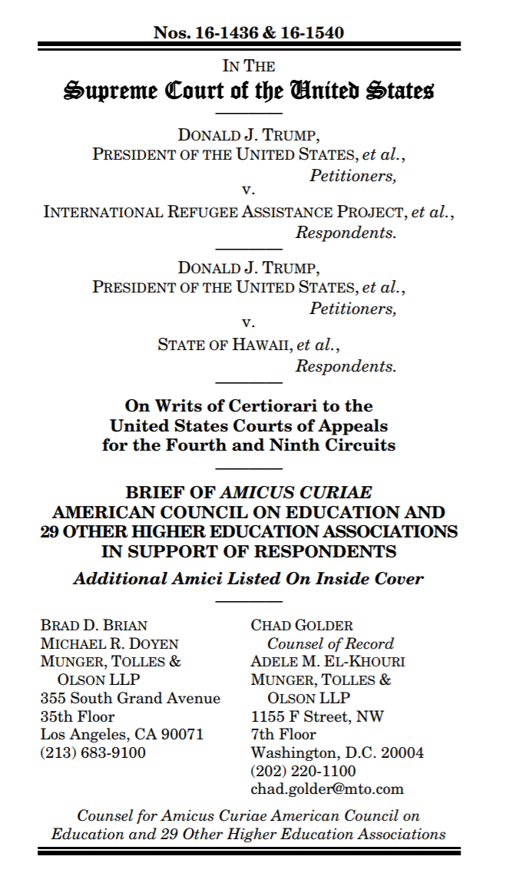

Slide 13
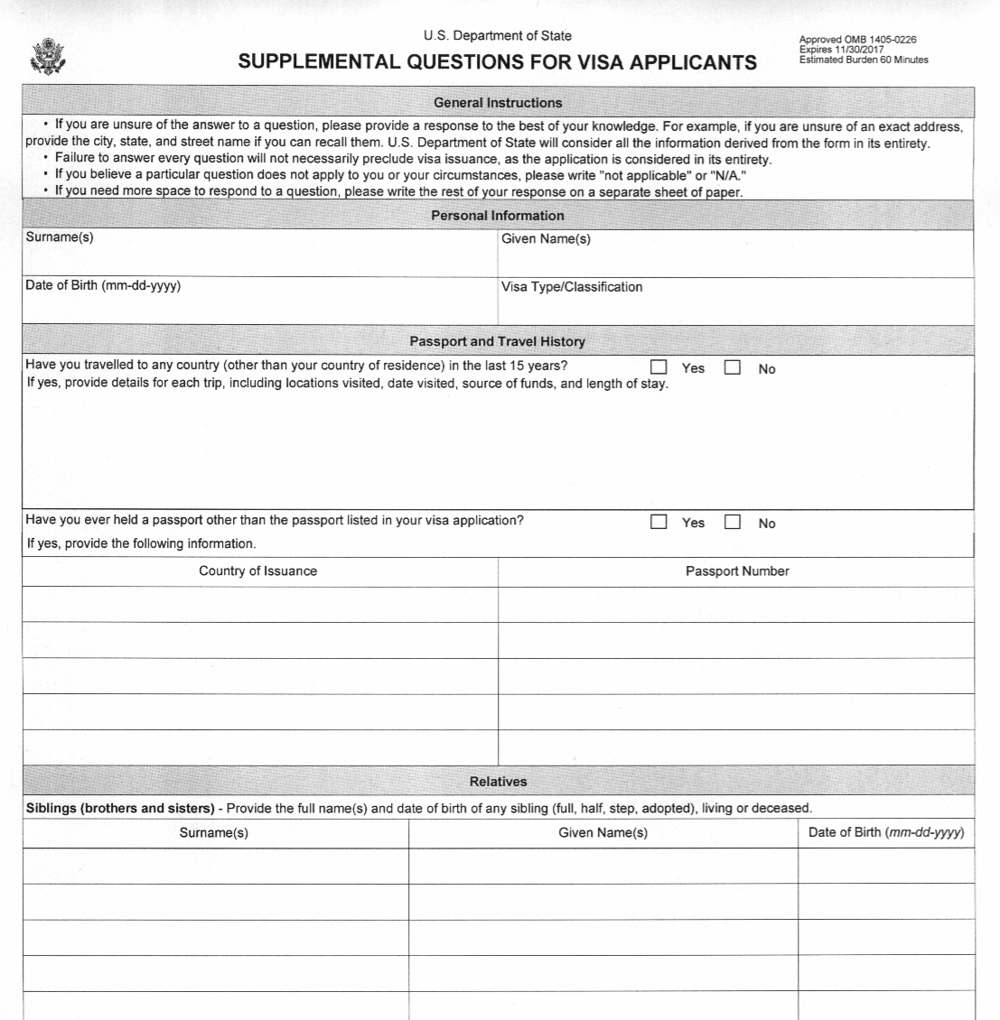
OMB Emergency Review: Supplemental Questions for Visa Applications

Slide 14
Undocumented Students & The DREAM Act
11 Million undocumented immigrants in the United States
Approximately 65,000 undocumented students graduate high school in the United States each year
The DREAM Act
Development, Relief and Education for Alien Minors
Legislative proposal to provide undocumented youth with an expedited path to citizenship through attending college or serving in the military
Would remove federal restrictions that prevent public universities from providing in-state tuition rates to undocumented students.

Slide 15
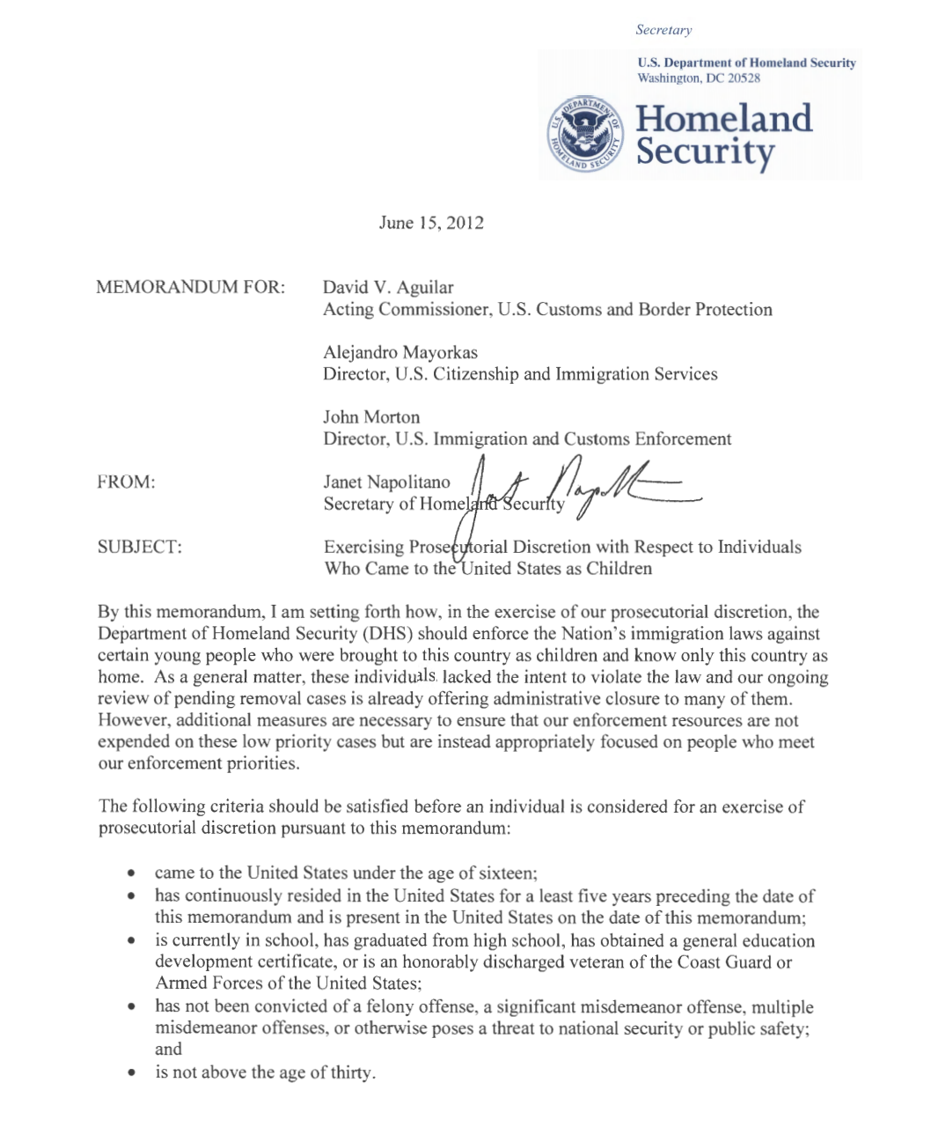

Slide 16
President Obama’s Executive Actions
2012: Deferred Action for Childhood Arrivals (DACA)
https://www.dhs.gov/deferred-action-childhood-arrivals
https://www.uscis.gov/humanitarian/consideration-deferred-action-childhood-arrivals-process/renew-your-daca
You may request consideration of deferred action for childhood arrivals if you:
Were under the age of 31 as of June 15, 2012;
Came to the United States before reaching your 16th birthday;
Have continuously resided in the United States since June 15, 2007, up to the present time;
Were physically present in the United States on June 15, 2012, and at the time of making your request for consideration of deferred action with USCIS;
Entered without inspection before June 15, 2012, or your lawful immigration status expired as of June 15, 2012;
Are currently in school, have graduated or obtained a certificate of completion from high school, have obtained a general education development (GED) certificate, or are an honorably discharged veteran of the Coast Guard or Armed Forces of the United States; and
Have not been convicted of a felony, significant misdemeanor, three or more other misdemeanors, and do not otherwise pose a threat to national security or public safety.

Slide 17
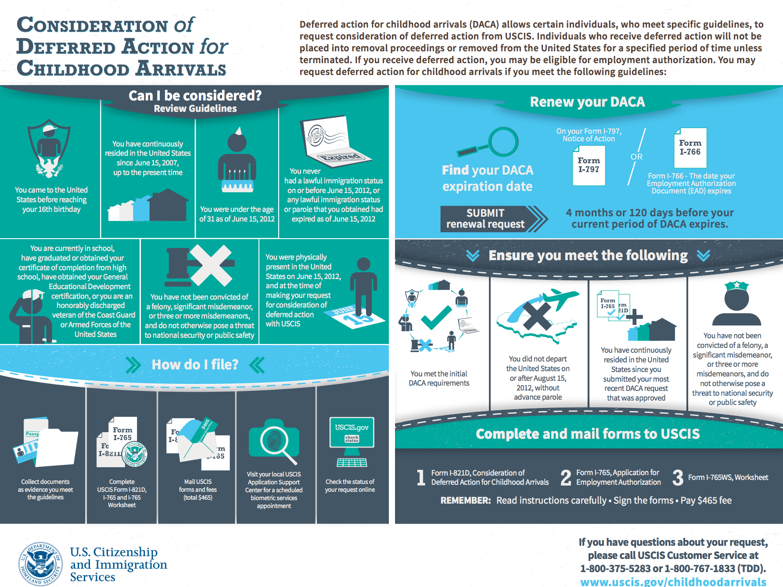
Deferred Action for Childhood Arrivals (DACA)

Slide 18
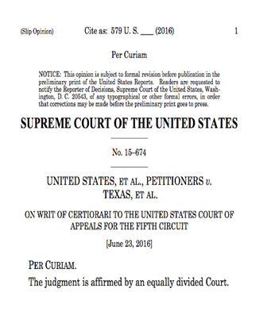
President Obama’s Executive Actions
2014: DHS announced the process for DACA renewals, and President Obama proposed an expanded DACA program, as well as a DAPA program.
The 2012 DACA program limited eligibility to individuals who entered before June 15, 2007 and who were born on or after June 16, 1981.
Under expanded DACA, individuals would qualify if they have lived in the United States since January 1, 2010 regardless of their age.
Expanded DACA would have increased the period of DACA and work authorization from 2 years to 3 years.
Deferred Action for Parents of Americans and Lawful Permanent Residents (DAPA) Criteria
Have a U.S. citizen or legal permanent resident son or daughter as of November 20, 2014;
Have continuously resided in the United States since at least January 1, 2010;
Are physically present in the United States on November 20, 2014 and at the time of applying;
Have no lawful immigration status on November 20, 2014;
Are not an enforcement priority, which includes individuals with a wide range of criminal convictions (including certain misdemeanors), those suspected of gang involvement and terrorism, recent unlawful entrants, and certain other immigration law violators;
Present no other factors that would render a grant of deferred action inappropriate; and
Pass a background check.
2015: A federal district court in Texas issued a preliminary injunction that blocked DAPA and expanded DACA programs from being implemented. The Fifth Circuit upheld the district court’s order.
2016: The Department of Justice petitioned and the Supreme Court took the case, deadlocking at a 4-4 decision.

Slide 19
An Uncertain Future: DACA in Limbo
Trump Campaign Policy Platform
https://www.donaldjtrump.com/policies/immigration/
“Hillary Clinton will protect and expand President Obama’s illegal and unconstitutional DACA and DAPA executive actions that give millions of illegal immigrants social security numbers, work authorization, travel authorization, eligibility for benefits, and tax credits in violation of the United States law.”

Slide 20
An Uncertain Future: DACA in Limbo
The President-elect’s Administration Transition
https://www.greatagain.gov/policy/immigration.html
“A Trump Administration would execute on the following ten-point plan to restore integrity to our immigration system, protect our communities, and put America first:
Block Funding for Sanctuary Cities
Cancel Unconstitutional Executive Orders
https://www.greatagain.gov/policy/immigration.html

Slide 21
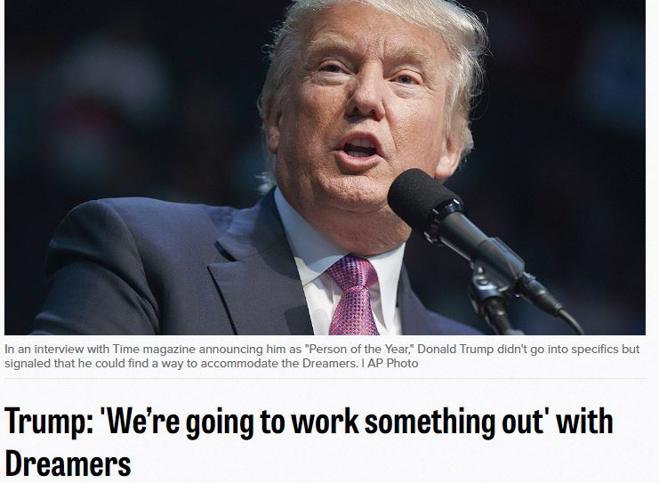
Post-election Interviews
What we are going to do is get the people that are criminal and have criminal records, gang members, drug dealers, where a lot of these people, probably 2 million, it could be even 3 million, we are getting them out of our country or we are going to incarcerate but we’re getting them out of our country, they’re here illegally. After the border is secure and after everything gets normalized, we’re going to make a determination on the people that they’re talking about who are terrific people, they’re terrific people but we are gonna make a determination at that. But before we make that determination...it’s very important, we are going to secure our border.”
“We’re going to work something out that’s going to make people happy and proud. They got brought here at a very young age, they’ve worked here, they’ve gone to school here. Some were good students. Some have wonderful jobs. And they’re in never-never land because they don’t know what’s going to happen.”

Slide 22
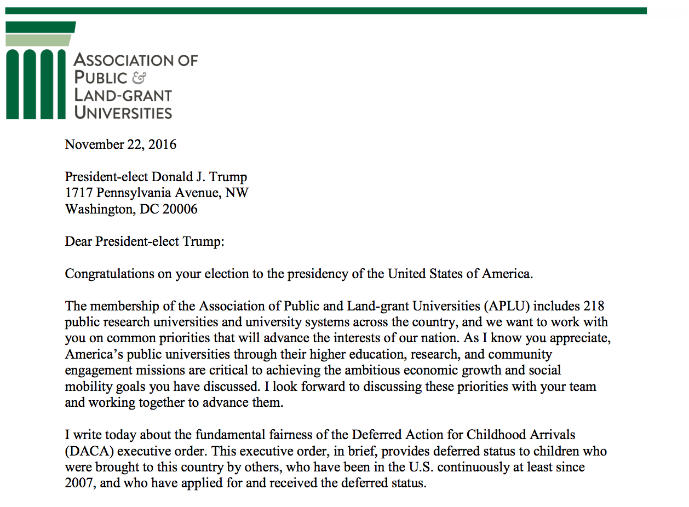

Slide 23
The Higher Education Community’s Response

Slide 24
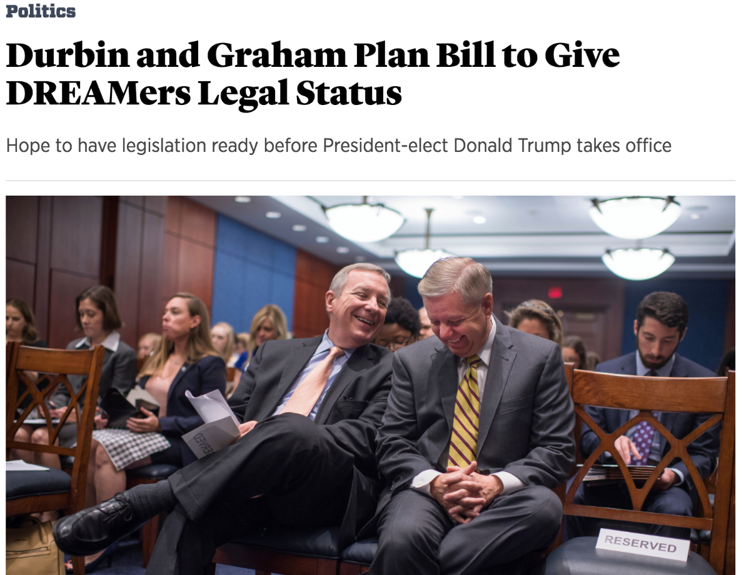
Response from Policymakers

Slide 25
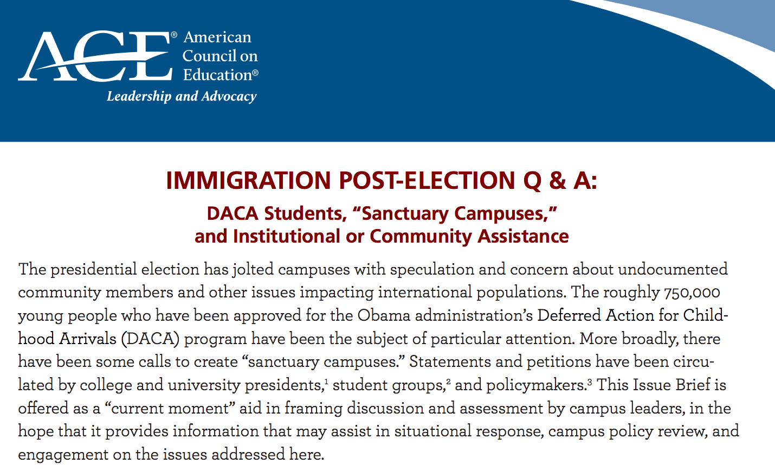
Further Reading & Additional Resources
American Council on Education: Immigration Post-Election Q&A: DACA Students, “Sanctuary Campuses,” and Institutional or Community Assistance

Slide 26
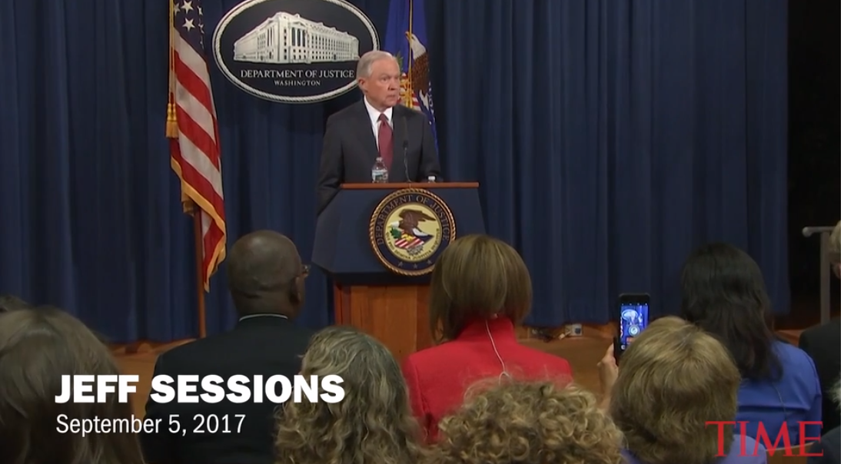
September 5, 2017
Attorney General Jeff Sessions Announces Rescission of the DACA Program

Slide 28
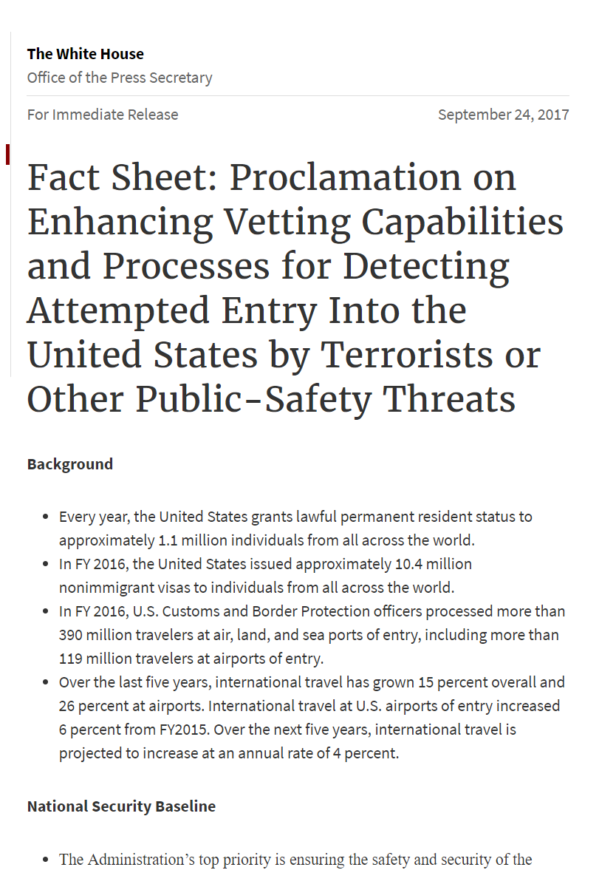

Slide 29
Iran Libya Somalia Syria Yemen Chad North Korea Venezuela

Slide 30
Hanan Saab
Assistant Director, International Issues,
Congressional & Governmental Affairs
Association of Public and Land-grant Universities
hsaab@aplu.org

