Slide 1
Driving Policy Compliance Through Collaboration
Carolynn Blankenship, University of Michigan
Marie Peterson, The Ohio State University
Notes:
(Carolynn)

Slide 2
Agenda
Introductions - About UOM and OSU
Travel Policy in Higher Education ( Refresher)
Driving Compliance
Compliance Approaches
Communication
Q&A Discussion
Notes:
(Carolynn)

Slide 3
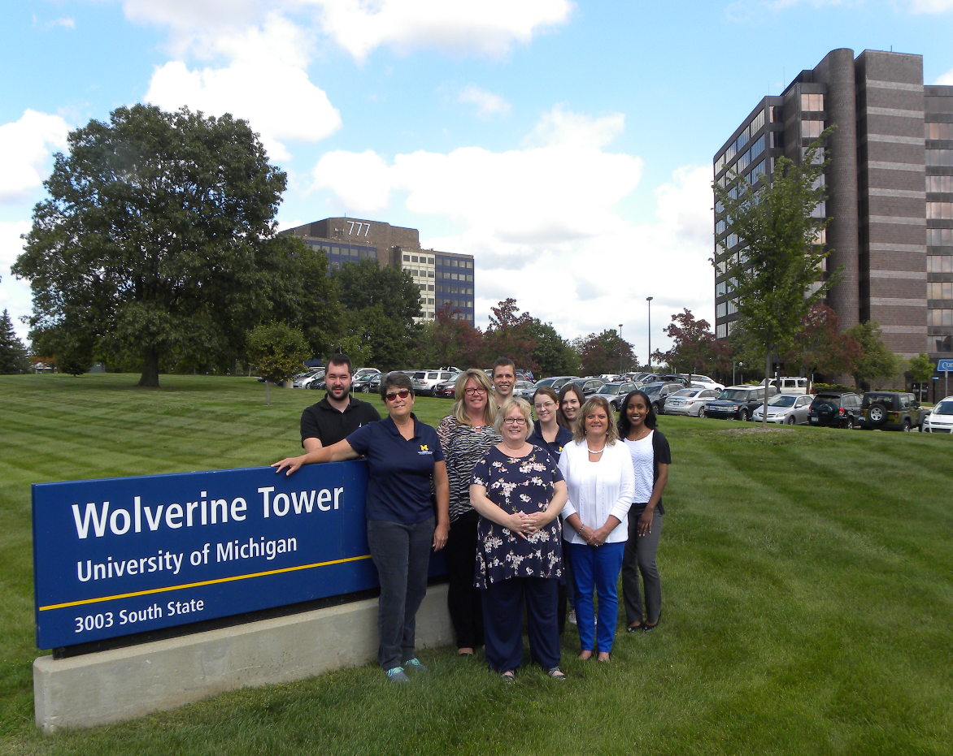
Introductions
Notes:
(Carolynn)
Our Audit and compliance team:
*Administration of our PCard program, consisting or over 6,000 PCards with an annual spend of approximately $90M
*Administration of the U-M Travel & Expense System (Concur) which sees over 140,000 expense report a year
*Work with our procurement team to fulfill the “travel manager” position

Slide 4
Notes:
(Carolynn)

Slide 5
Introductions
Notes:
(Carolynn)
Our Audit and compliance team:
*Administration of our PCard program, consisting or over 6,000 PCards with an annual spend of approximately $90M
*Administration of the U-M Travel & Expense System (Concur) which sees over 140,000 expense report a year
*Work with our procurement team to fulfill the “travel manager” position
“Block M” transition

Slide 6
Introductions
Notes:
Well, that’s interesting Carolynn, given we make it our mission to strike out that block M in our neighborhood.

Slide 7
Introductions
Notes:
(Marie) – 1.5 minute
Nice Segway, right?
For those of you who know college football, particularly in the midwest … Carolynn and I felt we needed to cut to the chase and acknowledge the elephant in the room and reassure all that in spite of a rigid football rivalry between our institutions athletic program, we have been long time collaborators through the Big 10 in our mission to strive for success in our Travel Programs.
With that out of the way…Good Afternoon…My name is Marie Peterson and I’m the Travel Manager for The Ohio State University.
At little bit about OSU…
Our current policy was a collaborative effort with a last release date of October 2015 with an intended purpose to appropriately drive over $40M worth of travel spend.
Audit for Compliance by each college’s Service Center and by Internal Audit; frequency annually
Compliance Initiatives:
Working toward mandate of TMC and rental Car Contract to increase compliance to secure improvements with duty of care and the university’s efficiency plan
Ok, enough about us…We invited you to our session today to discuss policy (again)…or more specifically driving compliance of our travel policies.
To set the foundation of our discussion on compliance achieved through collaboration, we going to do a quick flashback to the SCTEM presentation of 2016 (titled Travel Policy in Higher Education)…

Slide 8
Travel Policy in Higher Education
Notes:
(Marie) – 35 sec.
…this will be a brief refresher for last year’s attendees, where we covered the policy basics and fundamental steps involved in the construction of travel policy in higher education in order for it to be effectively structured for compliance.

Slide 9
Travel Policy in Higher Education
Core Reminders/Objectives:
Policies are not “guidelines”
Policy should:
Avoid ambiguity (clear/concise)
Identify values, expectations and controls
Apply to all constituents
Drive Compliance
Notes:
(Marie) – 20 sec
As a refresher, the core objectives and reminders for a travel policy include:
They are not guidelines
Policy should be clear/concise
Identify the controls intended
Apply to all constituents
And ultimately drive compliance

Slide 10
Travel Policy in Higher Education
Fundamental Steps of Building Travel Policy:
Establish a Policy Development Support Team
Define Objectives and Expectations
Identify the Guiding Principles
Distinguish the Constituents
Develop the Framework Guidelines
Apply Writing Standards
Create Compliance Plan and Measurements
Communicate, Publish and Distribute
Notes:
The fundamental steps that should be considered in the development of travel policy…
Establish a Policy Development Support Team – For OSU, we incorporated a representative from Internal Audit (who does our compliance audits), and other key constituents of our policy including Athletics and Sponsored programs. Collaboration during the early stages of development ensures comprehension of the objectives and supportive buy-in.
2. Define Objectives and Expectations - Determine if the main priority is reducing travel spend, abiding by external influences/rules or improving the overall well-being of your traveling employees…in most cases its all of the above. To ensure compliance, travelers or arrangers shouldn’t get caught in the bureaucracy of the policy and make a poor or costly decision.
3. Identify the Guiding Principles – these may be unique to your institution (values of institution, IRS requirements, federal/state governance) – ethical practices of State of Ohio
4. Distinguish the Constituents - Make clear who will be subject to your travel policy and cover their specific needs – don’t leave out your travelers!!
5. Develop the Framework Guidelines – use a standard template, be consistent, keep it simple
6. Apply Writing Standards – be clear for interpretation by a diverse population (in my world the policy is being interpreted by everyone from students with international influences to faculty with a keen sense of legal ease for splitting vernacular hairs
7. Create Compliance Plan and Measurements – determine how measurement is performed and how frequent to determine the success of your policy and if it is doing its job to promote compliance
8. Communicate, Publish and Distribute - a business travel policy is only as strong as the traveler’s and arranger’s awareness of it. So having an effective strategy in place to communicate your policy is vital to ensure smooth implementation and achieve maximum compliance.

Slide 11
Will they come?
Notes:
If you build it they will come…but will they come?
The assumption is that…if you build it they will find it…read it front to back before traveling…understand it and ultimately abide by the content fully, right?
Establishing compliance with our policies does not begin and end with the introduction and distribution of rules and regulations. It takes the right amount of collaboration, the right types of communication mediums, and the right methods to measure compliance that will demonstrate a successful policy.

Slide 12
Driving Policy Compliance
Why can’t that be reimbursed?
Where is that written?
But it’s MY grant $$
What? No First Class?
No one told me I couldn’t!
Notes:
Sound familiar?
These are just a few of the questions we all hear on a frequent basis. Could it be that our traveler’s awareness of policy is limited by their accessibility to it, their knowledge of it? How do we drive ongoing compliance of our policy if our travelers are not privy to its existence.
How do we make them partners in the compliance goal?

Slide 13
Driving Policy Compliance
Driving Policy Compliance --- Why is this important?
Policy compliance is necessary to protect your institution and it’s constituents…not to create extra burden.
Notes:
No matter what type of institution your university is associated (public or private, big spend or small), policy compliance is an essential part of operations and ultimately critical to ensuring the protection of your institution and its constinuents. Its not established to create extra burden

Slide 14
Driving Policy Compliance
Results of Compliance:
Safeguards funding to institution
Prevents fines, penalties or reputational risk
Ensures prompt reimbursement of expenditures
Confirms consistency among constituents
Generates measurable output
Notes:
Enforcing compliance in your travel policy will ensure funding is protected and potential rule violations are detected before incurring costly penalties for your institutions and its constituents.
Policy compliance can also demonstrate the satisfaction of the employee through consistent expectation messages for employee behavior, not to mention improvements to timely processing of reimbursements…this allows your staff stay focused on your organization’s broader goals, and helps operations run smoothly.
Lastly, compliance results can allow institutions to strive for measurable output that can be used to leverage other cost savings or revenue earning initiatives.
The results of having policy compliance can be extensive….our list may not be inclusive of all possible results for your institution, but should give you a pretty good idea of the security and successes that come from compliance…let’s now consider the compliance approaches…

Slide 15
Compliance Approaches
VS.
Dictatorship Approach:
Write the policy based on central needs
Publish the policy and communicate
Hold people to policy “because that is how it has to be”
Collaborative Approach:
Understanding needs of your customers
Development of supportive policy
Protection of the institution and it’s constituents
Notes:
(Carolynn)
So how do you implement a compliance approach…what kind of approach?

Slide 16
Driving Policy Compliance
Dictatorship Approach:
Are you just pushing out policy with no input or consideration to your constituents?
Administration is seen as difficult to deal with, causing avoidance
Can result in the user asking forgiveness instead of permission
Too much autonomy, not enough teamwork
Us vs. Them
Notes:
(Carolynn)

Slide 17
Driving Policy Compliance
Collaborative Approach – Engaging Users:
When you communicate with your customer…do you listen to “understand” or do you just listen to “reply”?
Collaborate: Understand the business needs of your customers and help them understand the need for compliance
Action: Develop policy that supports the business needs of your customers and compliance
Result: Protection of the institution and it’s constituents
Notes:
(Carolynn)

Slide 18
Driving Policy Compliance
Collaborative Approach – Promote Buy-in:
How does collaboration fit into driving compliance?
Talk to your customers, understand their needs
Learn their pain points
Work together to find solutions
Determine training needs
Make sure policy is necessary and meaningful
Make sure processes support what is necessary
Don’t implement something if it is not actionable
Notes:
(Carolynn)

Slide 19
Driving Policy Compliance
Collaborative Approach – Continual Improvement Engagement:
Processing and Functional Enhancements
New System Interface
Infrequent Traveler Resources
Implemented Concur Mobile and Tripit Pro apps
Expense It app Pilot
Notes:
(Carolynn)

Slide 20
Communication
Now you understand your users --- How do you help?
Develop and communicate training materials
Know before you go
Timelines and guidelines around expense report submission
Not always what you say, but how you say it
“You can’t do that, but you can take this approach…”
“We can’t reimburse for first class airfare, but your unit can pay the difference as taxable”
Ensure users know your policies and why they are needed
Notes:
(Carolynn)

Slide 21
Communication
University of Michigan Resource Examples:
Guide for Infrequent Traveler
Travel Quick Tips
Travel & Expense System Quick Tips
Videos
http://procurement.umich.edu/travel-expense/booking-travel/information-new-and-infrequent-travelers
Notes:
(Carolynn)

Slide 22
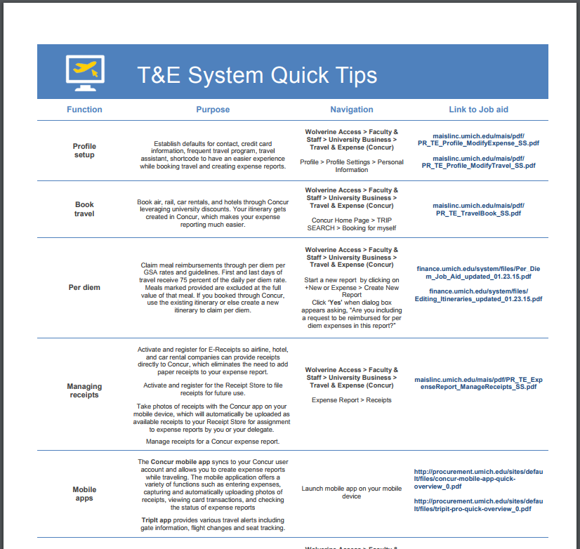
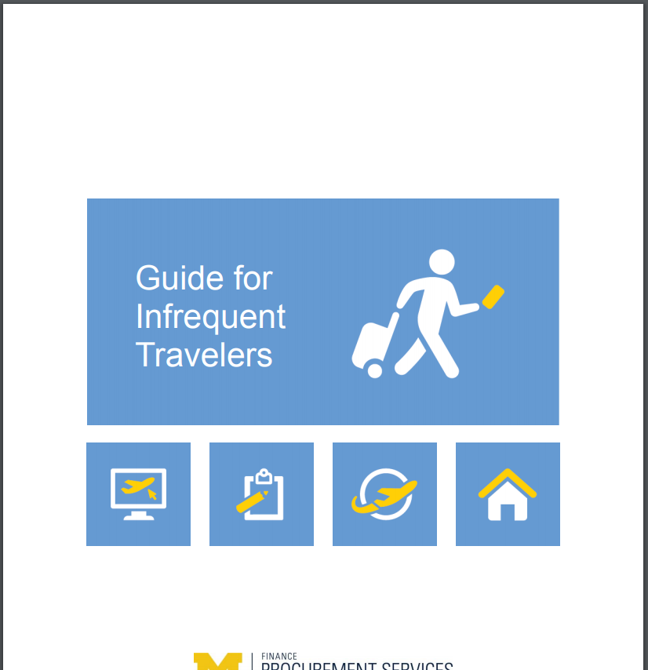
Communication
Notes:
(Carolynn)

Slide 23
Q&A
Questions?
Comments?
Notes:
(Carolynn)

Slide 24
Q&A
How does your institution measure compliance?
How frequently is compliance audited?
How does your institution respond to compliance infractions?
Notes:
(Carolynn)

Slide 25
Contact Information
University of Michigan Carolynn Blankenship
Audit & Compliance Supervisor, Procurement Services
Phone: 734.763.4331
Email: cblanken@umich.edu UOM Web: http://procurement.umich.edu/travel-expense
The Ohio State University Marie Peterson Manager Travel, PCard and Asset Management Phone: 614.292.9425 Email: Peterson.265@osu.edu OSU Web: http://osutravel.osu.edu
Notes:
(Carolynn)

