Slide 1

They said “Higher Ed is so different…”
… what I wish I would have known.
Cindy Shumate
Princeton University
September, 2015 SCTEM

Slide 2
Agenda
Why I said “yes”
What I found
What we launched
What I discovered
Why this is important

Slide 3




The Road to Princeton
Small business
Multi-national – met and implemented Cliqbook
Global travel and meetings, standard business travel and expense – implemented Cliqbook
Decentralized, out-dated, entitled, per diem, little technology, complex documentation – introduced Concur Travel and other technologies
Most complex - decentralized hierarchy, business + personal travel, group travel, layers of travelers, precise and complex expensing – implemented Concur Travel and Expense

Slide 4
Princeton Pre-Launch
Travelers booking on retail websites
Using small local travel agency
Only 1 airline contract – no reporting
Paying with personal credit cards
Local hotels listed on 3rd party website
Expensing with paper reports – entering totals – no detail
Up to 45 day wait for reimbursement

Slide 5
Maybe there was another way…
F&T began large reorg project .
Travel expense became a major focus.
Negotiated discounts sounded good.
Electronic booking sounded easy.
Integrated travel to expense seemed so logical…
Notes:
- F&T began large reorg project – new chart of accounts
- Travel expense became a major focus – potential savings, process efficiencies
- Negotiated discounts sounded good
- Electronic booking sounded easy
- Integrated travel to expense seemed so logical

Slide 6
Implementation Considerations
Safety – Service – Savings
Defining team roles
Change management strategies
Communicating to a decentralized campus
Configuration decisions
Recognition of the “learning curve”
Long relationships – Long memories
How to teach an industry that doesn’t always make sense and changes constantly?!
Notes:
Story – department head for Computer Science challenged booking Amtrak.

Slide 7





Who are the travelers/bookers?
Faculty
Staff
Grad Students
Undergrad Students
Special Students
Others
Admins/Bookers – the real stars
Notes:
Rules for some and not others?
Admins are the rockstars.

Slide 8
Fast forward for Travel…
Team members learned roles, technologies, new processes
Concur was configured, reconfigured – still tweaking
Pre-launch trainings resembled a syllabus of courses
Air contracts - negotiated for 2nd time - deeper discounts, more benefits
No mandate for faculty; No travel access for Students - TripLink encouraged
Support labs were invaluable
TMC found pilot and post-launch were very different
Notes:
Challenging conventional thinking.
New processes.
Continuous improvement.
Volumes can change the environment.
Self-realization of knowledge deficiency can drive the learning curve.
We are here to help.
Gathering of meaningful data.
Constantly evolving.

Slide 9
Year 1 Travel Metrics
64% of all travel bookings in system – TMC and Concur
Of system bookings, 60+% in Concur Travel
Of Concur Travel bookings, 81% unassisted
??% TripLink itineraries forwarded
First time leveraged supplier negotiations
Notes:
What’s possible without a mandate.
Setting the right expectations.
Cost avoidance.

Slide 10
Fast forward for Expense…
Year 1 Metrics
Expanded credit card program
96% expense reports in Concur Expense
Reduced cost of cutting checks
First time access to data details
Reimbursed in 2-3 days vs. 45 days – direct deposit
Paperless receipts, mobile/ scanned photos
Notes:
Expense mandate for staff/students, but still not for faculty
96+% expense reports online through Concur
Paperless receipt environment – major savings
Reimbursements in 2-3 days vs. 30-45 days – high customer satisfaction
Reduced cost of cutting checks; direct deposit for employee reimbursements
Access to new data details never before available – leveraged supplier negotiations for first time.
Fighting the fights that need to be fought. 80/20 rule.
Driving efficiency and effectiveness.
Improving the experience for staff and students.

Slide 11
Gaps - Discoveries Unique to Higher Ed
Policy – Program - Process
Guest Travel – high volume
Group Travel – higher volume
Fly America Act – critical for funding compliance
Business + Personal itineraries – important for faculty travelers
Travel Risk/Care – mandated for student travelers
Communication complexity on campus
Notes:
The fork in the road that leads away from traditional corporate programs.
Required different processes.
Spectrum of travel is far broader in higher ed than corporate.
Accountability to funding.
Traveler tracking and safety. Duty of care responsibilities. Risk mitigation.

Slide 12
Guest travel

Slide 13
Guest Travel
Who are they?
  NON-profiled travelers -- speakers, visiting professors, conference attendees, performers
Why is it important to manage their travel?
  Travel volume goes to our airline/supplier contracts
  TMC can provide travel support to guests
  Expenses track through our online system vs. A/P
  Decreases “Cash Out of Pocket” for guests
  Increases credit card throughput – less cash reimbursement
Impact
  45% of Princeton travel in system is for guests
Solutions
  Concur Guest Booking or Sponsored Travel
  Email introductions to TMC, travelers call directly

Slide 14
Group travel

Slide 15
Group Travel Segments
Discovery – This is not M&E, but more like Leisure because of cultural intent and combined trip purpose.
AIR
If names known, then can book individual tickets.
Uncertain itinerary details; hinders advance booking
LODGING
Hotel might already be known – long relationships.
Alternate lodging might be a consideration.
GROUND
Bus, shuttle, cars, rail
Airport transfers and point-to-point
“OTHER”
Lowest fare is key.
Often need multiple options.
Hotel might need to be sourced.
Considerations include insurance, form of payment, language
Hydrafoil down the Danube River (for example)
    Department organizers want single point of contact to book entire itinerary.

Slide 16
Group Travel Solutions
Discovery – No one has a centralized and easily applicable solution.
Use Group Travel Request form to get started.
Air
  If names are known, then can book individual tickets.
  If names are unknown, then a block of tickets can be reserved directly with carrier.
Hotel
  Hotel/lodging might already be known – professor may have contact.
  Hotel sourcing through 3rd party at no cost – they work on commission.
  Hotel sourcing through new 3rd party online tools .
Ground
  Utilize affiliate relationships of your preferred car services to assure pricing, insurance, form of payment, clear instructions, reliability.
“Other”
  Might require some creativity for booking.
Considerations
Who will do booking and create complete group itinerary?
How do you calculate service fee?

Slide 17
Fly America Act

Slide 18
Travel bookers need to know funding source, be responsible for compliance.
Fly America Act
What is it?
Act states that you must book on a US carrier unless no US carrier flight is available.
Required for?
Sponsored research funds
Federal grants
Visibility to Approvers?
Concur comment on itin – not electronically yet
TMC counselor comment on itin – “This flight is Fly America Act compliant.”
Choosing compliant option?
Concur Air Search shows American flag icon
TMC counselors extensively trained

Slide 19
Business + Personal

Slide 20
Business + Personal
Faculty often add personal segments to their business travel.
BOOKING
Step 1 - Search “business only” itinerary – SAVE
Step 2 - Search “business PLUS personal” itinerary – BOOK

Slide 21
Business + Personal
Faculty often add personal segments to their business travel.
BOOKING
Step 1 - Search “business only” itinerary – SAVE
Step 2 - Search “business PLUS personal” itinerary – BOOK
EXPENSING
If airfare was paid for with T&E card, itemize between Airfare and Personal; write check to PU for personal difference; attach “business + personal” and “business only” itineraries.
If airfare was paid for with personal credit card, expense “business only” airfare as “Cash Out of Pocket”.
If airfare was paid by 3rd party, do not expense in Concur.
Spouse, companion or dependent airfare is always paid for with a personal credit card and is not expensed in Concur.

Slide 22
Travel Risk

Slide 23
Travel Risk…
Things can happen on the road.
Medical emergencies
Governmental conflicts
Worker strikes, shutdowns
Civil unrest
Lost or stolen documents
Personal assaults
Language barriers
Notes:
STORIES
– Bag snatchers.
- Room service ransacking and heist.

Slide 24
Accountability vs. Liability
Organization needs to prove accountability to avoid being held liable.
Students / Parents
Staff – organizational resources
Faculty – intellectual capital

Slide 25
Accountability vs. Liability
Organization needs to prove accountability to avoid being held liable.
Students / Parents
Staff – organizational resources
Faculty – intellectual capital
Solutions
Concur Messaging – SMS/email
iJet or ISOS
Location Check-in – mobile phones
Others…?

Slide 26
Travel Risk or Travel Care
Organization needs to be prepared.
Pre-trip alerts/info (pulled)
During-trip alerts/info (pushed)
Traveler tracking (world map)
Travel support by TMC
Pro-active protocols established among university departments
Crisis management – communication, evacuation
Traveler education - personal safety, cultural differences, K&R
  Know how you rank on the Travel Risk maturity waterfall.

Slide 27
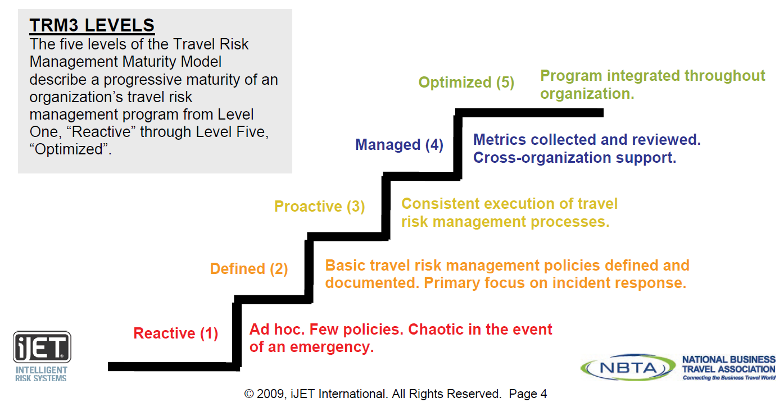
  Know how you rank on the
  Travel Risk Maturity waterfall.
Notes:
Pre-trip alerts/info (pulled)
During-trip alerts/info (pushed)
Traveler tracking (world map)
Travel support by TMC
Pro-active protocols established among university departments
Crisis management – communication, evacuation
Traveler education
Personal safety
Cultural differences
K&R

Slide 28
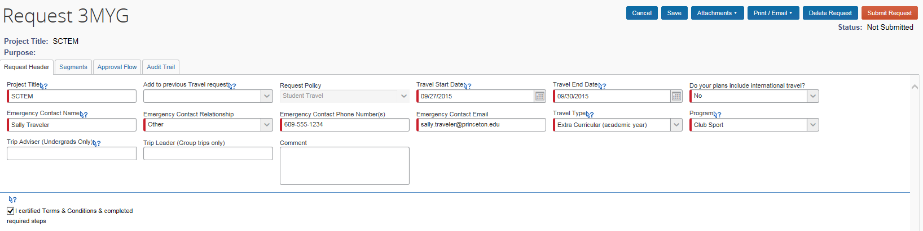
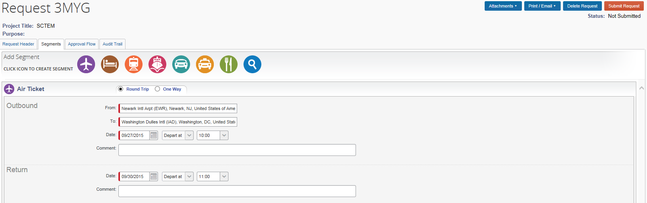
Travel Request Solution
Mandated for undergrad students

Slide 29
More considerations…

Slide 30
Travel Management Company (TMC)
Online Team
Provides online fulfillment
Larger call center if help is needed
User tech support
Used for booking individual travel, including guests.
Full-Service Counselor Team
Team configuration -designated, dedicated, on-site?
Phone/email SLA’s
Special service processes – guest travel, FAA review, business + personal
Group travel - same team or separate?
After Hours
24 / 7 / 365
Integrated with full-service process support?
Account Manager…
… is travel manager’s pro-active partner, navigator for TMC resources.
Notes:
Expectations.
Requirement for multi-faceted solution.
Account manager is navigator – key relationship.

Slide 31
Reporting
Measure – Manage – Make Decisions
Reporting Needs
Reporting Sources
Concur Reporting Channels
Departments
Travel Manager
Senior Leaders
TMC
Credit Card
Suppliers
Expense Tool*
General Ledger
Accounts Payable
Concur Travel – GDS, TripLink
Concur Intelligence – Travel, Expense
Concur Audit – missed savings to negotiations, policy compliance
Expense Manager
Expense tool includes both credit card AND cash.
Expense tool is only source to inform General Ledger!
Notes:
Reporting Needs –
Departments – to report expenses to funds and accounts.
Travel Manager – to access actual data for supplier negotiations and overall program management.
Senior leaders – to understand impact of managing travel activity and expense!
Reporting Sources –
TMC Credit Card Accounts Payable
Suppliers General Ledger Expense Tool*
Expense tool is only source that informs the General Ledger!
Expense tool includes credit card and cash expenses.
Concur Reporting Channels –
Concur Travel – GDS and TripLink
Concur Intelligence
Expense -- Credit card and Cash
Travel -- GDS, TripLink and travel booked outside system
Concur Audit
Policy and contract compliance
Missed savings capture

Slide 32
Why focus on these discoveries? Communication – Compliance – Consistency
“Know thy self!”… help your suppliers help you.
Higher Ed is a business with special needs…
service, flexibility.
Suppliers are trained to sell to corporate…
savings, mandates.
Moving from an unmanaged to a managed Travel and Expense concept requires patience, constant communication and attention to detail.
Notes:
University business is the minority of most of your supplier’s accounts. The sales reps are trained to sell to corporate accounts. Savings. Mandates. Making numbers.
Universities are primarily about service and flexibility. University business is diverse – from the individual round trip business traveler to multi=leg multi-traveler business plus personal trips.
Set up processes, then test on admins.
Choose suppliers that know higher ed.
Know how to lead your suppliers in building processes to help you.

Slide 33
…an integrated end-to-end managed travel and expense program for higher education!
QUESTIONS?
Thank you!

