Slide 1
The Challenges of Travel Risk Management in Higher Education
Jeff Winton
Director
Concur
Jason Grunin
Associate Director
University of Tulsa

Slide 2
Introduction
Travel Risk Management in Higher Ed is complicated
Travel Risk Management in Higher Ed is critically important
Inherent risks includes potential loss of life, financial loss, legal action, and reputation damage

Slide 3


“The travelers are clueless. With the SARS scare, people going into China and Asia were cautioned. I had faculty calling me saying, ‘You’re not going to keep me from going there, are you?’ They feel as bulletproof as a 20 year-old.”
  -Collegiate travel manager
“Travel Risk Management in Higher Education: Challenges and Opportunities.” PhoCusWright. April 2014
Travel Risk Management in Higher Education
is a critical topic
accurate information in a streamlined way. That’s the challenge that we have. We’re dealing with all kinds of systems.” ~ Collegiate travel manager.”
"What we’re looking for is a system allowing us to pull in the most accurate information in a streamlined way. That’s the challenge that we have. We’re dealing with all kinds of systems.”
  -Collegiate travel manager
“Travel Risk Management in Higher Education: Challenges and Opportunities.” PhoCusWright. April 2014
“The fact that the university deals with diﬀerent traveling constituencies, who travel for diﬀerent reasons and to diﬀerent locations for short- or long-term periods of time, complicates the threat and risk proﬁle and the university’s duty of care responsibilities.”
  -Lisbeth Claus, PHD (Willamette University)
“A Global View of the University's Duty of Care Obligations.” URIMA Journal. April 2010
Notes:
“The travelers are clueless. With the SARS scare, people going into China and Asia were cautioned. I had faculty calling me saying, ‘You’re not going to keep me from going there, are you?’ They feel as bulletproof as a 20 year-old.”
Collegiate travel manager
“What we’re looking for is a system that allows us to pull in the most accurate information in a streamlined way. That’s the challenge that we have. We’re dealing with all kinds of systems.”
Collegiate travel manager
An airtight travel risk program is a fantasy, due to the extreme difficulty of pulling in comprehensive data and providing services to address any situation
“It’s basically a spreadsheet we ask people to complete. It would be nice to improve on that, but frankly it’s one of those projects that is on the pile. We are in the early stages of talking about reinvigorating the possibility of a travel registry, so independently-traveling faculty could volunteer to register. I think one day that will come. More and more of our peer institutions have implemented travel registries, some mandatory.”
“I’ve been here 18 months, working on putting the new travel program and the risk piece in place. It’s a hard slog to effect change in the academic world. In a corporation, where you just review the ROI and get on with it, we would have knocked this over in three months.”

Slide 4

Non-Mandate Culture
Compliance with Pre-Trip Registrations
Travel Risk Management in Higher Education is complicated
Latent/Static
Itinerary Data
Study Abroad
Faculty & Staff
?
!
During Trip
Disruptions
Emergency
Communications
Notes:
Where is your data?
You have multiple business functions that require information, and that information is all over the place in different systems in different departments. Those systems are managed by different vendors and may perform other functions beyond what you may need to process a transaction.
When you take inventory of how you are currently performing this function today, there are likely points along the way that require manual intervention, that require the massaging of information, or that would benefit from tighter integration.
Because the current process is so cumbersome, the conventional thinking is to automate (or re-automate), and thus eliminate these onerous steps, because if you can do that alone, then you can achieve savings. And those savings will bolster the business case. And the stronger the business case, the better chance the company will prioritize this project, and you can get out of the hell you are in today.

Slide 5

Disparate Process = Disparate Data
Home Grown System
Mobile Check-ins
Pre Trip Registrations
Paper Form
ERP
Study
Abroad
Other TMC
Online Booking Tool
Supplier.com Itineraries
Traveler Database
HR feeds
Web Form
TMC
Web service
GDS feeds
Direct TMC feeds

Slide 6
Disparate Process = Disparate Data
Home Grown System
Who is traveling
on behalf of the
university?
And where
are they now?
How do I
know if something
goes wrong?
And how do I then
reach them?
Mobile Check-ins
Pre Trip Registrations
Paper Form
ERP
Study
Abroad
Other TMC
Online Booking Tool
Supplier.com Itineraries
Traveler Database
HR feeds
Web Form
TMC
Web service
GDS feeds
Direct TMC feeds

Slide 7

Notes:
If you had students, faculty, or researchers here, could you reach them?

Slide 8
Capture ALL your data
Mobile Check-ins
Pre Trip Registrations
Study
Abroad
Single
Open
Platform
Supplier.com Itineraries
HR feeds
Web service
GDS feeds
Direct TMC feeds

Slide 9
Capture ALL your data
Mobile Check-ins
Pre Trip Registrations
Study
Abroad
Single
Open
Platform
Supplier.com Itineraries
HR feeds
Web service
GDS feeds
Direct TMC feeds

Slide 10
Two-way communication is critical
Single
Open
Platform
SMS, email, phone,
mobile app
Multiple message gateways
SMS Priority
Automated emails
Employee check-in

Slide 11
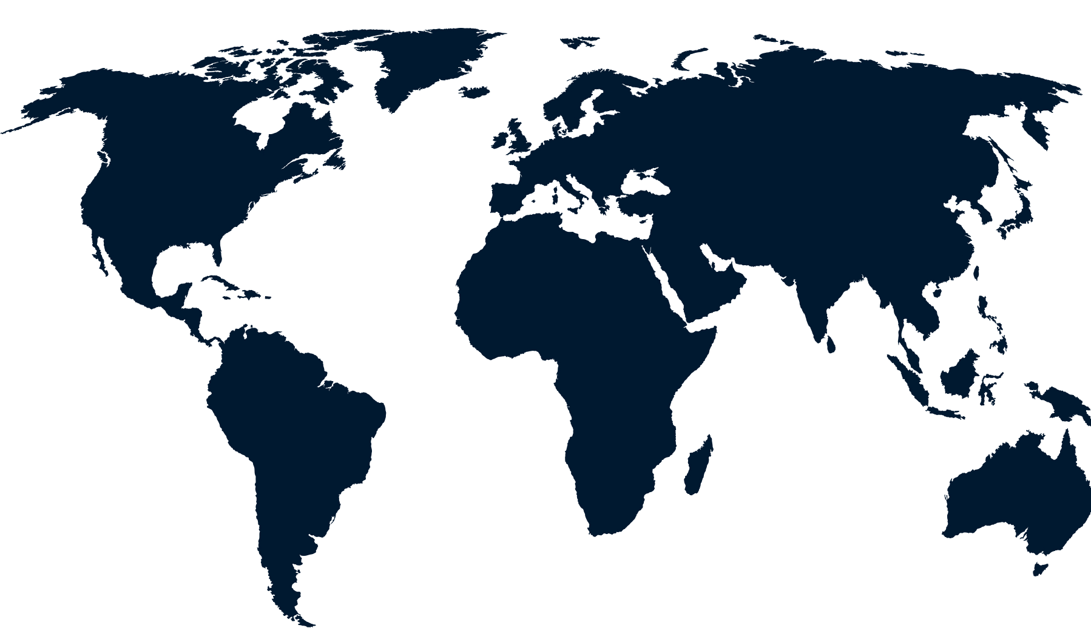
Single view of faculty, staff, and students
Monitor delays, disruptions
and disasters
Initiate and track two-way communication
Communicate now emergency messages
Notes:
A single look at all your employees:
Concur Messaging gives you a one-look overview of all employee locations (not jus your travelers) and country-specific risk levels on a dynamic, interactive map. You can filter and sort by geography and risk level, as well as initiate two-way communication and track responses—all with a simple click.
Many providers give access to mapping technology and plot it with travelers and maybe even employees. An effective Mapping technology allows you to use the same search results and then push information to those employees affected by the incident. It could be summed up as a tool to be used for Delay, Disruption or Disaster for all employees.

Slide 12
Best Practices in TRM in Higher Ed
Pre travel briefings and information for health, safety, culture, transportation and security
Include parents in the preparation process to greatest extent possible; content specifically developed for parents
Acquire and verify international contact details for students
Use social media to monitor
Implement scholastic based insurance and assistance – verify coverage
Create crisis management team, plan and practice
Implement travel and expense policy to the extent possible

Slide 13
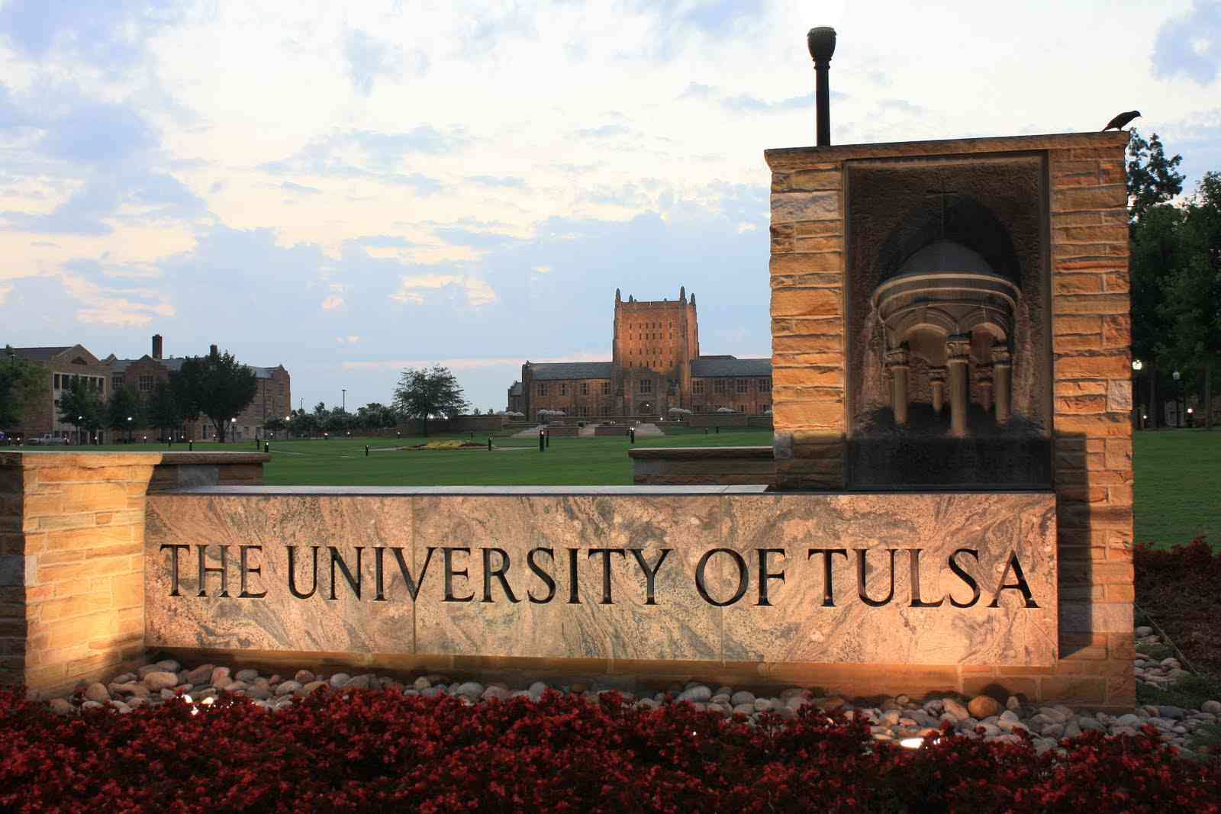
University of Tulsa Overview
Located in Tulsa, Oklahoma, Private, Not-for-Profit
FY16 Operating Budget: $200 Million
300+ Acres, 200+ Buildings
Total Enrollment: 4682
Total Employment: 1345
3 campus locations – 250+ acres, 3,278,590 sq. feet

Slide 14

2013 and before
$6-7m/annual expenditures on Travel
No visibility into destinations or whereabouts
Unmanaged
Lack of travel policy
Optional student insurance offering

Slide 15
2014/5 Admin Travel Stats
Traveler Volume: 2500+ Unique Trips
Travel Destinations: Physical Presence in 3 countries; frequent travel to 68+ Countries
69% Online booking, 31% Agent booked
$6.7m/T&E budget

Slide 16
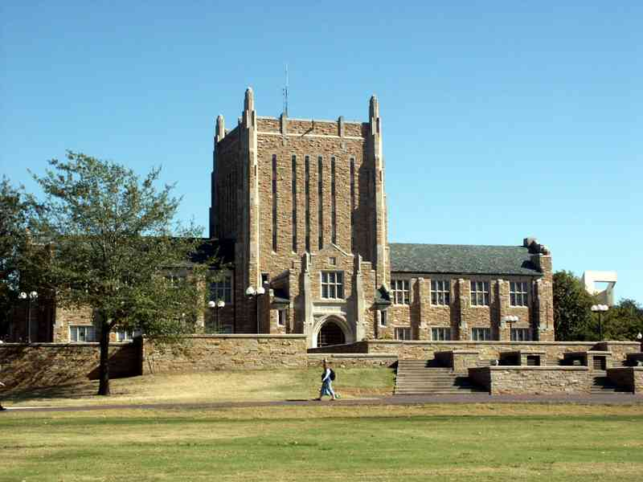
Policies
Pre-trip education
Traveler tracking
Air booking policies
High risk countries

Slide 17
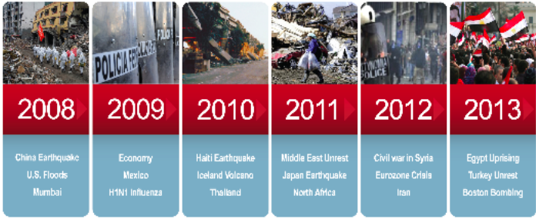
The Issues:
Personnel
Duty of Care
Information
Study Abroad
Change Management
Insurance
“Policy”/Sojourns
Group Travel
Communication

Slide 18
Personnel
What or who will be your notification that something requiring this response is necessary?
Administrative tasks
Crisis Management Team (Shared Responsibility)
After hours contact

Slide 19
Duty of What?
Duty of Care
“a company’s legal, ethical, and social obligation to protect the health and safety of its employees”
Standard of Care
if others in industry are doing something to protect their constituents, then you can be held liable for not doing so

Slide 20
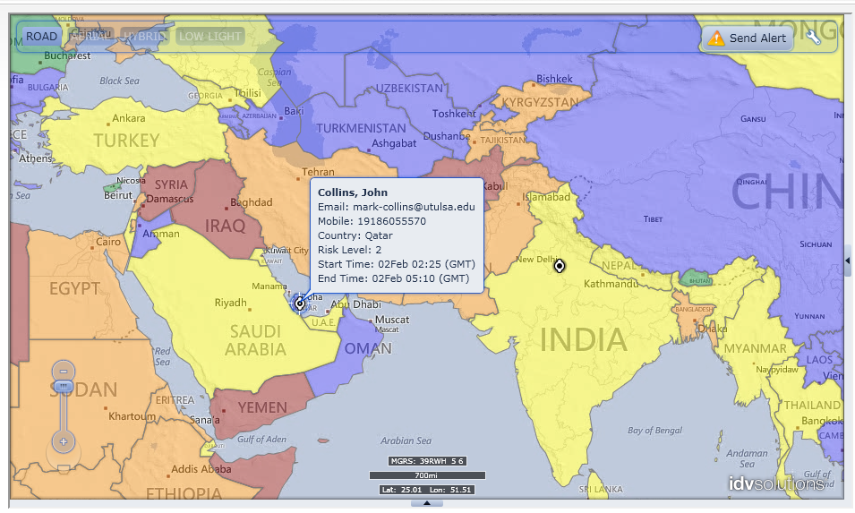

Slide 21


Information
Employees, and Students provide
  Cell Phone
  Home Number
  Emergency Contact Info
Automation from ERP system to Sabre* Profile
Nightly update
One location for travel itineraries
Subscription sources, mainstream media,
Crisis Management Team, government liaison

Slide 22
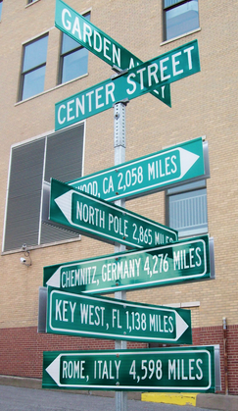
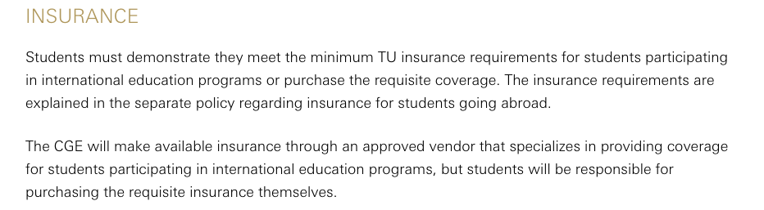
Center for Global Education Study Abroad
All sponsored travel info via TerraDotta portal
66 countries average per year
Travel details – flights, local cell phone, etc
Resources while abroad
Tips and Safety suggestions
Web portal

Slide 23

Change Management
Difficult
Utilization of leadership
Communication
“Policy enforcement”
Reason for change

Slide 24

Insurance
Is everyone covered?
  Travel Policy Compliance
  Policy and procedure
  Pre-trip approvals/notifications
Medical and Security Support Resources
  Are there exceptions to coverage?
  Numbers or concentration of passengers
    e.g. traveling sports teams, boosters, etc

Slide 25
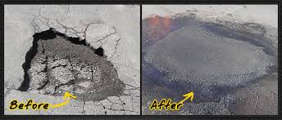
Policy, Sojourns, Insurance Gaps
100% of Students on TU policy or provide Opt-Out and proof of insurance
Connected Policies
  Workers Compensation
  Global Travel Policy/Worldwide Assistance
  Kidnap, Ransom, Extortion
Comprehensive Coverage
  Employees, Faculty and Staff
  Their spouse, or domestic partner, & children
  Students Traveling with Employees
  Students Traveling by themselves without Employees or Faculty on TU sponsored & sanctioned academic activities or programs

Slide 26
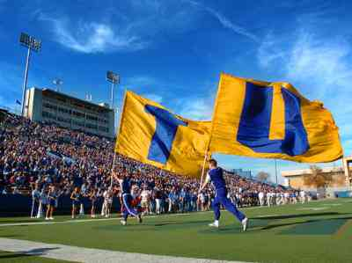
Group Travel
Examples of these groups include (but not limited to):
  Athletic teams
  Specialized groups (e.g. Study Abroad)
  High Profile
Understand the specific risks to group travel
  Know what questions to ask your suppliers in order to assist in the risk management of group travel

Slide 27
Communication
Who communicates to whom in regards to traveler status?
What contingency plans are in place?
Importance of medical/security resources (in- house or supplied by a third party vendor)
High Risk Country / TU Student Travel policy exception approval process

Slide 28
Questions?
Jason Grunin
  jason-grunin@utulsa.edu
Jeff Winton
  jeff.winton@concur.com

