Slide 1
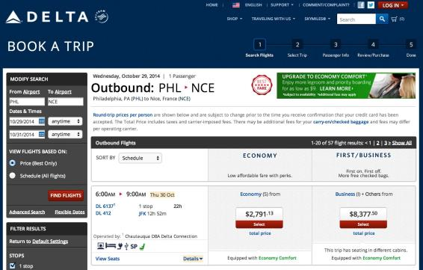
But Delta also admitted it has problems with its own channels…
“You can’t buy it [Economy Comfort] at checkout on our web site. You have to purchase the ticket first. You can’t buy it by itinerary. If you’re going from Portland, Maine to Portland, Oregon, you’re connecting into one of our hubs and you have to buy it leg by leg.”
Delta chief revenue officer Glen Hauenstein

Slide 2
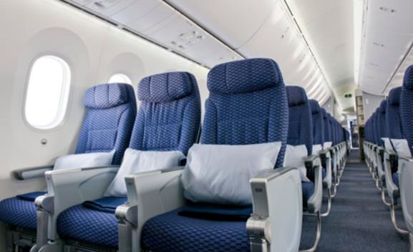
Recent months have seen a softening of rhetoric and gradually improved relations between airlines and GDSs, as the latter have improved visibility of ancillary products.
CASE STUDY:
How United Airlines is trying to shore up Economy Plus revenue

Slide 3
Enter IATA’s New Distribution Capability (NDC), a new XML-based data transmission standard for airlines that will improve ancillary items’ visibility through the travel agent (indirect) channel. It has received the green-light from the US DOT.

Slide 4
NDC was very controversial at first…and there were many questions
Was it really about driving better retailing of ancillaries or was its true intention to kill off GDSs?
Would it facilitate discriminatory pricing? The Business Travel Coalition was particularly concerned about the possibility that travelers who always bought business-type fares might not see less expensive fares or offers.
Would travelers’ privacy and security be protected?
At a time when passengers are mobile, social and very vocal, these issues received a lot of attention in the news and from savvy frequent flyers, who broadcast their concerns on social media.

Slide 5
But concerns have largely been put to rest. Farelogix, whose Direct Connect schema served as the foundation for IATA’s NDC, notes:

Slide 6
Others now tend to agree…
“The good thing about that change in tune from IATA last year is it really wisely said, ‘this is not about killing off the GDSs’. That was critical to gaining support from the corporate travel community who still rely on the GDS channel for their flight researching and booking.” Crucially, “everything has to be discoverable.”
Travel analyst Harteveldt.

Slide 7
What’s next?
Airlines need to build – or farm out the build – of NDC-compliant XML APIs. Airlines will then be able to distribute their differentiated content to travel sellers via the API, as this will be fully integrated with airlines’ GDS partners.
United Airlines and Amadeus have already announced they are using NDC 1.0 to sell Economy Plus seats.
In a year, at least half-a-dozen airlines APIs will be fully integrated with GDSs, predicts Farelogix.
Agencies, GDSs and airlines each benefit from having rich and differentiated content sold in the indirect channel. Corporate travelers benefit as a result.

Slide 8
And what about the regular Joe or Jane traveler?
“Ultimately, it’s the traveler who may stand to benefit the most here. A clean interface that allows people to truly compare apples to apples by knowing how much each ancillary option costs (if at all, depending upon status) would be a huge leap forward. And getting offers tailored to a traveler’s need is helpful if done right. Naturally, just because the airlines put the direct connect out there, however, doesn’t mean it gets to the traveler. That only happens on airline-controlled channels.” Brett Snyder, aka Crankyflier.

