Slide 1
It’s Personal How the travel buying experience is evolving to meet the needs of the individual
Mary Kirby
Editor and Publisher
Runway Girl Network

Slide 2
Product unbundling has allowed airlines to generate huge ancillary revenue gains in recent years.
Some of the biggest airlines, including United Airlines, Delta Air Lines and American Airlines, are now engaged in all aspects of ancillary revenue.
A large emphasis is placed on checked baggage and the sale of frequent flier miles or points to partners.
But other prominent ancillaries include:
Priority seating (extra legroom seats)
Onboard retail (including buy-on-board food and beverage programs)
Inflight entertainment and connectivity
More sophisticated upsells range from packaged expedited security to chartered drivers for sightseeing during extended layovers.

Slide 3
A quick snapshot of IdeaWorks’ latest findings on ancillary revenue…
Global airline ancillary revenue grew from $2.45 billion in 2007 to $31.5 billion in 2013 – an increase of 1200%.
Ancillary revenue for the 59 reporting airlines in IdeaWorks’ study reached an average of $16 per passenger in 2013, easily surpassing global figures for profit per passenger.

Slide 4
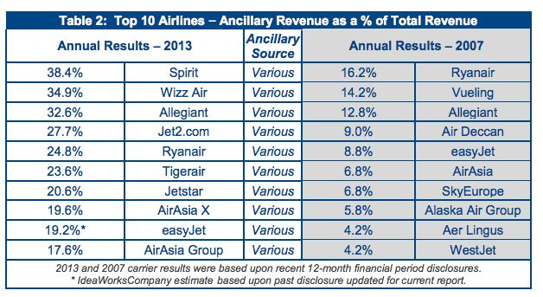
When ancillary revenue is described as a percentage of revenue, low-cost carriers come out on top. So the pressure is on legacies to bolster their merchandising.
When ancillary revenue is described as a percentage of revenue, it is

Slide 5
Some airlines are now rebundling previously unbundled ancillaries, and engaging in other creative merchandising schemes. JetBlue sells extra space, expedited security and early boarding under the ‘Even More’ brand. The airline expects to post $190 million in Even More revenues in 2014.

Slide 6
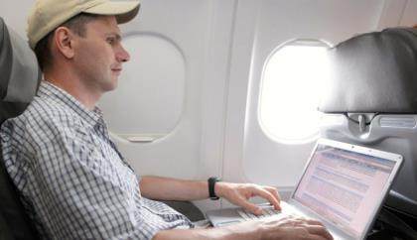
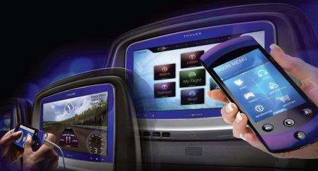
Ancillary revenue generated from inflight entertainment (IFE) and connectivity is not significant, but will grow in the coming years…
Current take rate for paid inflight Wi-Fi is roughly 7%, though this figure is steadily climbing. Some carriers are already seeing double-digit take rates on international flights, and as much as 30% usage on US transcon flights.
Advanced payment solutions from IFE system manufacturers are expected to expand the types of revenue streams offered to airlines (contactless payments, real-time CC). Thales suggests bundling all revenue-generating products into one package available on the IFE system. It estimates that large carriers could generate up to $396 million per annum.

Slide 7
The paradigm shift is clear…airlines are moving from being commodity sellers to bona fide retailers.
“Airlines are no longer competing solely on schedules and price, but rather on the ability to deliver a custom-tailored shopping and travel experience that meets or exceeds customer expectations. Airlines are striving to personalize what they offer, whether it be for-sale optional services, earned traveler rewards, premium white-glove service, or real-time ‘customer recovery’ after a trip disruption.”
Travel technology firm, Farelogix

Slide 8
Maximizing product visibility and allowing passengers to personalize their experience is crucial. But this has not always been achievable…
For years, a debate raged over whether Global Distribution System (GDS) technology could support new merchandising requirements. And some carriers – American Airlines and Air Canada, for instance – started adopting Direct Connect technology to bypass GDSs, and their associated fees.

Slide 9
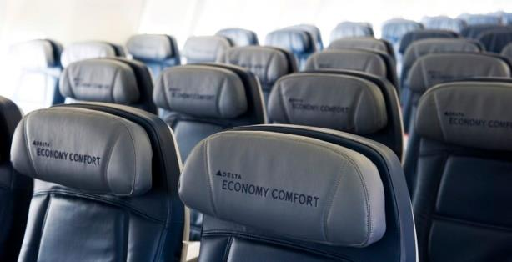
Last year, Delta summed up the conundrum, saying in reference to the carrier’s Economy Comfort extra legroom product:
“If you want to go into the market to buy it, you can’t buy it through most GDSs, which account for a significant portion of our sales.”
Delta chief revenue officer Glen Hauenstein

