Slide 1
Tech Trends and Travel Management for 2014 and Beyond
What’s Trending
And Why Should You Care?

Slide 2
Our Speakers
Moderator:
Tony D’Astolfo, Managing Director, PhoCusWright
Panelists:
Michael Jacques
Director Business Development and Partnerships
Kathleen Roberts
Director of Business Development
Laurie Wooderson
Global Corporate Sales Manager

Slide 3
Our Format
We’ve identified 4 technology trends impacting managed travel
Moderator will ‘frame’ the trends
Panelist will present their point of view
Open interactive dialogue will ensue
Audience participation is encouraged!!

Slide 4
Our Topics
Open Booking or Open Season on Managed Travel ?
The new C’s of Managed Travel: From Cost, Control, Convenience, to Content, Context, and Consumerism.
Social Traveler: Facebook has over 1B users….social media reaches 84% of internet users….maybe it’s time managed travel took social media seriously! So, now what?
Mobile – Everybody has a smartphone & tablet. Everybody says Mobile is the future. So why aren’t travel managers answering the call?

Slide 5
Open Booking

Slide 6
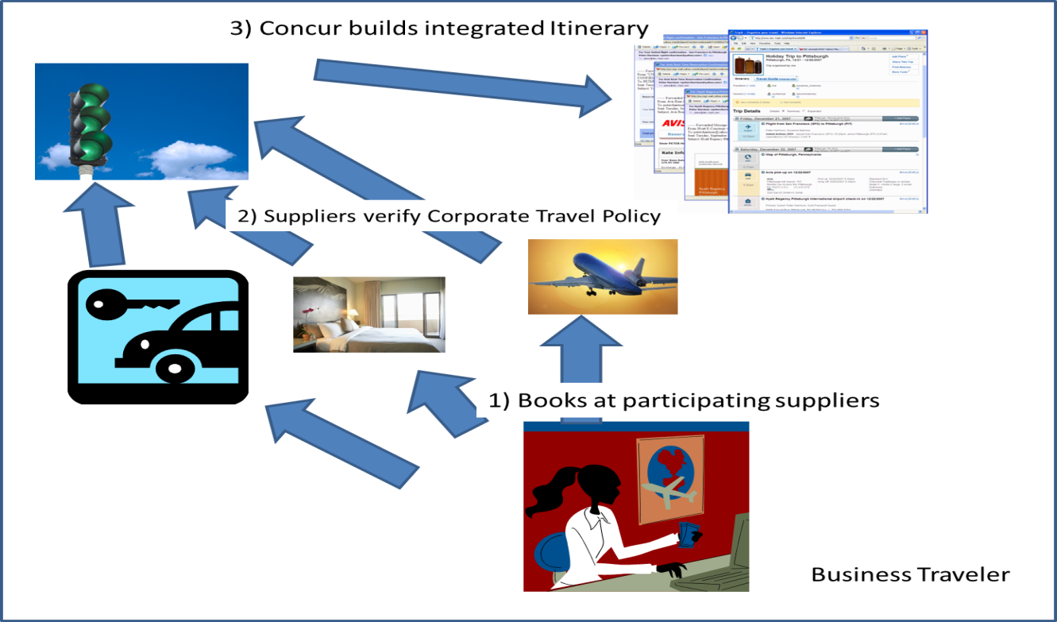
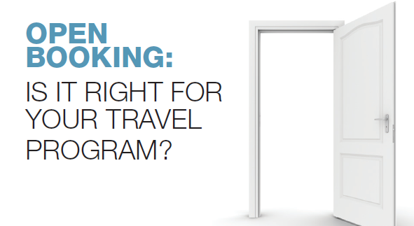
Promising Model or Compliance Nightmare?
Source: PhoCusWright Inc.

Slide 8
Open Booking….an Open Dialogue
The Opportunity:
Tactical & Strategic
Retrieve pre-trip data on program leakage
Policy Management
Discover program optimization opportunities
The Landscape:
Solutions are emerging in the market
Plays to continued focus on “consumerization” of corporate booking tool
The Challenges:
Duty of Care
Data consolidation, reporting
Agent support

Slide 9
Travel’s New ‘C’ Words

Slide 10
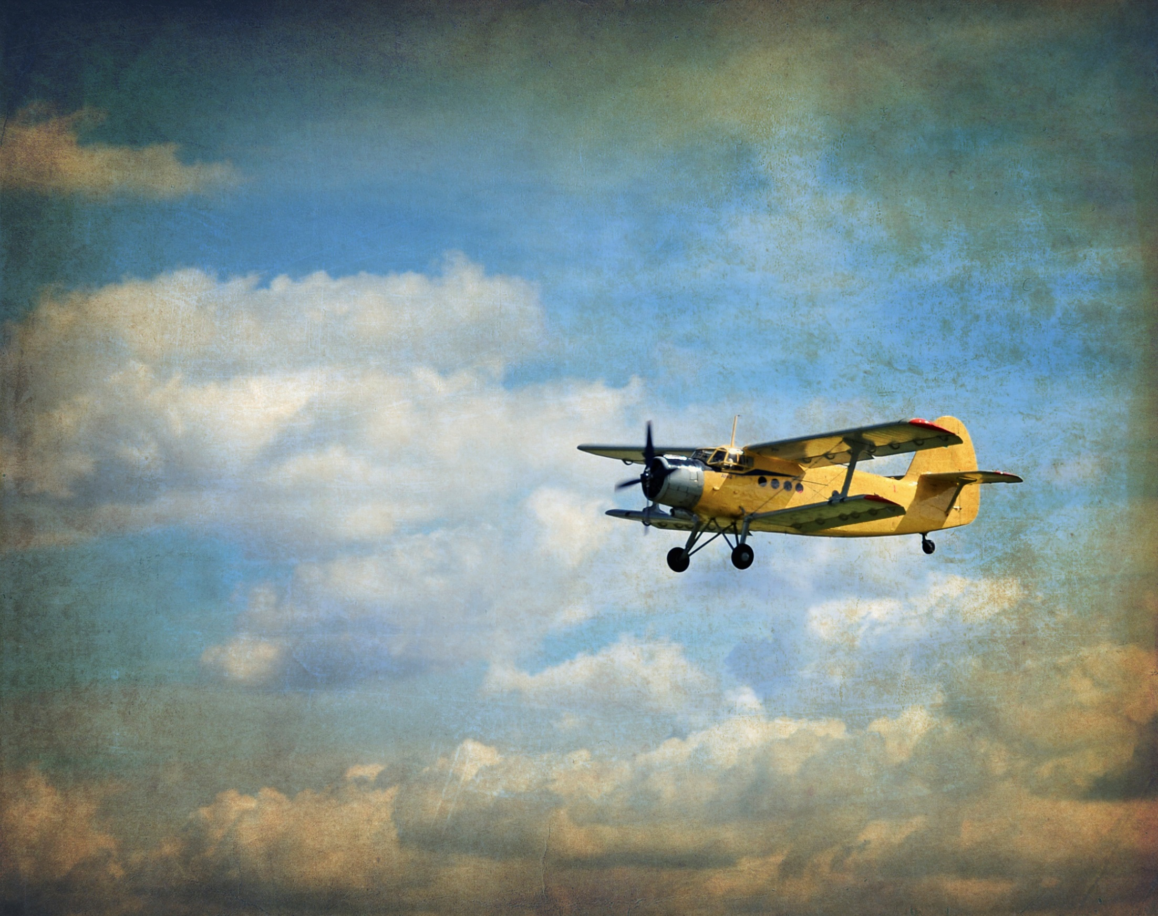
In the Good Old Days of Managed Travel
It was all about the 3 C’s

Slide 11
COST
CONTROL
CONVENIENCE
Source: PhoCusWright Inc.

Slide 12
Fast Forward to Today…
…and Travel Managers could be holding on for dear life as they deal with 3 new C words…
…Content, Context, Consumerism

Slide 13
The New C’s of Managed Travel
Delivering the right content to the right individual at the right time!
Content
Context
Consumerism
PRE TRAVEL
DURING TRAVEL
POST TRAVEL
Planning & Booking
On the Go
Ongoing Travel & Expense Management
Notes:
Define / share use cases for each stage of the journey – what are the enablers (Big Data)
Emphasize traditional and non-traditional
Post travel is about feedabck

Slide 14
Content Situation Gets Even More Complicated
Web Fares
Non-GDS Offerings
Ancillaries
Spend Beyond Air/Hotel/Rental Car
Mobile Only Offerings
Sharing Community

Slide 15
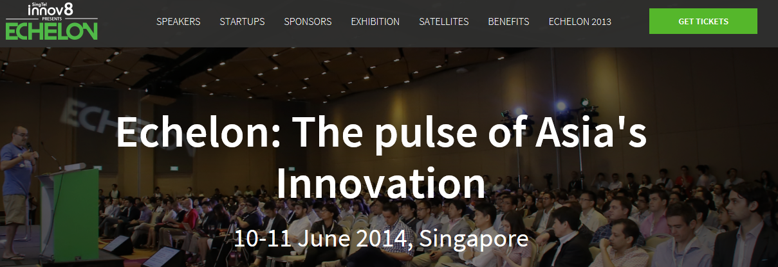
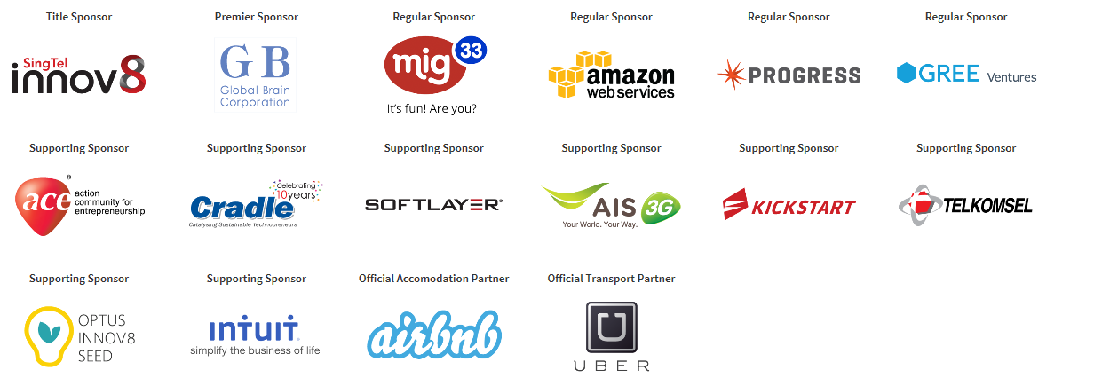
Content Situation Gets Even More Complicated

Slide 16
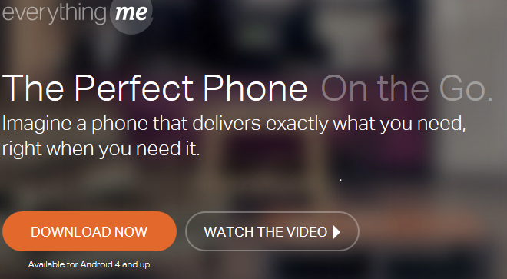
Contextual Search Could Fundamentally Change Everything
“EverythingMe delivers the right apps, contacts and information to the homescreen, exactly at the right place and time. Whatever a person is into, wherever they are, they’ll get personalized suggestions that match their interests and lifestyle.”
Sources: Everything.me

Slide 17
Social Traveler

Slide 18
General Social Media Engagement
Facebook has roughly 1 billion users
Social media reaches 84.4% of Internet users
Average of 336.9 minutes/visitor/month
Question: Please indicate how much you agree or disagree with the following statements. Select one for each statement.
Base: U.S. online travelers who are active users of online social networks (2013 N=1,909)
Source: PhoCusWright's Traveler Technology Survey 2013

Slide 19
Participation in Popular Online Social Networks
Question: In which of the following online social networks, if any, have you actively participated in the past 12 months?
Base: U.S. online travelers (2013 N=2,203; 2012 N= 2,029; 2011 N=1,932)
Source: PhoCusWright's Traveler Technology Survey 2013

Slide 20
Participation Social Networks, by Age
Question: In which of the following online social networks, if any, have you actively participated in the past 12 months? How old are you?
Base: U.S. online travelers (2013 N=2,203)
Source: PhoCusWright's Traveler Technology Survey 2013

Slide 21
Social Traveler
The Opportunity:
Tactical: Educate, feel the pulse of and facilitate knowledge sharing among travelers.
Strategic: Drive deeper traveler engagement to improve the experience and support program goals
The Landscape:
Companies continue to invest in social enterprise solutions
Travel programs continue to practice in and enjoy positive results from using their social enterprise
Specialized resources are emerging to support this evolution.

Slide 22
Mobile

Slide 23
Mobile Trends
Tablets and Smartphones Impact Every Stage of Trip Life Cycle
The planning phases have been extended by tablets and smartphones
Booking is still emerging, but the major emphasis is on local content; dining, ground transportation
Information needs to be immediate and relevant
The biggest opportunity is for in-destination, location-based services
Expense experience is enhanced by Mobile: Sharing is instantaneous and requires immediate response
Notes:
Mobile and tablets are here to stay and now impact every stage in the travel life cyle –
Planning – how many looked for a flight/hotel on their mobile/tablet?
How many Booked? While still emerging for flight/hotel – we are seeing more and more bookings take place at resturants/ground transportation.
Trip – throughout the trip, travelers expect updates/notification – they expect relevant, and timely information to better their trip.
And of course, expense – now days, many are using their tablet or mobile for filing expenses.
– so how can we continue to better the mobile experience

Slide 24
% of Travelers Who Use Mobile Devices* During Trip Planning Life Cycle, by Age
Average: 47%
*Smartphones and tablets.
Question: Please indicate which of the following travel-related activities you have done online using your desktop/laptop, smartphone or tablet in
the past 12 months. Select all that apply for each row. How old are you?
Base: U.S. online travelers (N=2,203)
Source: PhoCusWright's Traveler Technology Survey 2013
Notes:
Bar Chart with multiple bars

Slide 25
Mobile Activity, by Product Segment
Hotel
Question: Which travel products have you researched or booked online using your tablet
during the past 12 months? Select all that apply for the products you researched or booked
Base: Hotel stayers (N=1,969); Flyers (N=1,436); Car renters (N=634); Destination Activity Purchasers (N=635)
Source: PhoCusWright's Traveler Technology Survey 2013

Slide 26
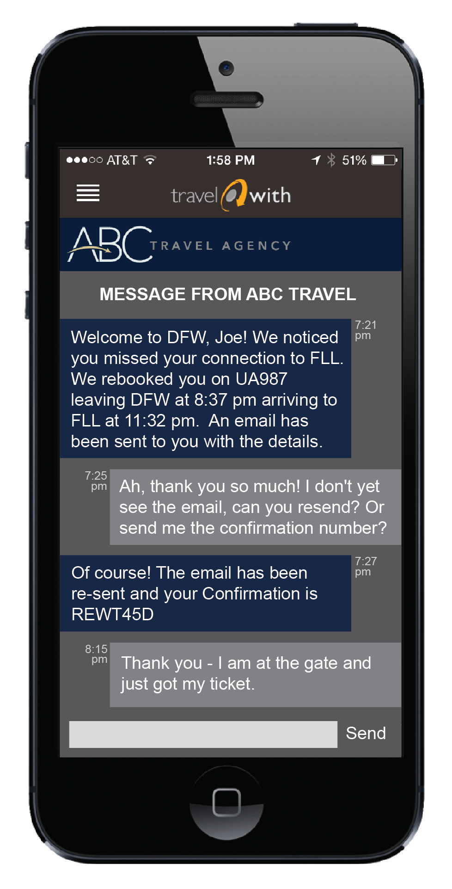
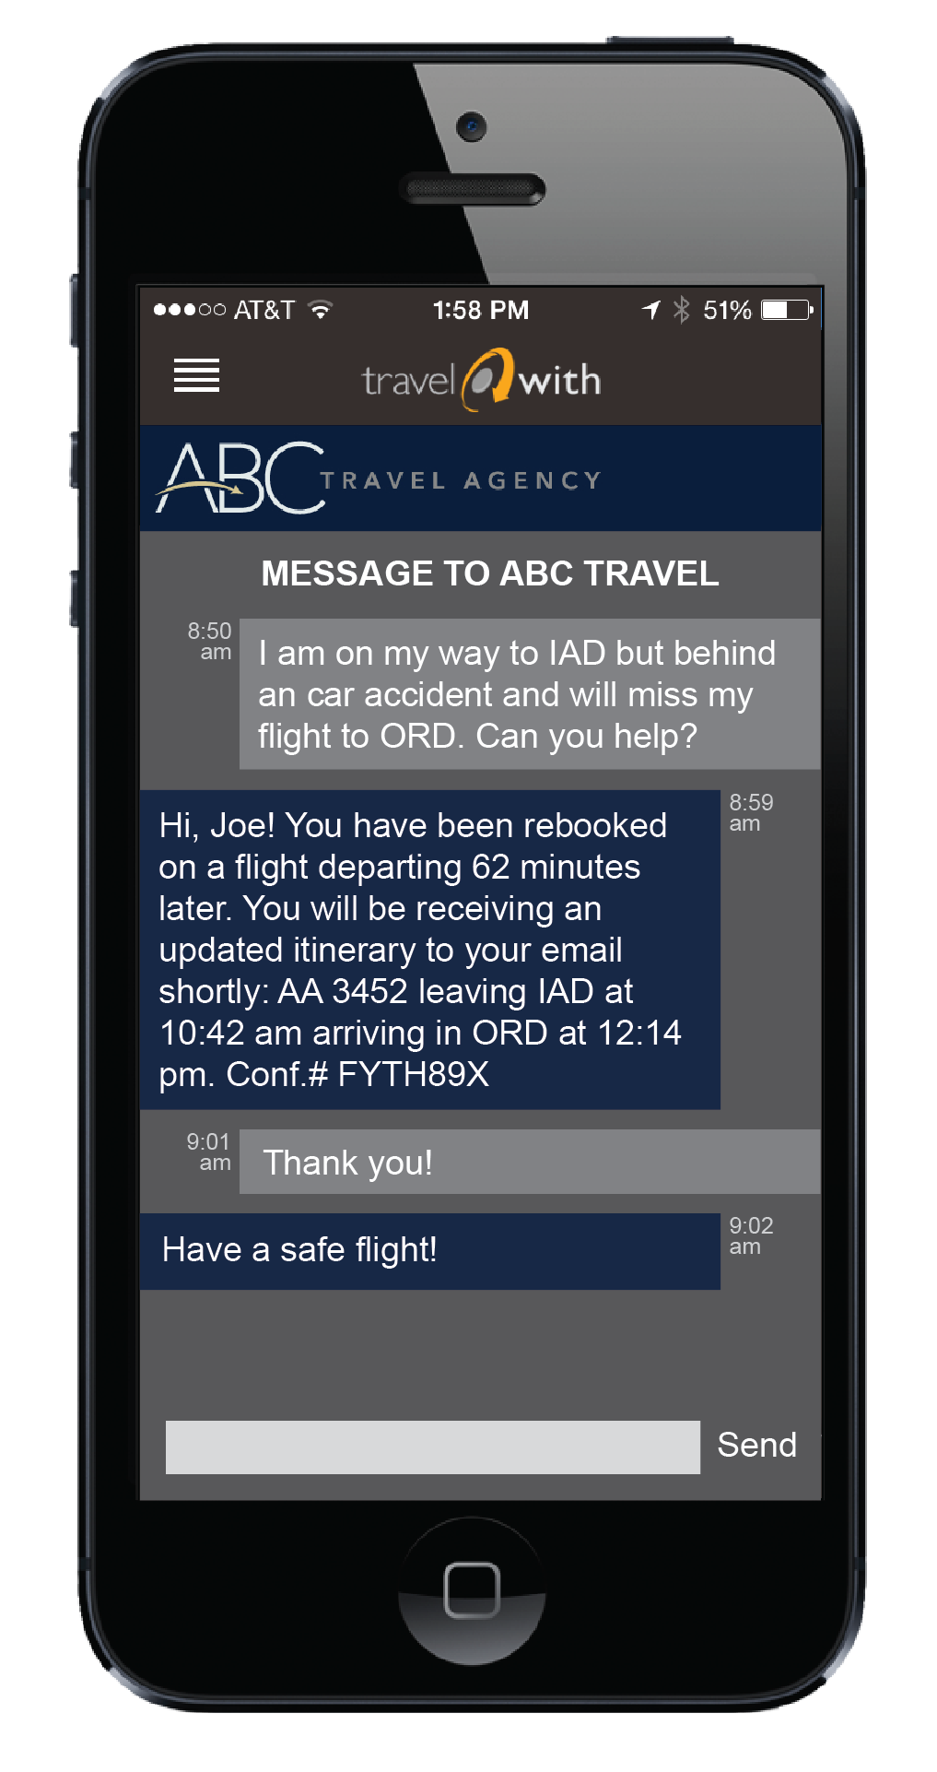
Two-Way Communication
Notes:
Why not travel?
Read examples -

Slide 27
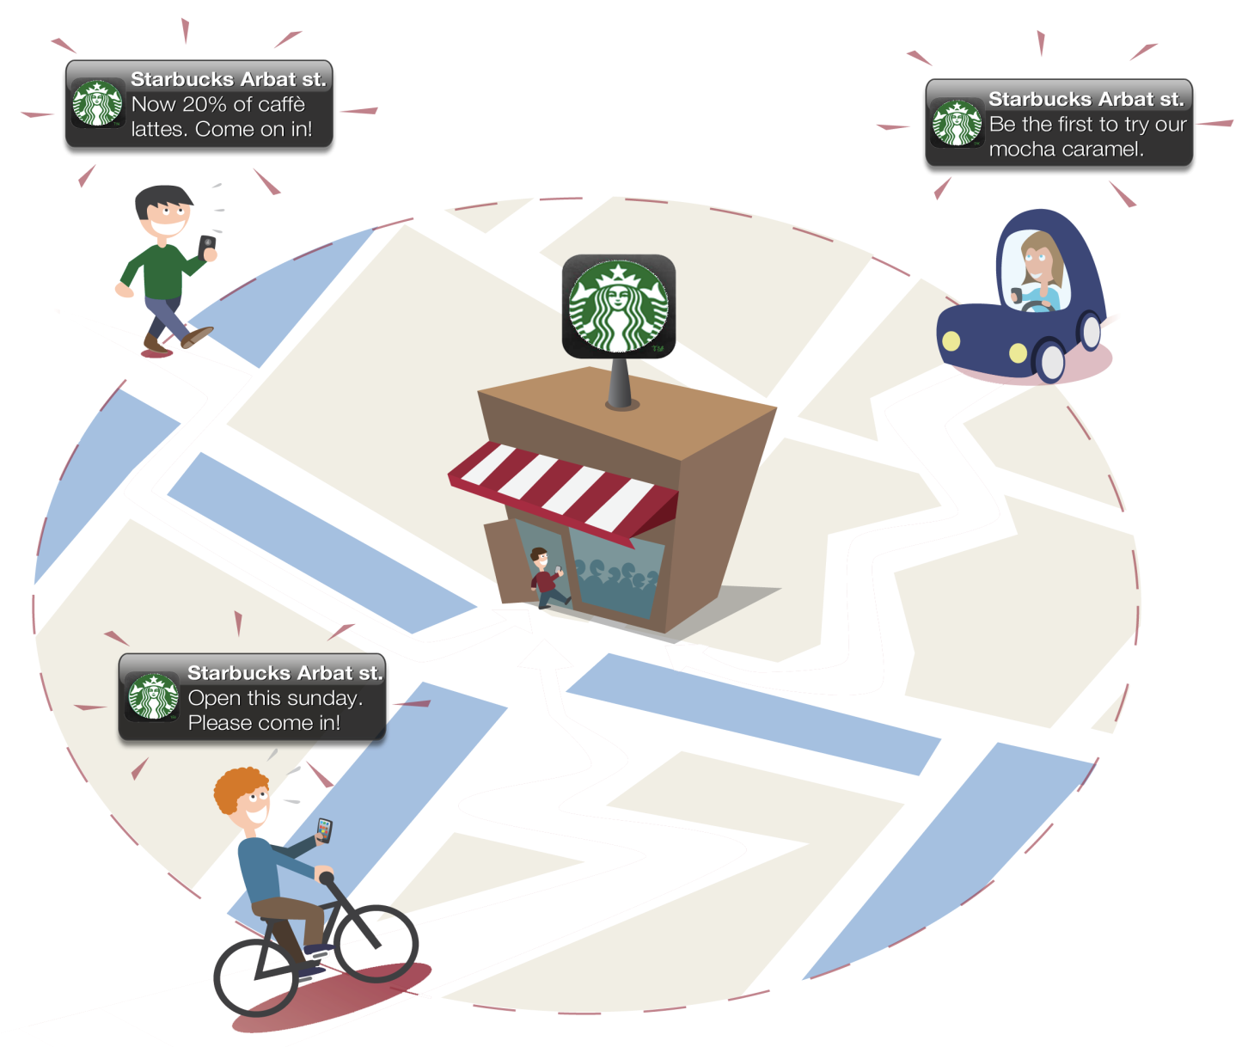
Geofencing
Notes:
Do these alerts look familiar? Lots of companies are doing it - Starbucks, Retail me Not – it is called geofencing
Geofencing is a location-based service that sends messages to smartphone users who enter a defined geographic area. companies send promotions to customers' smartphones when they enter a store, mall or neighborhood or area!
Again – why not travel?

Slide 28
Geofencing Check In
Notes:
Again – why not travel?

Slide 29
Thank You!
Moderator:
Tony D’Astolfo, Managing Director, PhoCusWright
Panelists:
Michael Jacques
Director Business Development and Partnerships
Kathleen Roberts
Director of Business Development
Laurie Wooderson
Global Corporate Sales Manager

