Slide 1
Phat Data

Slide 2
Phat = Cool: Pretty Hot and Tempting

Slide 3
Dilbert Says…..

Slide 4
Stats, Stats and more Stats
Over 3 Quintillion bytes of data – Produced EVERY DAY!!!
90% of all data in the world has been created in the last two years
One GDS alone processes up to 3.7 million bookings per day
Facebook has over 1.1 billion users
Millennials:
75% have social media profile
Are preferring LinkedIn & Twitter
83% sleep with their smart phones
84% user generated content has impacted travel decisions
57% update social media while traveling regardless of business or leisure
59% Business Travelers went out of policy on at least one major travel expense
47% of non-compliant travelers cite convenience as reason

Slide 5
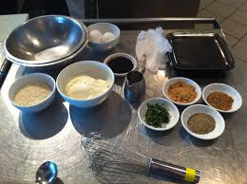
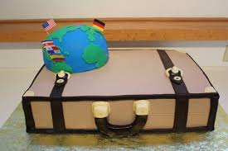
Getting to Wisdom
“Our industry has a lot of different ingredients that go into making the tastiest managed travel program you’d ever want to digest. We have more ingredients than most verticals but we don’t bother to use those ingredients. Instead we just keep eating the same stale cake!” Rock Blanco

Slide 6
Getting to Wisdom
Data
Information
Wisdom
What Data?
Why?
So What?
Take Action!

Slide 7
In order to change the state of data in our industry it will take four things:
Getting to Wisdom
Travel program alignment with corporate business objectives
Understanding the behavioral economics of our travelers….listening, personalization
Buyers insisting on actionable data:
Program specific, real time
Suppliers investing in required changes:
Infrastructure, transparency

Slide 8
Industry Impacts
Business Traveler
Suppliers
Managed Travel
Will expect managed travel programs to ‘understand’ their travel patterns and preferences
Mobile technologies will continue to drive content and data to a travelers finger tips
Travelers experience will become less about booking process, and more about the consumption period of the trip
Next generation of travelers and technologies offers more data and opportunities to travelers
Continued use of data to personalize offerings and “own the traveler”
Utilization of data to control pricing – enhanced capabilities – more dynamic, more personalized
Airlines are using data to predict cancellations – weather, mechanical
Provide technologies to capture bookings regardless of where they originate and report on the data
Pushing offers through social media
Demand for better, real time information is critical
Travel buyers will need to become more technically savvy and analytical
Programs become more traveler-centric
Policy and program decisions will be based on internal behaviors and impacts, rather than external benchmarks
Better ability to gain 100% insight into travel program
Enhanced meetings and events
Data will move from functionally discrete information in a siloed environment to a collaborative environment housed in the cloud.

Slide 9
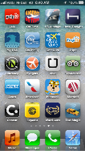
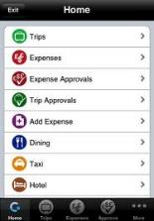
Traveler-Centric
Your flight delay, has caused a misconnect, we have rebooked you on the next flight departing at 7:00pm, proceed to gate
A 27
“Welcome to NY, reminder your hotel rate is $309 and includes breakfast and internet.”
“There has been a reported incident at or near your location. Please reply to advise your safe”
Actionable – Near Real Time Data Foundation

Slide 10
Challenges
Some key necessary changes to current technologies need to take place – Data Structure
Data ownership
Privacy issues must be addressed
Ultimately the ability to manage the massive amounts of data
Buyers and suppliers must work in a more collaborative environment to solve big data challenges
Data becomes a commodity, who is willing to pay

Slide 11
What’s Next
We first need to accept that technology has the ability to transform our data into wisdom
Do you have a Phat Data strategy in place?
Begin asking yourself – So What?
I get these reports each month – so what?
Travel buyers need to open a dialogue with suppliers.
How are you preparing for a future model?
What are your goals in marketing directly to our travelers?
In what ways will you support my corporate initiatives in a new model?
Internally, what Business Intelligence tools are available to you?
Am I remaining relevant, how am I preparing for the future?
Continue to read BTE for more insight!

Slide 12
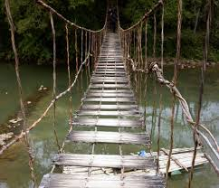
Data Today….

Slide 13
Data Tomorrow…

Slide 14
Last Words
“These days people seek knowledge not wisdom. Knowledge is of the past, wisdom is of the future.”
Vernon Cooper

Slide 15
Questions

Slide 16
Call, Email, Follow, Like, Tweet Me!
Jennifer Steinke
Manager, Corporate Travel
ACT, Inc
Jennifer.steinke@act.org
480-286-4130 – Cell
@jennifersteinke
Business Travel Executive Magazine
www.askebte.com
October: Phat Data Introduction
November: Getting to Wisdom
December: Phat Trends
January: Phat Meetings
February: The Functional World of Phat Data
March: Phat Data, Phat Expense
April: Phat Review
May: Phat Data’s Changing Landscape
June: Real Wisdom
July: Intelligence Worth Sharing
August: The Unsung Hero
September: Unique Applications

