Slide 1
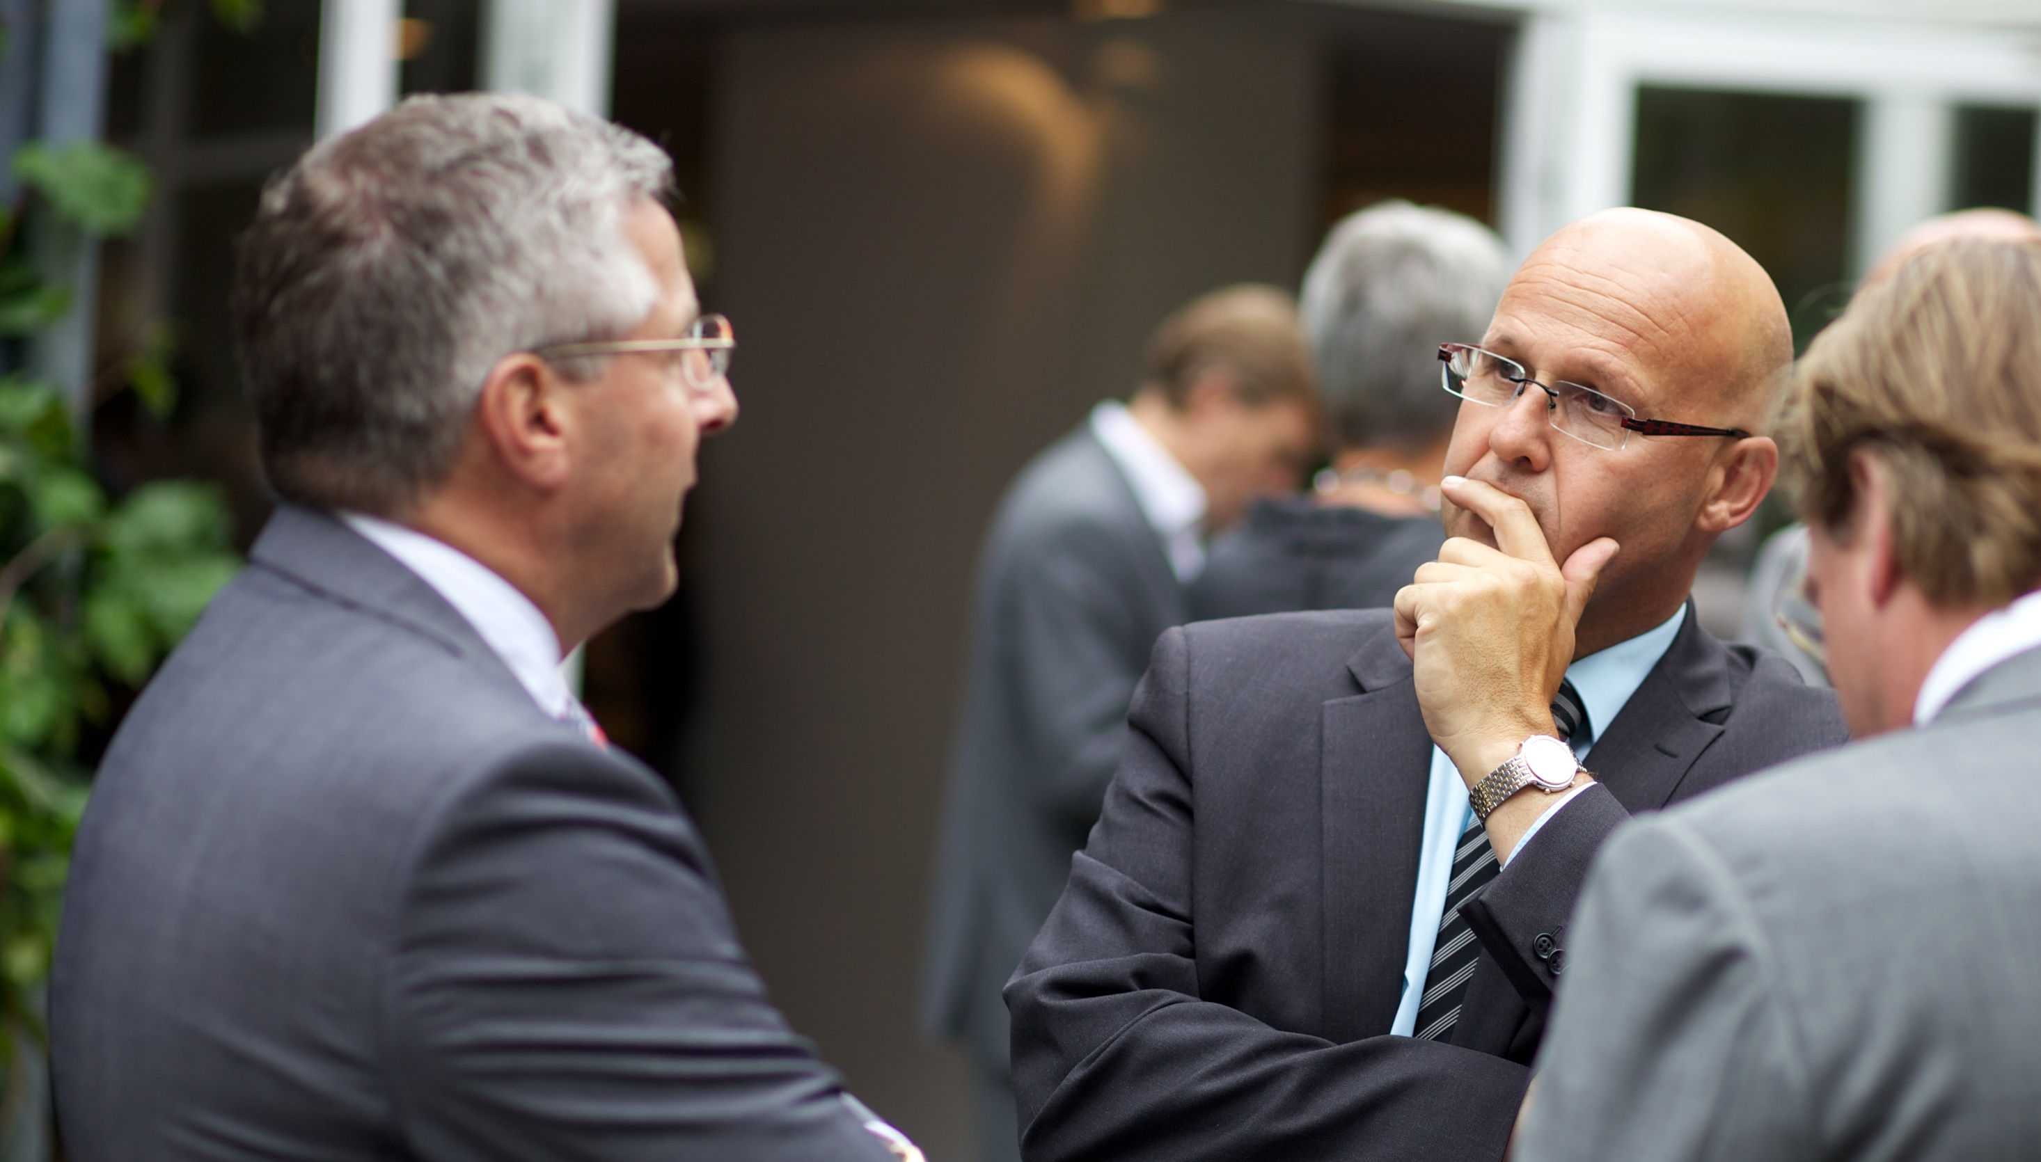

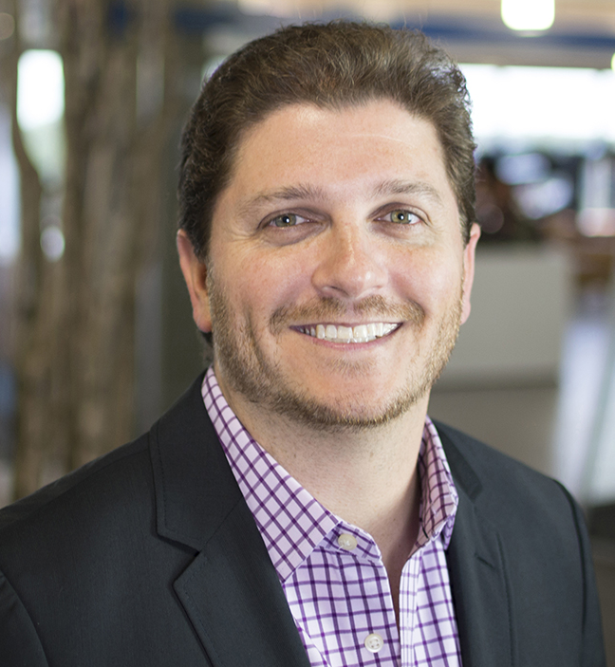


Meetings Management
Simplified
Brian Ludwig
Senior Vice President
Cvent Inc.
@Cvent

Slide 2

Meetings Management Technology Myths
It’s too complex and hard to implement.
It’s too expensive.
It only works for
large universities.
Success requires
a mandate from IT.

Slide 3

Why do I Need Technology?
Visibility
View event activity by department, campus, supplier, etc.
Analyze spend by vendor, event, department, etc.
Measure savings and ROI against established targets
Risk Mitigation
Create an audit trail to monitor compliance on legal, regulatory,
and operational risks
Track compliance with state and university-wide regulations
Know when and where meetings are occurring to track attendee welfare and safety

Slide 4

Why do I Need Technology?
Process Automation
Streamline processes to maximize staff efficiency
Automate repetitive activities across all meetings and events
Increase productivity by 27%*
Savings
Consolidate group business to leverage and build preferred suppliers
Enhance supplier negotiations using standard procurement practices
Reduce booking costs by 15%*
*Source: Frost and Sullivan’s Analysis of the US & Global Meetings and Events Market

Slide 5

Travel
Mobile
Apps
Website
Finding
Venues
Registration
Marketing
Budget
Analytics
Database
Fee
Processing
Social
Excel
Housing
Check-in
Badges
Email

Slide 6





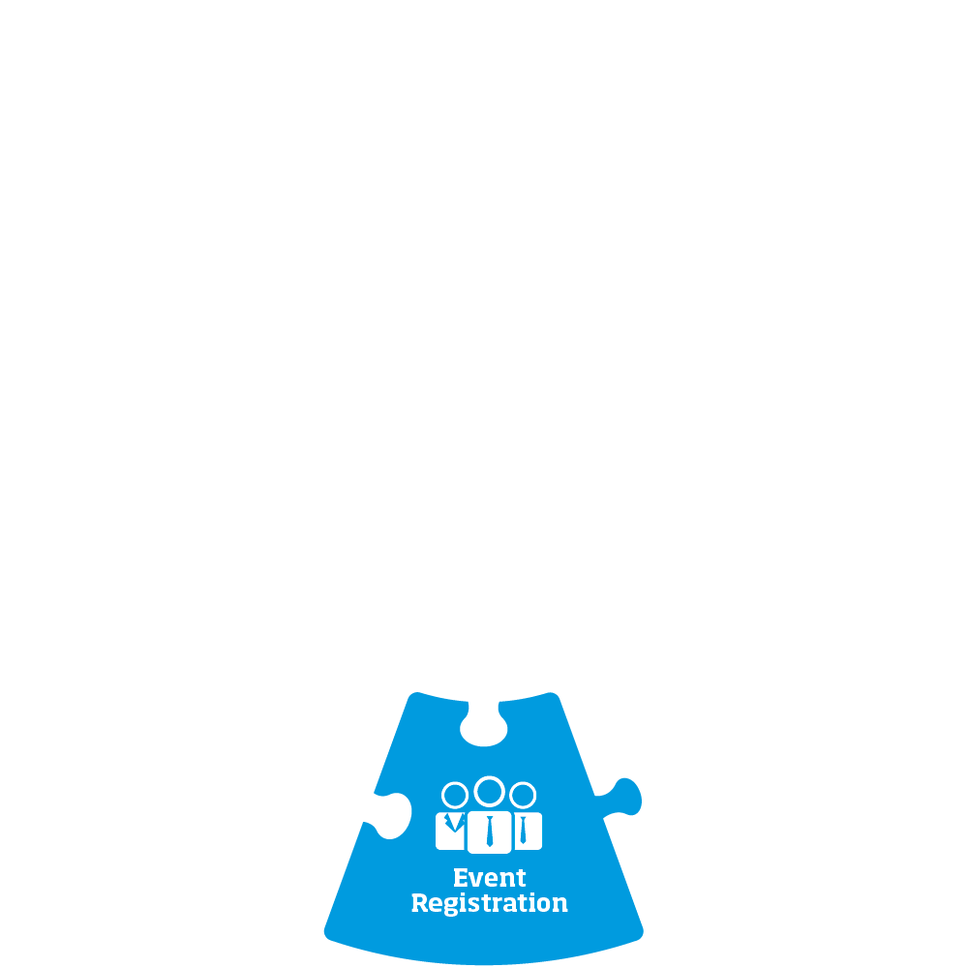


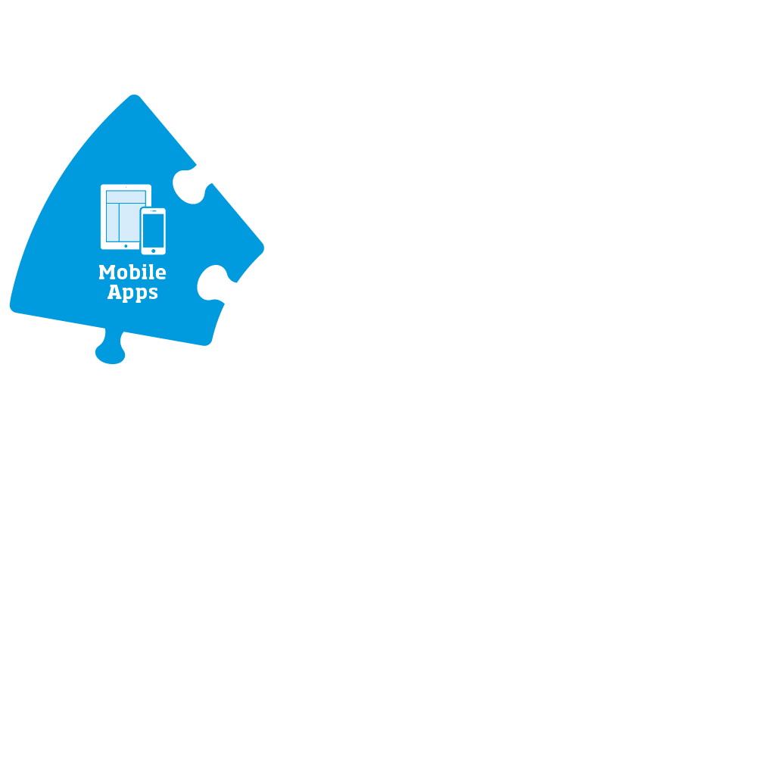




Slide 7
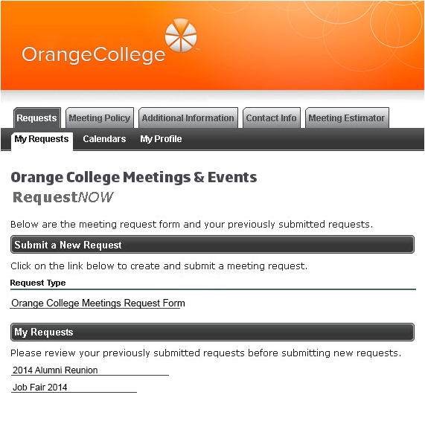
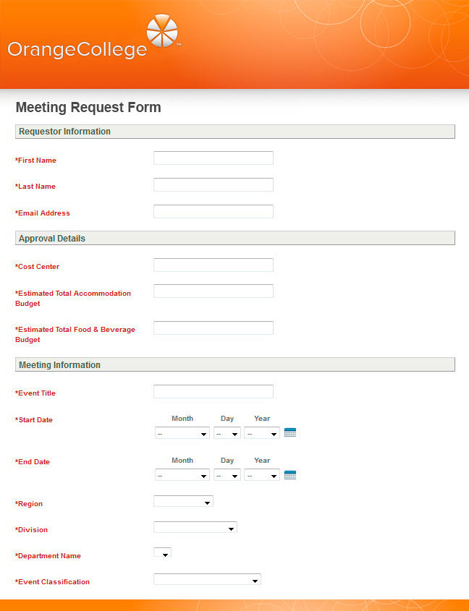

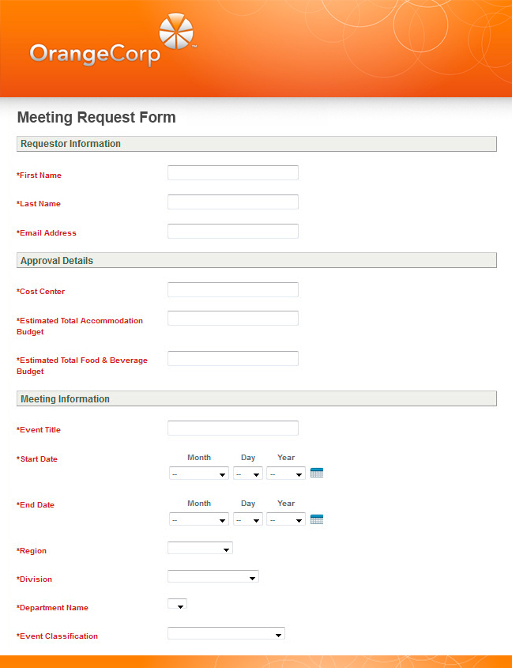
Collect Event Data Across the Entire University
Sally
Smith
ssmith@orange.edu
Admissions
$50,000
$20,000
  Register all university meetings into a
  centralized database
  Meeting requests routed based on your school’s
  unique policies
  Look and feel supports college’s branding guidelines
  Meeting specs migrate into supplier RFPs and into attendee websites
Mid-Atlantic Regional Meet
Aug
18
2014
Aug
20
2014
Mid-Atlant
Mid-Atlantic
Admissions
Recruitment
Notes:
© 1993 Koob and Fletcher / © 2001 Marasco Newton Group
Leadership: Attitude, Function, and Style -- 2001
Page 7

Slide 8
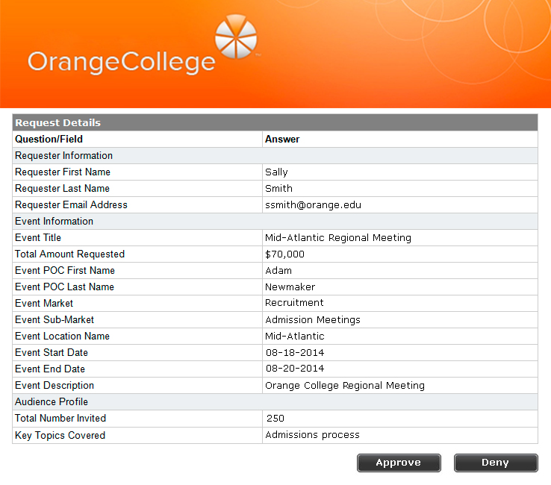
Approval Notification Sent to Specified Meeting Approver
Meeting Request Email Notification
Notes:
© 1993 Koob and Fletcher / © 2001 Marasco Newton Group
Leadership: Attitude, Function, and Style -- 2001
Page 8

Slide 9

Build a Robust Approval and Procurement Process
Alumni Department
(No approval required)
All Other Departments
(Approval required: Process
contingent on meeting budget)
Meeting request
submitted
Requester completes and submits MRF
Request automatically becomes a meeting
Confirmation
to requestor
Request automatically becomes a meeting
Confirmation
to requestor
Notification sent to sourcing agent and meeting planner
Denied
(requestor
notified)
Under $10,000
Departmental Approval Required
Over $10,000
Finance
Approval Required
Denied
(requestor
notified)
Sourcing agent logs in and completes sourcing process
Approved
Requester
Approver
Planner
Online registration site launches
System
Sourcing Agent

Slide 10
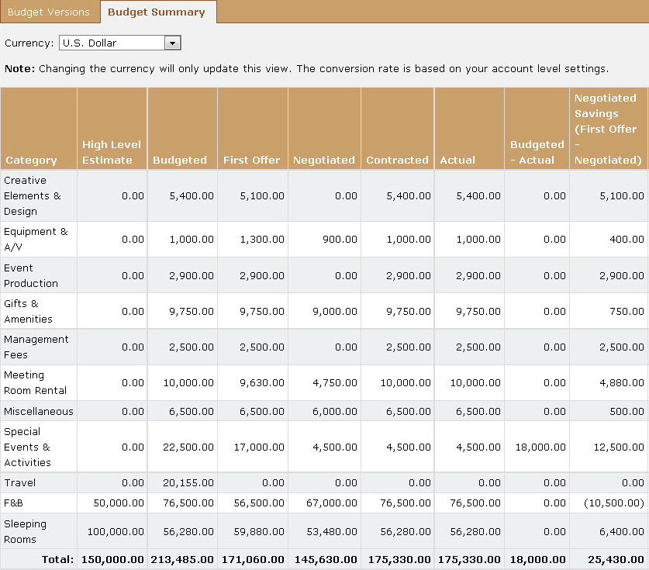
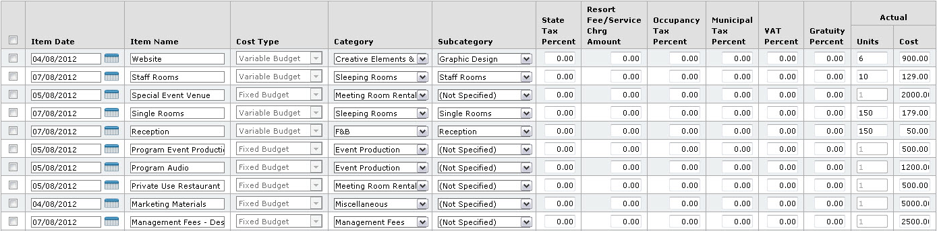
Begin Building Meeting Budget
  Develop templates
  Use an excel-like interface to clone or edit budget items
  Create multi-dimensional budgets to meet expectations and requirements
  Integrate with other modules to reduce manual entry
Notes:
© 1993 Koob and Fletcher / © 2001 Marasco Newton Group
Leadership: Attitude, Function, and Style -- 2001
Page 10

Slide 11




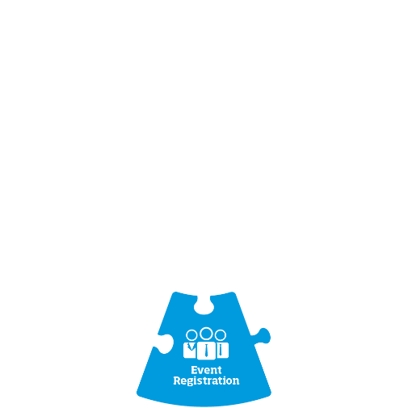


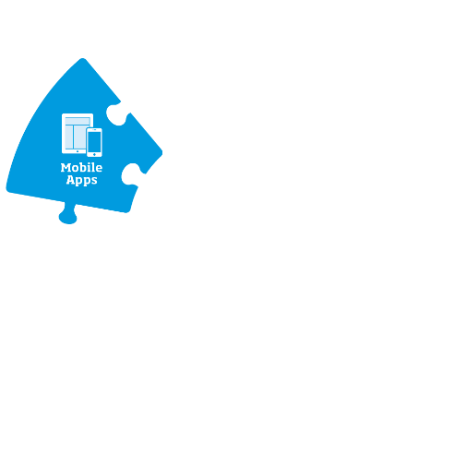

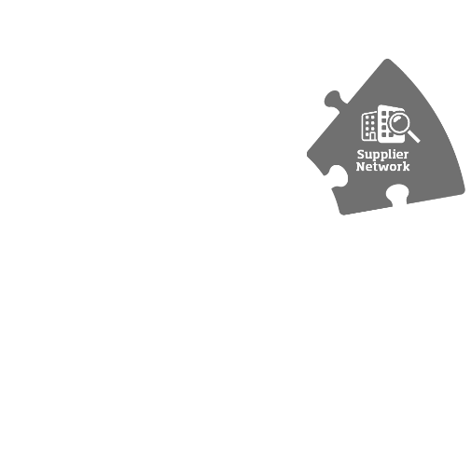


Strategically Source Event Venues
Travel
Mobile
Apps
Website
Finding
Venues
Registration
Marketing
Budget
Analytics
Database
Social
Excel
Housing
Fee
Processing
Check-in
Badges
Email

Slide 12
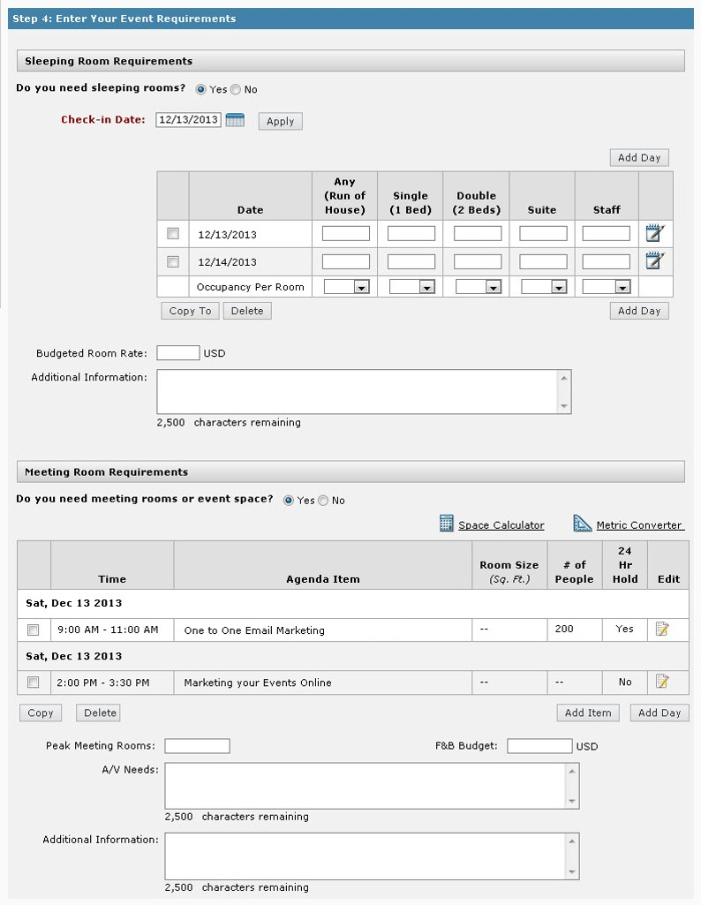
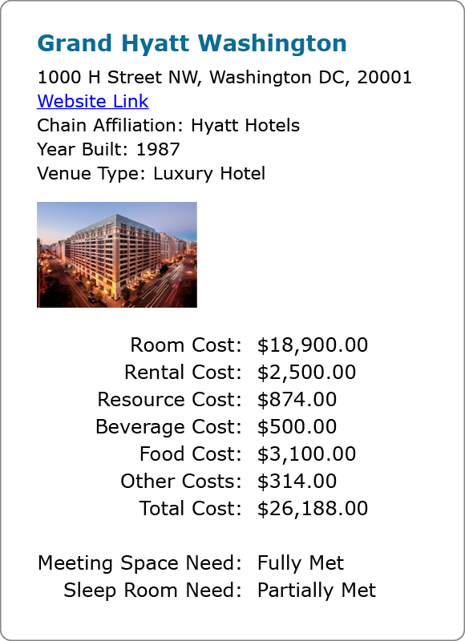
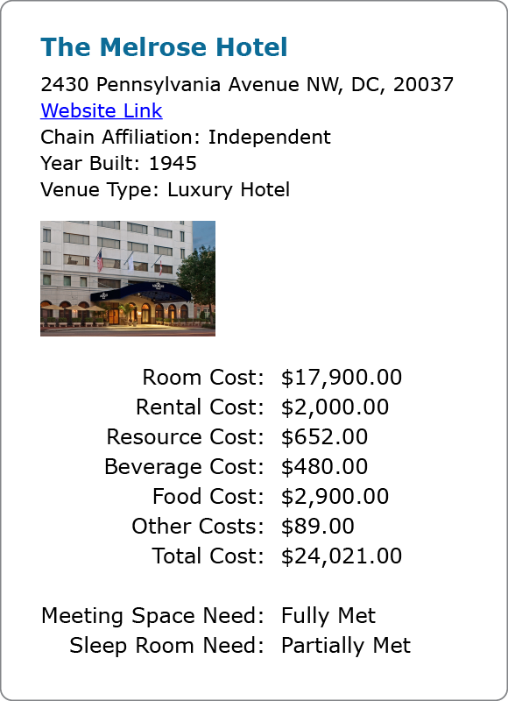
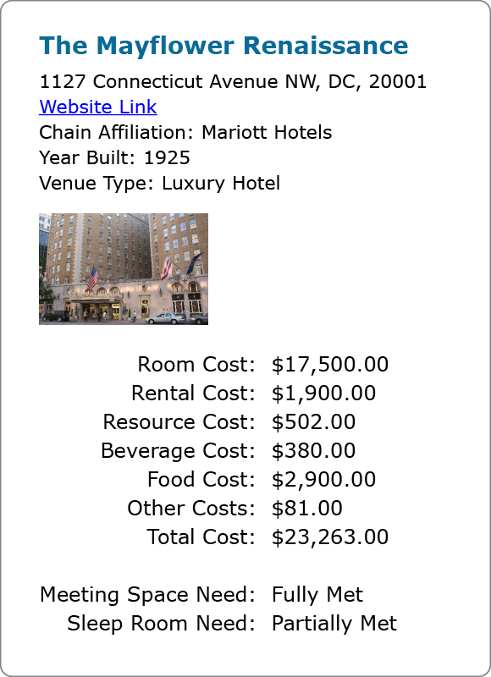
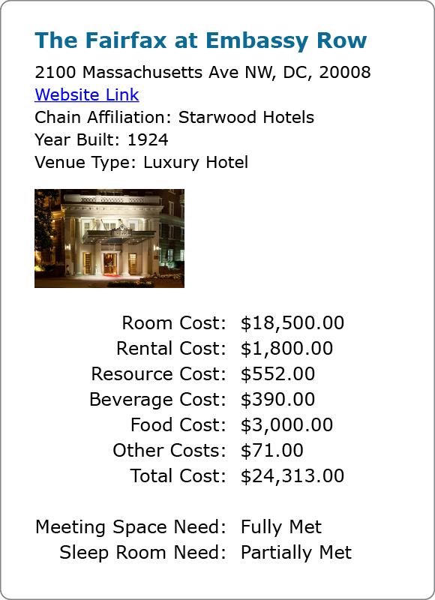
RFPs and Bids
Develop RFPs for off campus events that can easily be cloned for similar events in the future
Submit RFP to multiple suppliers at once
Send RFPs directly to National Sales Offices of preferred vendors with negotiated rates
Easily compare bids side by side to make an informed decision

Slide 13
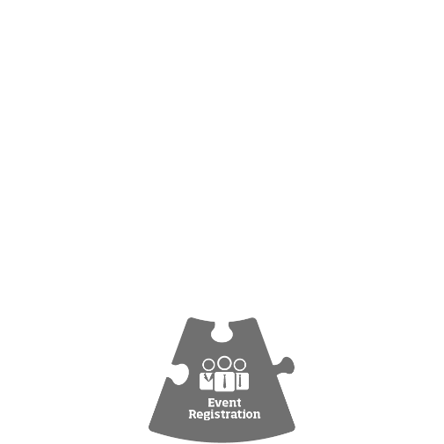
Offer Modern Attendee Registration
Travel
Mobile
Apps
Website
Finding
Venues
Registration
Marketing
Budget
Analytics
Database
Social
Excel
Housing
Fee
Processing
Check-in
Badges
Email

Slide 14

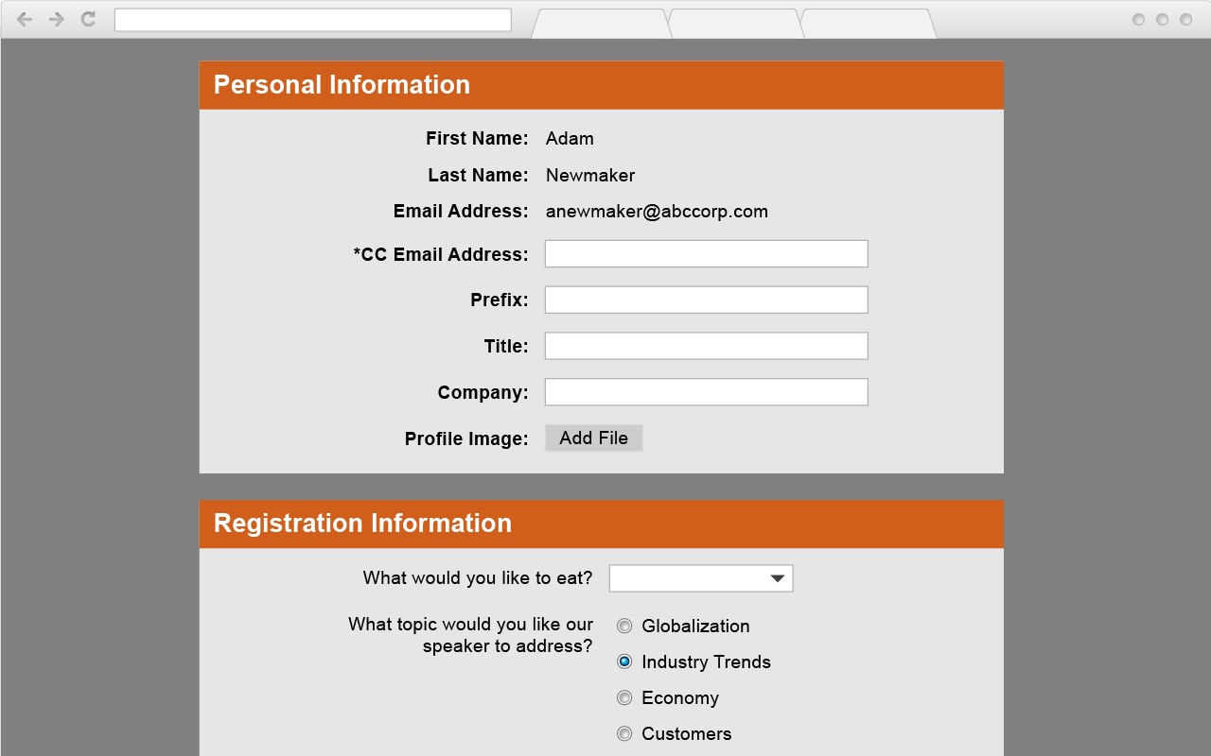
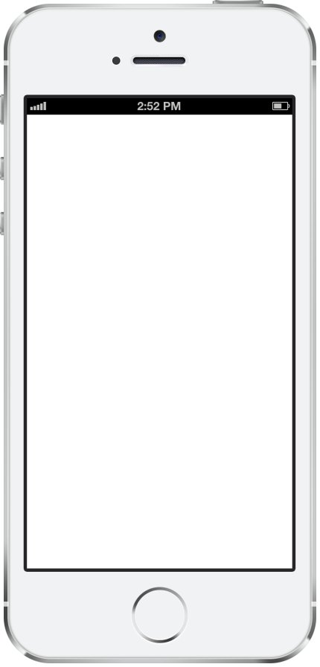
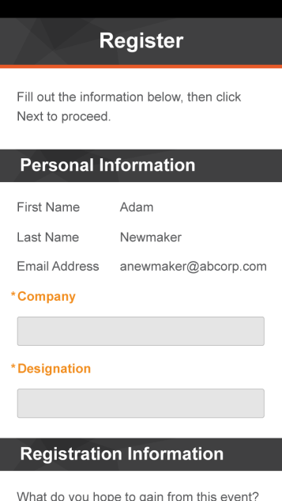
Registration
Register from your computer
Or from a mobile device
Or from a mobile device

Slide 15
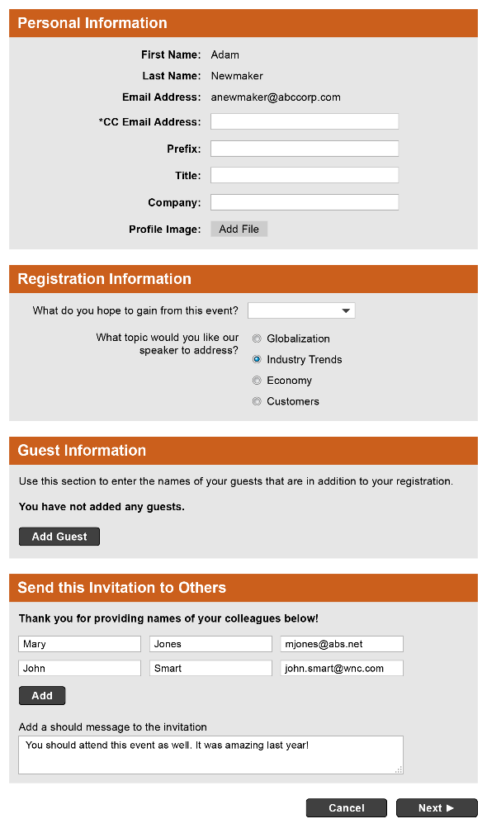
Registration Form
Pre-population
jsmith@abccorp.com
Mr.
Executive VP
ABC Corp

Slide 16
Registration Form
Pre-population
Ask questions
Register guests
Forward Invitation
jsmith@abccorp.com
Mr.
Executive VP
ABC Corp

Slide 17
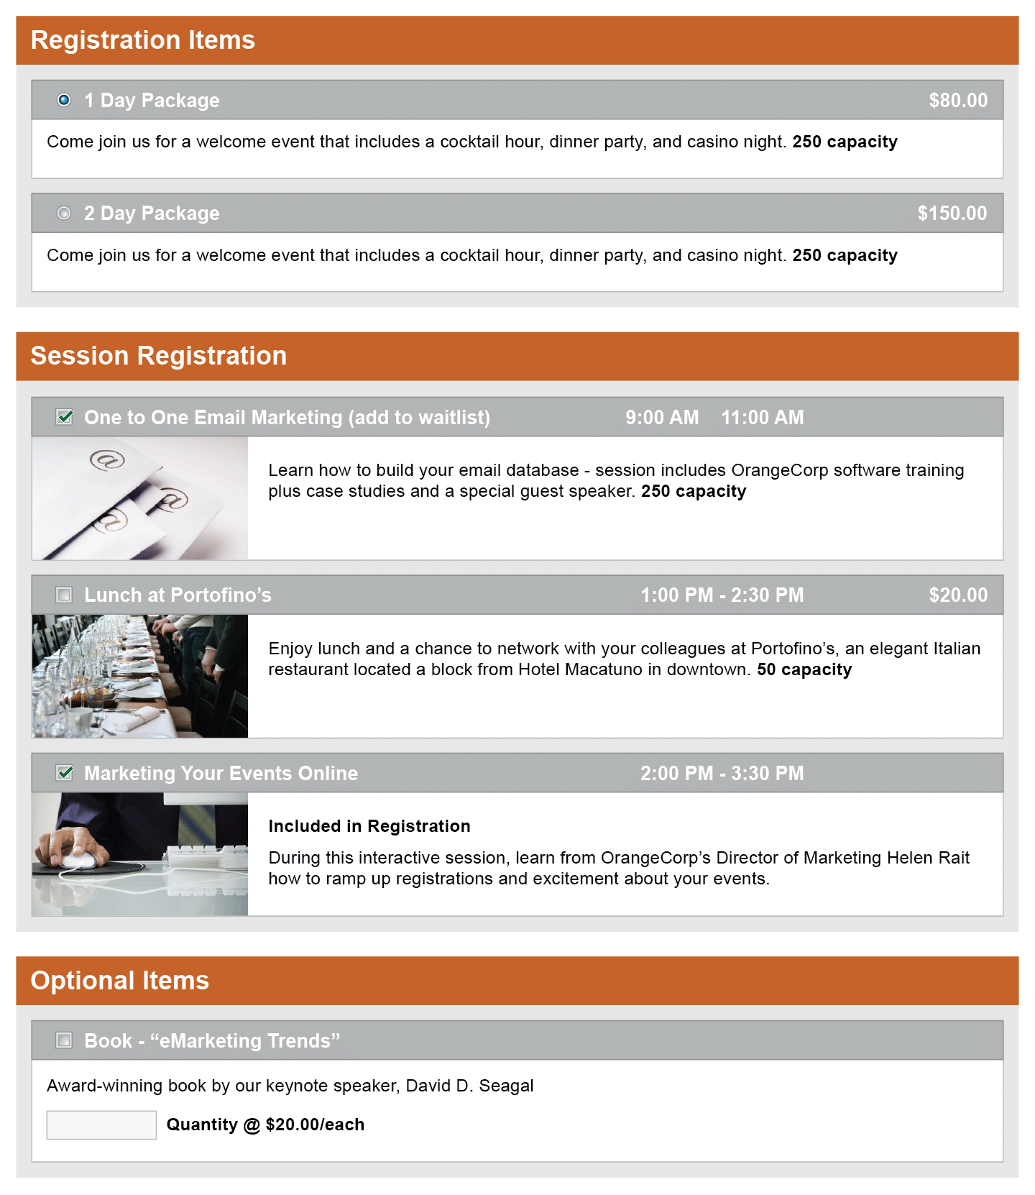
Robust Registration
Multi-day, multi-track, and
multi-session registration
Differentiated pricing based
on attendee type
Set session capacities
and allow waitlists
Offer registrants ability to purchase quantity items
(i.e. books, t-shirts, etc.)
or make donations

Slide 18
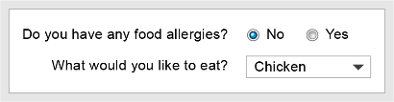
Robust Registration
Ask conditional questions based on session selection

Slide 19
Robust Registration
Create dynamic registration paths for different types of attendees
Alumni

Slide 20
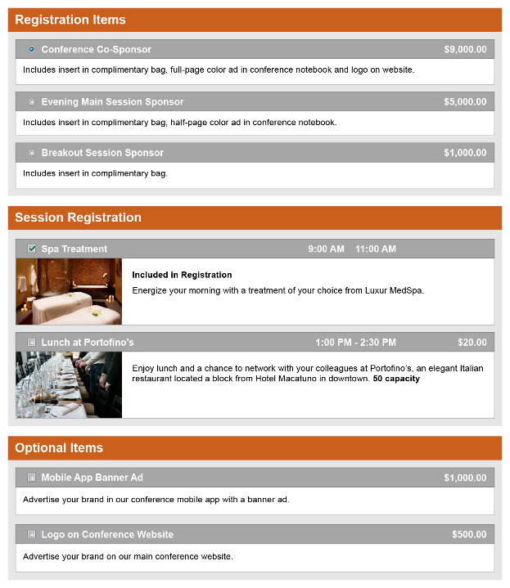
Robust Registration
Create dynamic registration paths for different types of attendees
Only ask relevant question to the corresponding registrants
Alumni
Sponsor

Slide 21
Robust Registration
Create dynamic registration paths for different types of attendees
Only ask relevant question to the corresponding registrants
Limit visibility for agenda items based on registration type
Sponsor

Slide 22

Integrate Hotel and Travel Booking
Travel
Mobile
Apps
Website
Finding
Venues
Registration
Marketing
Budget
Analytics
Database
Social
Excel
Housing
Fee
Processing
Check-in
Badges
Email

Slide 23
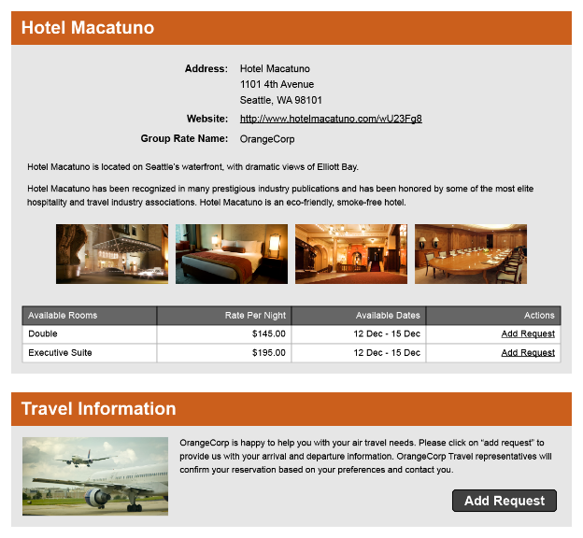
Housing & Travel
Collect housing and travel details during registration

Slide 24
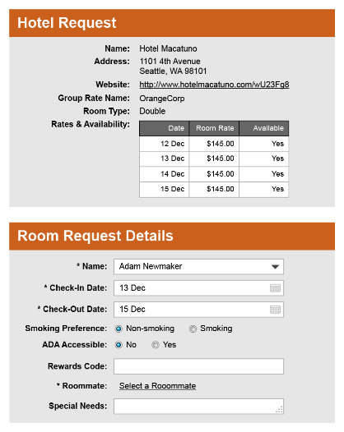

Housing & Travel
Collect housing and travel details during registration
Manage room block inventory
Automated roommate matching

Slide 25
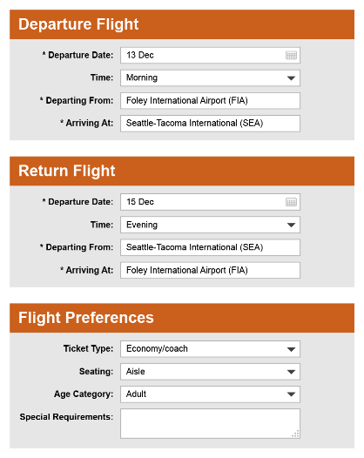

















Housing & Travel
Collect housing and travel details during registration
Manage room block inventory
Automated roommate matching
Send reports or alerts to hotel
or travel manager
Travel integration
Travel Department
Approved!

Slide 26
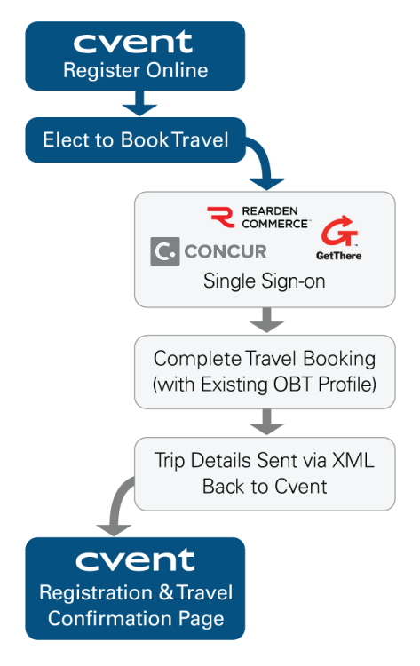
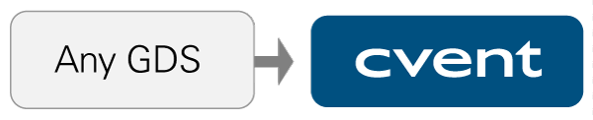




Integrate with Internal Travel Technologies
Online Booking Tool Integration
(Provides seamless travel booking for meeting attendees)
GDS Integration
(Allows for PNR retrieval of flights booked)
  PNRs pulled from GDS to Cvent
  (scheduled or manual)
  PNRs are auto-matched to Cvent meeting registrants
  Cvent user has combined view of meeting and travel data (arrival and departure lists)
Notes:
© 1993 Koob and Fletcher / © 2001 Marasco Newton Group
Leadership: Attitude, Function, and Style -- 2001
Page 26

Slide 27
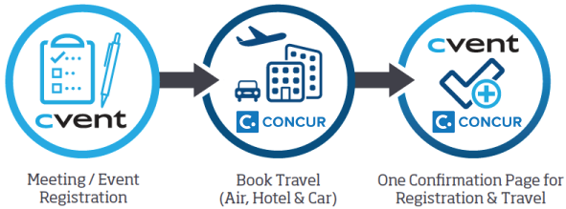
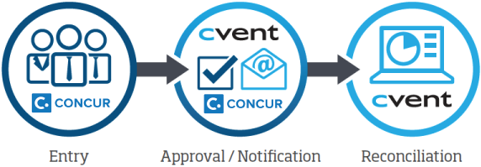
Cvent – Concur Partnership
Travel Integration
Expense Integration
Notes:
© 1993 Koob and Fletcher / © 2001 Marasco Newton Group
Leadership: Attitude, Function, and Style -- 2001
Page 27

Slide 28









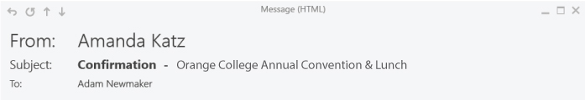

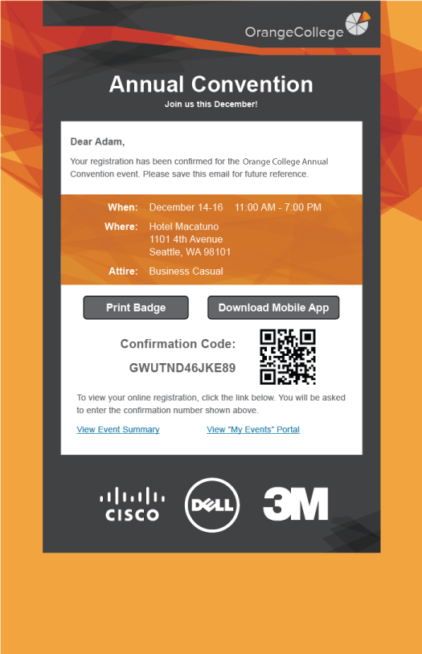











Partner Sites
Website
Email Marketing
Email Forward

Slide 29



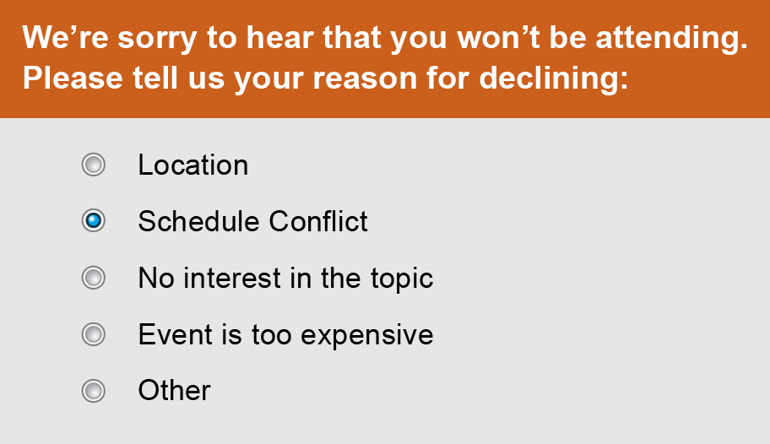
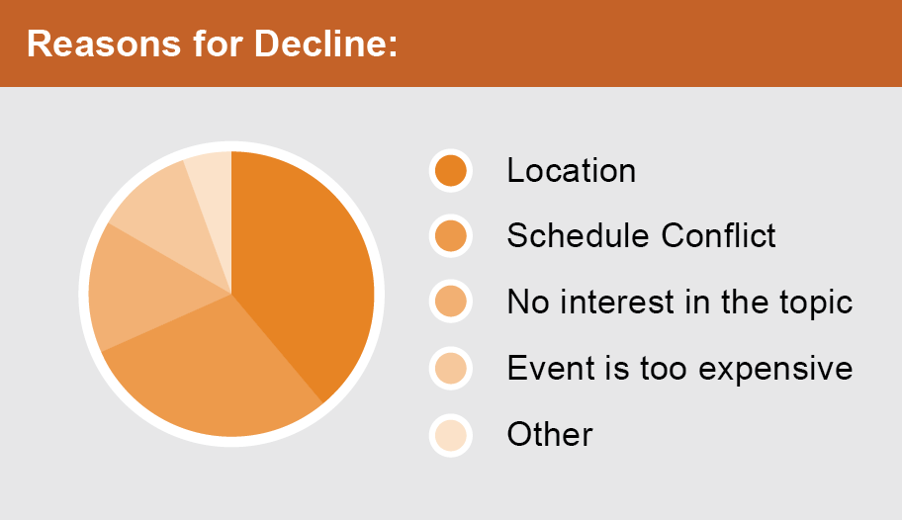
Partner Sites
Website
Email Marketing
Email Forward

Slide 30


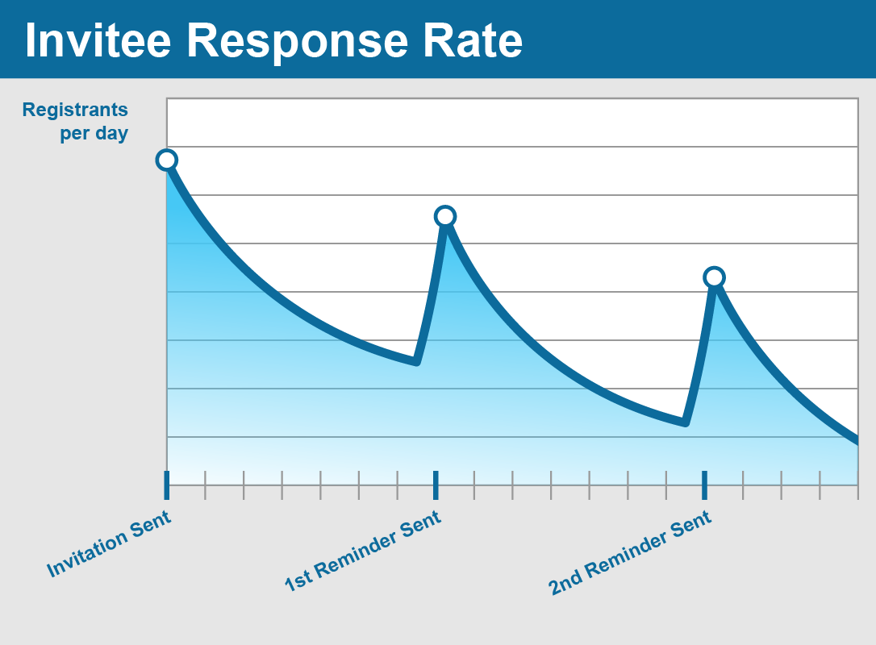
Partner Sites
Website
Email Marketing
Email Forward

Slide 31

Leverage Data to Drive Future Meetings
Travel
Mobile
Apps
Website
Finding
Venues
Registration
Marketing
Budget
Analytics
Database
Social
Excel
Housing
Fee
Processing
Check-in
Badges
Email

Slide 32

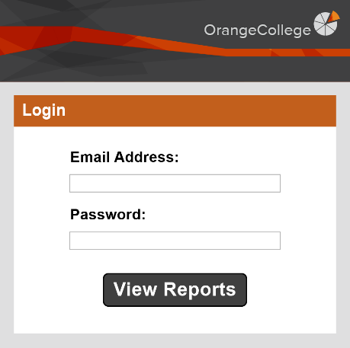


Parked Reports
Provide links to private reports

Slide 33
Parked Reports
Provide links to private reports
Stakeholders always have up to date information
jgalford@orange.edu
*******

Slide 34
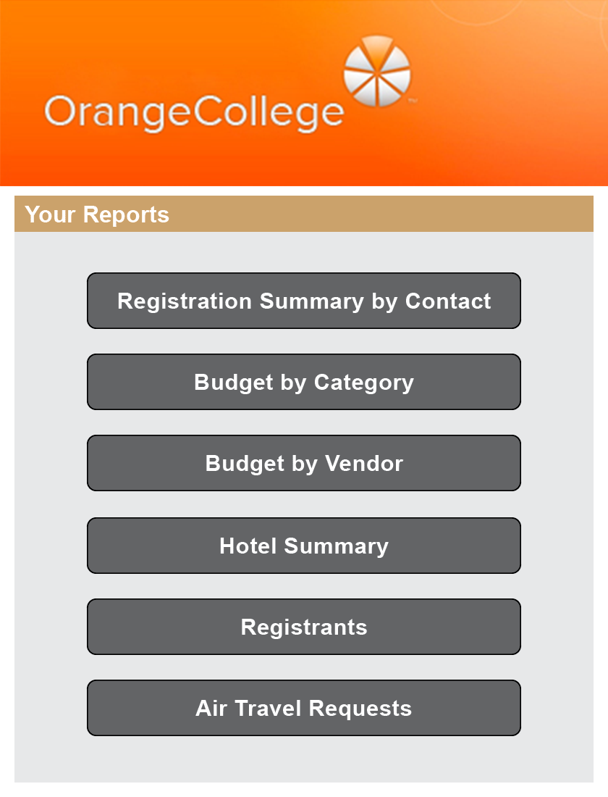
Parked Reports
Provide links to private reports
Stakeholders always have up to date information

Slide 35
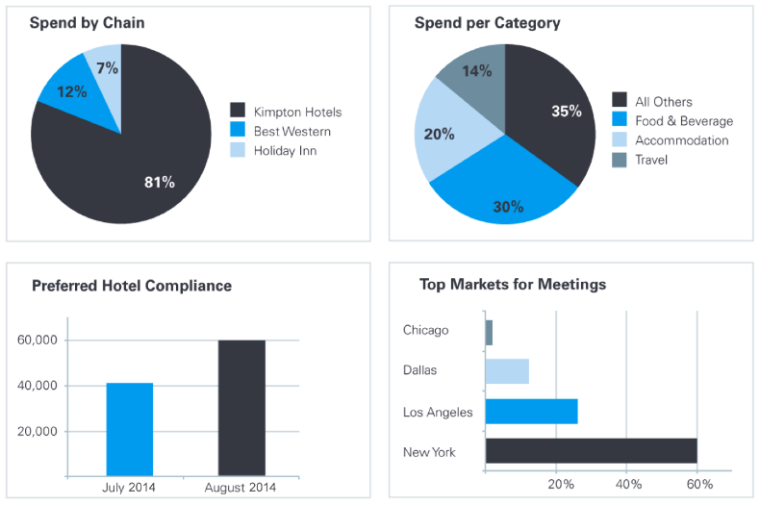
Track Account-Level Data with Dashboards
  Provides account-level analysis with trends in sourcing and meeting activity

Slide 36
Key
takeaway

Slide 37

“Create a Meetings Management program that solve people's problems and addresses their pain points.”
Focus on easing pains of staff as well as event attendees
Automate internal communication & tracking of meeting requests
Create SLAs to push internal adoption across the entire institution
Have data that shows meetings spend, savings and ROI
Recognize departmental goals and develop a meetings program that achieves those goals

Slide 38


Brian Ludwig
Senior Vice President
Cvent Inc.
@Cvent

