Slide 1
DATA…DATA
DATA
I HAVE IT. NOW WHAT?
Debbie Gulliver – University Travel Manager, Michigan State University
Laura Bassett – Executive Vice President, Corporate Travel and Technologies - Conlin Travel
David Heard – Vice President, University Travel – Anthony Travel
Charlie Corbin - Business Development Manager - STA Travel

Slide 2
UNIVERSITY CHALLENGES

Slide 3
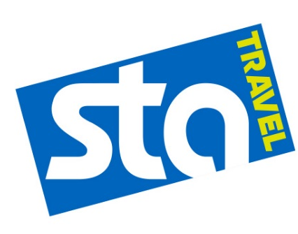
ABOUT US
Travel Management Companies
“Without data…it’s just an opinion.”
-W. Edwards Deming
With the explosion of travel booking mechanisms, data channels, and data points, data is everywhere. It is time to make this data work for you. It is the basis for future decisions, the life-preserver for crisis management, the leverage point for savings and the ground floor of innovation. Your travel management company should be your partner and provide guidance and tools to help your college / university achieve your goals.

Slide 4
CONSOLIDATION
GETTING STARTED
THE PAST
THE PRESENT
THE FUTURE
Static
Many sources
Paper
Old info
Automation
Real time
Usable
Actionable
Drawing Conclusions
Preparing for the Future

Slide 5
THE PAST
CUTTING OUR TEETH

Slide 6
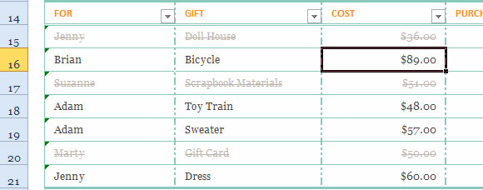
EVOLUTION OF DATA
HOW DO WE GET IT?
The impressive holiday list on EXCEL!
The hand written note from your kids

Slide 7
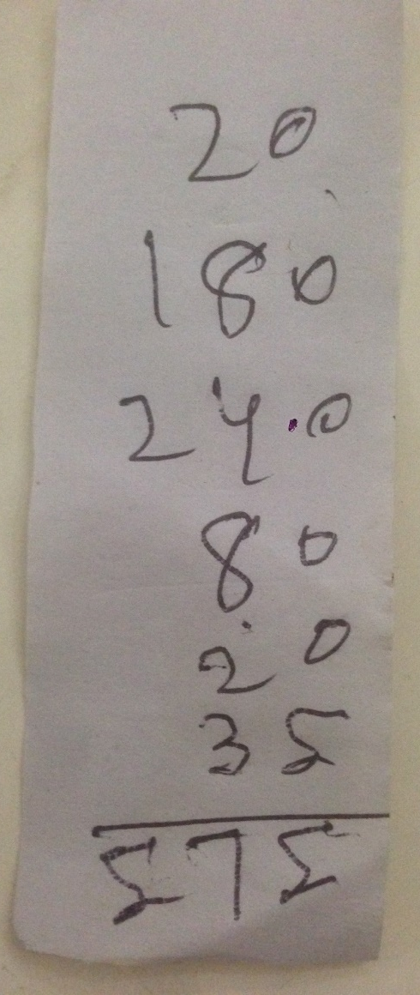
EVOLUTION OF DATA
HOW DO WE GET IT?
IT’S ALL DATA
The impressive spreadsheet…30 days late
The hand written note from your kids travelers

Slide 8
THE PRESENT
THE WORKFLOW FOR CONSISTENT DATA

Slide 9
GATHER THE DATA
WHERE IS IT ALL?
Web
Agencies should work together
Identify a lead
Identify the “master” data
Data comes in all sizes, formats and breakdowns
Existing databases
Multi tab Excel spreadsheets
Text files
Be aware of future data channels
Direct data from vendors
Expense systems
Manual entry
Mobile entry
Flat Files
Future Sources: Mobile uploads
Direct vendor feeds

Slide 10
WHO NEEDS THE DATA?
KNOWING YOUR USE CASES
These needs are the
DATA POINTS
Travel Managers utilize data in different times for various reasons.
Yearly data for reviews with vendors for negotiations
Monthly reporting on usage of booking sources
Real-time for duty of care
Department Managers may need data for specific movements or goal monitoring
Arrival manifests for meetings
Adoption goals
Policy compliance goals
Fiscal Officers – is it a time vs money perspective?
Grant based usage
Account allocation
Lost savings
Travelers could get in on the action with
Gamification options
Expense related inquiries
Travel Managers
Department Managers
Fiscal Officers
Travelers

Slide 11
GETTING GOOD DATA
CONSISTENT INTEGRITY
FLAT FILES
CLOUD BASED DATA
Sources without databases Even data that is in Excel or text files can be sent securely to be mapped and loaded.
Feed cloud based data
Cloud based data can be sent regularly through secure connections into the mapping process.
Mapping & Normalization
ERP SYSTEMS
Travel Management Companies data stored behind firewalls
Most agencies utilize mid-office products designed to push and pull data into reporting tools.

Slide 12
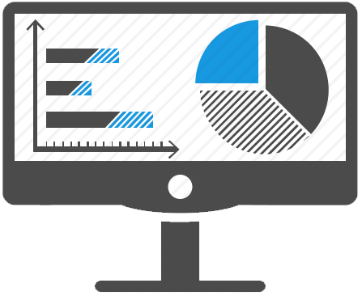
GETTING GOOD DATA
CONSISTENT INTEGRITY
TMC OVERSIGHT and RESPONSIBILITY. Travel Management Companies should be reviewing the data for accuracy and reconciling against mid-office systems on a regular basis. Error reports should be set up to catch anomalies.
Cleanse & error generation
DATA AVAILABLE TO END USERS Division parameters will allow you to still look at data by source as well as the data points determined in the planning stage.

Slide 13
DRAWING CONCLUSIONS
USEFUL INFORMATION
Basic
Intermediate
Advanced
Reporting
The most widely used metrics provide information on what happened in the past
Air O&D markets
Rental Car Cities
Hotel nights
Most common use:
Vendor negotiations and budgeting
Analyzing and Monitoring
Benchmarking used to identify key drivers
Why are we spending more on travel?
Inflation
Changes in the travel industry
Change in preferred partners
Advanced purchase
Most common result:
Adjustment to travel policy
Actioning
Real time data used to make quick decisions
What is happening right now?
World events
Duty of Care / Risk Management
Influence consumer behavior in the future
Most common use:
Mitigation of unforeseen costs

Slide 14
THE FUTURE
WHAT DO WE SEE?

Slide 15
PREPARING FOR THE FUTURE
WHERE DOES THIS TAKE US?
Predictive Analytics: Where Data is Going….
Predictive analytics interpret current and historical facts to forecast the future. While it guides direction, the accuracy depends upon the quality of historical data, model created, and knowledge of past events.
What-if analysis can quickly demonstrate how policy tweaks affect travelers and business units. It can also define who needs assistance implementing changes to ensure high satisfaction levels and avoid talent attrition. Today’s society more effectively consumes data and draws useful conclusions. More importantly, business intelligence tools have become significantly easier to use.
What we are seeing: Consumer data moving to a “Universal Profile”. Logging into Facebook automatically logs the consumer into email, social media, shopping, etc. Applications present consumers with real-time marketing interests based on online interaction. What we might see: Artificial intelligence mining personal devices that alter travel plans due to delays and schedule changes.

Slide 16
THANK YOU FOR YOUR TIME TODAY.
Debbie Gulliver gullive5@ctlr.msu.edu
Laura Bassett lbassett@conlintravel.com
David Heard DavidHeard@anthonytravel.com
Carlie Corbin Charlie.Corbin@statravel.com

