Slide 1

Gayle Stetler, Purdue University
JoE Jacobson, concur
Annual Conference & Tradeshow
Celebrating 26 years of service to the Collegiate Travel Marketplace
Gaining Greater Visibility
Through Travel & Expense Automation
Notes:
Welcome everyone and thanks for attending this session titled “gaining greater visibility through travel and expense automation”
For the next 75 minutes, Gayle Stetler and I will walk you through a journey surrounding by data; because when it comes down to travel and expense, data has the potential to drive smart decisions.
However, I realize the “data to drive smart decisions” is more of less the goal, the end-game and what higher ed institutions (and corporate America for that matter) want to eventually achieve through automation. I also understand that not everyone in this room, or on this stage, has this perfect set of T&E data then can leverage to make smart decisions.
Institutions are at various places in their quest for accurate, easily accessible data. So instead of just focusing on the end game, Gayle and I thought it was apriority to take a wider, more holistic view of this data journey – while obviously keeping the sessions objective at top of mind.
Hope you enjoy it and have lots of easy questions for me, and difficult ones for my colleagues.

Slide 2


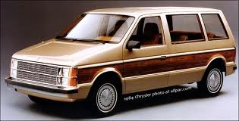



About
Annual Conference & Tradeshow
Celebrating 26 years of service to the Collegiate Travel Marketplace
Notes:
First, I think it is always fun to learn something personal about the person talking to you.

Slide 3
About YOU
Annual Conference & Tradeshow
Celebrating 26 years of service to the Collegiate Travel Marketplace
How would you define your T&E automation?
Fully automated
Some automation
Fully manual
Other
Notes:
Well, enough about me. Let’s learn about you.

Slide 4

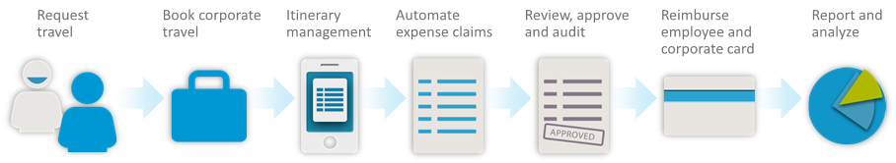
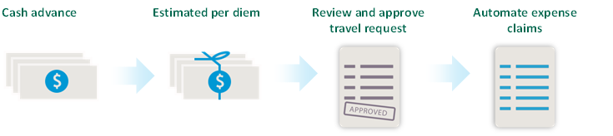
About
Annual Conference & Tradeshow
Celebrating 26 years of service to the Collegiate Travel Marketplace
Notes:
For those who have not heard of Concur, I wanted to share a few slides to describe what we do.
I’m sure many of you in the room are familiar with the following process. Maybe waaay too familiar.
Concur’s mission is to automate this process. From a pre-trip approval request, to travel booking, expense submission and reimbursement to data analysis.
And our goal is to leverage our solution platform to drive the unnecessary costs from this process when done manually or even semi-automated.
<click>
And in terms of Travel Request – which I know is common in Higher Ed, there is a separate automated workflow for that process.

Slide 5
About
Annual Conference & Tradeshow
Celebrating 26 years of service to the Collegiate Travel Marketplace
Data to drive smart decisions
Notes:
If you look at the last icon, that is the end-game and represents a lot of what this session is about.
That last icon is the data - and the data is accessible and accurate and can help drive smart decision making.

Slide 6

About
Annual Conference & Tradeshow
Celebrating 26 years of service to the Collegiate Travel Marketplace
Data to drive smart decisions

Slide 7
About
Annual Conference & Tradeshow
Celebrating 26 years of service to the Collegiate Travel Marketplace
Data to drive smart decisions
Vendor negotiations
Cash expense
Duty of care
Budget/Grant accuracy
Policy compliance
Fraud & misuse reduction
Notes:
So, you might be asking – decisions on what?
Directly from our Higher Ed clients, here are some of the areas they have indicated data us critical for smart decision making.
Cash expense example – rebates.
Policy example. Internet vs. Aircard.

Slide 8
About
Annual Conference & Tradeshow
Celebrating 26 years of service to the Collegiate Travel Marketplace
Data to drive smart decisions
Expense exceptions
300k+ card rebate
50% airport parking discount
2-12% airfare discount
Advanced airfare purchase
Outstanding Expense Reports
Notes:
And here are some specific examples where Concur’s higher ed clients have gained visibility into data and made decisions they had a difficult, if not impossible time doing before.

Slide 9
About
Annual Conference & Tradeshow
Celebrating 26 years of service to the Collegiate Travel Marketplace
Data to drive smart decisions
What data do we need to evaluate an automated system?
What data is needed to get the “data to drive smart decisions”?
What data do we have today?
What data do we want?
What will we do with the data when we get it?
Notes:
Like I discussed in the beginning, your data journey might not be near this point. So, let’s back up and ask a few questions around data.
What data do we need to evaluate an automated system?
What data do we have today?
What data do we want?
What will we do with the data when we get it?

Slide 10
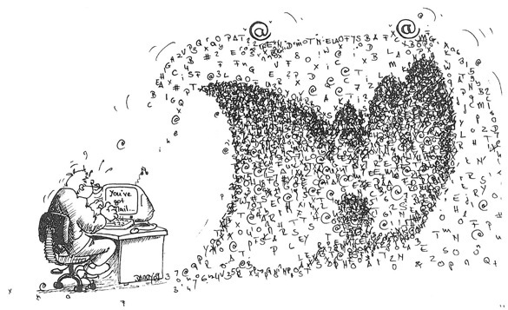
About
Annual Conference & Tradeshow
Celebrating 26 years of service to the Collegiate Travel Marketplace
Data to drive smart decisions
With this influx of data, how do I avoid…
Notes:
And when I get all this wonderful data….how do I avoid this thing?
So, now I want to pass it over to Gayle who is going to walk us through this data journey and then articulate her ideas around gaining visibility and making data-driven decisions.

Slide 11
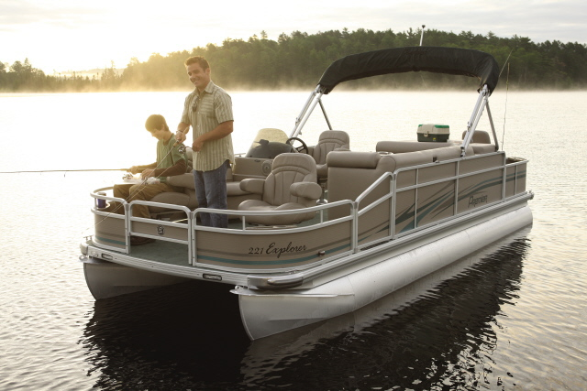



Gayle Stetler
Annual Conference & Tradeshow
Celebrating 26 years of service to the Collegiate Travel Marketplace
Notes:
When Joe contacted me about co-presenting the topic of “Gaining Greater Visibility Through Travel & Expense Automation”, I thought…that’s a great topic, but Purdue isn’t there yet. We certainly know that data analytics and reporting are important to the process, but we just didn’t have any of that data at Purdue yet.
Then we began to discuss where Purdue was in the process of automating the travel process, and how we had gotten to that point. The data gathering project that we went through in building the case for implementing an automated solution was quite extensive. After this discussion, we thought it might make an interesting session to share 1) what data was collected, 2) how that data was used, and 3) what was the outcome?
Today, I am going to share that story, as well as what our ‘dream state’ would be. If I could wave a magic wand to get data, what data would it be?

Slide 12
Annual Conference & Tradeshow
Celebrating 26 years of service to the Collegiate Travel Marketplace
Data to Drive Decisions: The Business Case
Provide visibility into the $30 Million annual travel spend
Automate compliance
Increased Risk Management
Provide spend management reports to department heads and business managers
Notes:
We started with a business case that included many objectives, but some of the objectives that can only be accomplished by automation and data. These objectives were:
Providing visibility into travel spend to the Procurement Strategic Sourcing team. Strategic Sourcing has been a hot topic at Purdue for the last couple of years, and we have never been in a position to strategically source travel services……due to lack of data.
To automate certain compliance checks – According to an Aberdeen Group study, about 20% of T&E spend is out of policy with 1 in 5 expenses in violation. That certainly adds up quickly! We want to know who and how often our rules are being challenged. In a manual, paper based process, this is nearly impossible to determine, without many man hours of data collection.
Increased Risk Management – We want to know where are people are….at any given moment
Provide spend management reports to dept heads and business managers – Prior to automation, this information was collected from the paper travel authorization.
We believe that this set of objectives, and well as many others, will be accomplished by using data.

Slide 13
Annual Conference & Tradeshow
Celebrating 26 years of service to the Collegiate Travel Marketplace
Data to Drive Decisions: Pre automation
Notes:
The first thing we did was created a “Travel Resource Group” of about 30 people to participate in a variety of tasks throughout the project. We engaged the Purdue University Technical Assistance Program to lead the group through LEAN OFFICE training. The major exercise that group performed was to create a value stream map of the current state of travel in order to identify areas that need improvement.

Slide 14
Pre-Automation:
What Data was Collected?
Annual Conference & Tradeshow
Celebrating 26 years of service to the Collegiate Travel Marketplace
Pre-Automation: What Data was collected?
Notes:
Here is where we get to the “What data was collected”. The top 5 pieces of data that influenced our decision on creating the future state were:
1)Multiple copies of the Form 17, or Pre-trip authorization. You can see that in just this piece of the process, it is copied 5 times. We discovered that there were many reasons for all of the copies – but mostly for reference information.
2)We learned that not everyone in the approval process really needs to approve anything. They simply need to be notified that the trip will take place.
3)We learned that the accuracy on expense reports prepared and being sent to the Travel Office for processing is only about 50%!
4)We learned that the longest delay time in the reimbursement process lies within the approval process. Anywhere from 2 to 18 days!
5)We learned that there was redundancy in processes between the Business Office and the Central Travel Office.

Slide 15
Annual Conference & Tradeshow
Celebrating 26 years of service to the Collegiate Travel Marketplace
Pre-Automation: What did we do with this info?
Multiple copies of pre-trip authorization
Asked Why!!
Not everyone in approval process really “approves”
Identification of notification vs. approval
Low accuracy rate coming in for processing
Identification of errors
Long delay times in reimbursement process
Where was delay? Why?
Redundancy in processes
Compared processes across groups
Notes:
What did we do with this information?
Each of the 5 discoveries led us to the conclusion that there was a desperate need for an online system and automation of the process. So we took what we had learned and designed our future state of travel.
1)Asked Why - The reason the pre-trip authorization for was copied so many times was because we had no visibility into travel except that piece of paper. An online system with easy access by travelers and delegates would fix that.
2)We identified all of the areas in the process, and which ones required notification only, and did not need to be part of the ‘approval’ process.
3)We singled out policies that were often the culprit for expense reports being inaccurate when they were submitted for reimbursement
4)We discovered that the delay in reimbursement was due to how many approvers were in the approval chain. We evaluated the need for pre-trip approval AND approval at reimbursement time. If it was approved before the trip, why would we need approval from all of those people again just to pay it.
5)We compared the processes between the business office and the central travel office to reduce

Slide 16
Pre-Automation: What was the outcome?
Multiple copies of pre-trip authorization
Asked Why!!
Online system allowing visibility into Travel data
Not everyone in approval process really “approves”
Identification of notification vs. approval
Eliminated paper forms – Created notifications to all areas formerly in “approval” process
Low accuracy rate coming in for processing
Identification of errors
Built in policy compliance
Long delay times in reimbursement process
Where was delay? Why?
Eliminated approvals, except fiscal
Redundancy in processes
Compared processes across groups
Redefined Business Office tasks vs. Central Office tasks
Notes:
What was the outcome?
The next major task the Travel Commodity Group was challenged with was creating a value stream map of the “to be” travel process. What we ended up with is a new Travel Process supported by a highly integrated, automated system – Concur
1) The system will allow all of those people who were holding onto a piece of paper for information, visibility into travel in their departments in an online system. Data at their fingertips.
2) Eliminated the paper forms – Created notifications to all areas that were formerly in the ‘approval’ process. Reports in Concur were built to user specifications. Depending on the need in the particular area, some are getting those reports burst out to them daily, while others are running their own reports for the information.
3) Built in policy compliance – Many of the errors we found on inaccurate reimbursement requests were simple errors that could be eliminated simply by building rules into the system.
4) Eliminated all approvals, except fiscal. If it was approved before the trip, why would we need approval from all of those people again just to pay it.
Eliminated redundancy by defining Business Offices tasks vs. Central Travel Office tasks.
We were surprised to see that the top 5 issues we found are the reason we had the 3 of the 4 objectives in our business case.
So, all of this led to the design of our future state of travel, utilizing an automated travel system to provide visibility; to automate compliance, increase risk management; and provide spend reports to business areas.

Slide 17
Annual Conference & Tradeshow
Celebrating 26 years of service to the Collegiate Travel Marketplace
Post-Automation: Access to Data!
What previous manual data will now be automated?
Pretty much everything!!
Before:
In-State Travel
Out-of-State Travel
Foreign Travel
Domestic Airfare
Foreign Airfare
Notes:
What have we achieved, Post Automation? Access to Data!
The way our system was set up…..many, many years ago, was to record travel on our general ledger by only a handful of criteria. We didn’t have any real data to drive any type of decisions.
In-State Travel
Out-of-State Travel
Foreign Travel
Domestic Airfare
Foreign Airfare
As a result of our travel process transformation, we now have access to data from two sources. We have access to many standard reports in Concur, as well as the ability to write our own reports; and we have access to over 150 reports from our travel agency.

Slide 18
Annual Conference & Tradeshow
Celebrating 26 years of service to the Collegiate Travel Marketplace
Post-Automation: Data to Drive decisions!
What previous manual data will now be automated?
Pretty much everything!!
Before:
In-State Travel
Out-of-State Travel
Foreign Travel
Domestic Airfare
Foreign Airfare
After:
Sourcing/Vendor negotiations
Preferred vendor usage
Policy compliance
Traveler tracking
Vendor compliance
Spend breakdown by unit
Benchmarking
Reimbursement Days
Notes:
What have we achieved, Post Automation? Access to Data!
The way our system was set up…..many, many years ago, was to record travel on our general ledger by only a handful of criteria. We didn’t have any real data to drive any type of decisions.
In-State Travel
Out-of-State Travel
Foreign Travel
Domestic Airfare
Foreign Airfare
As a result of our travel process transformation, we now have access to data from two sources. We have access to many standard reports in Concur, as well as the ability to write our own reports; and we have access to over 150 reports from our travel agency.

Slide 19
Annual Conference & Tradeshow
Celebrating 26 years of service to the Collegiate Travel Marketplace
Goal | Strategy | Strategic Sourcing/Cost Containment | Control
Objective | Optimization of process and system Policy development and management Benchmarking Forecasting | Supplier management Supplier negotiations | Analyze traveler behavior Utilization of preferred vendors Risk management Policy compliance
Who | Central Travel Office Individual business units Finance | Procurement Central Travel Office | Comptroller Procurement
What Data | Spend breakdown by unit # of days for reimbursement | Report by expense type details “Lost savings” report Vendor compliance report – Booked vs. Actual | Vendor usage report Traveler tracking “Lost savings” report
Notes:
We have three basic goals for the data that we will now be able to extract. For now, we have identified the top 7 pieces of data that will help us achieve the objectives set forth in our business case.
To develop a strategy
Objective: To leverage data to improve policies, processes and programs, to identify policies and procedures that may need to be modified to support optimization, to collect data for benchmarking and forecasting.
Who is expected to use this data?:
What data is available?:
Spend Breakdown by unit
Internal department budgetary compliance
Also allows departments visibility into outstanding travel plans in order to accurately forecast and budget their funds.
Reimbursement Days – How fast is our process now, after the redesign? Before, it took anywhere from 2 to 6 weeks to get through the reimbursement process. Our goal was to reduce that amount of time significantly. Now we can pull this information from the automated system to see if the changes we have made have been effective.
Strategic Sourcing/Cost containment
Objective: Drive down cost by partnering with suppliers, and have the information necessary to successfully negotiate with those suppliers.
Spend by Expense Type - Before automation, we had no way of knowing how much money was spent by expense type, not to mention WHERE that money was spent. But we DO understand that when we know where and how our employees are spending, we can leverage that information to negotiate discounts. We plan to use this data to manage vendor programs, and negotiate discounts with suppliers and vendors. We spend $30M annually on travel services, and until we automated the process, we had never been able to strategically source any travel services……because we had NO data!
Now we will have access to information like:
Hotels cities bookings with hotel chain breakdown, Car rental analysis by vendor, City-pairs w/carrier information,
Lost Savings Report - Our policy states that the lowest logical fare/room rate should be used, and we have built in reminders - but that won’t guarantee people select the lowest reasonable fare. We plan to use a ‘lost savings report’ to identify airfares and hotel rates expensed that exceed available rates at the time of booking. We will likely use that same report when analyzing traveler behavior and policy compliance.
Vendor Compliance
Booked vs. actual expenses. We want to know when there is a discrepancy between what is booked vs. what is actually expensed by the traveler, and request refunds from vendors, if necessary.
Control
Objective: to monitor vendor utilization, policy compliance, and analyze behavior to make sure our policies are effective. And of course, duty of care is of utmost importance to us.
Policy Compliance- Some examples
Advance Purchases– To what extent are our travelers complying with our advance booking policy?
Class of service – how often it business/first class booked?
Traveler tracking
One of the objectives of our process redesign was to improve risk management for our travelers. We plan to use a ‘who is where when’ report to be proactive when our staff are in areas of natural disaster, or other types of disaster, to get them the help they need….whether it is a simple hotel change or complete evacuation.
Reporting of preferred vendor usage (analysis by vendor)
We plan to monitor usage of preferred vendors with reports that provide analysis by vendor. We only had visibility of this as the paper reimbursement came across our desk in the past. Post-automation, we will be able to report on and drill down into data and pinpoint areas that are not using our negotiated rates with preferred vendors.

Slide 20
Annual Conference & Tradeshow
Celebrating 26 years of service to the Collegiate Travel Marketplace
Post-Automation: More data!
Agency Reports:
Top 10 Travelers (History)
Hotel booking analysis by city
Hotel booking analysis by vendor
Car rental analysis by vendor
Class of service report
City pairs
Passengers on a plane
Upcoming travel plans
Advance purchases (hotel, car and air)
Traveler by country
Concur Reports:
Advance air purchases booked average
Air segments by class
Booked by airline
Booked by car rental company
Booked by hotel
Spend trend by expense type
Total airline ancillary fees
Workflow cycle times by manager/processor
Cash advance analysis
Expense type details
Notes:
Magic Wand!! Some examples of the many reports we plan to add to our matrix in the future.

Slide 21
Annual Conference & Tradeshow
Celebrating 26 years of service to the Collegiate Travel Marketplace
Have I avoided this?
Agency Reports:
Top 10 Travelers (History)
Hotel booking analysis by city
Hotel booking analysis by vendor
Car rental analysis by vendor
Class of service report
City pairs
Passengers on a plane
Upcoming travel plans
Advance purchases (hotel, car and air)
Traveler by country
Concur Reports:
Advance air purchases booked average
Air segments by class
Booked by airline
Booked by car rental company
Booked by hotel
Spend trend by expense type
Total airline ancillary fees
Workflow cycle times by manager/processor
Cash advance analysis
Expense type details
Notes:
Magic Wand!! Some examples of the many reports we plan to add to our matrix in the future.

Slide 22
About YOU
Annual Conference & Tradeshow
Celebrating 26 years of service to the Collegiate Travel Marketplace
How would you define your T&E mandate?
  Full mandate
  Soft mandate
  No mandate
  Other
Notes:
Again, more about you.

Slide 23

About
Annual Conference & Tradeshow
Celebrating 26 years of service to the Collegiate Travel Marketplace
= 55%
OUT OF POLICY
LEAKAGE
IS REAL regardless of mandate
Notes:
Research indicates that leakage, regardless of mandate, is a reality.
And leakage causes some issues, specifically with visibility to data.

Slide 24
About
Annual Conference & Tradeshow
Celebrating 26 years of service to the Collegiate Travel Marketplace
  > Institutions lose data visibility & control.
  > Faculty & staff travelers lose service & support.
  > TMCs lose the chance to serve and support customers.
LEAKAGE
AFFECTS EVERYONE
Notes:
Here are just 3 examples where leakage can affect both data but support of travelers.
What Concur is doing is looking at this leakage problem differently than we have in the past.
Instead of fighting it, we are embracing.
And data is driving that embrace. So, not getting into details – the objective is called Open Booking and applies to hotels and car rentals – it is the ability for data to be captured in Concur regardless of where it was booked, providing full visibility into the data.

Slide 25
About
Annual Conference & Tradeshow
Celebrating 26 years of service to the Collegiate Travel Marketplace
  > Developing a solution get and display budget/grant data real-time
  > Monitor spend before it happens
Target date: April 2012
  > Better approval decision making
  > Visibility for approvers and budget/grant owners
Budget & Grant
Visibility
Notes:
Budget management is something we are researching right now, to get budget data directly from your budgeting system and display it in Concur real-time to help approvers make informed decisions as they review travel requests and expense reports.
Further into future – prior to next spring
What is the Solution?
Get Budget data and display it
Help manage all Budgets
Comprehensive Spend Management
Monitor spend before it happens
Real-time data- Pending, Planned,
and Actual
Configurable
Better approval decision-making
Budget Dashboards

Slide 26


Annual Conference & Tradeshow
Celebrating 26 years of service to the Collegiate Travel Marketplace
Notes:
Mobile will be up shortly.

