Slide 1
Charter Travel & Risk Management
A How-To Guide for
Motor Coaches and Charter Air

Slide 2
Panel Speakers
John Anthony President/CEO Anthony Travel
Phil Hanley Safety Compliance Director Trailways Travel
Wenda Singor-Dueck, Director Operations Control, Argus International

Slide 3
Phil Hanley, Speaker
30 years experience with the Federal Department of Transportation, Federal Motor Carrier Safety Administration
Various Field and Headquarters positions
Chief, Passenger Carrier Safety Division
Program Manager, Consolidated Safety Services/ Dynamic
Pupil Transportation Safety Program
Department of Defense Military Bus Program
Defense Travel Management Office
Trailways Transportation, Safety Compliance Director
An Association of 72 motor coach carriers with strict safety prerequisites

Slide 4
Responsibilities of Colleges and Universities
Your responsibilities when using motor carrier transportation services are to:
Protect students, faculty, and staff
Exercise appropriate duty of care
Reduce the risk of fatalities and injuries
Reduce liability for your institution

Slide 5
Types of Vehicles to Consider
Large enough to transport passengers and luggage comfortably
Vehicles used for inter-city travel, tours, or commuter services (36 passengers or more)
School buses (no luggage in the aisles)
15-passenger vans
Safety Caution issued by the National Highway Traffic Safety Administration

Slide 6
Who should be involved in the decision making process?
When selecting a motor coach supplier:
Risk Manager
Legal
Department requesting/requiring the charter transportation
Transportation department
Travel Management Company (TMC)

Slide 7
Liability Risk & Public Policy
Increased liability risk for colleges and universities
April 10, 2014: Ten (10) people were killed and dozens were injured when a tour bus carrying Los Angeles-area high school students crashed in Northern California.
41 states have passed laws preventing colleges and universities from being indemnified for the risk of accidents and 5 more are pursuing laws.
Public Policy is moving to increased due diligence

Slide 8
Due Diligence = Critical
Check references and reputation
Review safety performance and records
Verify insurance requirements
Ask how they qualify, select, and control drivers
Drug and alcohol testing
Hours of service compliance
i.e., limits, relief drivers
Drivers’ qualifications

Slide 9
Documentation & Ratings
Documentation of the motor coach supplier’s:
Safety program
Driver recruitment and vetting program
Vehicular accident prevention program and current accident rate (no higher than 1.5).
CSA/SMS scores could play a large role in the awarding of contracts and/or charter for colleges and universities. Majority of colleges/universities require a cumulative score of less than 100.

Slide 10
What is Compliance, Safety, and Accountability (CSA)?
Federal Motor Coach Safety Administration’s (FMCSA) data-driven safety compliance and enforcement program
Designed to improve safety and prevent commercial motor vehicle (CMV) crashes, fatalities, and injuries
CSA’s Three Core Components:
The Safety Management System (SMS)
Safety Interventions Process
Safety Fitness Determination

Slide 11
What is the Safety Management System?
The Safety Management System (SMS) quantifies the on-road safety performance of carriers to identify candidates for interventions, to determine the specific safety problems exhibited by a carrier, and to monitor whether safety problems are improving or worsening.
SMS is FMCSA’s field workload prioritization tool that:
Calculates safety performance based on seven (7) Behavior Analysis and Safety Improvement Categories (BASICs)
Triggers the Safety Interventions process – i.e., warning letters, investigations

Slide 12
BASICs
BASICs focus on behaviors linked to crash risk:
Unsafe Driving
Hours-of-Service Compliance
Driver Fitness
Controlled Substances/Alcohol
Vehicle Maintenance
Hazardous Materials
Crash Indicator

Slide 13
More CSA/SMS Information
For more information about CSA/SMS, visit:
http://csa.fmcsa.dot.gov
http://ai.fmcsa.dot.gov/sms/
http://bitly.com/SaferBus
www.fmcsa.dot.gov/

Slide 14
CSA/SMS Website Tips
Must have the carrier’s DOT number to navigate these websites.
While FMCSA and third parties are monitoring the passenger carrier industry, supplement this data with your own research. CSA/SMS data may not always accurately reflect actual crash risk of a motor carrier.
If you fail to do your due diligence, be sure you have an excellent crisis action plan in place!

Slide 15
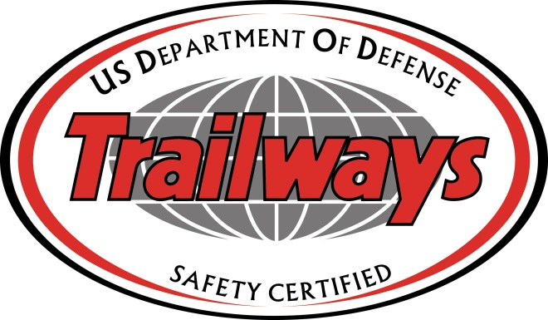
Other Sources of Information:
Defense Travel Management Office, The DoD Center for Travel Excellence:
http://www.defensetravel.dod.mil/site/bus.cfm
Trailways’ carriers must have a DOT
Satisfactory Rating and a DoD Rating
of a one (1) or a two (2);there are
five (5) possible ratings:
http://www.trailways.com/team-trailways/motorcoach-listing-companies/country-state

Slide 16
“There are old pilots,
and there are bold pilots,
but there are no
old, bold pilots.”

Slide 17
Aviation Safety
All must have a safety mentality above all else
Eliminate/reduce risk of fatalities
Do not cut corners
Do not be a “cowboy”
Examples of traveling despite risks (i.e., weather, mechanical) where issues could have been avoided

Slide 18
Charter Safety Services
What you do and why you do it
What that means to colleges and universities
Why it’s important
Operators
What types are there?
What’s the difference?

Slide 19
Audits & Ratings
Certain criteria of safety
Different categories
Ratings
How you choose pilots, fuel, etc.
Corrective measures for poor ratings

Slide 20
Planning
Lead-time for entering agreement
Timeline for services
Players – Who should be involved form the college/university?

Slide 21
Thank you!
QUESTIONS?

