Slide 1


Change and Resistance:
Effective Ways to Lead Change and Work with Resistance
Presented by Sherry Steinaway
September 29, 2014

Slide 2

Leading Change
Establish a Sense of Urgency
Form a Powerful Guiding Coalition
Create a Vision
Communicate the Vision
Empower Others to Act on the Vision
Plan for and Create Short-Term Wins
Consolidate Improvements and Produce Still More Change
Institutionalize New Approaches
John P. Kotter, Leading Change

Slide 3
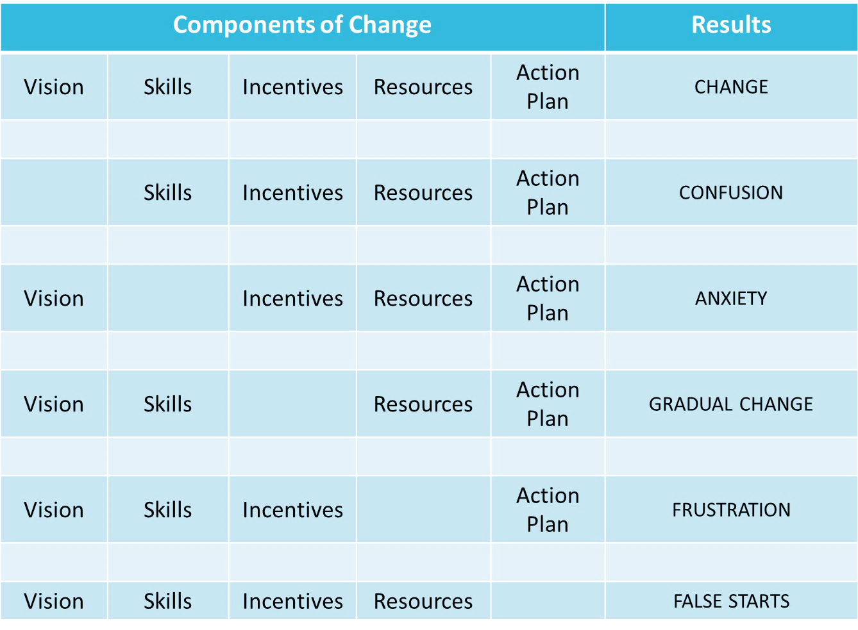
Components of Change

Slide 4
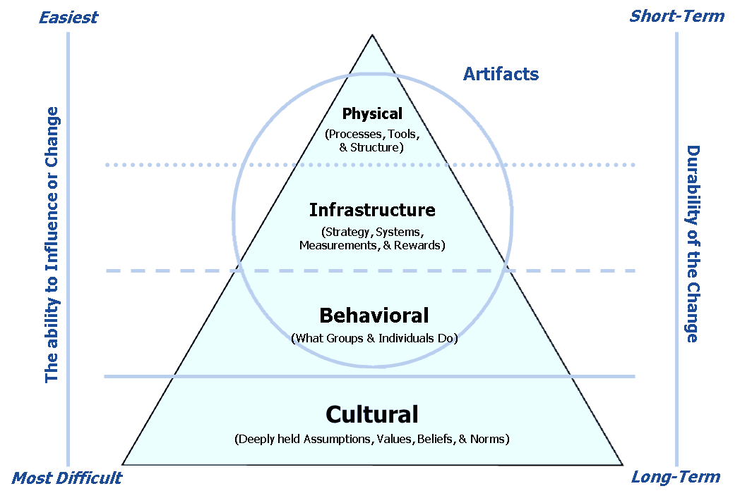
Organizational Levels & Change
Adapted from Helping You Build and Sustain a Great Organization! Russell Consulting, Inc.

Slide 5
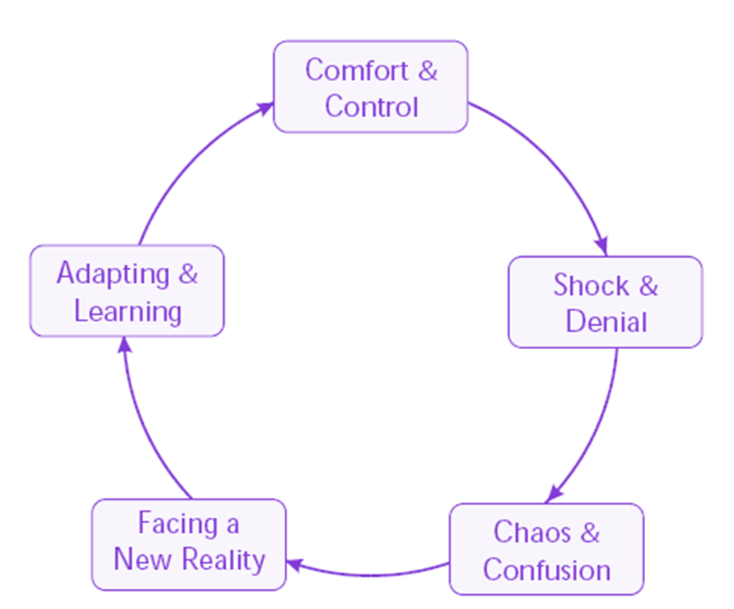
Cycles of Change
- Dan Oestreich

Slide 6
Change vs. Transition
Change
Transition
Disruption in expectations
External event
Related to circumstances & situation
Psychological reorientation to the change event
Internal process
Related to state of mind, sense of identity

Slide 7

Transition: The Three Phases
Ending
Neutral Zone
Beginning
Phase 1: Ending: … letting go of the old ways.
Phase 2: Neutral Zone: … limbo between old sense of identity and the new.
Phase 3: Beginning: … develop new identity, experience new energy, discover new sense of purpose.

Slide 8
Types of Change
Normative Change: The normal, everyday changes that everyone faces.
Non-normative Change:
Unexpected change often referred to as a crisis.
From Change: Loss, Opportunity, and Resilience, Professor Sharon Danes, University of Minnesota, 2005

Slide 9
Reactions to Change
NEW BEGINNING
Excitement
Endings
Energy
Denial
Hope
Anger
Impatience
Anxiety
Sadness
Acceptance
Frustration
Skepticism
Disorientation
Creativity
Depression

Slide 10
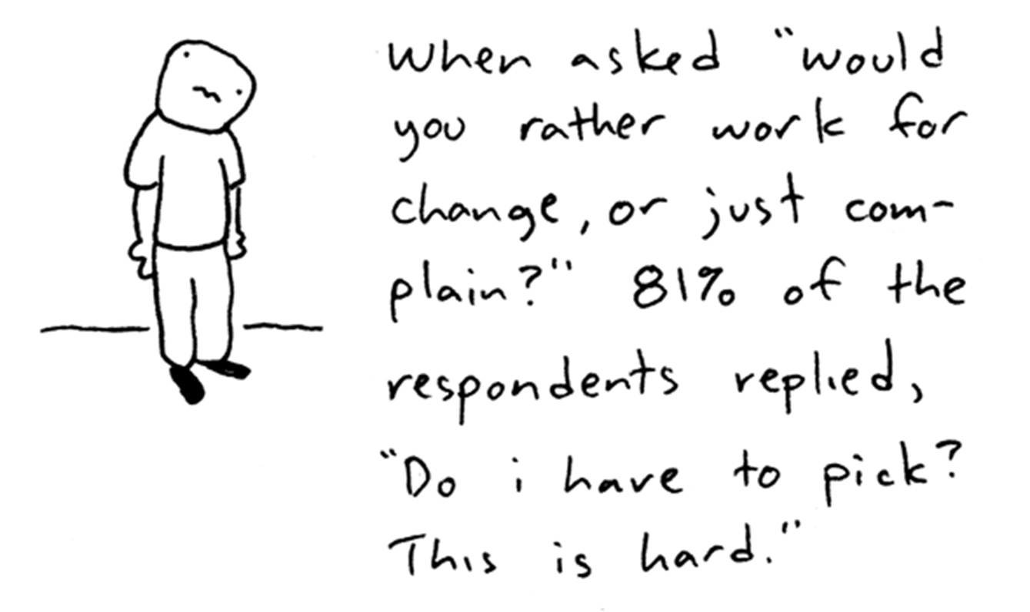
Expect Resistance

Slide 11
Human Nature
People want to maintain control over their lives
We develop self-confidence and psychological health by building stable and effective relationships with others
Our sense of control, comfort, and well-being results from the degree of certainty we have about our life and our future
Change disrupts our ability to predict what’s in store for us. The more a change disrupts our ability to envision our future, the greater our confusion, fear, anxiety, and self-doubt
Adapted from Helping You Build and Sustain a Great Organization!, Russell Consulting, Inc.

Slide 12
Origins of Resistance
Some people fear loss.
Some people mistrust those who lead.
Some people disagree on the change.
Some people don’t tolerate change well.

Slide 13
The PERCEIVED Losses
Job security
Psychological comfort and security
Control over one’s future
Purpose/meaning
Competence
Social connections & status
Territory
Power
Future opportunities
Trust in others
Independence and autonomy
Adapted from Leading Change, Jeffrey & Linda Russell

Slide 14
Engaging Resistance
Successful approaches to engaging resistance from Most to Least effective:
Including others in planning
Listening to resisters
Coalition building
Presenting counterarguments
Deal making
Reasoning with resisters
Building relationships
Rewarding constructive actions
Working towards consensus
Hiring supportive individuals
Encouraging resisters to leave
Engaging Resistance: How Ordinary People Successfully Champion Change, Anderson, A.D. 2011

Slide 15
Engaging Resistance
Including Others in Planning
Spend time creating a change management plan
Determine how others (staff, stakeholders) will be included in the process
Develop and disseminate the change strategy and process
Create a communication plan and determine formal and informal leaders to involve as messengers

Slide 16
Engaging Resistance
Listen to Resisters
Hold formal and informal meetings
Create feedback systems for staff and stakeholders
Listen to understand
Listen for identified obstacles
Listen until it hurts

Slide 17
Engaging Resistance
Coalition … a definition
A coalition is a temporary alliance or partnering of groups in order to achieve a common purpose or to engage in joint activity.
Douglas H. Yarn, The Dictionary of Conflict Resolution. (San Francisco: Jossey-Bass Publishers, 1991), 81

Slide 18
Engaging Resistance
Coalition Building
Identify and involve early adopters open to collaboration
Engage people early to build goals that are similar and compatible
Clarify expectations and appreciate others’ agendas
Anticipate obstacles and conflicts
Focus on interests, not positions

Slide 19
Resilience Defined
For normative change: Continued ability to view change as opportunity; ability to manage at the speed of change.
For non-normative change: Ability to bounce back from the consequences of unexpected change.
From Change: Loss, Opportunity, and Resilience, Professor Sharon Danes, University of Minnesota, 2005

Slide 20
Why Resilience at Work?
Changing requirements in Higher Education and technology
Unfunded mandates
Multiple changes occurring frequently and simultaneously
Pressures to do more with less
Work/Life balance OUT of balance
Workplace diversity; with diversity comes differences which can lead to conflict
Increasing pressure to achieve higher levels of performance
Uncertainty about the future
Adapted from Helping You Build & Sustain a Great Organization!, Russell Consulting, Inc.

Slide 21
Dimensions of Resilience
Self-assurance
view life as challenging; filled with opportunities
Clarity of vision
stick to a goal; obstacles are given appropriate attention
Flexible
manage ambiguity; set priorities be prepared to negotiate
Organizational skills
open to different options when faced with uncertainty
Problem-solving skills
see problems as challenges and opportunities
Interpersonal competence
communicate effectively with others
Social connections
draw lessons from experiences; creatively reframe change situations
Proactive
share ideas, opportunities, and solutions with others
From Change: Loss, Opportunity, and Resilience, Professor Sharon Danes, University of Minnesota, 2005

Slide 22
Strengthening Resilience
Remind people what isn’t changing
Increase opportunities for social connections
Increase communication about the coming changes/challenges
Shift grousing/whining toward problem solving
Listen to people’s anxieties and fears
Acknowledge their losses
Engage staff in developing a shared vision of a realistically optimistic future
Explain the “whys” of the change/challenge
Break problems/challenges into bite-size pieces
Model good practices and behaviors
Encourage good work/life balance
Adapted from Leading Change Training, ASTD Press

Slide 23
Thank you for your time and interest!
Sherry Steinaway
University of Washington
Associate Director, RAPID
Email: sherry@uw.edu

