Slide 1

Challenges and Opportunities around Change Management
Mike Kingery, Arizona State University
Paul VanDieren, University of Notre Dame
Mary Gallagher, Huron Consulting Group
Society of Collegiate Travel and Expense Management
September 28, 2015

Slide 2
Topics
Fundamentals of change management
How Arizona State University used these fundamentals during the planning and implementation of their Concur T&E solution
How Notre Dame use these fundamentals to address ongoing improvements of their Concur T&E solution
Q&A

Slide 3
Huron Education
Higher Education Procurement Practice
Our Procurement Solutions team has completed over 200 procurement-related projects, including Travel & Expense, with more than 100 leading public and private universities.
Travel & Expense Management
Travel program assessment
and improvement
Technology and TMC selection, planning and implementation
Optimization
Change management/ business process transformation
Procurement/ Payables
Transformation
Source to settle operational assessment and improvement
Organizational redesign and development
Technology selection, planning, implementation and optimization
Program and change management
Spend Analysis and
Strategic Sourcing
Spend analytics
Category expertise
Sourcing strategy advisory
Bid event and negotiation support
Knowledge transfer and training

Slide 4
Change Management
The challenges of conducting change within higher education
No mandates!
The faculty need to see the benefits in order to change.
Don’t change how we do things.
My job is already complicated and T&E is only a small percent of what I do in my job.

Slide 5
Addressing Change
Change at an individual level
Individuals must complete each step of the change progression
Messages should include why the change and why change now
Messages should be tailored for each audience, such as faculty, travel administrators, and leadership
Address benefits and anticipated resistance
Awareness
Desire
Knowledge
Ability
Reinforcement
Why?
Why now?
Motivate
Drivers
Skills needed
Behaviors required
To do my job
No barriers
What will make it stick?
Metrics
Consequences
Notes:
An individual’s resistance is a result of “lack of desire”
When someone says “I can’t do my job” – they lack knowledge and/or ability

Slide 6
Addressing Change
Execute at an organizational level
Preparing for Change
Strategy
Managing Change
Configure balanced solution
Audit compliance
Educate team
Establish stakeholders
Communicate and train
Establish plan
Reinforcing Change
Manage resistance
Analyze feedback
Implement improvements
Notes:
Preparing for Change:
Conduct readiness assessments
Identify anticipated resistance
Document strategy
Architect team structure and prepare the team
Develop sponsorship model and prepare sponsors
Managing Change
Create communication plan
Create sponsor roadmap
Create training plan
Create resistance management plan
Integrate plans into the overall project plan
Execute plans
Reinforcing Change
Collect feedback
Audit compliance
Identify and address gaps
Identify and address resistance and pockets of resistance
Celebrate successes
Transition to business as usual

Slide 7
Addressing Change
Combined organization and individual steps
Preparing for Change
Strategy
Managing Change
Configure balanced solution
Audit compliance
Educate team
Establish stakeholders
Communicate and train
Establish plan
Reinforcing Change
Manage resistance
Analyze feedback
Implement improvements
Awareness
Desire
Knowledge
Ability
Reinforcement
Why?
Why now?
Motivate
Drivers
Skills needed
Behaviors required
To do my job
No barriers
What will make it stick?
Metrics
Consequences
Efforts are executed at an organization level; however, change happens at an individual level

Slide 8
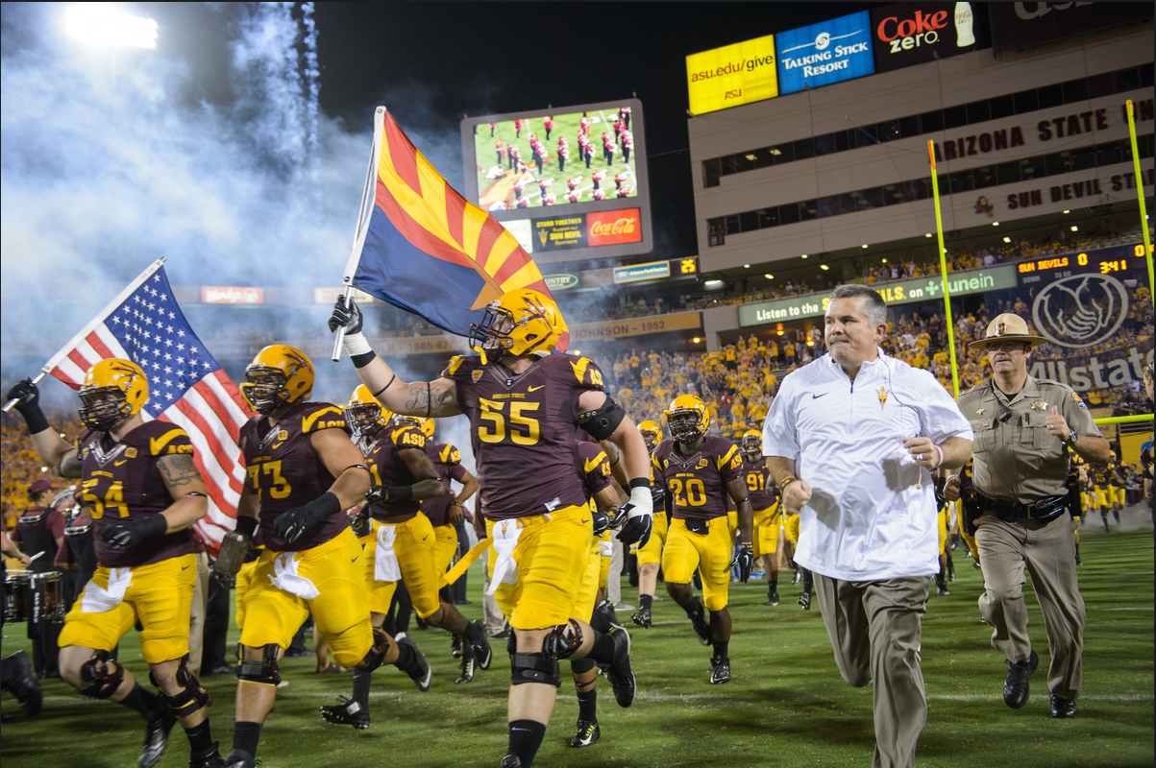

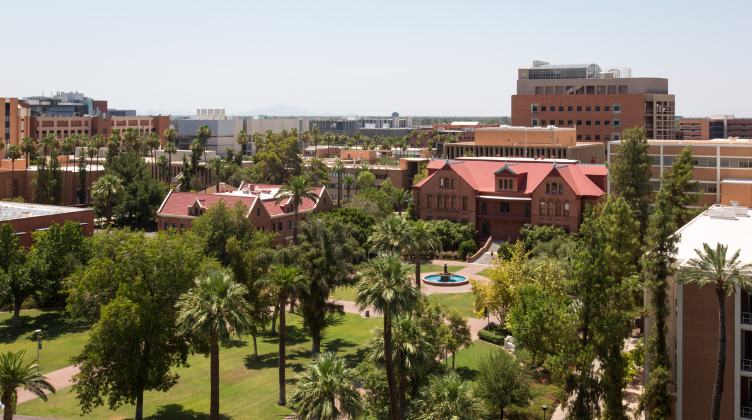

Arizona State University

Slide 9
Arizona State University
Facts and figures
ASU facts:
  6 campuses
  Largest enrollment of any US university
  14,000 faculty/staff (no medical school) and 85,000+ students
Travel facts:
  20,000 claims and $28 million in spend per year; about 1/5 of spend is Athletics
  Over 7,000 individual travelers
  14% of claims are international travel, comprising 22% of spend
  50% new or infrequent travelers (1 or less trips per year) but less than a fifth of ASU’s total trips

Slide 10
Our Project Goals
For “My ASU Trip”
A duty of care program to assist faculty, staff, and student travelers in case of emergencies
End-to-end integrated travel request, booking, and expense management
An environmentally sustainable, paperless system with carbon footprint reporting capabilities
A travel card program that will interface trip expenses into the expense report
Consolidated and detailed travel information, allowing ASU to negotiate vendor discounts and/or enhanced services

Slide 11
Travel and Expense Program Assessment
Project approach and timeline
Jul ‘14 | Aug ‘14 | Sep ‘14 | Oct ‘14 | Nov ‘14 | Dec ‘14 | Jan ‘15 | Feb ‘15 | Mar ‘15 | Apr ‘15 | May ‘15 | Jun ‘15 | Jul ‘15
Plan
Configuration and testing
Develop training and communications materials
Pilot
Continue training and enhance communications materials
Travel Advisory Group Meetings
Town halls
Pilot
Go Live
We completed our business process transformation and implementation within a 12-month period
The month-long investment of upfront planning helped the implementation go smoothly
Travel Advisory Group meetings were valuable for early input into our design
We had no shortage of volunteers to be pilot users; in fact, we had to limit it
Pilot users were happy to participate and gave excellent feedback on travel card, booking, and workflow

Slide 12
Massive Cultural Change
Change Management was going to be a HUGE part of our implementation
Before Change:
After Change:
New automated solution
New travel management company (TMC)
New travel card program (one did not exist before)
Departments would be responsible for approving exceptions and policy compliance
Faculty would feel the changes, as the automated system enforced compliance
Paper and home-grown limited online system – it was not sustainable!
Departments across University relied on the Travel Team to enforce the policy
AZ statute that travel must be authorized prior to booking – was our policy for decades but could not enforce

Slide 13
Preparing for Change
Build the team and define the future state processes
Conducted Pre-implementation Planning session with Huron Consulting to ensure we refined our processes
  Interviewed finance and campus users, including faculty/Provost Office
  Defined business processes based on new features and best practices
  Changed TMC strategy
  Finalized card strategy
  Identified potential resistance points to address as part of the change management plan
Defined extended project team and obtained alignment throughout the project
  ASU project team
  Concur project team
  Huron assistance
  Travel Advisory Group
  Steering Committee

Slide 14
Preparing for Change
Define your change management strategy
Activities to address Awareness and Desire
  Provide weekly tidbits to engage campus users and generate excitement
  Conduct a widespread set of Town Halls, close to go-live, to explain what, benefits to them, when, and how to get trained
Activities to address Knowledge and Ability
  Create online documentation for all types of learning
  Reinforce the theme that Travel will have three distinct steps:
    Request, Travel, Expense
  Develop training sessions to meet multiple audiences
    Open campus training sessions
    Hands-on training - primarily for travel administrators
    Faculty-specific training within departments
Activities to address Reinforcement
  Address known resistance, such as “I can find an airfare cheaper elsewhere”
  Establish a Travel Service Center

Slide 15
Preparing for Change
Develop your sponsorship model
Travel Advisory Group
  Comprised of key travel personnel from across university
    Included Chief Fiscal Administrator from the Office of the Provost, Dean of Students, Study Abroad, Athletics, and representatives from each college
  Met regularly throughout the project timeline
    Told us what they wanted/needed in a travel system
    Vetted changes and reviewed their feedback
      Implementation team tried to streamline things (approvals, encumbrances) that TAG refused
      Easing policy limitations
    TAG members appreciated their involvement; want same for new ERP
Received valuable feedback from other universities and Huron during Plan and Implementation phases

Slide 16
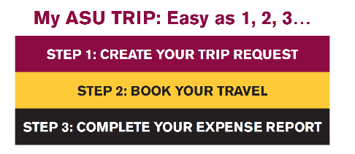
Managing Change
Executed upon our strategy
Produced a wealth of documentation as part of our weekly updates
    How-to guides, video walkthroughs
    A person could be fairly trained if they read our weekly updates throughout the project
Supplemented with other key documents and information
    Business cards with contact info, quick reference guides, online travel card app
Impressed upon users that ASU travel is a 3-step process
    Request, Travel, Expense
Travel Service Center was formed
    Same travel team
    Help desk – formal call-in and resolution process
    Trainers – holding monthly training sessions
Ensured proper reporting for negotiations and overall program health
    Financial Services, Purchasing, and Sustainability

Slide 17
Managing Change
Executed upon our strategy
Activity | # held | Volume
Town Halls, across 5 of the 6 campuses | 25+ | 1200 + attendees
Department-specific training sessions | 35+ | 1400+ attendees
Help desk calls to Travel Service Center | daily | 100+ emails/calls
Despite all efforts, overall users are not utilizing online resources we’ve provided; 90% of their questions are covered in our materials
Plan on sending out infrequent traveler reminders once up and running
Our goal is that 1 year from now - everyone will say ...
“why didn’t we do this sooner?”

Slide 18
Early Results
Trending positive in month 3
Our new TMC has been incredible
Issued over 1,500 new travel cards within 3 months
To date (since July 1) in the new system , we have:
  5,500 approved requests
  3,700 airfares booked
  2,500 approved/paid expense reports
Number of complaints is dropping, acceptance growing

Slide 19
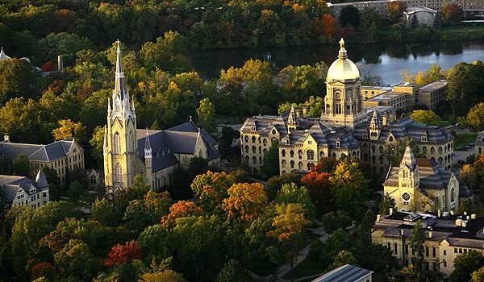
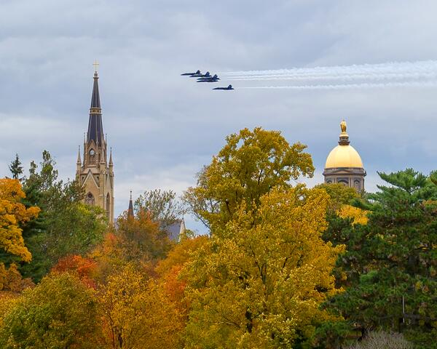
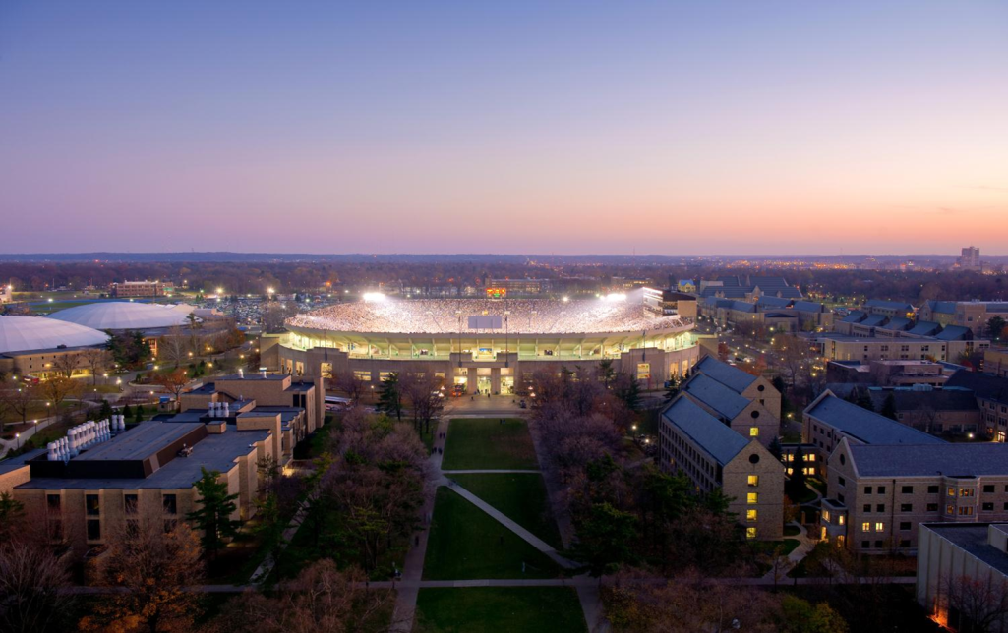


University of Notre Dame

Slide 20

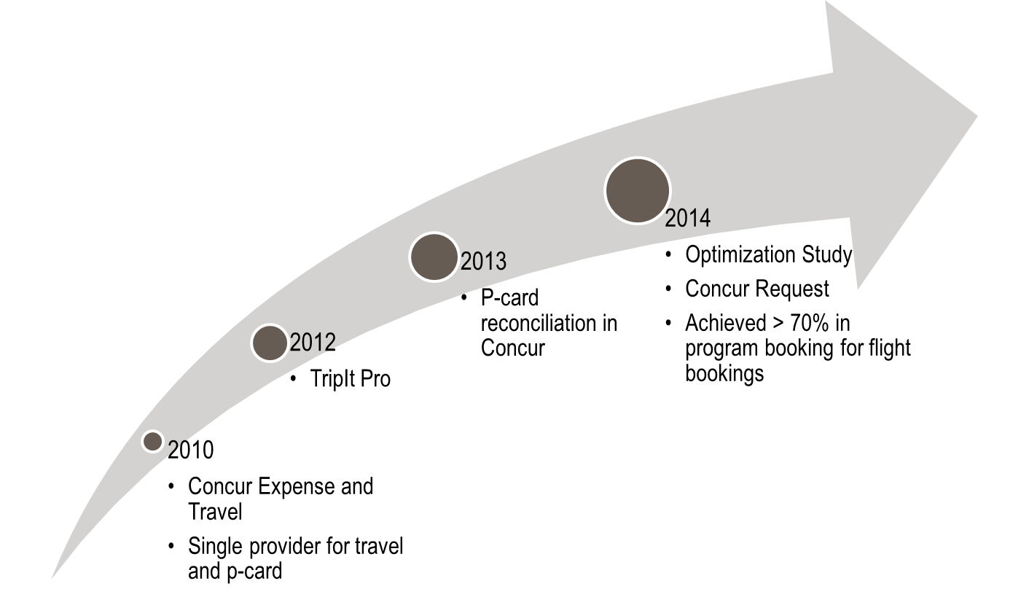
ND’s Travel & Expense Program
Background information
12,000 students; 4,000 FT employees
42k expense reports; $35-$40M annual T&E spend
Approx. 55% infrequent travelers (< 2 per year)
Notes:
Travel is a complex area; very personal in nature

Slide 21
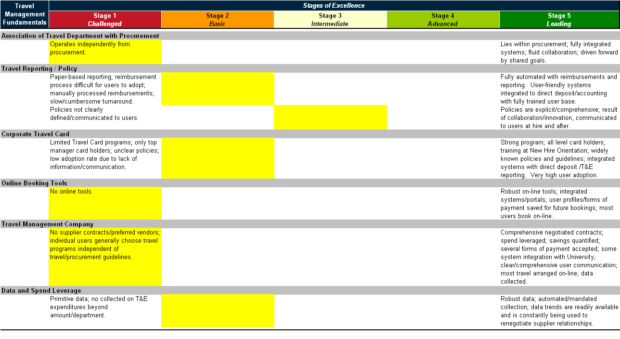
Initial Assessment of ND’s Travel Program
Notre Dame
Majority of Universities
2008 ratings

Slide 22
After a few years on managed travel . . .

Slide 23
Notre Dame Travel Program
Achievements; 2010 - 2014
100% Automation
Paperless T&E environment
Process visibility – individuals know where their reimbursement is within the approval flow
Faster reimbursement – from 4-11 days to 1-3 days
Less returns and follow up – from approximately 25% to < 5%
Detailed expense reporting available
Improved contracts / discounts
Negotiated campus-wide card program plus discounts for airfare, rental car, charter buses, charter flights, and local hotels – annual benefit of $1.1M
Formalized TMC contract with one provider
Other improvements
Implemented Concur p-card reconciliation to address compliance concerns
Achieved some advances in travel reporting

Slide 24
But, opportunities still exist . . .

Slide 25
Notre Dame Travel Program
Optimization 2014 assessment
Notre Dame Optimization Study (2014)
In the chart below, Notre Dame’s current state is depicted with a icon.

Slide 26
Stages of Excellence in Travel Management
Huron’s assessment from 2008 and revised 2014 assessment
2008 ratings
Majority of Universities
Leading Universities
2014 ratings

Slide 27
New Opportunities
Increase “In Program” bookings
Increase “In Program” Bookings; could result in:
    $200k Increased Card Rebate
    $300k Traveler Discounts
  Additional improvements in compliance through consistent purchasing channels
  Implementation of a comprehensive Duty of Care program

Slide 28
Change Management Tactics

Slide 29

Noted Keys to Past Success
Change management activities
Obtain executive level support
Focus on traveler/user satisfaction; not just the $$$
Provide support for end user
Communicate, Communicate, Communicate
  Travel Advisory Group
  Business Managers
  Super Users
Mandate where feasible
Conduct vendor management

Slide 30
#1) Market the Program
Tell people what the program did for them
As a result of the travelND program implemented in 2010, we’ve been able to achieve the following:
Achieve in-program (Concur booking tool plus TMC) air bookings adoption of > 70%
Negotiate campus-wide discount programs for airfare (Delta and United), rental car (National/Enterprise), charter buses, charter flights, and local hotels
  Cumulative savings of > $2 million over last 3 fiscal years
Implement a card program (Chase) generating rebates of > $800k over last 3 years
Convert paper expense report process to 100% electronic
  Reduce A/P’s follow up with submitters/approvers from approx. 25% to < 5%
  Increase process visibility – submitters know where their reimbursement is in approval flow
  Realize faster reimbursements – from average of 4-11 days to 1-3 days
  Achieve detailed expense reporting at campus, department, and individual traveler levels

Slide 31
#2) Tactics to Consider
Continue using change management fundamentals after implementation
Awareness and Desire
  Further influence behavior (promotions, communications, non compliance reporting to campus leadership, etc.)
  Modify policy and solution to disincentive non-desired behavior
  Push out information when possible; “give it to me when I need it, not when it’s convenient for you”
Knowledge and Ability
  Develop and offer program training and technical training (Mobile App, TripIt Pro, Receipt Store, etc.)
  Work with Concur toward Higher Ed specific considerations and enhancements
Reinforcement
  Conduct campus-wide survey to understand current challenges and campus tone
  Reach out to heavy user and problematic departments
  Refine solution

Slide 32
#3) Keep Leadership Informed
Status of our program improvements - Dashboard
travelND Category | Status | Comments
Travel Resources |  | Travel Procurement Specialist hired Help Desk Coordinator not yet hired Search for Training Resources
Travel Sourcing |  | Delta Starwood, Wyndham, Var. London, Dublin & local props National/Enterprise, Park/Ride/Fly, Zip Car
Anthony Travel |  | 5 Year Master Agreement Includes Athletics & Investments agreements
Travel Systems |  | Some known issues; Travel Team continues to address
Travel Card |  | 100% conversion from AMEX to Chase Visa
Notes:
Anthony Travel
5 year Master Agreement
Basic bookings and traveler support; no cost to dept
Investments & Athletics included (at pre-negotiated rates)
Additional services (at proposed rates)
International Studies & Special Events outside of contract
5 year LaFortune lease
At FMV
Tied to Master Agreement

Slide 33
#4) Consider Your Infrequent Travelers
They represent your largest volume of travelers
Huron’s analysis of higher education institutions indicates that approximately 50-70% of travelers are infrequent travelers, which is further compounded by an ongoing influx of new employees.
When you have trained a traveler, if they cannot apply it immediately, they will quickly forget the nuances that were trained.
Infrequent traveler is defined as a traveler that has not
traveled within the past 12 months.

Slide 34
Push Information When It’s Needed Most
Infrequent traveler communications when they are traveling
Create a three-part email process (using Concur Intelligence – report scheduling feature) with links to your educational guidance that pushes information to infrequent travelers – when they start their travels.
  Preparing for your trip
    Trigger is based on approved travel request or booked itinerary
    Send email with webpage link that highlights what they should do to prepare for their trip.
  Know before you go
    Trigger is five (5) days prior to the trip start date
    Send email with webpage link that highlights what they need to know during their travels
  Things to know to prepare an expense report
    Trigger is the last day of their trip
    Send email with webpage including step-by-step guidance on preparing an expense report.

Slide 35
Change Management Observations
It was a combination of things that worked for ND
Stair-step approach
Persuasion rather than force (honey vs vinegar)
Combine changes that may be perceived as negative with positives when possible
Lead by example and evidence - or you'll not change people
The need for tolerance and patience; keep eye on LT prize
Time softens impacts - people will get used to the change
Accept that no single change is likely to please everyone - everyone wants something different
Notes:
Enforced change - might is right

Slide 36
ND’s Optimization as Change Management Example

Slide 37
Reduce Bookings Outside of Managed Program
Possible Approaches
“Heavy handed” Approach
  Mandating travel (like Concur Expense); blame “duty of care”
“Middle of the Road” Approach
  Create “hoops” for those seeking reimbursement but not utilizing managed travel programs
“Lighter touch” Approach
  Reporting non complying departments to Exec Leadership
Recommendation: Chose the “Middle of the Road” Approach
More tolerant & patient than a mandate, but still moves the needle

Slide 38
New Opportunities
Increase efficiencies around receipt management
Current University policy requires receipts for non meal items over $25 and all meals
Analysis shows that 81% of annual expense report transactions other than air, lodging and car rentals were under $75 but represented only 25% of total spend
Recommendation: Establish new receipt threshold. No receipt required for expenses under $75 if using Notre Dame’s Travel Card.
A popular decision; combined with recommendation that may be perceived as less popular

Slide 39
New Opportunities
Implement a Duty of Care Program
Need consistent plan for locating and communicating with students traveling, both domestically and internationally.
Need comprehensive duty of care/risk management program in place for all ND travelers. University is vulnerable in the event of an in-travel emergency requiring assistance from the University.
Desire two-way communication mechanism.
Recommendation: Establish duty of care program for undergrad students traveling internationally first; eventually all travelers
Stair-stepped approach, marketing – not always about the $$$

Slide 40
Questions and Answers

