Slide 1

Annual Conference & Tradeshow
Celebrating 26 years of service to the Collegiate Travel Marketplace
Ch-ch-changes
Tips for Successfully
Navigating Change
Sandy Hicks, CPPB
Assistant Vice President & Chief Procurement Officer
University of Colorado

Slide 2
Annual Conference & Tradeshow
Celebrating 26 years of service to the Collegiate Travel Marketplace
“Change is inevitable – except from a vending machine.”
~ Robert C. Gallagher

Slide 3


Annual Conference & Tradeshow
Celebrating 26 years of service to the Collegiate Travel Marketplace

Slide 4

Annual Conference & Tradeshow
Celebrating 26 years of service to the Collegiate Travel Marketplace

Slide 5
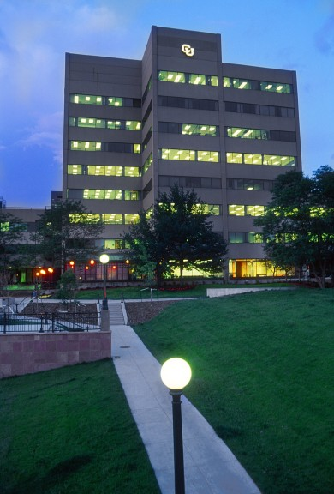
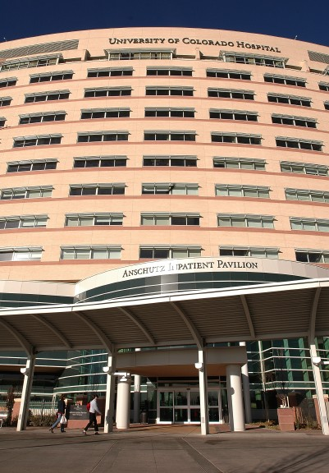
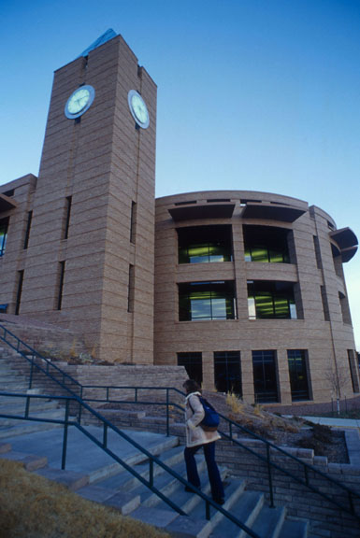
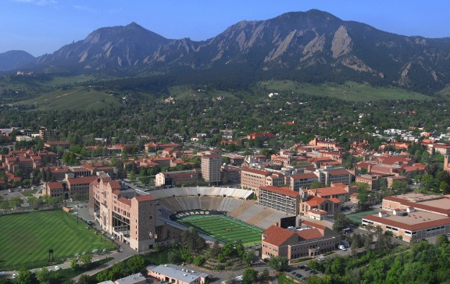
University of Colorado
Annual Conference & Tradeshow
Celebrating 26 years of service to the Collegiate Travel Marketplace
Denver campus
Anschutz Medical
campus
Colorado Springs campus
Boulder campus

Slide 6
Procurement Service Center
Annual Conference & Tradeshow
Celebrating 26 years of service to the Collegiate Travel Marketplace
Strategic Goals:
Streamline the procure-to-pay process
Lead in the use of technology
Enhance services provided to our customers

Slide 7
Changes
Annual Conference & Tradeshow
Celebrating 26 years of service to the Collegiate Travel Marketplace
1. April 2009 Concur Expense System
2. Aug 2010 Moved Offices
3. Dec 2010 Revised P-Card Program
4. Jan 2011 Changes to Procurement Rules
5. April 2011 New Travel Program
6. June 2011 Revised Travel Card Program
7. July 2011 Revised Fiscal Procedures
8. Aug 2011 eProcurement Platform

Slide 8
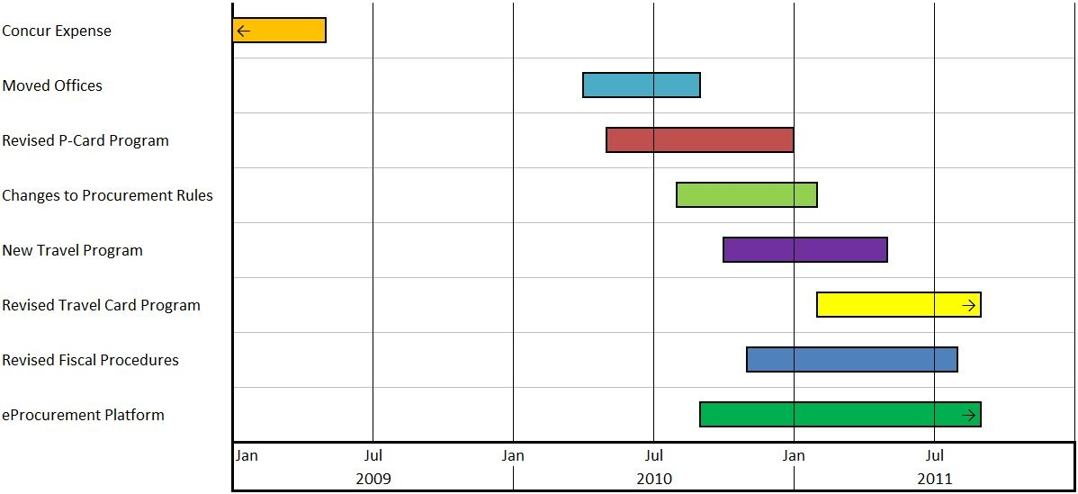
Changes
Annual Conference & Tradeshow
Celebrating 26 years of service to the Collegiate Travel Marketplace

Slide 9


Change Is Hard
Annual Conference & Tradeshow
Celebrating 26 years of service to the Collegiate Travel Marketplace
“Faced with the choice between changing one’s mind and proving there is no need to do so, almost everyone gets busy on the proof.”
~ John Kenneth Galbraith

Slide 10
Change Destroyers
Annual Conference & Tradeshow
Celebrating 26 years of service to the Collegiate Travel Marketplace
People leading the change think that announcing change is the same as integrating change
People’s concerns with change do not surface or are not addressed
People being asked to implement change are not involved in the planning
Source: Kenneth Blanchard

Slide 11
Change Enablers
Annual Conference & Tradeshow
Celebrating 26 years of service to the Collegiate Travel Marketplace
Vision
Communication
Management Support and Sponsor
Communication
Understanding of Workplace Culture
Communication

Slide 12
Change Enablers
Annual Conference & Tradeshow
Celebrating 26 years of service to the Collegiate Travel Marketplace
Commitment
Communication
Plan
Communication
Training
Communication
Flexibility
    Communication

Slide 13

Leadership Team
Annual Conference & Tradeshow
Celebrating 26 years of service to the Collegiate Travel Marketplace

Slide 14
Lessons Learned
Annual Conference & Tradeshow
Celebrating 26 years of service to the Collegiate Travel Marketplace
Vision Statement
Present a clear picture of the change and reasons why, including benefits of change
Have your elevator speech ready
Vastly improved reporting
Time saver
Greater efficiencies
Excellent ROI
Cost savings

Slide 15
Lessons Learned
Annual Conference & Tradeshow
Celebrating 26 years of service to the Collegiate Travel Marketplace
Know Audience
Executive
End Users
Own Staff
Suppliers

Slide 16
Lessons Learned
Annual Conference & Tradeshow
Celebrating 26 years of service to the Collegiate Travel Marketplace
Executive
Find sponsor
Get support from peers
Brief multiple times
Keep at high level
Emphasis benefits to them

Slide 17
Lessons Learned
Annual Conference & Tradeshow
Celebrating 26 years of service to the Collegiate Travel Marketplace
Your staff
Timing is crucial
Right amount of information
Invite questions and suggestions
Listen to questions; respect suggestions
Keep updated

Slide 18
Lessons Learned
Annual Conference & Tradeshow
Celebrating 26 years of service to the Collegiate Travel Marketplace
Suppliers
Bring in strategic suppliers early
Solicit their advice
Learn from their history
Keep updated

Slide 19
Lessons Learned
Annual Conference & Tradeshow
Celebrating 26 years of service to the Collegiate Travel Marketplace
End Users
Find allies among key departments
Use them to garner executive support
Point out benefits
Ask their opinion
Involve as pilot group

Slide 20
Annual Conference & Tradeshow
Celebrating 26 years of service to the Collegiate Travel Marketplace
“If you wait to do everything until
you’re sure it’s right, you’ll
probably never do much of anything.”
~ Win Borden

Slide 21
Strategies
Annual Conference & Tradeshow
Celebrating 26 years of service to the Collegiate Travel Marketplace
Electronic Newsletter
PSC Communicator
“Coming soon” announcements
Important dates
Go live dates
Ongoing information
How to get help
Who to contact

Slide 22

Strategies
Annual Conference & Tradeshow
Celebrating 26 years of service to the Collegiate Travel Marketplace
End User Involvement
Select strategically
Part of RFP team
Pilot group
Ask for and consider their advice
Use their experience as selling point to rest of university

Slide 23
Strategies
Annual Conference & Tradeshow
Celebrating 26 years of service to the Collegiate Travel Marketplace
Training
Own staff
  Provide overview(s) early in process
  Classroom and/or online
  Determine ‘go to’ experts
  Provide written documentation and/or step-by-step guides

Slide 24
Strategies
Annual Conference & Tradeshow
Celebrating 26 years of service to the Collegiate Travel Marketplace
Training
End Users
  Identify audience
  “JIT” training
  Classroom and/or online
  Determine level of detail
  Help Desk for follow up questions

Slide 25
Strategies
Annual Conference & Tradeshow
Celebrating 26 years of service to the Collegiate Travel Marketplace
Townhall Meetings
Face-to-face time with end users
Invaluable throughout change process
Prepare agenda
Multiple times & locations
Leave time after for questions/concerns

Slide 26
Strategies
Annual Conference & Tradeshow
Celebrating 26 years of service to the Collegiate Travel Marketplace
FAQs and Tips
Include in newsletter
Incorporate in training documentation
For own staff, ensure everyone who needs to know, gets the information
Post internally for future reference

Slide 27
Strategies
Annual Conference & Tradeshow
Celebrating 26 years of service to the Collegiate Travel Marketplace
Suppliers
Ongoing communication crucial
Designated contacts
Business reviews
Phone conferences
Keep advised of changes as appropriate

Slide 28
Strategies
Annual Conference & Tradeshow
Celebrating 26 years of service to the Collegiate Travel Marketplace
Stay Flexible
Be prepared to revise plans
Listen and adapt
Consult with leadership team
Embrace change

Slide 29
Strategies
Annual Conference & Tradeshow
Celebrating 26 years of service to the Collegiate Travel Marketplace
Positive attitude
Upbeat
Use humor

Slide 30

Notes:
http://www.youtube.com/watch?v=pv1JPEeaMmY&feature=player_embedded

Slide 31
Take Aways
Annual Conference & Tradeshow
Celebrating 26 years of service to the Collegiate Travel Marketplace
Develop the Vision
Involve the right people
Listen and learn
Provide training
Stay Engaged
Communicate, communicate, communicate

Slide 32

Annual Conference & Tradeshow
Celebrating 26 years of service to the Collegiate Travel Marketplace
Change brings
opportunity.
~Nido Qubein
If you take the attitude of embracing change and finding the good in it, your life will be easier and happier.
~anonymous

