Slide 1
Can A fully Automated travel program exist & Succeed in higher education?
Annual Conference & Tradeshow
Celebrating 26 years of service to the Collegiate Travel Marketplace

Slide 2
Background and Problems
Can a Fully Automated Travel Program Exist & Succeed in Higher Education

Slide 3
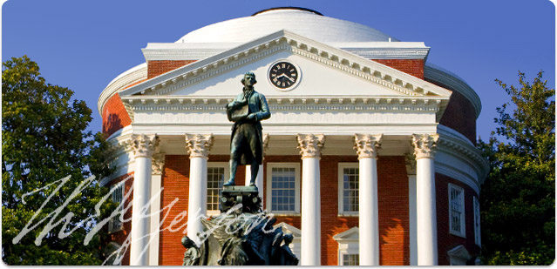
Background
Public Institution of Higher Ed founded by Thomas Jefferson in 1819
Does not have a
“Travel Department”
FY 2011 University purchased approximately 22 million dollars worth of Travel related services
8 million in Air
1.5 million in rental car
13 million in lodging
Can a Fully Automated Travel Program Exist & Succeed in Higher Education

Slide 4
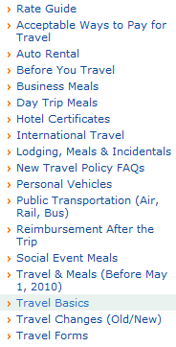
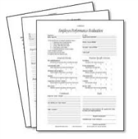
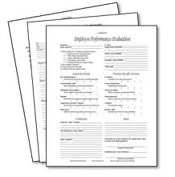
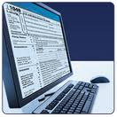
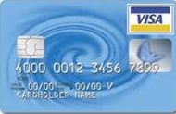
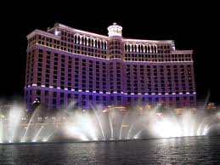
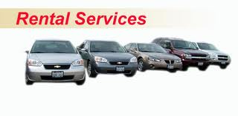
Procurement
Here they are:
Accounts Payable
What are the travel rules?
9
Travelers
Travel MGMT Vendors
Online booking sites
Hotels
Airlines
Rental Car

Slide 5
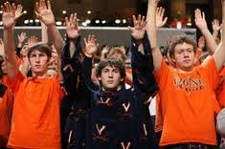
Guest & Visitors
Prospective Students
Visiting Family
Website
Visiting Professors
Travel agent or booking site
Sports fans

Slide 6
The Problem
Lack of Fiscal Management
Not using available Technology
Process was fractured and confusing
No University Guests & Visitor travel assistance
Can a Fully Automated Travel Program Exist & Succeed in Higher Education

Slide 7
Crossroads Decision
Create a new travel position
or
Outsource
Can a Fully Automated Travel Program Exist & Succeed in Higher Education

Slide 8
Vision and Goals
Can a Fully Automated Travel Program Exist & Succeed in Higher Education

Slide 9
Vision of Travel MGMT
Post travel audit of vendor charges
Single Award Travel MGMT Vendor
Accurate spend Reports
Online Travel Booking Engine
Customized online booking tool
P-card allowed for lodging
Traveler monitoring and Risk MGMT
Can a Fully Automated Travel Program Exist & Succeed in Higher Education

Slide 10
Vision of Guest & Visitors
Prospective Students
Visiting Family
“One-stop-shop”
Visiting Professors
Sports fans
Website
With Travel Tools
Can a Fully Automated Travel Program Exist & Succeed in Higher Education

Slide 11
The Vision
Create a Travel Management Program that is:
Fiscally strategic and well managed
2) Technologically innovative
3) Simplified
4) Guest & Visitor friendly
Can a Fully Automated Travel Program Exist & Succeed in Higher Education

Slide 12
Implementation & Results
Can a Fully Automated Travel Program Exist & Succeed in Higher Education

Slide 13
Step 1
Travel MGMT
Online Booking Tool
Travel MGMT Vendor
UVA Travel

Slide 14
Things a Travel MGMT Program Should have
Single Award: PanAm (formerly Travelectra)
Low transactional cost / no implementation cost
Price match guarantee
Completely customizable booking tool
Travel rules with hard or soft stops
Different rules for different departments
Automated (synchs with data sources)
100% post trip Audit
Travel Risk and information management
Allow P-card to be used for all three pieces of travel: Air, hotel, and car
Can a Fully Automated Travel Program Exist & Succeed in Higher Education

Slide 15
Travel MGMT: Success Overview
What | Old way (9 contract vendors) | PanAm
Average $ | $30 to $45 | $4.35 to $17.75
Online Booking solution | None | Customized solution
Ability to negotiate with airlines | Near impossible | Yes
P-card on Hotel spend | No | Yes
Post travel Audit | Not included | 100% audit of transactions
Revenue stream | None | Yes
Can a Fully Automated Travel Program Exist & Succeed in Higher Education

Slide 16
Travel MGMT: Money
UVA Reservation System
Go online
Can a Fully Automated Travel Program Exist & Succeed in Higher Education

Slide 17
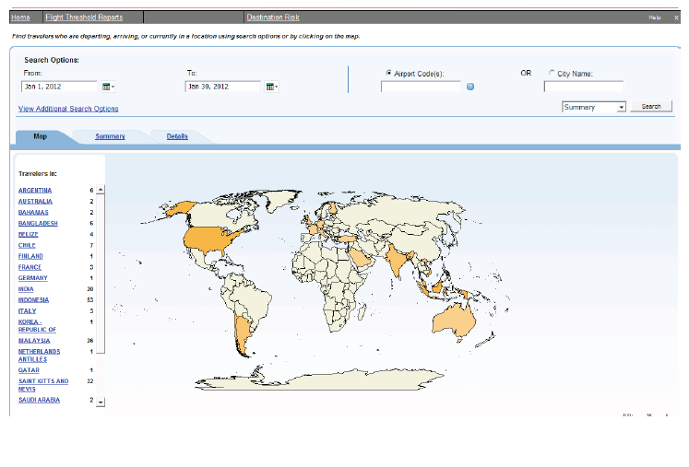
Where are your Travelers?
Can a Fully Automated Travel Program Exist & Succeed in Higher Education

Slide 18
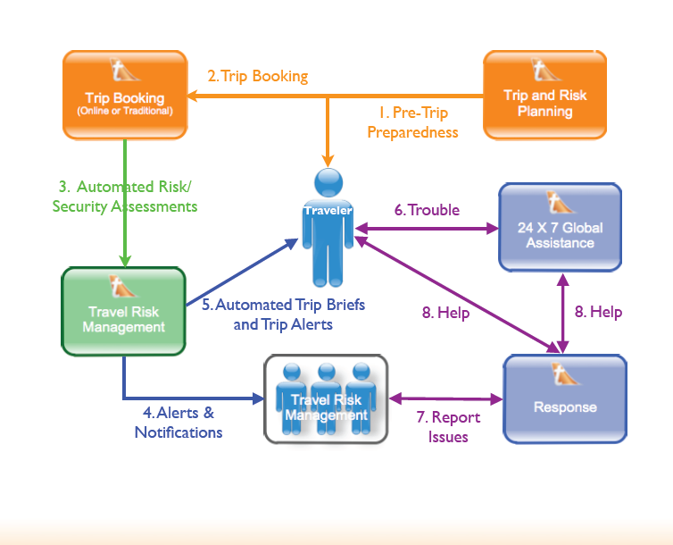
Risk Workflow
Can a Fully Automated Travel Program Exist & Succeed in Higher Education

Slide 19
Step 2
Guests & Visitor Travel
G & V Lodging Widget
Online Booking Tool
Travel MGMT Vendor
UVA Travel

Slide 20
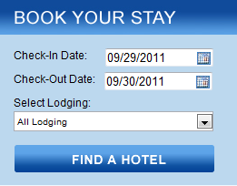
Lodging Widget RFP
What is a Widget?
Who are UVA’s Guests & Visitors?
Can a Fully Automated Travel Program Exist & Succeed in Higher Education

Slide 21
Travel MGMT: Money
UVA Lodging Widget
Go online
Can a Fully Automated Travel Program Exist & Succeed in Higher Education

Slide 22
Step 3
Create Local Lodging Contracts
G & V Lodging Widget
Online Booking Tool
Travel MGMT Vendor
Local
Lodging
UVA Travel

Slide 23
Local Lodging Process
UVA Department
Call hotels for availability and rates
Local Lodging Vendor
Give rates and availability
Circle back around to best option
Soft confirmation / Hold
Create PO and give vendor
order confirmation
Final confirmation communication
Stay occurs
Send invoice to AP
PO Increase needed?
AP
PO adjustment
Pay invoice
Ask Procurement – where is it in the process

Slide 24
Things a Local Lodging Program should have
Competitive rates and friendly T&Cs
Long Agreement term
Vendor to vendor contractuals spelled out
Local corporate reward points: $50,000 in room certificates annually
University department approved “order confirmation document”
Last room availability clause
P-card used for payment method
Revenue stream
Can a Fully Automated Travel Program Exist & Succeed in Higher Education

Slide 25
Revenue for Local Lodging
Negotiated with Travelectra to:
Waive booking fees for local lodging
Charge the local hotels a 8% transaction fee
Travelectra keeps 4% / UVA gets the other 4% (about 80K annually)
Can a Fully Automated Travel Program Exist & Succeed in Higher Education

Slide 26
Future
Identify Cooperative contracts
Step 4
Create National / Worldwide
Travel Contracts
National Hotel Contracts
G & V Lodging Widget
Online Booking Tool
Travel MGMT Vendor
Local
Lodging
UVA Travel
Car Rental contracts
Air Contracts

Slide 27
Answer to the Question
Can a Fully Automated Travel Program Exist & Succeed in Higher Education?
Can a Fully Automated Travel Program Exist & Succeed in Higher Education

Slide 28
Pros
Are we better off than we were 2 years ago?
Pros
Fees / Rates / Discounts
P-card + lodging
New Revenue Steams
Services for University G&Vs
Better understanding of travel spend
Travel & Risk MGMT
Online booking tool
Can a Fully Automated Travel Program Exist & Succeed in Higher Education

Slide 29
Lessons Learned
Online booking tool
Implementation
Size of team
Slippage
Travel policies
Updating
Conflicting with system capabilities
Audit requirements
Local Lodgers
Transaction fees
Internal website updates
Can a Fully Automated Travel Program Exist & Succeed in Higher Education

Slide 30
Tips for success
Trust
Communication
Shared Vision
Make no assumptions
Long term commitment
Can a Fully Automated Travel Program Exist & Succeed in Higher Education

Slide 31
Answer to the Question
Can a Fully Automated Travel Program Exist & Succeed in Higher Education?
Can a Fully Automated Travel Program Exist & Succeed in Higher Education

Slide 32
Questions?
Kevin Crabtree – Senior Buyer
University of Virginia
Procurement & Supplier Diversity Services
kc5yc@virginia.edu
434-924-4219
Can a Fully Automated Travel Program Exist & Succeed in Higher Education

