Slide 1

Michael Casella – Citi
Director Public Sector
Annual Conference & Tradeshow
Celebrating 26 years of service to the Collegiate Travel Marketplace
Alternative Payment Solutions

Slide 2

Alternative Payment Solutions
Advanced
Agenda
Why Alternative solutions?
Industry Trends & Challenges
Alternative Payment Solutions
  Ghost Cards
  Virtual Card Overview
  Virtual Card for Accounts Payable
  Declining Balance Cards
  Stored Value Cards
Meeting Cards
®
Notes:
Changed Paylink to BIPC…this is OLD branding that was only for the GSA back in 2008.

Slide 3
Alternative Payment Solutions
Advanced
Why Alternative Solutions Exist
Commercial Cards have evolved over the last 20 years
Many clients have asked banks for enhanced features
Clients have asked for more control and flexibility during a purchase
Clients have asked for the product to do more while spending time on things that matter
  Doing more with less?
  Tending to other objectives vs managing the card?
Let’s touch on these now!
Notes:
Not sure if “mission” is going to resonate with your audience for SCTEM?

Slide 4

Alternative Payment Solutions
Advanced
Industry Trends & Challenges
Trends
  AFP 57% of B2B payments are still made by check
    43% are by either cards, ACH, or wire
  Clients are looking for Decreased costs, increased cash forecasting, increased fraud controls, ease to monitor payments and perform audits
Challenges include
  Lack of a single payment file standard across payment types
  IT integration and competition for IT resources
  Storing payment information to ensure proper disbursement
  Supplier reluctance to change processes (see above)
  Cross-border payments (different formats)
  Contracting with a payments portal for multiple payment methods
Notes:
AFP is Association Financial Professionals…. The Challenges on right side are from internal Citi research performed by Peter Schiff Smith’s P2P team.

Slide 5
Alternative Payment Solutions
Advanced
Ghost Card
Features:
  Non-card account for preferred supplier relationship; i.e.Travel Agency
  Account number held by vendor
  A Seller Initiated Payment
  Allows many employees to purchase without issuing multiple cards
  Integrates with ERP systems or Electronic Purchasing Systems
  Allows for MCC-specific controls
  Can have temporary credit limits for added controls
Applications and Uses:
  Central travel airline accounts
  Purchases made via Internet or intranet
  Elimination of low-value invoices (e.g. UPS, FedEx, etc.)
Notes:
Ghost Card needs to be moved down into the body of the slide.

Slide 6
Alternative Payment Solutions
Advanced
Virtual Card Accounts (VCA) is an electronic payment solution that offers unparalleled control and flexibility without the need to issue plastic cards
What is a Virtual Card Account (VCA)?
Non-plastic account number for purchases
  The “real” billing account/card is never shared with merchants
  Unique virtual card numbers (VCNs), linked to real card, are created for secure purchasing
Transparent to merchant at point-of-sale
  Standard 16-digit account number, expiration date, three-digit security code created for seamless transacting by the merchant
Virtual Card Numbers can be requested by authorized users or a system interface
  Web interface, batch file, real-time XML API

Slide 7
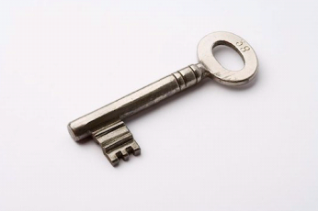
Alternative Payment Solutions
Advanced
Security
Controls
Clients’ real card number is never shared with suppliers
VCA users can only access specific purchase types and have individual spend limits
Single-use virtual card numbers–lock-down potential misuse
Internal Controls
Web user interface:
  Create user groups for different access types
  Multi-level approval flows
Policy Compliance Controls:
  Issue VCNs with amount, MCC, supplier and date controls
Efficiency
Real-time VCN requests and management
Automated processes using the batch or XML API interfaces
Secure delivery of VCNs by encrypted e-mail available
Streamlined record keeping with one-to-one VCN transaction mapping
Able to assign custom data fields per VCN for simple reconciliation and reporting
Merchant Controls
Set VCN with appropriate authorizations / controls:
  Single or multi-use
  Maximum amount
  Validity Period
  MCC Groups
  Supplier

Slide 8

Alternative Payment Solutions
Advanced
Virtual Cards–For Accounts Payable
  What is Virtual Cards for Accounts Payable?
A card-based settlement method
Pay invoices using Virtual Card Accounts
Single-use electronic commercial card numbers
Set exact transaction amount controls and set expiration date
Simplified reconciliation
Enhance card transaction data with client-supplied data
e.g. invoice numbers or payment reference numbers
Automated payment processing
Request by file & deliver card numbers and payment information to suppliers via secure e-mail
No new process for suppliers
Process transactions as standard card transactions; no additional setup or training required for card-accepting suppliers
Global, consistent solution
Available in over 30 local currency markets (availability varies amongst banks)
Notes:
This slide reiterates points from earlier overview slides….

Slide 9

Alternative Payment Solutions
Advanced
Virtual Cards–For Accounts Payable
Virtual Card Accounts enables clients to seamlessly use card payments for Accounts Payable spend, helping to remove process inefficiencies and generate key financial benefits.
Benefits
VCA Enablers
Exact Amount Control
Pay invoices to the penny, avoiding short payments and reducing exception processing
Set Validity Period
Defined start and end dates to track and manage outstanding, unprocessed card payments
Single-Use
Reduced fraud and supplier misuse Improved transaction risk management
Controlled Payments, Reduced Fraud
Streamlined Processing
Batch File Interface
Automated method to generate card numbers from an ERP or AP system
Secure Delivery of Card Numbers
Encrypted e-mail delivery from Citi to suppliers
Enhanced Reconciliation
Capture invoice numbers, payment reference numbers, etc.,
to streamline reconciliation and reduce reliance on merchant-provided data
Standard 16-digit account numbers
No additional enablement or training is required for card-accepting suppliers
Eligible for Commercial Cards Rebate
Budget Optimization Benefits
Notes:
VCA Enablers:
The ways in which virtual cards work differently than regular cards & are ideal for Electronic Accounts Payable Card Programs, behaving more like an electronic check than a traditional commercial card
Group 1: Lock down / control so that card payment works more like check or EFT.
Group 2: Automated creation, delivery, reconciliation so that the process can be similar to other payment types in AP.
Benefits
Working Capital Improvements: A traditional commercial card benefit, immediate payment to suppliers & short-term credit extension to client increases DPO and reduces suppliers’ DSO. This is a lever which can be used alongside payment terms when determining how to pay suppliers. If the additional interchange which comes from a card payment is raised, this is one factor… can pay slightly sooner on a card and still benefit.
Reduced Paper & Streamlined Process: Replace checks with virtual cards and speed up the shift to electronic payments. Automate card payments and reconciliation. Save check printing and mailing costs. Save operational costs in reconciling. Reduced check and postage costs. Free payment method vs. fee-based payment methods.
Eligible for Rebate: A traditional commercial card benefit extended to Accounts Payable payments

Slide 10
Alternative Payment Solutions
Advanced
Advanced
Declining Balance Cards
Features
Centrally Billed Accounts
Specific purposes and/or time periods
  Accounts have a set credit limit and do not refresh
Once the balance is used, the card becomes inactive
Merchant Category Code restrictions can be placed on the card
Unique data available for amount available on statements
Targeted for reimbursable business expenses that need additional controls
  Such as Project Spend
  Meeting and Events
  Contract Spend
Notes:
Now we are getting into more plastic card type/solutions.

Slide 11

Alternative Payment Solutions
Advanced
Advanced
Stored Value Cards
Prepaid Cards are a standalone product
  The accounts are paid in advance and the value of the payment is loaded onto the card
  Cards can be single or reloadable
  Generally, there is a one-to-one relationship between each card and the corresponding account that holds the funds, but other configurations are available
  Moderate controls are available for this product
  Prepaid cards have a separate electronic access system to support the product (e.g. to load value, to view transaction activity, etc.)

Slide 12


Alternative Payment Solutions
Advanced
Advanced
Stored Value Cards-Usage
Prepaid cards can be used as cash or check replacement
One of the key elements of the applicability of a prepaid card is
whether or not the funds placed on the card can be used in their
entirety and are truly the “property” of the cardholder
  These cards are often used for benefit payments or as a
substitute for cash rebates

Slide 13

Meeting Card Solutions

Slide 14
Meeting Cards
Market Overview
  Size, Trends, Challenges
Meeting Card Solutions
  Solution Spectrum
  Virtual Card Account
  Declining Balance
Implementing for Success – Best Practices
Summary

Slide 15
Meeting Space – Trends
Changing trends create new opportunities
Meetings are smaller in scale
  Two - thirds of corporate meetings now comprise of less than 50 people
  Creates need to manage small meetings
Outsourcing
  Move towards outsourced planning units due to reduction in workforce
  Creates need for higher controls
Lower cost destinations
  International meetings are trending towards lower cost destinations including Asia, selected Middle East and African countries
  Creates need for broader coverage and acceptance
Growth of non travel and procurement groups
  Movement of meeting planning under procurement teams versus travel
  According to Visa, 46% of spend is non travel related
  Creates new optimization opportunities

Slide 16
Meetings Space – Spend & Save Estimates
Large potential for benefits and saves!
SPEND ESTIMATES
Meeting spend estimated at 2–3% of a company’s revenues
Companies | Potential Meeting Spend | Assume 2% captured on a card
Fortune 50 companies | $166 Billion | $3.3 Billion
Fortune 100 companies | $ 244 Billion | $4.9 Billion
Fortune 500 companies | $ 503 Billion | $10 Billion
Other Market Size Estimates
  $75 billion globally (Bearing Point)
  $200 billion globally (Aberdeen)
SAVE ESTIMATES
5% cost saves associated with efficiencies from a Meeting Card Solution
For a typical $1Billion in revenue company, resulting save ~ $1.5Million
* Sources: Fortune.com, Bearing point, Aberdeen, Citi internal analysis

Slide 17
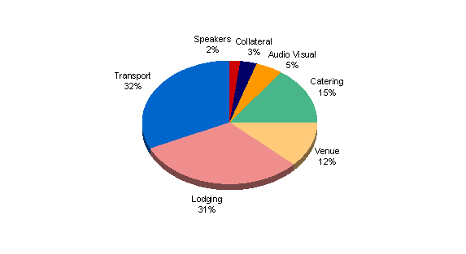
Meetings Space – Spend Categories
Move towards non-travel related categories
Lodging and transport remain key categories
Non travel spend categories account for 40% of spend, not captured on T&E programs
Growing categories include equipment costs given remote meetings

Slide 18
Meeting Space – Trends
Opportunity is Global
While the US represents the largest share, European destinations dominate the top 10 countries for meetings and events
UK alone is sized at £22 billion (Evening Standard 2010)
Ranking | Country | Market Share
1 | U.S.A. | 10.08%
2 | France | 7.15%
3 | Germany | 4.89%
4 | The Netherlands | 4.41%
5 | Austria | 4.31%
6 | Spain | 4.08%
7 | United Kingdom | 3.95%
8 | Finland | 3.66%
9 | Italy | 3.65%
10 | Singapore | 3.36%
Source: The International Congress and Convention Association, Visa, meetingsnet.com

Slide 19
Meeting Space – Key Challenges
Lack of spend visibility
Inadequate tracking, reporting and analytics have resulted in the inability to estimate the meeting spend accurately
Fragmented processes
Multiple payment methods, processes, stakeholder and planners result in fragmented processes resulting in inefficiency and the inability to reconcile easily
One size DOES NOT fit all
Variances due to global versus regional programs, centralized planning versus decentralized planning, varying stakeholders need require customized solutions
Lack of policy
Unlike traditional corporate spend, no established policies, mandates or consistent processes for meetings and events spend
Limited meeting program knowledge
Limited knowledge on implementing meeting card programs – require education around effective implementation, change management ideas and policy enforcement

Slide 20
Meeting Cards – Meeting Key Challenges
 | Separation of spend Data consolidation for better supplier negotiation Informed decision making for senior management | Meeting Planners Sourcing and Procurement Managers Travel Managers
 | Enhanced controls over budgeting and planning Higher security, reduced risk of fraud, misuse Improved compliance | Meeting Planners Card Program Managers
 | Simplify the payment processes Streamline reconciliation; integration with ERP and AP systems Improved supplier relationships via quicker payment | Sourcing and Procurement Managers Accounts Payables Teams
 | Global solution, high acceptance Custom controls Integration with Arcaneo for end to end solution | Meeting Planners Sourcing and Procurement Managers Card Program Managers
What is it?
Why is it Important?
To Whom is it Important?
VISIBILITY
CONTROLS
PROCESS EFFICIENCY
GLOBAL, FLEXIBLE SOLUTION

Slide 21
Meeting Cards – Solution Spectrum
A set of solutions to meet clients varying needs
Meeting Card - Plastics
Meeting Card - Virtual Card Accounts
Standard card controls – credit limit, transaction size, MCC specific controls, declining balance feature
Physical card in hand plastic for meeting planners and travelers
Standard approval/application process
Reporting and analytics available via card management tools
Backend data integration consistent with current T&E programs
Reconciliation is based on existing card processes including reallocation functionality via existing tools
Standard card fraud controls
Enhanced controls – merchant level control, date ranges, single/multi use
Virtual account numbers (VCN) for card not present transactions; real time issuance
Inbuilt workflow capability via web interface
Reporting and analytics available via card management tools
Custom data fields allow PO/Meeting specific data to be captured and appended to transaction data
Transactions tied to unique VCNs for streamlined record keeping along with custom data fields
Real card number not issued; transactions limited to controls on VCN
Payment Solution

Slide 22


Meeting Card Solution - using Virtual Card Accounts
Inbuilt workflow approval, enhanced transaction level controls and reconciliation
Replaces a real card account with a unique 16 digit Virtual Card Account (VCA) for purchases and payment settlement
  Transparent to the merchant at the point-of-sale
  No plastics
  Real-time generation of virtual numbers against a single billing account
Transaction Controls
  Specify amount, date of transaction
  Specify merchant group/specific merchant
Workflow Capability
  Optional approval chain via a web based interface
  Post-transaction compliance reporting
Robust Reconciliation
  Simpler reconciliation – each transaction can be set to an individual Virtual Card Number with multiple custom data fields
  Add up to 30 user-defined reference fields that can be linked to each virtual account for tracking, reporting, and reconciliation

Slide 23


Meeting Card Solution – using Declining Balance Card
Set meeting budgets, control overall spending
Specialized card with a preset credit limit that does not refresh automatically, but decrease over time
Balance depletes as transactions post to the account, ensuring clients are billed only for the predetermined credit limit
Controls
  Used only until the approved amount to spend over the pre-determined life of the card
  Used only for approved types of transactions
Reconciliation leverages existing card processes
  Transactions and can be uploaded to expense management or ERP systems
Ideal for maintaining overall event budgets, limit usage of cardholders

Slide 24
Implementing for Success: Best Practices

Slide 25
Best Practices Approach
Key recommendations for a successful program
Understand your organization’s specific needs
Get executive sponsorship for the meeting program
Have a defined policy specific to meeting spend
Engage critical stakeholders
Deploy an internal communication plan
Make the card the single payment option for meeting spend
Allow for software solution integration for better reconciliation
Robust reporting and analytics
Track the overall program to ensure compliance

Slide 26
Best Practices - Understanding Your Organization
The meeting solution you deploy is defined by your organization’s specific requirements
  Current planning structure
    Centralized planning via a single group
    Decentralized planning via multiple groups, adhoc basis
    Combination of centralized and decentralized structures
  Meeting types to be covered
    Definition of meetings ( e.g. >$ 5,000 only to be covered)
    Organization wide/ department specific meetings
    Internally managed versus outsourced meetings
  Stakeholders
    Key stakeholders and roles
    Key sponsors
    Budget holders
  Technology and data requirements
    Existing budgeting/planning software
    Backend ERP system
    Data and reporting requirements

Slide 27
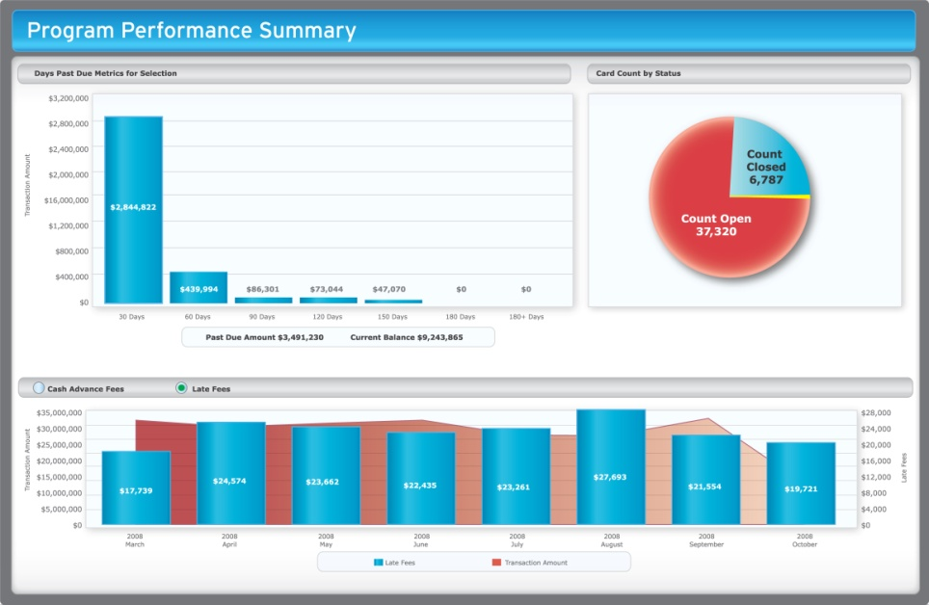
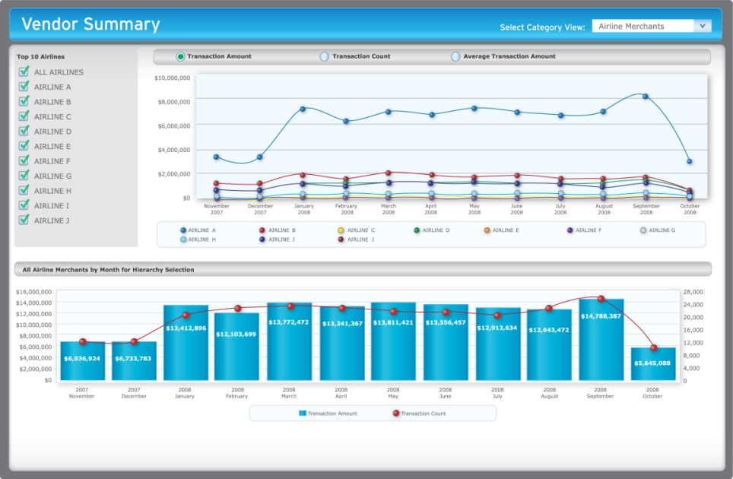
Reporting and Data Analytics
Robust reporting is critical to success
  Leverage your vendors existing card management and reporting capabilities
  Access program level metrics, trends, anomalies for higher spend visibility and control
  Monitor program via aggregated and detailed transaction level reporting to ensure policy compliance
  Negotiate better discounts via vendor specific dashboard reporting
  Analyze performance against strategic objectives and goals

Slide 28
Best Practices - The Importance of a Policy
Successful meetings program require change management
Why is a policy important?
  Essential to a successful program – e.g organizations’ travel policy statistics reflect success of T&E programs
  Normalizes fragmented processes, inconsistency amongst multiple planning groups
  Allows monitoring the effectiveness of a program
Key Components of a policy
  Define meetings covered under program (e.g. spend above $5000, greater than 50 people)
  Detail meeting card application and approval process
  Highlight decision makers/approvers
  Include training resources/links
  Ensure internal reporting requirements
Travel versus Meeting policy*
No Policy
5%
Policies Established
but Not Mandated
37%
Travel Policy
Policies Established
and Mandated
58%
No Policy
No Policy Use T&E
20%
40%
Meetings Policy
Policy Established
but Not Mandated
21%
Policy Established
and Mandated
19%
*Best Practices Roadmap to Strategic Meetings Management Success, ProMedia
Notes:
28

Slide 29
Meeting Solutions
Reduce spend, meetings and supplier base
Streamline end-to-end meetings management
Reduce
Streamline
Quantify Meeting and Events spend
Quantify
Demonstrate ROI
Report
4-steps
Best in Class Recommendations
Identification of end users
Defined policy
Meetings technology solutions
Consolidated reporting
Tracking compliance to policy
Executive sponsorship
Single payment solution
Preferred suppliers
Communications plan

Slide 30
Thank You

Slide 31
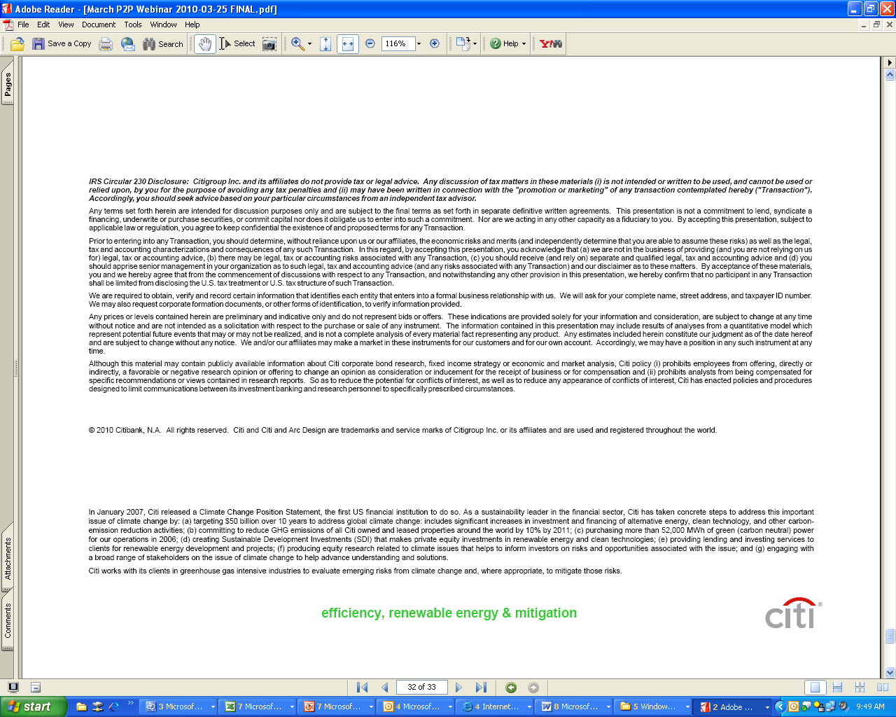
24

